Slide 1
Voice Command Based Object Identifying Robot using Speech and Image Feature Extraction
Project Members:
Kanhaiya Lal Shrestha 069BEX417
Dipkamal Bhusal 069BEX414
Bishal Lakha 069BEX410
Bishal Heuju 069BEX409
Project Supervisor:
Dr. Nanda Bikram Adhikari

Slide 2
TABLE OF CONTENTS
1. Motivation
2. Introduction
3. Application
4. System overview
5. Methodology
Speech recognition
Object recognition
System implementation
6. Experiments
7. Problems encountered
8. Conclusion

Slide 3
MOTIVATION
Development of general-purpose service robots
Interfacing hearing and vision to an embedded system

Slide 4
INTRODUCTION
Robots intelligent enough to understand speech and recognize object
Interfacing two human senses, hearing and vision to machine
Speech signal to command robot
Robot able to identify and track the object
Proof-of-concept of assistant robot

Slide 5
APPLICATION
Home assistant robots
Standalone systems can make use of speech recognition and computer vision

Slide 6
SYSTEM OVERVIEW
I/O
Remote Controlled
Camera
Image Acquisition
Human to Machine Interface
Processing
Voice Recognition
Object Recognition
Voice Command
Machine to Human Interface
Real World Robot Movements
Speaker
M
M

Slide 7
METHODOLOGY

Slide 8
SPEECH RECOGNITION
Isolated word
Pattern recognition approach

Slide 9
PATTERN RECOGNITION-TEMPLATE METHOD
Train voice signals
Test voice signal
Get feature vectors
Get feature vectors
MFCC
MFCC
Match feature vectors between train and test signals
Command recognized

Slide 10
FEATURE EXTRACTION

Slide 11
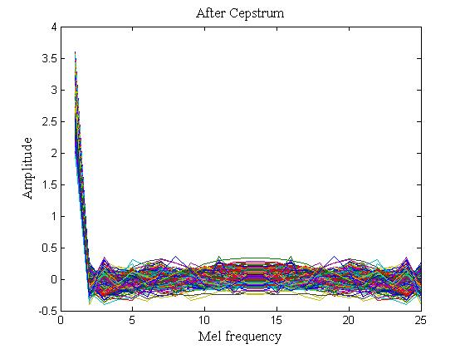
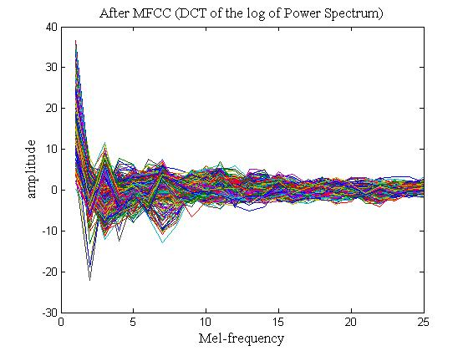
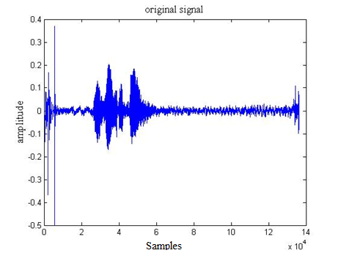
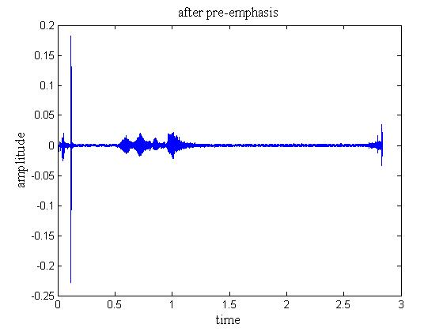
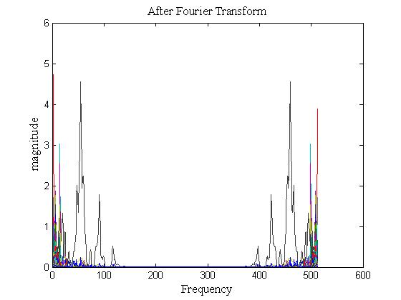
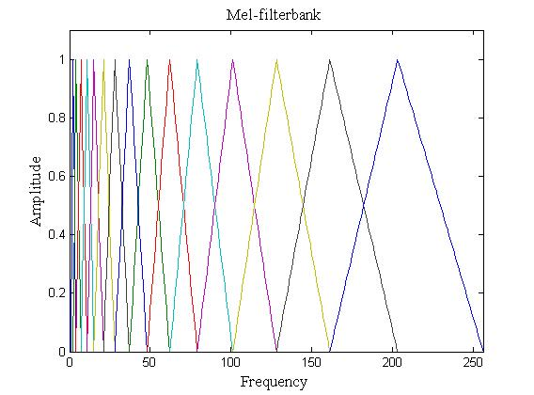
MFCC
Pre-emphasis
Framing
Windowing
Based on the known variation of the human ear’s critical bandwidth with frequency
Speech
DFT
Delta Energy and Spectrum
Discrete Cosine Transform
Mel filter bank
Output

Slide 12
TRAINING
System trained to store the reference MFCC features
System uses the pyAudio library to take an input sample .wav file
System trained to recognise two words; IDENTIFY and FOLLOW

Slide 13
FEATURE COMPARISON

Slide 14
DTW
A time series alignment algorithm for measuring similarity between two temporal sequences which may vary in time or speed.

Slide 16
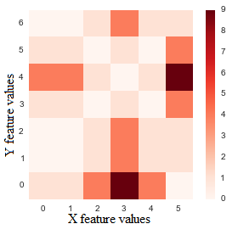
Using Euclidean distance, we get the distance matrix and the shortest distance shows the level of similarity.

Slide 17
RESULTS
RESULTS
MFCC feature extraction
DTW for comparison
Trained under 20 times
Voice command based object identifying robot using feature extraction
17

Slide 18
OBJECT RECOGNITION
Identification of an object in the given image/video.
Object recognition system can tell if the given image contains a cup or a pen or other
Can be ‘Specific’ or ‘Generic’

Slide 19
BAG-OF-FEATURES
Generic object recognition
Image is represented as a histogram of visual words
Involves Feature detection and description, Visual vocabulary formation and Classification

Slide 20
KEY-POINTS DETECTION AND DESCRIPTION
Uses Speeded-Up Robust Transform (SURF) method
SURF combines Hessian keypoint detector with its own feature descriptor
Provides scale and rotation invariant descriptor

Slide 21
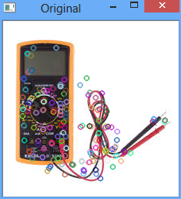
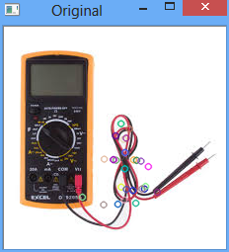
SURF KEY-POINTS DETECTION FOR DIFFERENT HESSIAN THRESHOLDS

Slide 22
VISUAL VOCABULARY FORMATION AND IMAGE REPRESENTATION

Slide 23
K-MEANS ALGORITHM ILLUSTRATION
New cluster centroids found using mean of each cluster
C1
C2
C1
C2
Randomly Chosen Cluster Centroid

Slide 24
CLASSIFICATION USING SVM
If w.x + b > 1
x
If w.x + b < 1
x
w.x + b = 1
Optimal line
Support
Vectors
Margin

Slide 25
BLOCK-DIAGRAM
Train Images
Input test image
Bag of Words
Extract feature vectors
SURF
K-means
SURF
K-means
Train SVM classifiers
SVM classifiers
Maintain SVM’s parameters
Recognize the object
Learning part
Recognition part

Slide 26
OBJECT TRACKING
Near
Left
Far
Right
Optimal Distance
Reference Rectangle

Slide 27
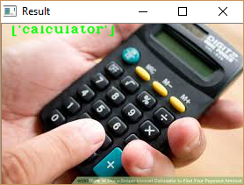
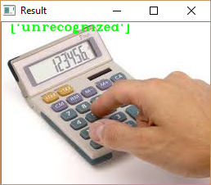
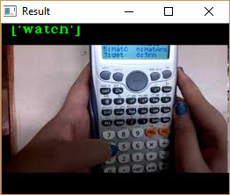
OBJECT RECOGNITION RESULT

Slide 28
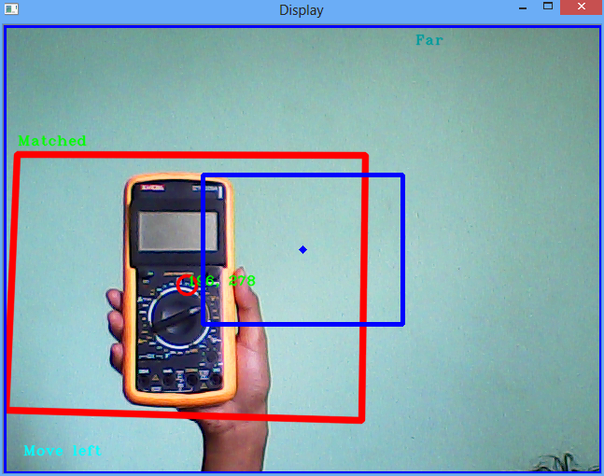
OBJECT TRACKING RESULT

Slide 29
SYSTEM IMPLEMENTATION

Slide 30

Processing System
Power Source
Input
Camera
Raspberry Pi
Control System
Servo Motors
Microphone
Atmega32
Microcontroller
S
S
Bluetooth Module
Motor Driver
Android Mobile Device
M
M

Slide 31
FLOW CHART

Slide 34
EXPERIMENTS ON SPEECH RECOGNITION

Slide 35
VARYING THE SIZE OF FEATURE VECTOR

Slide 36
VARYING THE SIZE OF FEATURE VECTOR

Slide 37
VARYING SAMPLING RATE

Slide 38
EXPERIMENTS ON OBJECT RECOGNITION

Slide 39
Object recognition efficiency without background

Slide 40
Object recognition efficiency with background

Slide 41
CONCLUSION
Implemented vision and hearing sense in a machine.
Robot identifies commands and the object shown.
It tracks the motion of the object identified.

Slide 42
REFERENCES
G. Z. Z. S. F. Zheng, “Comparison of Different Implementations of MFCC,” Journal of Computer Science & Technology, vol. 16, pp. 582-589, 2001.
N. Batra, “Programatically understanding dynamic time warping,” [Online]. Available: http://nipunbatra.github.io/2014/07/dtw/. [Accessed July 2016].
N. T. a. M. C. Marc T.law, Bag-of-Words Image Representation: Key Ideas and Further Insight, Switzerland: Springer International Publishing , 2014.
H. Bay, A. Ess, T. Tuytelaars and L. V. Gool, “Speeded-Up Robust Features (SURF),” 2008.
S. R. Gunn, “Support Vector Machines for Classification and Regression,” Faculty of Engineering,Science and Mathematics School of Electronics and Computer, 1998.

Slide 43
Thank You !

