Slide 1
Task-4
Indian Electric Vehicle (EV) Sales & Market Dashboard
(2015–2025)
“A visual understanding of how India is shifting to electric mobility”
Prepared by: Bishal Kumar Mishra
Tools Used: Power BI, DAX
Dataset: Indian EV Sales (2015–2025)
Date: 20-11-2025

Slide 2
Introduction
This project analyzes India’s EV sales over a 10-year period.
The purpose of the dashboard is to understand EV adoption, category-wise performance, and how the market has evolved over time.
The analysis includes sales trends, penetration rates, category contributions and a short-term forecast.

Slide 3
Problem Statement
India’s EV market has grown rapidly in recent years, but the growth hasn’t been uniform across categories.
This project aims to answer:
How has EV adoption changed from 2015 to 2025?
Which categories are driving growth?
How is EV penetration improving year over year?
What does the near future look like based on trends?
The dashboard helps simplify the EV market story using clear visuals and KPIs.

Slide 4
Dataset Overview
The dataset covers 10 years of EV sales across India and includes:
- Sales of 2W, 3W, 4W & Electric Buses
- Year-by-year breakdown (2015–2025)
- EV penetration percentages
- Market segments like personal, passenger & cargo
- Metrics suitable for trend, comparison & forecasting visuals
Data was cleaned, structured and modelled in Power BI

Slide 5
KPIs Used
To highlight the core EV market performance, these KPIs were used:
🔹 Total EV Sales
Overall units sold across all categories.
🔹 YoY Growth %
Annual growth rate of EV sales.
🔹 Average EV Penetration
EV share within the total vehicle market.
🔹 Vehicle Category Count
Number of EV categories contributing to total sales.
These KPIs give a quick high-level overview before diving deeper.

Slide 6
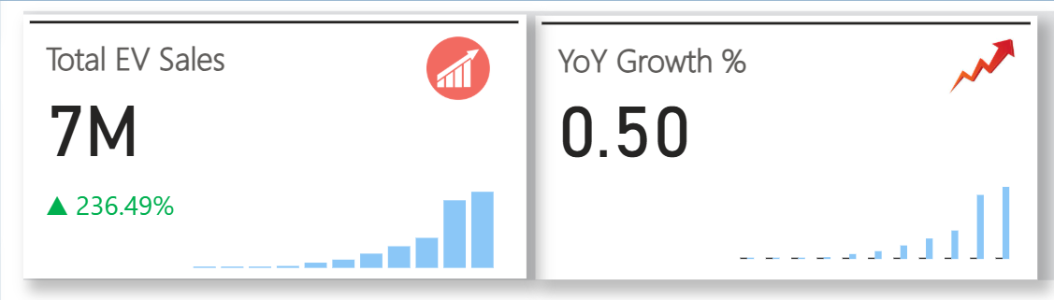
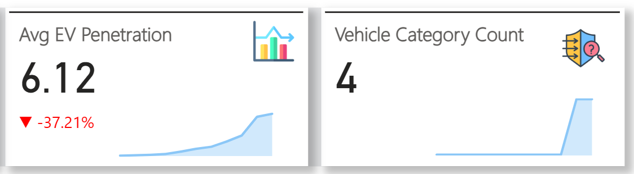
KPI Screenshots

Slide 7
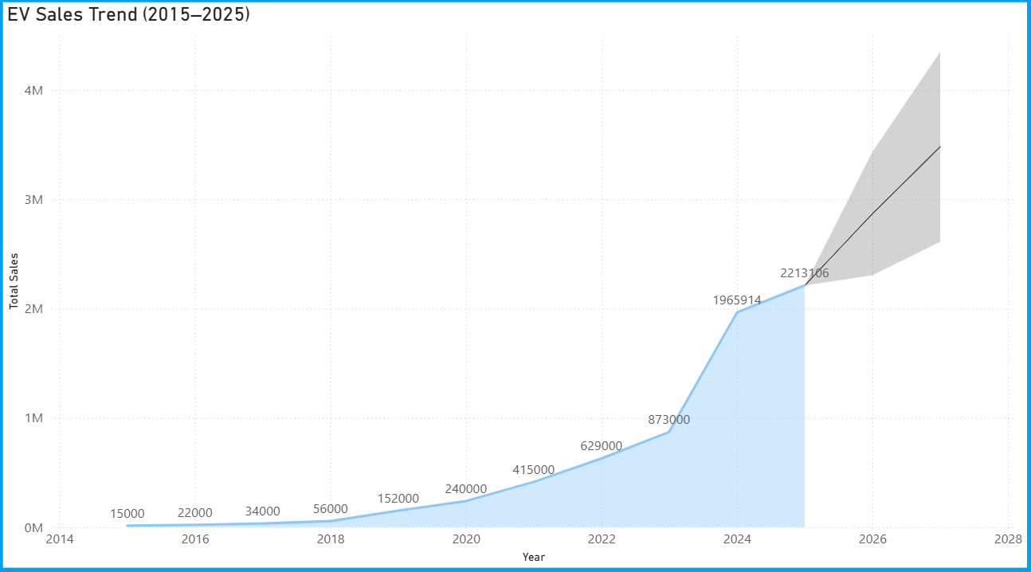
Sales Trend + Forecast Screenshot

Slide 8
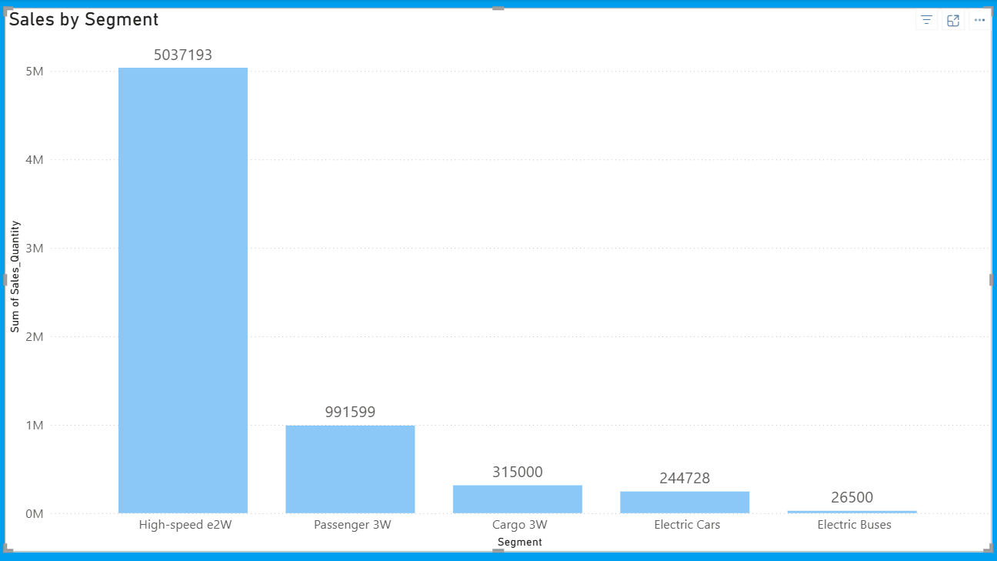
Category Comparison Screenshot

Slide 9
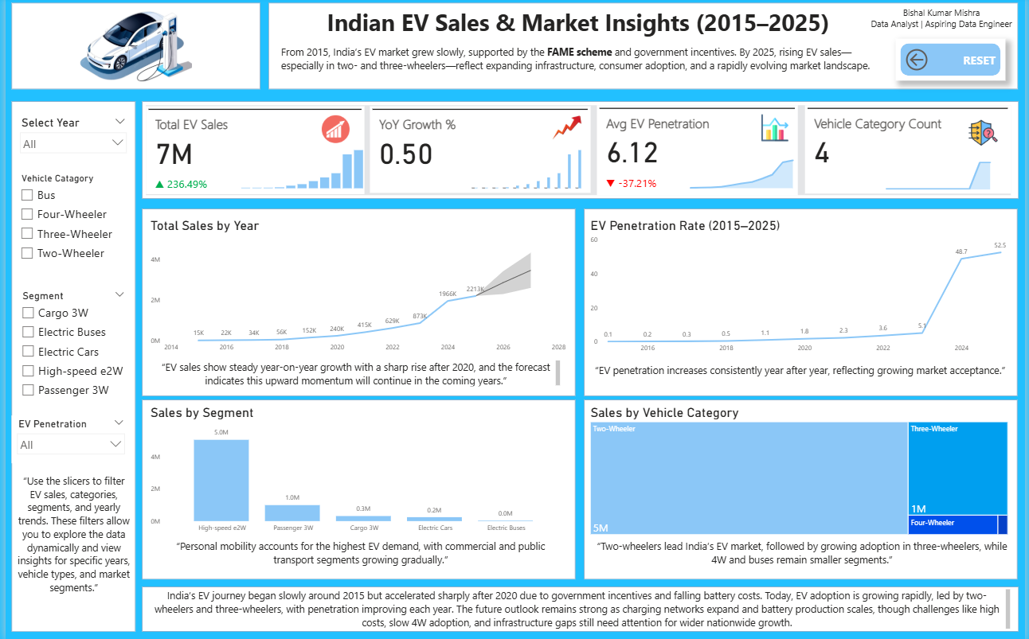
Full Dashboard Screenshot

Slide 10
Key Insights
Analysis of the visuals shows:
- EV sales rise each year, especially after 2020
- Two-wheelers lead EV adoption with the highest contribution
- Three-wheelers maintain strong and steady growth
- Four-wheelers and buses grow slowly but consistently
- EV penetration improves every year
The sales forecast indicates continued growth ahead
The market is expanding, driven mostly by affordable EV segments.

Slide 11
Problems & Proposed Solutions
Challenges Identified:
- Charging infrastructure is still limited
- Battery prices remain high
- Slow adoption of four-wheeler EVs
- Range concerns still influence buying decisions
- EV bus adoption is slow due to higher costs
Proposed Solutions:
- Expand fast-charging and public-private charging ecosystems
- Promote local battery manufacturing and swapping models
- Provide better financing options and incentives
- Develop highway charging corridors
- Encourage state-led EV bus procurement programs

Slide 12
Future Outlook
Looking ahead, India’s EV market shows strong momentum:
- EV sales expected to grow steadily in the next few years
- 2W & 3W will remain the biggest growth drivers
- More affordable 4W EVs may boost private car adoption
- Charging infrastructure will improve across cities & highways
- Domestic battery manufacturing will help reduce costs
Overall, the EV ecosystem is moving toward wider adoption and stronger market confidence.

Slide 13
Conclusion
The dashboard provides a clear picture of how India’s EV market has grown over the past decade.
Although challenges remain, the trend shows strong progress, especially after 2020.
These insights can support planning, investment decisions, and policy development as India continues its shift toward electric mobility.

