Slide 1


Slide 2
Hello and welcome to everyone
today I am here to present my presentation to all of you my dear friend and our respective teacher.
I will want to say special thank you to our respective teacher Mrs dharma kumarai ma’am for giving me the golden opportunity to present the presentation .

Slide 3
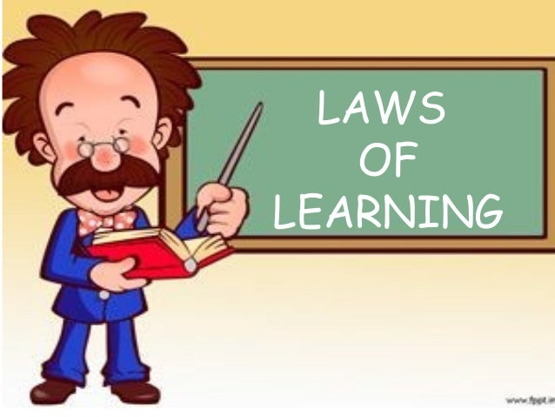
Theory of learning (trail and error)
# Primary law of learning.
law of Readiness.
law of Exercise.
law of Effect.

Slide 4

Law of Readiness.
It refers to being prepared for action. If an individual is not mentally or physically ready to learn, the process of learning cannot be effectively instilled.

Slide 5

Law of Exercise.
Repeated practice enhances the efficiency and durability of learning. Connections strengthen with practice and weaken when practice stops.

Slide 6

Law of effect.
The law of effect states that behaviors followed by pleasant or rewarding consequences are more likely to be repeated, while behaviors followed by unpleasant or punishing consequences are less likely to be repeated.

Slide 7


