Slide 1
Hello and welcome to everyone
today I am here to present my presentation to all of you my dear friend and our respective teacher.
I will want to say special thank you to our respective English teacher mr _____ sir for giving me the golden opportunity to present the presentation of the lesson .

Slide 2
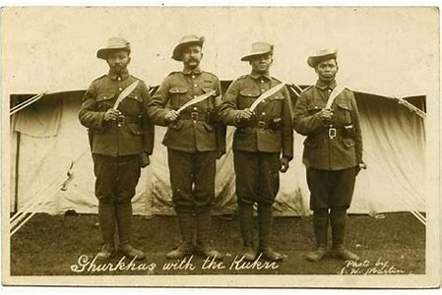
Letter From Foreign Grave
– D. B. Gurung

Slide 3
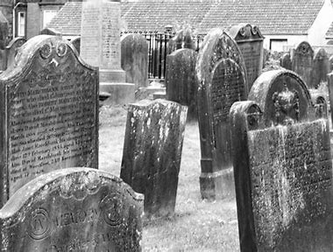
Dear mother This is a gesture of memory from your son, Who lives seven hundred seas away. I know how sad you must be without me. But I’m fine here in this valley of shadows, free From all mundane avarice, misery, and tears, Resting now at peace for ever and a day. The flesh that once was sleek and sound Has given way to dust, and now only we, the bones, Remain to discuss upon my ruined destiny.
I do clearly remember that dawn when the unsung
song Of sadness hung in the air, and I had to bid farewell To you all; the shadows had crowded over the dales And ravines like impatient ghosts; my dog Pangrey Whimpered on and on wagging its tail nervously As though it had known fully well that this departure Would never bring its master back again.

Slide 4
And with your eyes welling up with tears pressing your lips against My abir-daubed brow, you had blessed me in your breath “To be always brave.” I have tasted fire and swallowed it raw At many fronts from Burma, Ladakh, Nefa, Malaya, and Kargil To Germany, Italy, Tunisia, Falkland, and Kosovo. Yes, mother, I had been a hero all the while until a piece of glowing lead Pierced my heart like a bolt from the blue, Packing me off into a realm of dream and eternity-for ever more.

Slide 5
My fate has fastened my eyes to my kingdom where History broods amidst the debris of lies and hypocrisy. That’s why I lie buried here among my friends and enemies, Those who killed us and those whom we killed. We have everything In common here; we live in total harmony in a community Of true brotherhood. For we are the lost citizens of the world. Weep not for me oh my mother, For my war is over; now I need no more To risk the gunshots and shells or risk my khukuri, Or advance through the hell of the fronts. Yelling the dreaded words “Ayo Gorkhali.” By which, indeed, we scared our enemies to death, But, in return, the very mantra snatched away our own lives. Wars are always wars and death takes no prisoners, And soldier a mere little thing for sacrifice, mother. All my dreams, my youth, and my life-have been Plundered by those slow fat generals Who made their medals on young blood.

Slide 6
Oh my mother dear, The only thing I always regret is that I was unable to make up for your milk during This lifetime. For I died for the cause of others in a war of no glory. Forgive me, mother. And weep not for me any more, But ruminate for those living whose wars are now to be feared about.
– D. B. Gurung

Slide 7
Where is the son at this moment and where is his mother?
The son is in the grave in the foreign land which is very far away from his mother-land but the mother is at home at this moment.
B) Why is the son free from all misery and tears?
=> As the son has been already killed in the battle and buried in grave, he is having rest at peace. He doesn’t have any greed to earn money. Therefore , he is free from all miseries, greed and tears.
C) What is the son’s present fate?
=>The son’s present fate has been already ruined as he was killed in the battle.
D) What was the last moment like when the son had to bid farewell? => The last moment when the son had to bid farewell was full of sadness.
Everything was sad such as the ravines. His dog pangrey was impatient and wagging its tail nervously. The mother’s eyes were filled with tears and she was controlling herself pressing the two lips against each other.

Slide 8
E) What does the son remember vividly even today>
The son vividly remembers the moment when he had farewell. The valley was full of sadness. Even his dog predict the son’s future. He knew that his mother would not come back again, it was his last farewell.
f) Even his pargrey could predict the son’s future. What did he know?
Even his pargrey could predict the son’s future. He know that his master would not come back again; it was his last farewell.
g) What were the last words of blessing the young man’s mother spoke?
The young man’s mother blessed her son speak the last word’ to be always brave’.
H) Name the different war fronts that the young man was deputed to.
The names of the different war fronts that the young man was deputed to are Burma, Ladakh, Nefa, Malaya, kargil, Germany, Italy, Tunisia, Falkland and Kosovo.
Where is the young man lying today?
The young man is lying buried among his friends an enemies in the graveland of a
foreign country.
j) Why does the young man tell his mother ‘weep not for me, my mother?
The young men tells his mother ‘weep not for me, my mother because his war is
over and he doesn’t need to worry the gunshots and shells. This because he has
already been killed.
k) What is the son regretting for now?
The son is regretting for his inability to make up for the mother’s milk during his life- time. And he is also regretting for his death having no glory.

Slide 9
L) What is the message that the young man wants to write to his mother in this letter?
The last message that the young wants to write to his mother in this letter is that the youths who are living now have to think deeply taking the lesson from the past as they are likely to be killed in the countries if they join the foreign armies.

Slide 10
THANK YOU
SO
MUCH
EVERY ONE
THE END

