Slide 1
Database Management System
Er. Santosh Dahal

Slide 2
Data
. Data is nothing but facts and statistics stored or free flowing over a network, generally it's raw and unprocessed.
For example: When you visit any website, they might store you IP address, that is data, in return they might add a cookie in your browser, marking you that you visited the website, that is data, your name, it's data, your age, it's data

Slide 3
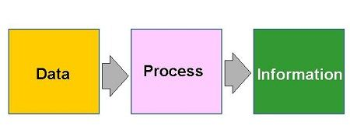
Information
Data becomes information when it is processed, turning it into something meaningful.

Slide 4
Database
A database is an organized collection of structured information, or data, typically stored electronically in a computer system.

Slide 5
`
Database Management System is basically a software that manages the collection of related data.
It is used for storing data and retrieving the data effectively when it is needed.
It also provides proper security measures for protecting the data from unauthorized access.
In Database Management System the data can be fetched by SQL queries and relational algebra.
It also provides mechanisms for data recovery and data backup.

Slide 6
DBMS
A database is a systematic collection of data. They support electronic storage and manipulation of data. Databases make data management easy.
Let us discuss a database example: An online telephone directory uses a database to store data of people, phone numbers, and other contact details. Your electricity service provider uses a database to manage billing, client-related issues, handle fault data, etc.
Let us also consider Facebook. It needs to store, manipulate, and present data related to members, their friends, member activities, messages, advertisements, and a lot more. We can provide a countless number of examples for the usage of databases.

Slide 7
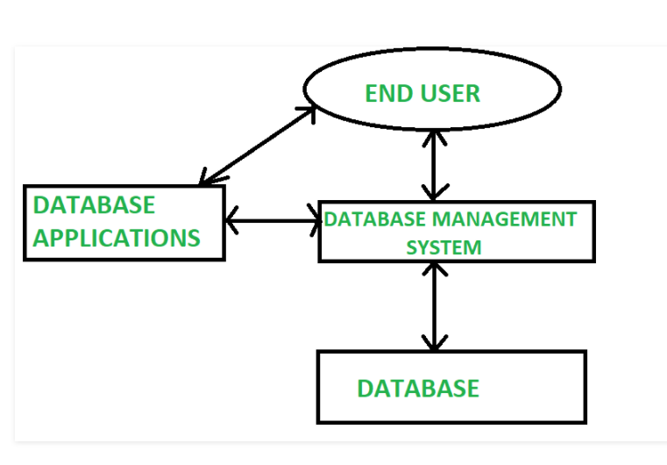

Slide 8
DBMS Example
Here are some examples of popular DBMS used these days:
MySql
Oracle
SQL Server
IBM DB2
PostgreSQL
Amazon SimpleDB (cloud based) etc.

Slide 9
DBMS ( Database Management System)
DBMS contains information about a particular enterprise
Collection of interrelated data
Set of programs to access the data
An environment that is both convenient and efficient to use
Database Applications:
Banking: transactions
Airlines: reservations, schedules
Universities: registration, grades
Sales: customers, products, purchases
Online retailers: order tracking, customized recommendations
Manufacturing: production, inventory, orders, supply chain
Human resources: employee records, salaries, tax deductions
Databases can be very large.
Databases touch all aspects of our lives

Slide 10
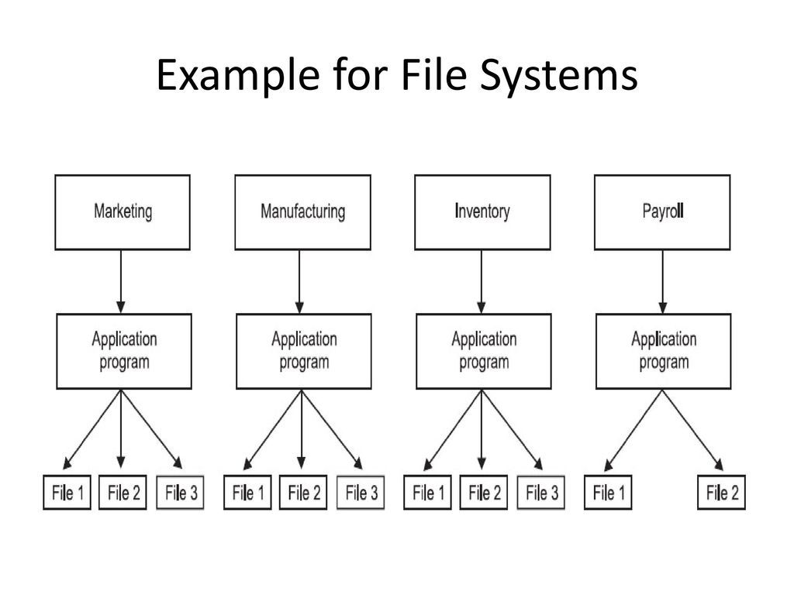
File system

Slide 11
File System
File system is basically a way of arranging the files in a storage medium like hard disk.
File system organizes the files and helps in retrieval of files when they are required.
File systems consists of different files which are grouped into directories.
The directories further contain other folders and files.
File system performs basic operations like management, file naming, giving access rules etc.

Slide 12
Drawbacks of File system
Data redundancy and inconsistency
duplication of information in different files
Difficulty in accessing data
Need to write a new program to carry out each new task
Data isolation
Multiple files and formats

Slide 13
Atomicity of updates
Failures may leave database in an inconsistent state with partial updates carried out
Example: Transfer of funds from one account to another should either complete or not happen at all
Concurrent access by multiple users
Concurrent access needed for performance
Uncontrolled concurrent accesses can lead to inconsistencies
Example: Two people reading a balance (say 100) and updating it by withdrawing money (say 50 each) at the same time
Security problems
Hard to provide user access to some, but not all, data

Slide 14
Difference between File System and DBMS :
 | File System | DBMS
 | File system is a software that manages and organizes the files in a storage medium within a computer. | DBMS is a software for managing the database.
 | Redundant data can be present in a file system. | In DBMS there is no redundant data.
 | It doesn’t provide backup and recovery of data if it is lost. | It provides backup and recovery of data even if it is lost.
 | There is no efficient query processing in file system. | Efficient query processing is there in DBMS.
 | There is less data consistency in file system. | There is more data consistency because of the process of normalization.
 | It is less complex as compared to DBMS. | It has more complexity in handling as compared to file system.
 | File systems provide less security in comparison to DBMS. | DBMS has more security mechanisms as compared to file system.
 | It is less expensive than DBMS. | It has a comparatively higher cost than a file system.
 | There is no data independence. | In DBMS data independence exists.

Slide 15
Transaction Management
A transaction can be defined as a group of tasks. A single task is the minimum processing unit which cannot be divided further.
A transaction is a unit of work that is performed against a database. Transactions are units or sequences of work accomplished in a logical order, whether in a manual fashion by a user or automatically by some sort of a database program

Slide 16
Let’s take an example of a simple transaction. Suppose a bank employee transfers Rs 500 from A's account to B's account. This very simple and small transaction involves several low-level tasks.
A’s Account
Open_Account(A)
Old_Balance = A.balance
New_Balance = Old_Balance - 500
A.balance = New_Balance Close_Account(A)
B’s Account
Open_Account(B)
Old_Balance = B.balance
New_Balance = Old_Balance + 500
B.balance = New_Balance
Close_Account(B)

Slide 17
In the context of transaction processing, the acronym ACID refers to the four key properties of a transaction: atomicity, consistency, isolation, and durability.
Atomicity − This property states that a transaction must be treated as an atomic unit, that is, either all of its operations are executed or none. There must be no state in a database where a transaction is left partially completed. States should be defined either before the execution of the transaction or after the execution/abortion/failure of the transaction.
For example, in an application that transfers funds from one account to another, the atomicity property ensures that, if a debit is made successfully from one account, the corresponding credit is made to the other account.
Consistency − The database must remain in a consistent state after any transaction. No transaction should have any adverse effect on the data residing in the database. If the database was in a consistent state before the execution of a transaction, it must remain consistent after the execution of the transaction as well.
For example, in an application that transfers funds from one account to another, the consistency property ensures that the total value of funds in both the accounts is the same at the start and end of each transaction.

Slide 18
Isolation
In a database system where more than one transaction are being executed simultaneously and in parallel, the property of isolation states that all the transactions will be carried out and executed as if it is the only transaction in the system. No transaction will affect the existence of any other transaction.
For example, in an application that transfers funds from one account to another, the isolation property ensures that another transaction sees the transferred funds in one account or the other, but not in both, nor in neither.
Durability
The database should be durable enough to hold all its latest updates even if the system fails or restarts. If a transaction updates a chunk of data in a database and commits, then the database will hold the modified data. If a transaction commits but the system fails before the data could be written on to the disk, then that data will be updated once the system springs back into action.For example, in an application that transfers funds from one account to another, the durability property ensures that the changes made to each account will not be reversed.

Slide 19
Database Users
Database users are the ones who really use and take the benefits of the database. There will be different types of users depending on their needs and way of accessing the database.

Slide 20
Software
user
Database

Slide 21
Application Programmers – They are the developers who interact with the database by means of DML queries. These DML queries are written in the application programs like C, C++, JAVA, Pascal, etc. These queries are converted into object code to communicate with the database. For example, writing a C program to generate the report of employees who are working in a particular department will involve a query to fetch the data from the database. It will include an embedded SQL query in the C Program.
Sophisticated Users – They are database developers, who write SQL queries to select/insert/delete/update data. They do not use any application or programs to request the database. They directly interact with the database by means of a query language like SQL. These users will be scientists, engineers, analysts who thoroughly study SQL and DBMS to apply the concepts in their requirements. In short, we can say this category includes designers and developers of DBMS and SQL.
Specialized Users – These are also sophisticated users, but they write special database application programs. They are the developers who develop the complex programs to the requirement.
Stand-alone Users – These users will have a stand-alone database for their personal use. These kinds of the database will have readymade database packages which will have menus and graphical interfaces.
Native Users – these are the users who use the existing application to interact with the database. For example, online library system, ticket booking systems, ATMs etc which has existing application and users use them to interact with the database to fulfill their requests.

Slide 22
Database Administrators
The life cycle of a database starts from designing, implementing to the administration of it. A database for any kind of requirement needs to be designed perfectly so that it should work without any issues. Once all the design is complete, it needs to be installed. Once this step is complete, users start using the database. The database grows as the data grows in the database. When the database becomes huge, its performance comes down. Also accessing the data from the database becomes a challenge. There will be unused memory in the database, making the memory inevitably huge. This administration and maintenance of the database are taken care of by the database Administrator – DBA. A DBA has many responsibilities. A good-performing database is in the hands of DBA.

Slide 23
Installing and upgrading the DBMS Servers: – DBA is responsible for installing a new DBMS server for the new projects. He is also responsible for upgrading these servers as there are new versions that come into the market or requirement. If there is any failure in the up-gradation of the existing servers, he should be able to revert the new changes back to the older version, thus maintaining the DBMS working. He is also responsible for updating the service packs/ hotfixes/ patches to the DBMS servers.
Design and implementation: – Designing the database and implementing is also DBA’s responsibility. He should be able to decide on proper memory management, file organizations, error handling, log maintenance, etc for the database.

Slide 24
Performance tuning: – Since the database is huge and it will have lots of tables, data, constraints, and indices, there will be variations in the performance from time to time. Also, because of some designing issues or data growth, the database will not work as expected. It is the responsibility of the DBA to tune the database performance. He is responsible to make sure all the queries and programs work in a fraction of seconds.
Migrate database servers: – Sometimes, users using oracle would like to shift to SQL server or Netezza. It is the responsibility of DBA to make sure that migration happens without any failure, and there is no data loss.

Slide 25
Backup and Recovery: – Proper backup and recovery programs needs to be developed by DBA and has to be maintained him. This is one of the main responsibilities of DBA. Data/objects should be backed up regularly so that if there is any crash, it should be recovered without much effort and data loss.
Security: – DBA is responsible for creating various database users and roles, and giving them different levels of access rights.
Documentation: – DBA should be properly documenting all his activities so that if he quits or any new DBA comes in, he should be able to understand the database without any effort. He should basically maintain all his installation, backup, recovery, security methods. He should keep various reports about database performance.

Slide 26
Database Architecture?
Database architecture uses programming languages to design a particular type of software for businesses or organizations.
Database architecture focuses on the design, development, implementation and maintenance of computer programs that store and organize information for businesses, agencies and institutions.
A database architect develops and implements software to meet the needs of users.

Slide 27
The design of a DBMS depends on its architecture. It can be centralized or decentralized or hierarchical. The architecture of a DBMS can be seen as either single tier or multi-tier. The tiers are classified as follows :
1-tier architecture
2-tier architecture
3-tier architecture
n-tier architecture

Slide 28

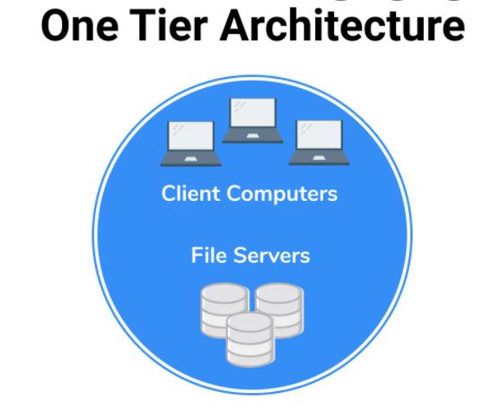
1-tier architecture:
One-tier architecture involves putting all of the required components for a software application or technology on a single server or platform.
Basically, a one-tier architecture keeps all of the elements of an application, including the interface, Middleware and back-end data, in one place. Developers see these types of systems as the simplest and most direct way.

Slide 29
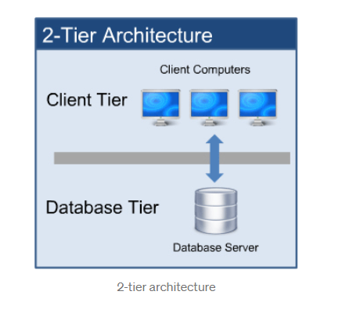
2-tier architecture:
The two-tier is based on Client Server architecture. The two-tier architecture is like client server application. The direct communication takes place between client and server. There is no intermediate between client and server.

Slide 30
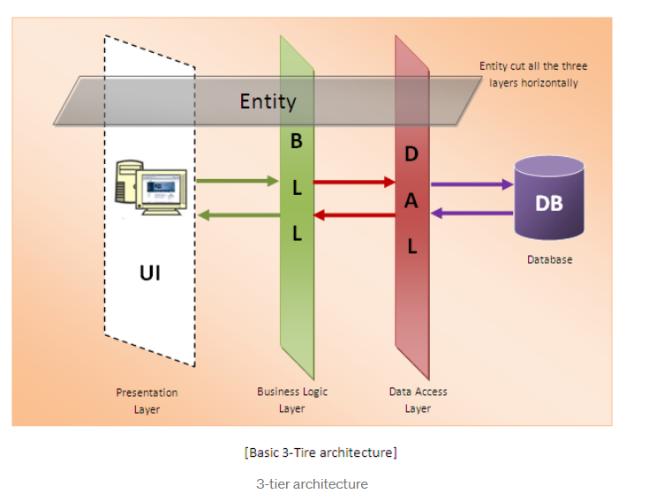
3-tier architecture:
A 3-tier architecture separates its tiers from each other based on the complexity of the users and how they use the data present in the database. It is the most widely used architecture to design a DBMS.

Slide 31
This architecture has different usages with different applications. It can be used in web applications and distributed applications. The strength in particular is when using this architecture over distributed systems.
Database (Data) Tier − At this tier, the database resides along with its query processing languages. We also have the relations that define the data and their constraints at this level.
Application (Middle) Tier − At this tier reside the application server and the programs that access the database. For a user, this application tier presents an abstracted view of the database. End-users are unaware of any existence of the database beyond the application. At the other end, the database tier is not aware of any other user beyond the application tier. Hence, the application layer sits in the middle and acts as a mediator between the end-user and the database.
User (Presentation) Tier − End-users operate on this tier and they know nothing about any existence of the database beyond this layer. At this layer, multiple views of the database can be provided by the application. All views are generated by applications that reside in the application tier.

Slide 32
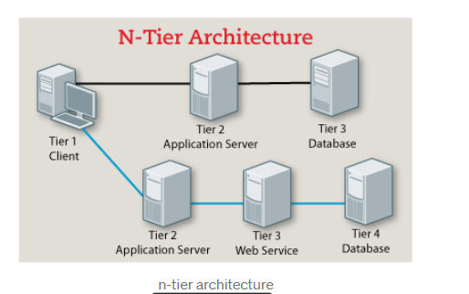
n-tier architecture:
N-tier architecture would involve dividing an application into three different tiers. These would be the
logic tier,
the presentation tier, and
the data tier.

Slide 34
It is the physical separation of the different parts of the application as opposed to the usually conceptual or logical separation of the elements in the model-view-controller (MVC) framework. Another difference from the MVC framework is that n-tier layers are connected linearly, meaning all communication must go through the middle layer, which is the logic tier. In MVC, there is no actual middle layer because the interaction is triangular; the control layer has access to both the view and model layers and the model also accesses the view; the controller also creates a model based on the requirements and pushes this to the view. However, they are not mutually exclusive, as the MVC framework can be used in conjunction with the n-tier architecture, with the n-tier being the overall architecture used and MVC used as the framework for the presentation tier.

