Slide 1
Leadership & Management Course No:-ICT. Ed. 444 Program: BICTE (4th Sem.) Nature of course: Theoretical

Slide 2
Contents:
Unit I: Introduction to Educational Leadership
Unit II: Leadership theory and styles
Unit III: Communication and Interpersonal Skills
Unit IV: Decision Making and Problem Solving
Unit V: Motivation and Team Building
Unit VI: Change management and Social Responsibility

Slide 3
Instructional Techniques
Introductory presentation on each topic of the unit by the teacher
Use of lecture, question answer, discussion, brain storming and buzz sessions for the theoretical contents.
Internal Evaluation (40 %)
Attendance – 5
Class participation – 5
First Assignment – 10
Second Assignment – 10
Third Assignment – 10

Slide 4
Final/Semester Evaluation (60 %)
Objective type of question (Multiple choice 10 x 1 = 10)
Short Answer Questions with two OR option ( 6 questions x 5=30)
Long answer questions with one OR option (2 questions x 10 = 20)

Slide 5
Chapter- 1
Introduction To educational leadership

Slide 6


Slide 7
Meaning of Leadership
Leadership is an important function of management. Organizational success depends on the quality of leadership.
Leadership is the process of influencing the subordinates so that they work hard in the achievement of group goals.
Leadership is guiding and influencing people to achieve goals willingly in a given situation.
It is action oriented and it is about inspiring people.
According to Stephen Robbins, “Leadership is the ability to influence a group toward the achievement of goals.”
According to Stoner, Freeman and Gilbert, “ Leadership is the process of directing and influencing the task related activities of group members.”

Slide 8


Slide 9
Nature /Characteristics of Leadership
1. Process of interpersonal influence: Leadership is a process of interpersonal influence. A leader influences the behaviour and activities of followers through power, inspiration, reward, motivation and other tools.
2. Leaders and followers: There should be mutual relation between a leader and followers. Followers are supposed to follow their leaders’ footsteps only by getting inspiration from his conduct, ability and behaviour.
3. Common goals: Leadership aims at the pursuit of common goals, in other words, a leader and followers must have common objectives. Leader directs and guides the followers to gain planned objectives.

Slide 10
4. Continuous exercise: Leadership is a continuous managerial process till the existence of an organization. The managers have to influence the behaviour and performance of subordinates on a regular basis. Whenever leadership becomes poor, the performance of employees turns into a mere routine function and organizational effectiveness may decrease.
5. Leadership is situational: The role of leadership assumes significance in critical situations. It is the duty of the leader to inspire subordinates to overcome the critical situation and help them to lead to the destination in a successful way

Slide 11
Contd…
.
6. Rest on power: Leadership rests on power rather than formal authority. Here, power focuses on the personal outstanding qualities and knowledge of the leader through which he influences the followers.
7. Blend of inspiration, motivation and communication: Leadership is a blend of inspiration, motivation and communication. It is the process of influencing the behavior and performance of followers by inspiring them.

Slide 12
Meaning of Management
In simple sense, Management is composed of 3 words i.e. manage+ men + t
Manage = to manage, men= by men & t= tactfully
Management is the process of getting things done through others with the help of basic activities like: planning, organizing, directing, co-ordinating and controlling.
It is a purposive activity of working others to achieve the organizational goals effectively by managing organizational resources which are limited.
Management is a science and art of getting things done with and through others which is done for the achievement of organizational goals effectively.

Slide 13
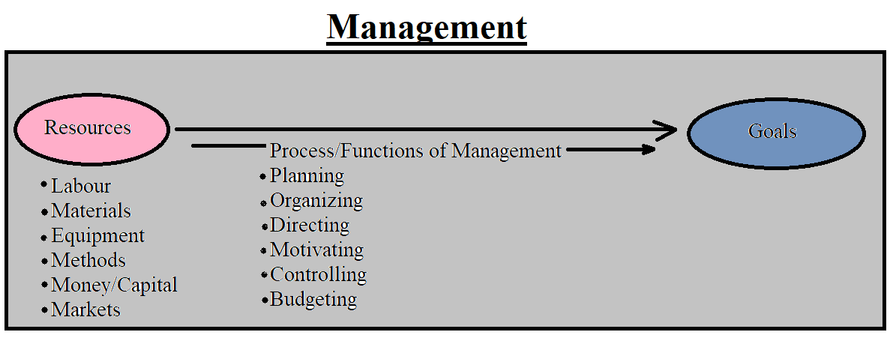
`

Slide 14
Leaders Born or Made
Trait Theory of Leadership
The trait approach to leadership is based on early research which assumes that a good leader is born and not made. It is a modification of the great man theory which assumes that leadership qualities can be acquired. The trait theory of leadership emphasizes that there are certain identifiable qualities that good leaders must possess. Leadership qualities may be in-born or they may be acquired through higher education, training and practice. Brief descriptions of some common traits that an effective leader should possess are as follows:
Achievement drive
Leadership motivation
Honesty and integrity
Self-confidence
Cognitive ability
Job related knowledge
Emotional Maturity
Creativity and originality
Achievement drive
Leadership motivation
Achievement drive
Honesty and integrity
Self-confidence
Traits of Leadership

Slide 15
Contd…
i. Achievement drive: Leaders having such trait have clear vision about the objective of the organization and procedures of achieving predetermined objectives.
ii. Leadership motivation: Leaders possess an intense desire to lead others to achieve common goals.
iii. Honesty and integrity: Successful leaders are trustworthy, reliable, and open. They build trustworthy relationship between themselves and with followers by showing true behavior.
iv. Self-confidence: Leaders belief in own-self and their ideas and ability. They have confidence for any kind of work they are doing.
v. Cognitive ability: Leaders are capable of exercising good judgment, strong analytical abilities, and conceptually skilled.
vi. Job related knowledge: Leaders have technical knowledge on all the activities done in the organization.
vii. Emotional Maturity: Leaders are well adjusted and never suffer from severe psychological disorders. They are flexible and dynamic.
viii. Creativity and originality: A leader must be creative in generating new ideas, concept, and knowledge for better performance of the organization.
ix. Organizing ability: A leader must have an organizing ability.

Slide 16
2. Behavioral Approach to Leadership
The failure of trait theory to identify the clear-cut set of traits has motivated researchers to focus attention on leadership behavior. Behavioral theory attempts to describe what an effective leader should perform in the day-to-day management. An effective leader is one who performs those acts, and who supports groups to achieve objectives. The overall goal of the behavioral approach is to identify and measure relevant leadership actions and behavior that leads to enhance subordinates productivity and morale.
The Ohio State Studies: The Ohio State Studies A group of researchers at Ohio State University conducted an extensive study of leadership behavior and effectiveness.
i. Initiating structure:
ii. Initiating Consideration:

Slide 17
Initiating Structure
Here, the leaders only give focus for completion to task.
Leaders give attention towards the goal achievement.
Task oriented
They believe employees as means to achieve production goals
Process = role ??
Followers = role??
Define structure of role/organize work

Slide 18
Considerations
Focus for job relation
Not focus for task/goal
Relationship between employees, feeling trust and respect
Give priority for employee satisfaction
If leaders are in high considerations then, they try to help and communicate with workers.

Slide 19
Conclusions
Most theories in the 20th century argued that great leaders were born not made.
They believe that leadership is something called trait which it’s born genetically.
But current studies in 21st century indicated that the leadership is much more complex.
Many scholars have told that leaders are made.
The best estimate offered by the research showed that only 1/3 of the leader were born and there are the 2/3 of the leaders were made.

Slide 20
In the modern era, whereby the leadership characteristics is classified as soft skills. It means that it can be learn and is acquired through a physical, psychological and practices.
For example: A person cannot be born with muscles, we all have to work towards it.
Mahatma Gandi’s parents weren’t leaders, he act as a leaders by himself.
Knowing the fact that leadership is mostly made is good for us because everyone can be a leader.

Slide 21
21st Century Leader Vs Classical Leader
Traditional leadership relies on authority and control, while modern leadership emphasizes collaboration and team work.
Traditional leaders may also be more focused on task-oriented goals, while modern leaders may be more focused on people-oriented goals.
Traditional leaders may also be more autocratic, while modern leaders are more likely to use motivational techniques.
Traditional leaders may be more likely to use formal power to influence others, while modern leaders may be more likely to use informal power.
Modern leaders are typically more focused on achieving results than traditional leaders.
Modern leaders are often committed to continuous learning, both for themselves and for their teams.
Modern leaders are more dynamic in nature as compared to traditional.

Slide 22
Chapter-2
Leadership Theory and Styles

Slide 23
Transformational Leadership (4 I’s )
The leader works to establish a committed relationship between the leader and the follower.
Transformational leaders make people understand the need of change.
They create a sense of possibility and vision for the future.
Have a desire for common goals, not “me” but “us”
Act confidence and express confidence in followers.
Transformational leaders possess charismatic-leader characteristics(vision, theoretical skills, etc).
They motivate people by appealing to higher ideas and moral values, defining a vision of the future and forming a base for credibility.
Mahatma Gandi, Abraham Lincoln, Nelson Mandela, etc. are denoted as Transformational Leaders.

Slide 25
ABC Analysis
One of the widely used techniques
Objective is to vary the expenses associated with control according to potential savings associated with a proper level of control.
The ABC approach means of categorizing the inventory items into 3 classes: A, B and C
The categorizing is done according to the turnover of various products.
VED Analysis (Vital Essential Desirable)
They are done to determine critically of an item and its effect on production and other services.
It is specially used for classification of spare parts.
If the part is vital most, it is given by “V”. If it is essential then “E”. If it isn’t so essential , it is given as “D”.
For “V” items large stocks are maintained while for “E” items minimum stock is enough.

Slide 26
FSN Analysis
The abbreviation for FSN is “Fast Moving, Slow Moving and Non-Moving”
In this analysis, the data of receipt or the last date of issue, which ever is later, to determine the no. of months which have lapsed from last transactions.
It is helpful in identifying active items which need to be reviewed regularly and surplus items and non-moving items are examined.
HML Analysis (High Medium Low)
The HML classification is same procedure as adopted in ABC
The core difference is HML classification unit value is the criterion and not the annual consumption value
The inventories should be placed as descending order & it is upto management to fix limits of these 3 categories.

Slide 27
Merchandiser Skills (Responsibilities) and Profile
Planning and developing merchandising strategies
Analyzing sales figures, customers reactions and market trends to anticipate product needs
Collaborating with buyers, suppliers, distributors and analysts to negotiate prices, quantities and time-scales
Maximize customer interest and sales level by displaying products appropriately
Forecast profits/sales and plan budgets
Remain up to date with industry’s best practices

