Slide 1
SkillNest
On-Demand Local Service Finder & Booking Platform
Software Requirements Specification & System Architecture Design
Created: May 2026

Slide 2
Project Overview & Scope
• SkillNest is an on-demand directory connecting customers with local freelance service providers (electricians, plumbers, painters, etc.).• Target Platforms: Cross-platform mobile applications implemented using Flutter framework.• Backend Core: Runs on Firebase Authentication (secure logins) and Google Cloud Firestore (real-time NoSQL storage).• Key Differentiator: Interactive location-based searching combined with a secure OTP handshake verification flow to safeguard physical job transactions.

Slide 3
System Features & Role Separation
• Customer Panel: Custom searches, maps integration for city tagging, job booking, OTP tracking, payments, and ratings submission.• Worker Directory: Custom profile details, base64 photo processing, charges management, availability toggle (Online/Offline), requests acceptance, and verification.• OTP Handshake Protection: Secures the connection. Jobs are only validated when workers verify the customer's unique code on-site.• Feedback Engine: Dynamic transactional review execution updating workers' total counts and average ratings atomically.

Slide 4
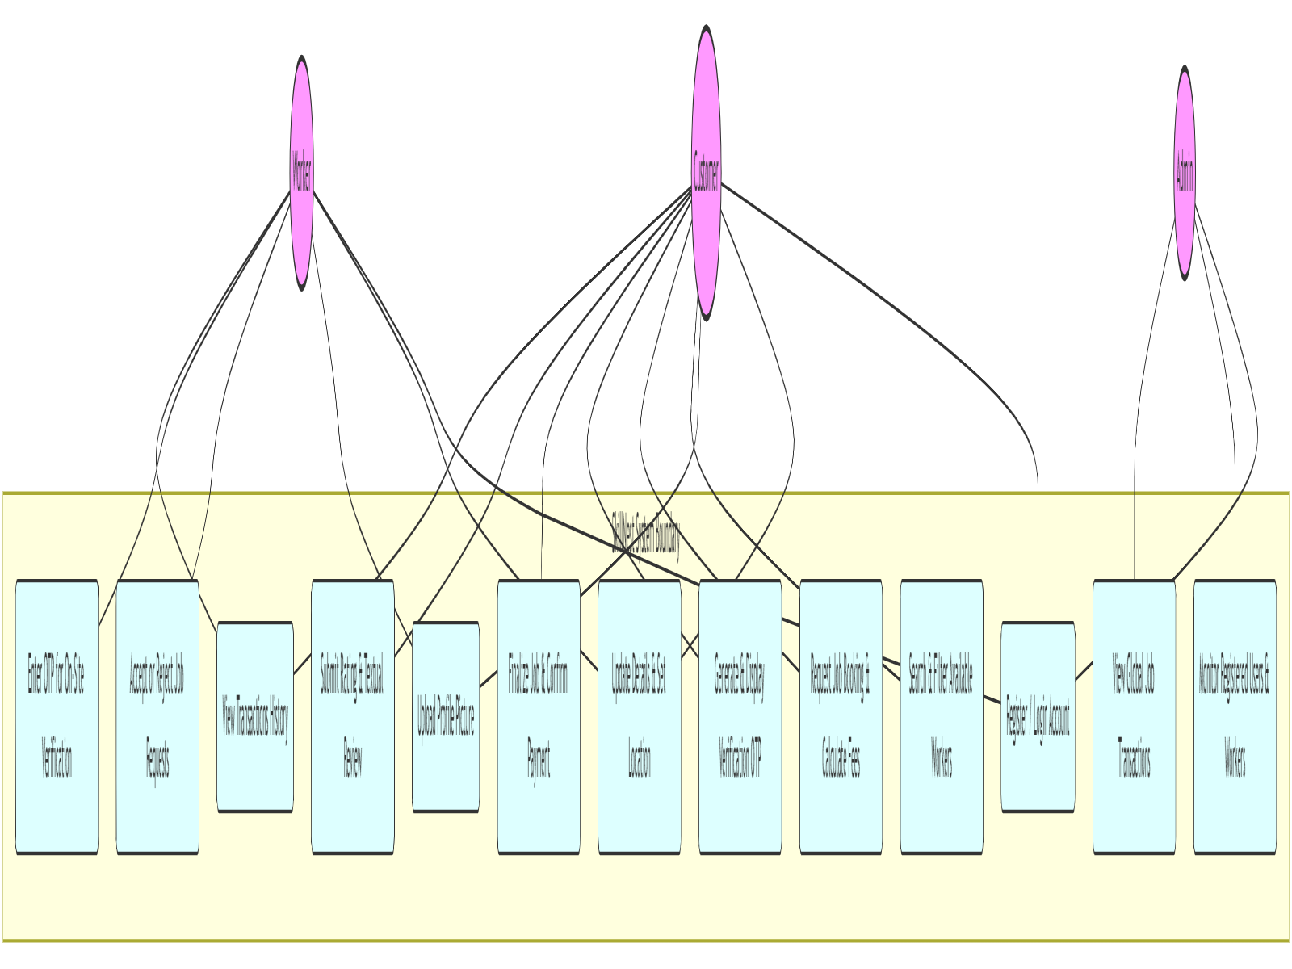
Use Case Diagram
• Customer Actor: Initiates profiles, registers location coordinates, searches, requests bookings, and submits ratings.• Worker Actor: Manages availability status, updates hourly pricing charges, accepts jobs, and executes verification code entries.• Admin Actor: Pulls global database lists for monitoring users, workers, and active transactions.

Slide 5
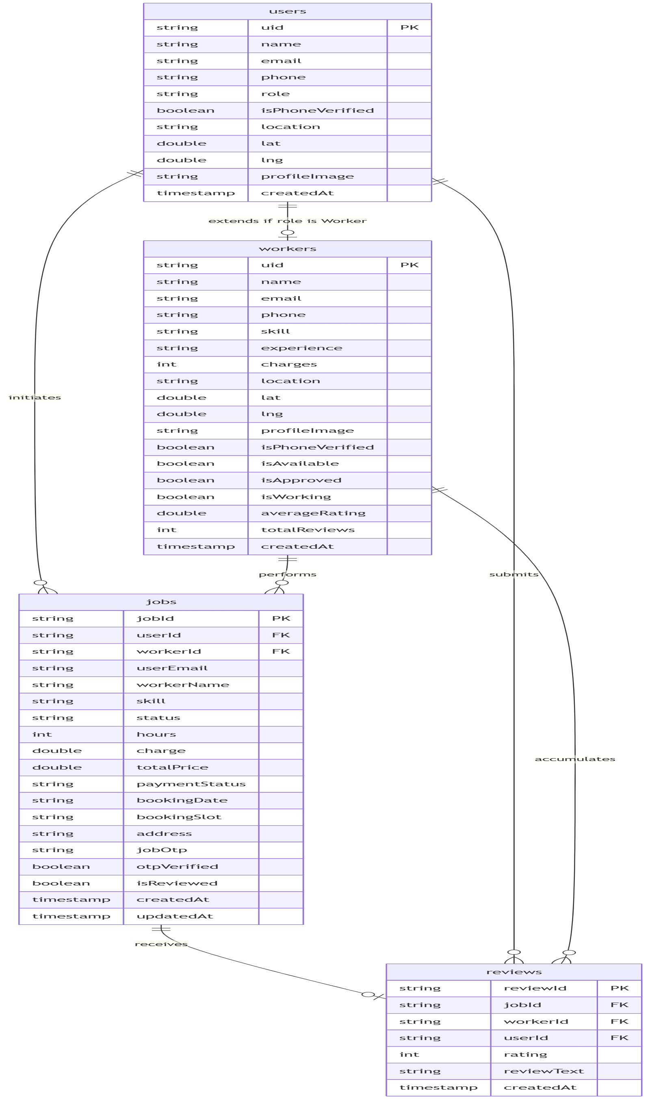
Entity-Relationship Diagram
• users collection: Core registry containing authentication credentials, location fields, and user roles.• workers collection: Sub-document extension for workers storing skill categories, charges, and ratings.• jobs collection: Pivot registry mapping transactions (payment status, OTP code, completion details).• reviews collection: Connects jobs to ratings feedback records.

Slide 6
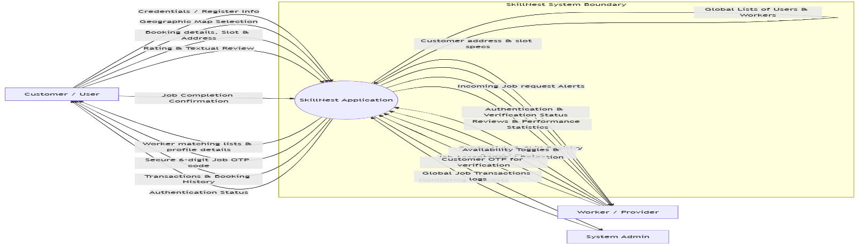
Data Flow Diagram (Level 0 - Context)
• High-level depiction of input/output boundaries.• Customer sends credentials, maps data, booking parameters, and completions.• Worker sends certifications, status toggles, and OTP entries.• System feeds matching provider lists, OTP warnings, and admin statistics.

Slide 7
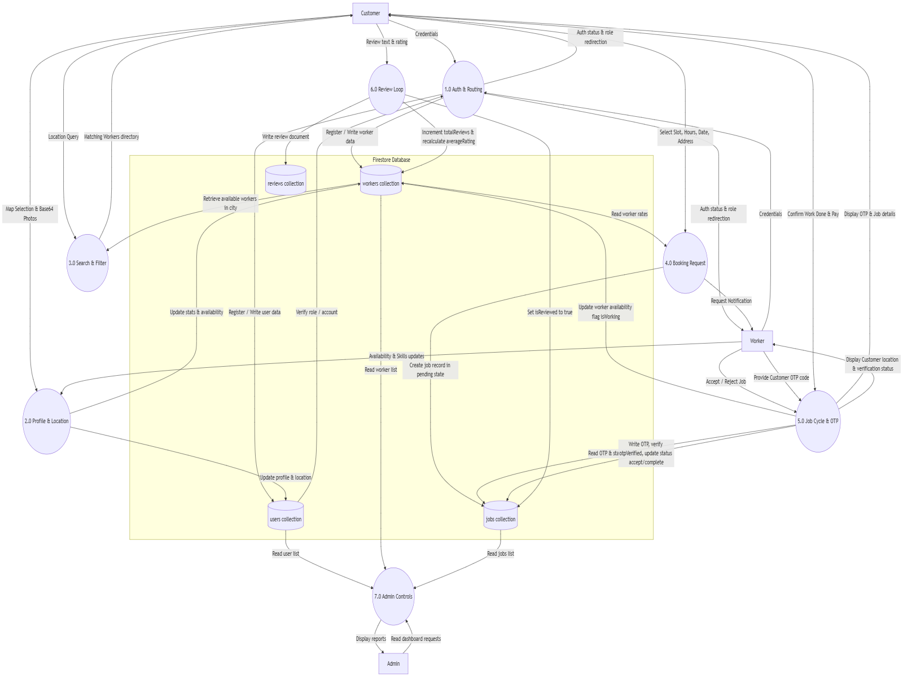
Data Flow Diagram (Level 1 - Detail)
• Authentication & Redirection (1.0): Validates logins.• Profile & Coordinates Management (2.0): Compresses images & updates Firestore.• Search & Booking Engine (3.0, 4.0): Evaluates matching locations.• OTP verification & Completion (5.0): Regulates job states.• Ratings Execution (6.0): Runs atomic calculation transactions.

Slide 8
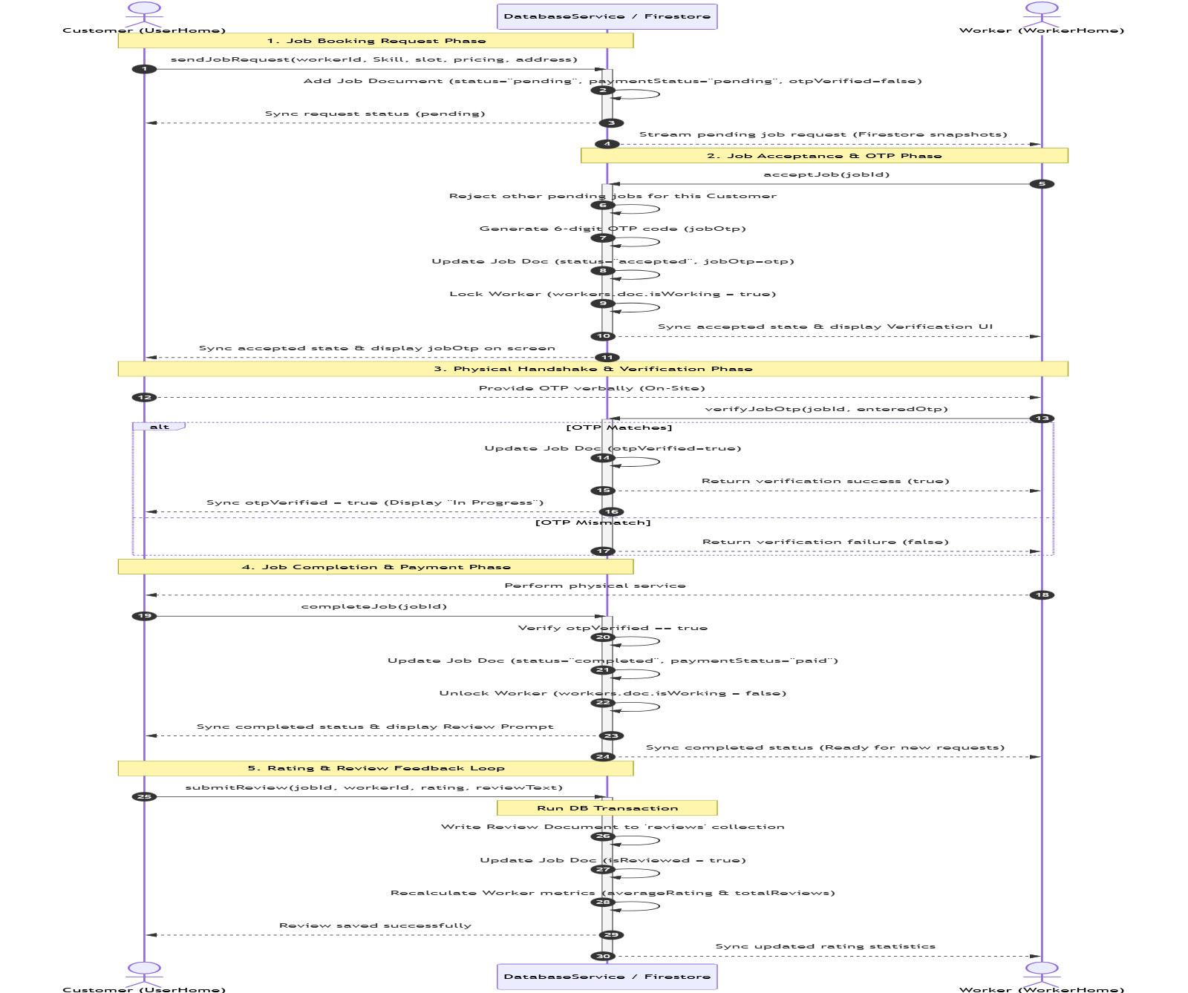
Transaction Sequence Diagram
• 1. Request Phase: Customer submits a booking. System stores status as pending.• 2. Acceptance: Worker accepts; system auto-rejects other requests, locks worker, and generates OTP.• 3. Verification: Worker inputs customer's verbal OTP, unlocking 'In Progress' state.• 4. Completion: Customer clicks complete, finalizing payment and resetting worker locks.

Slide 9
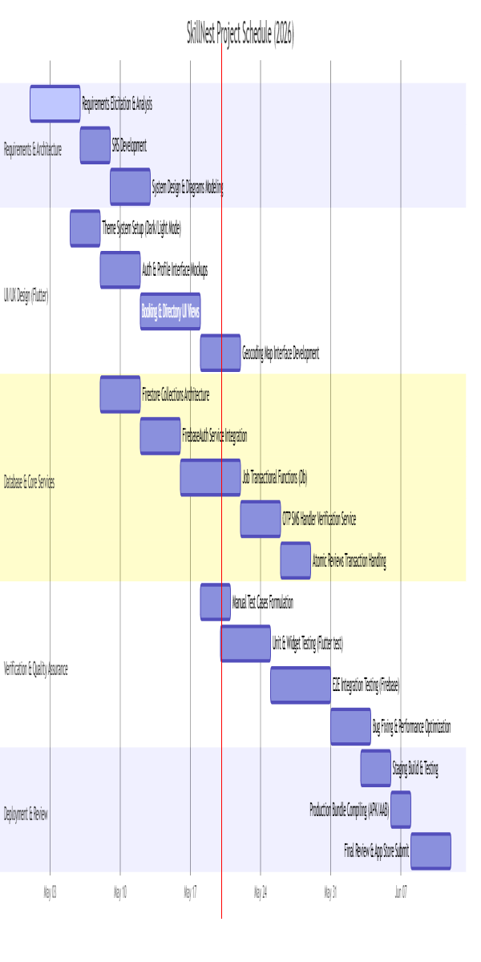
Development Gantt Chart
• Phase 1 (Requirements): Requirements elicitation, SRS draft, and architectural diagram modeling.• Phase 2 (UI/UX Design): Style system configuration, location pickers, and screen views mockups.• Phase 3 (Core Services): Firebase authentication, jobs transaction engines, and OTP verifier integrations.• Phase 4 (Testing & Deployment): Regression tests, widget mocks, and building production bundles.

Slide 10
Verification & Test Cases Summary
Test ID | Feature Area | Execution Steps Summary | Expected Result
TC-AUTH-02 | Worker Sign Up | Fill skills & experience registry, click Register. | Worker doc created with isApproved=false, routes to WorkerHome.
TC-PROF-02 | OSM Location Pick | Select location point on map, trigger Geocode Save. | Coordinates translated to city string, updates in users profile doc.
TC-SCH-01 | City Search Filter | Open customer lookup page in city 'Guwahati'. | Displays approved, verified workers in same city. Busy workers filtered out.
TC-JOB-02 | Acceptance Locking | Worker accepts booking ID. | Status shifts to accepted, generates OTP code, locks worker availability isWorking=true.
TC-JOB-03 | OTP Handshake | Worker enters matching 6-digit Customer OTP. | otpVerified field set to true in Firestore. Work starts in progress.
TC-REV-01 | Atomic Review Loop | Customer submits 4-star review comments. | Calculates worker rating average atomically via transactions, increments counts.

Slide 11
Technology Stack & Architecture Summary
• Core Frontend Framework: Flutter (Dart SDK) using clean state toggles and streams architecture.• Mapping Integrations: flutter_map using OpenStreetMap tile provider API, and geocoding package for geographic reverse-lookup.• Database Architecture: Google Cloud Firestore (NoSQL, collection-based triggers and document references).• Authentication Engine: Firebase Auth, augmented with a custom OTP verifier flow for transaction safety.• Verification Standard: Full coverage via structured unit services tests and role-based interface scenario test guides.

