Slide 1

OCD PATIENTS DEMOGRAPHICS & CLINICAL DATA ANALYSIS
PROJECT TITLE

Slide 2

PROBLEM STATEMENT Perform an exploratory data analysis (EDA) on a dataset containing demographic and clinical data of OCD patients. The analysis will focus on understanding the relationships between various demographic factors and clinical outcomes.

Slide 3
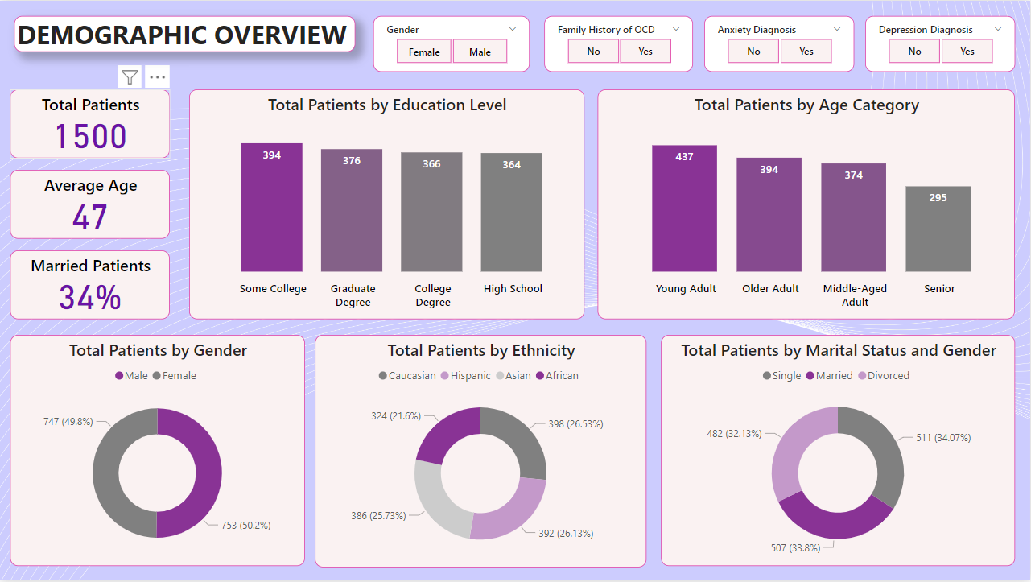
Analyses the demographic distribution of OCD patients and their characteristics.

Slide 4
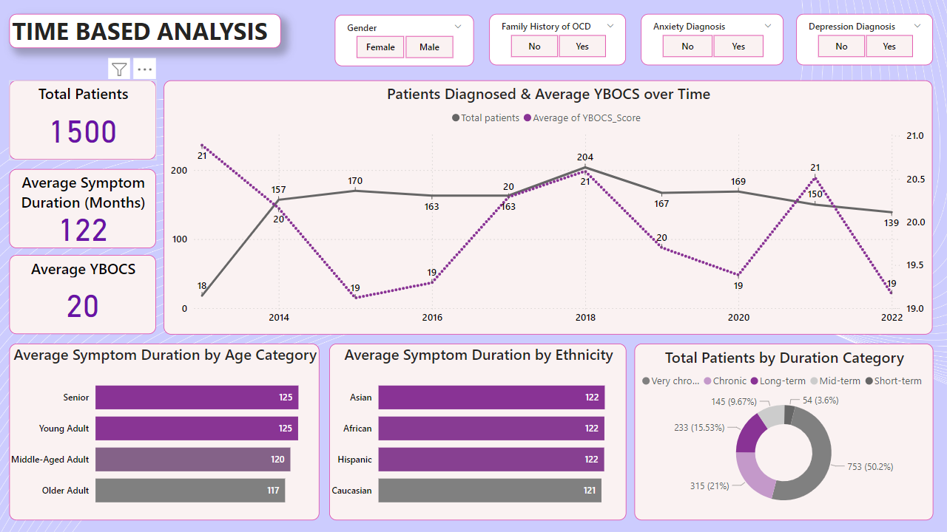
Examines OCD symptom trends and duration patterns over time.

Slide 5
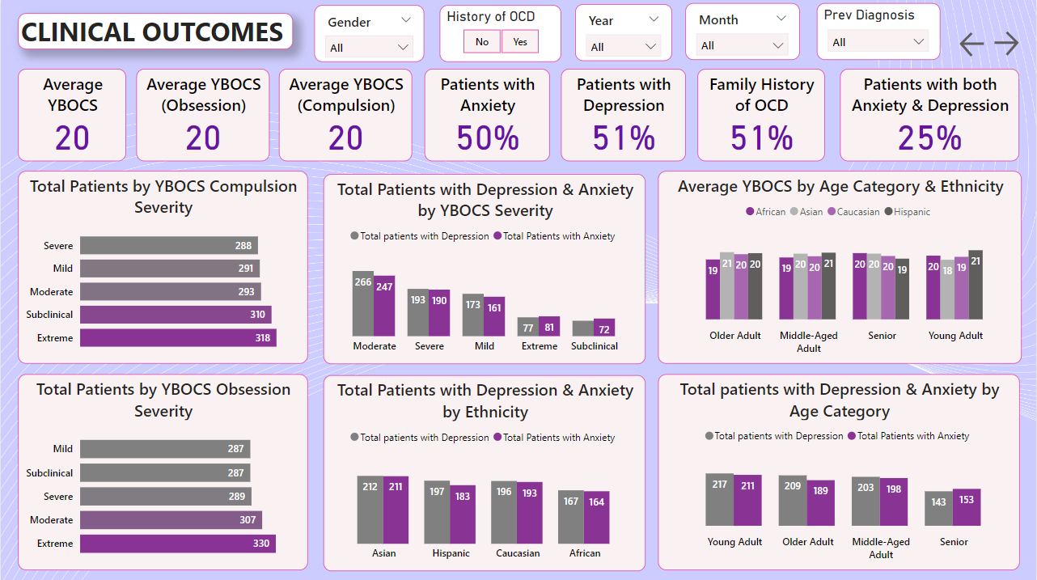
Analyses OCD severity, comorbid conditions, and their distribution across demographic and clinical factors.

Slide 6
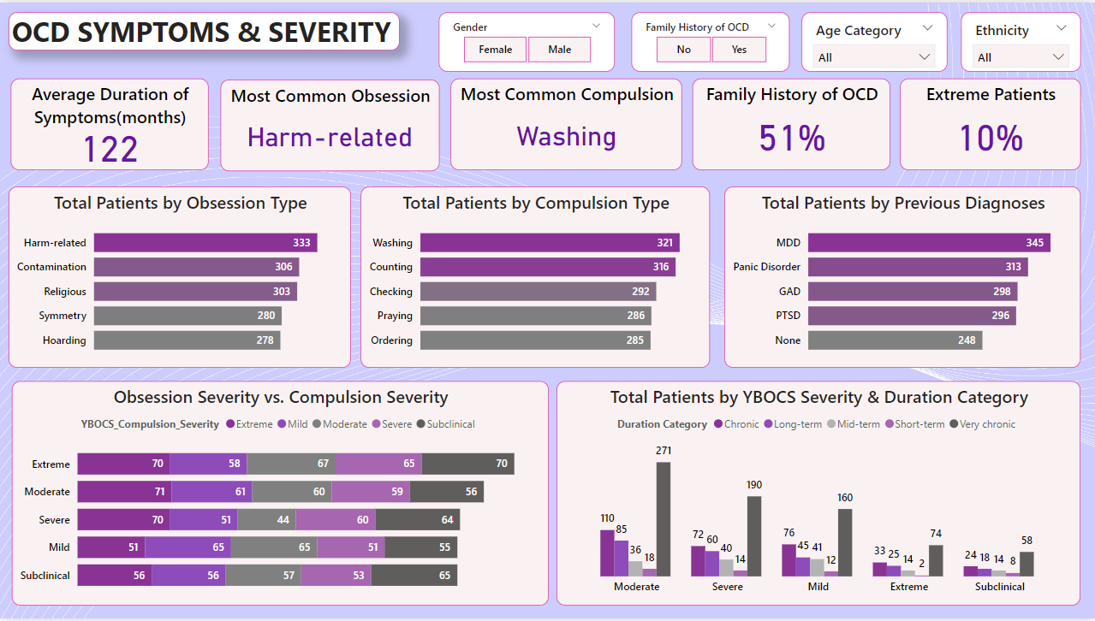
Identifies common OCD symptoms and assess severity levels among patients.

Slide 7
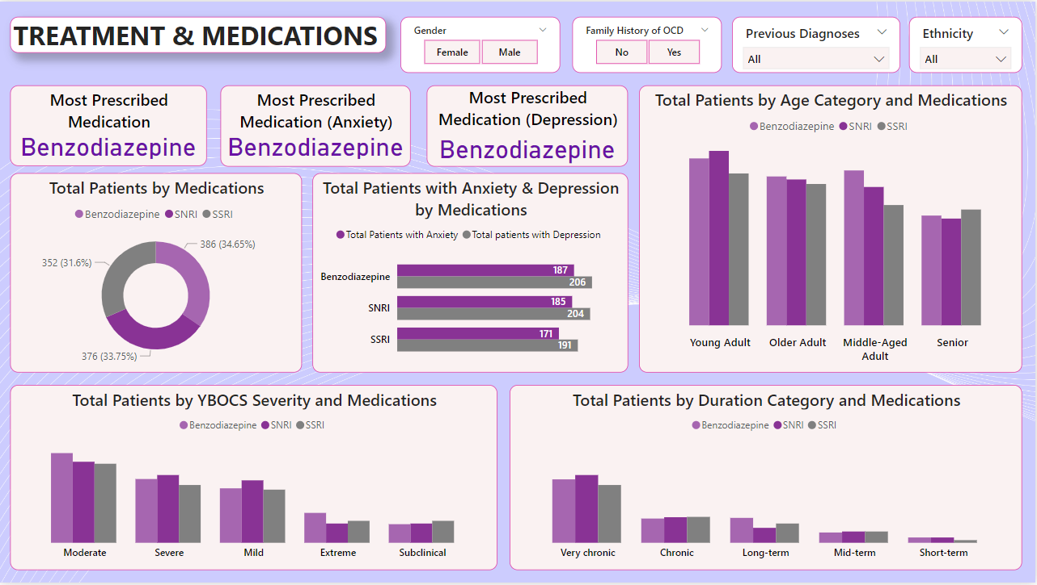
Evaluates the effectiveness and distribution of medications prescribed based on OCD severity, comorbidities and demographics.

Slide 8
Insights:
Total number of patients is 1,500 with an average age of 47 years.
Gender distribution is nearly equal (49.8% male, 50.2% female).
Most patients have "Some College" (394) or a "Graduate Degree" (376).
Age category distribution shows the largest group as Young Adults (437).
Marital status insights indicate that 34% of patients are married.
The ethnic breakdown shows a fairly even distribution, with Caucasian being the largest group (26.53%).
Average symptom duration is 122 months, with the average YBOCS score being 20.
Diagnosis trends over time show peaks in 2018 and a decline by 2022.
Symptom duration is longest among Seniors and Young Adults (125 months) and shortest for Older Adults (117 months).
All ethnicities have a similar average symptom duration (~122 months).
Duration categories indicate that 50.2% of patients are in the "Chronic" group.
Patients with extreme and subclinical compulsion severity have higher numbers compared to mild and moderate cases.
50% of patients have anxiety, and 51% have depression.
25% of patients suffer from both anxiety and depression.
51% of patients have a family history of OCD, indicating a potential genetic predisposition.

Slide 9
Insights:
Average YBOCS scores are consistent across ethnicities but vary slightly by age group.
Younger adults have the highest YBOCS scores compared to other age groups.
Most common obsession is Harm-related (333 patients), and the most common compulsion is Washing (321 patients).
51% of patients have a family history of OCD, and 10% fall into the "Extreme" category.
Co-occurring disorders are common, with the highest being MDD (345 patients), followed by Panic-Disorder (313).
Severe obsession severity is associated with moderate compulsion severity across most categories.
Duration and severity mapping shows that most moderate cases are Chronic (271 patients), while extreme cases are more prevalent in Very Chronic (74 patients).
Benzodiazepines are the most prescribed for OCD, anxiety, and depression.
Young adults and middle-aged adults are more likely to receive benzodiazepines and SNRIs.
Moderate and severe YBOCS cases are primarily treated with benzodiazepines and SNRIs.
Very chronic and chronic cases receive benzodiazepines slightly more frequently than other medication types.
Patients with both anxiety and depression are treated across all three medication types (Benzodiazepines, SNRIs, SSRIs), with benzodiazepines being the most common.

