Slide 1

INTRODUCTION OF HTMl course
What is HTML ?
HTML stands for Hyper Text Markup Language
HTML is not programing language
HTML describes the structure of a Web page
HTML elements tell the browser how to display the
content
by mohamett abshir

Slide 2



What do you need when learning HTML?
Computer
Browser
Code editor
by mohamett abshir

Slide 3
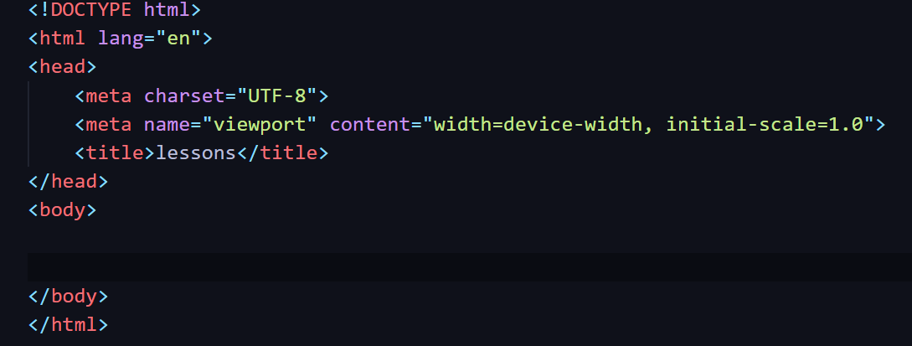
HTML Structure
1 : <!DOCTYPE html> All HTML documents must start with a document type declaration
2 : <html> Waa xididka dhamaan HTML-ka
3 : <head> Waxaa lagu daraa metadata (Title, CSS, iwm.)
4 : <body> Waxaa ku jira dhammaan waxa muuqda

Slide 4
Comman html tags
Semantic tags
< h1 > </h1>
<p> </p>
<a> href=‘#’> </a>.
<image src=‘#’> </image>
<ul> /ul>
<span> </span>
<header>
<nav>
<section>
<article>
<aside>
<footer
<main>

Slide 5
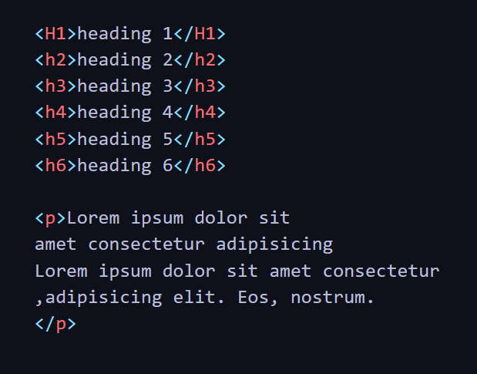
HEADING & PARAGRAPHS
Heading : are used to
define titls or section
headings .
Html provided 6 levels of heading
Paragraphs : it used to
Define paragraph text

Slide 6
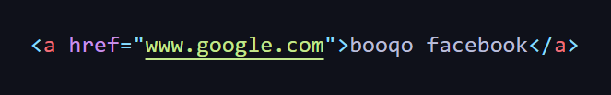

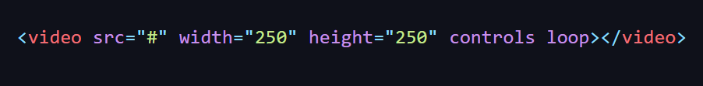
LINKS IMAGE AND VIDEO
links : in html :
Are created using the anchor tag attributes
Is used specify the url of page to link goe
Image : in html image added using <img> tag
Src attribute is used to specify image’s source
VIDEO : in html video embedded
using <video> tag

Slide 7
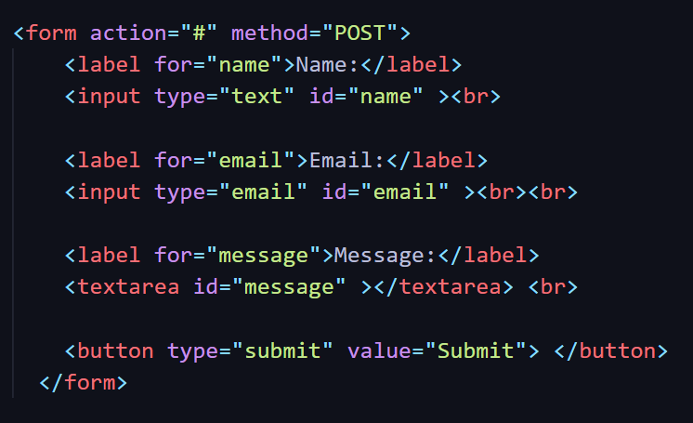
FORM
FORM allow users to submit Data to a
server . Use <form> tag
action : mesha lo dirayo xogta
Method : qabka lo dirayo
Types of form
Label : userka logu shega wxa u galinayo
Input : waxe xogta ka qabata userka
Button : userka u ogalanesa inu xogta so
diro

Slide 8
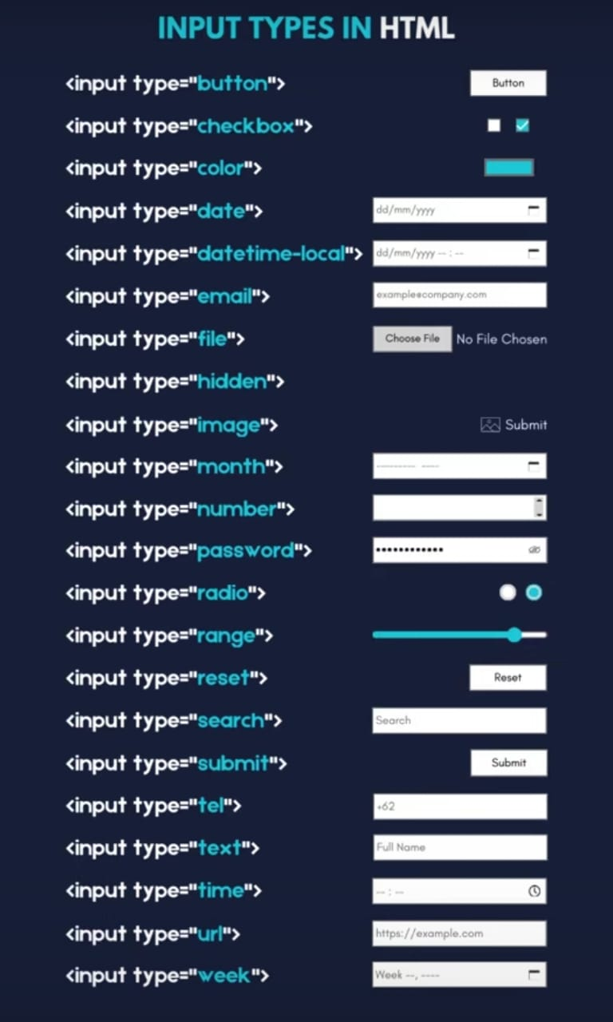
INPUT TYPE IN HTML

Slide 9
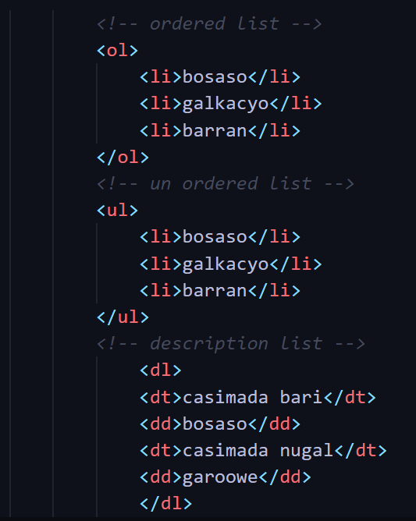
LISTS OF HTML
ORDERED LIST
UN ORDERED LIST
Is a list with nubers like ( 1 , 2 , 3 )
Is a lists with bullet points like ( . )
DESCRIPTION LIST
is list of terms and descriptions

Slide 10
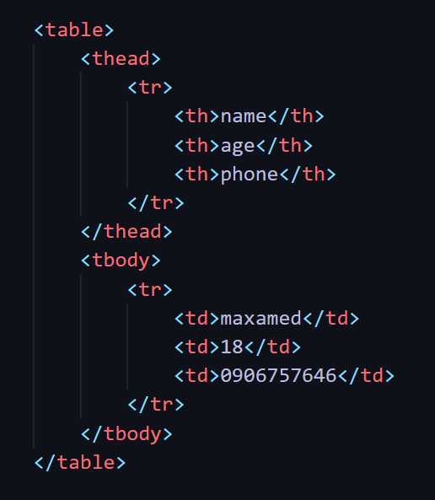
TABLE IN HTML
Table : is a way to organize
and display data in rows and columns
<table> : Defines the table.
<tr> : Defines a row.
<th> : Defines a header cell
<td> : Defines a standard data cell.

Slide 11
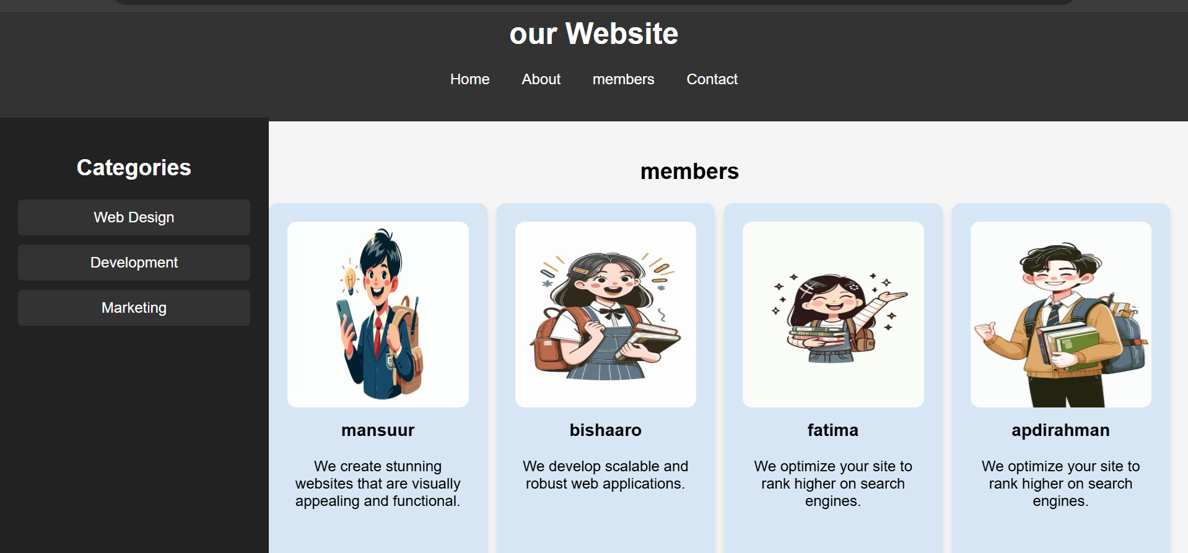

Slide 12
