Slide 1
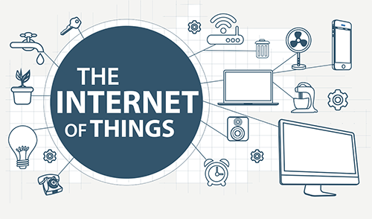
BISHIKH Pal
Cyient

Slide 2
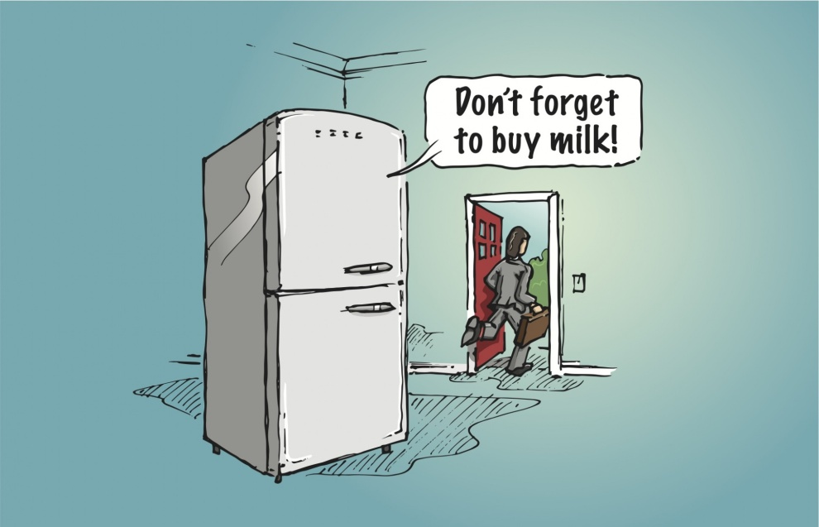

Slide 3
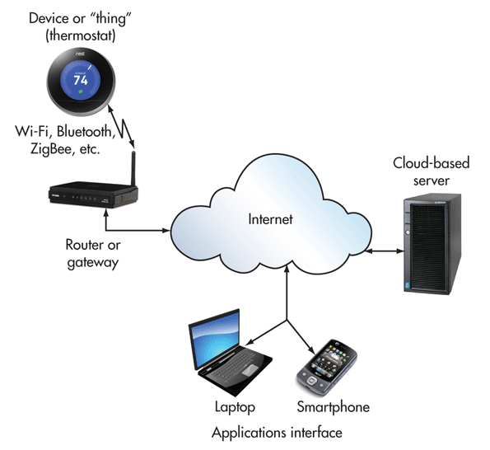
What is IoT?
The Internet of Things (IoT) is the network of physical objects—devices, vehicles, buildings and other items embedded with electronics, software, sensors, and network connectivity—that enables these objects to collect and exchange data.
Software

Slide 4
Where is IoT?
It’s everywhere!

Slide 5
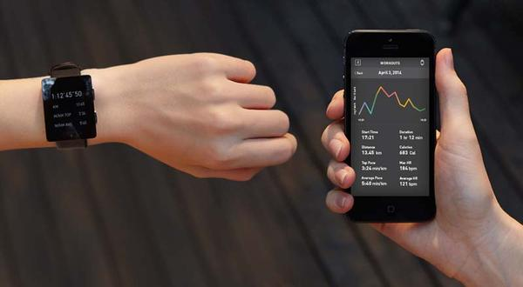
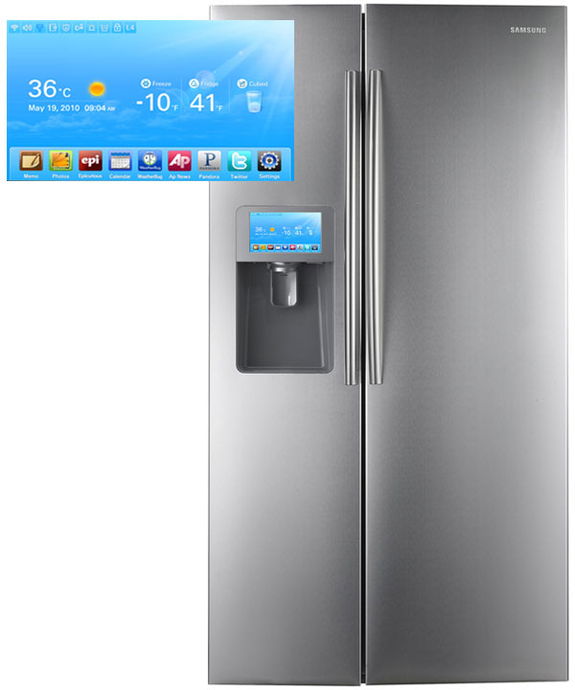
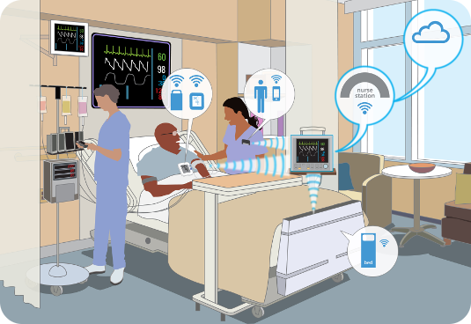
Smart Appliances
Wearable Tech
Healthcare

Slide 6
Benefits of IoT
Tracking behavior of systems in real-time
Enhanced situational awareness
Sensor-driven decision analytics
Process optimization
Instantaneous control and response in complex autonomous systems.

Slide 7











Working Model of IOT
Thing with Sensors & Embedded Electronics
IOT Cloud
Communication Module
Notification Server
Mobile Application

Slide 8
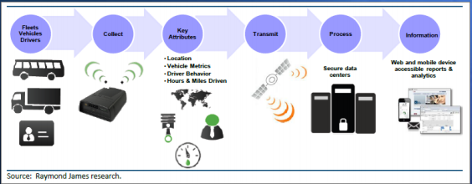
Case Study: Transportation

Slide 9
Threat vs. Opportunity
If misunderstood and misconfigured, IoT poses risk to our data, privacy, and safety
If understood and secured, IoT will enhance communications, lifestyle, and delivery of services

Slide 10
Proposals Selected in Open Innovation Challenge-IV

Slide 11

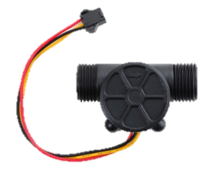

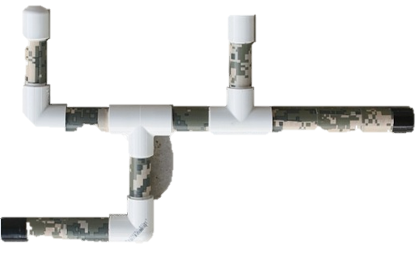
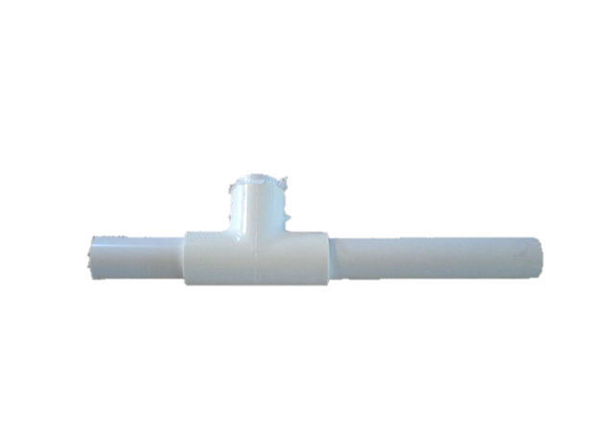


Monitor underground water pipeline water quality and identify leaks
Q₃
Raspberry pi
Q
Wi-fi
Q₂
Q₁
Data Processing
Action (Notification)
Google Drive

Slide 12

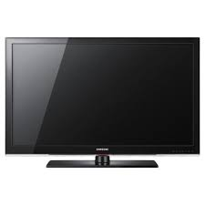

Live Fitness Feed, Diet and Fitness Assistant for Corporate Employees
Data Processing
Cyient
Mails
LCD Display
Server
Entrance
ID card
RF Reader
Camera
Pressure/Load strips

Slide 13
Thank You

Slide 14
Queries

