Slide 1


SMART INDIA HACKATHON 2025
TITLE PAGE
Problem Statement ID – 25027
Problem Statement Title- Develop a blockchain-based system for botanical traceability of Ayurvedic herbs, including geo-tagging from the point of collection (farmers/wild collectors) to the final Ayurvedic formulation label.
Theme- Blockchain & Cybersecurity
PS Category- Software
Team ID- 100746
Team Name (Registered on portal)

Slide 2

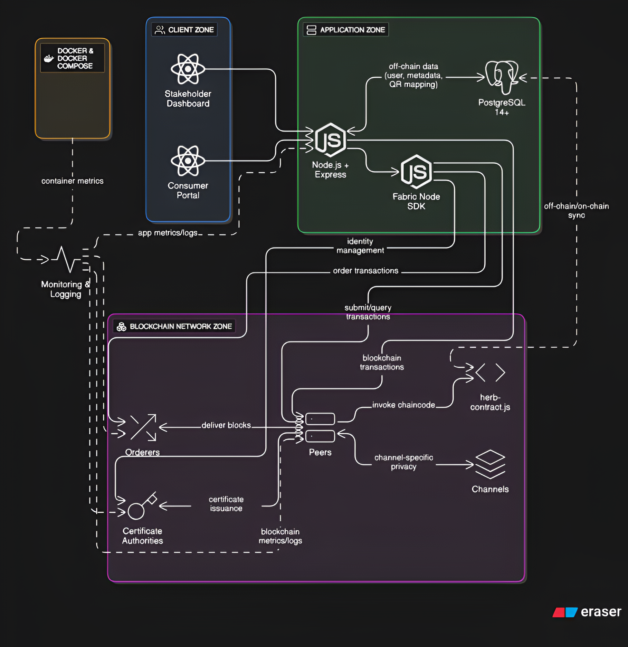
SOIL-TO-SHELF
CREATIVE CARTEL
Blockchain-Powered Traceability Platform for Ayurveda
Technology: Hyperledger Fabric (permissioned blockchain) ensures secure, immutable, transparent tracking.
Geo-Tagging: Farmers use a mobile DApp to log GPS, timestamp, species, and quality at collection, creating a blockchain-based CollectionEvent.
Smart Contracts (Chaincode): Enforce rules (geo-fencing, seasonal restrictions, quality validation) and record lifecycle events (collection, tests, processing) using composite keys for linked herb batch data.
Consumer Transparency: QR codes on products link to blockchain data, showing an interactive map, event timeline, quality certificates, and farmer details.
Problem Solving:
Adulteration/Mislabeling: Immutable records prevent tampering.
Provenance Loss: Geo-tagging traces herbs to their exact origin.
Unsustainability: Blockchain enforces compliance, discouraging over-harvesting.
Consumer Trust: QR-based transparency boosts confidence.
Scalability: Supports ₹1 lakh crore export potential with global credibility.
Innovations:
First “Soil-to-Shelf” blockchain traceability for Ayurveda.
Geo-tagged collection events for authenticity.
Composite key system for unlimited linked events.
Hybrid data strategy for blockchain efficiency.
Smart QR labeling for consumer access without apps.
Built-in compliance with National Medicinal Plants Board guidelines.
Stakeholder Benefits:
Farmers: Fair pay and recognition.
Manufacturers: Assured quality and compliance.
Regulators: Real-time monitoring.
Consumers: Verified authenticity, safety, and sustainability.

Slide 3
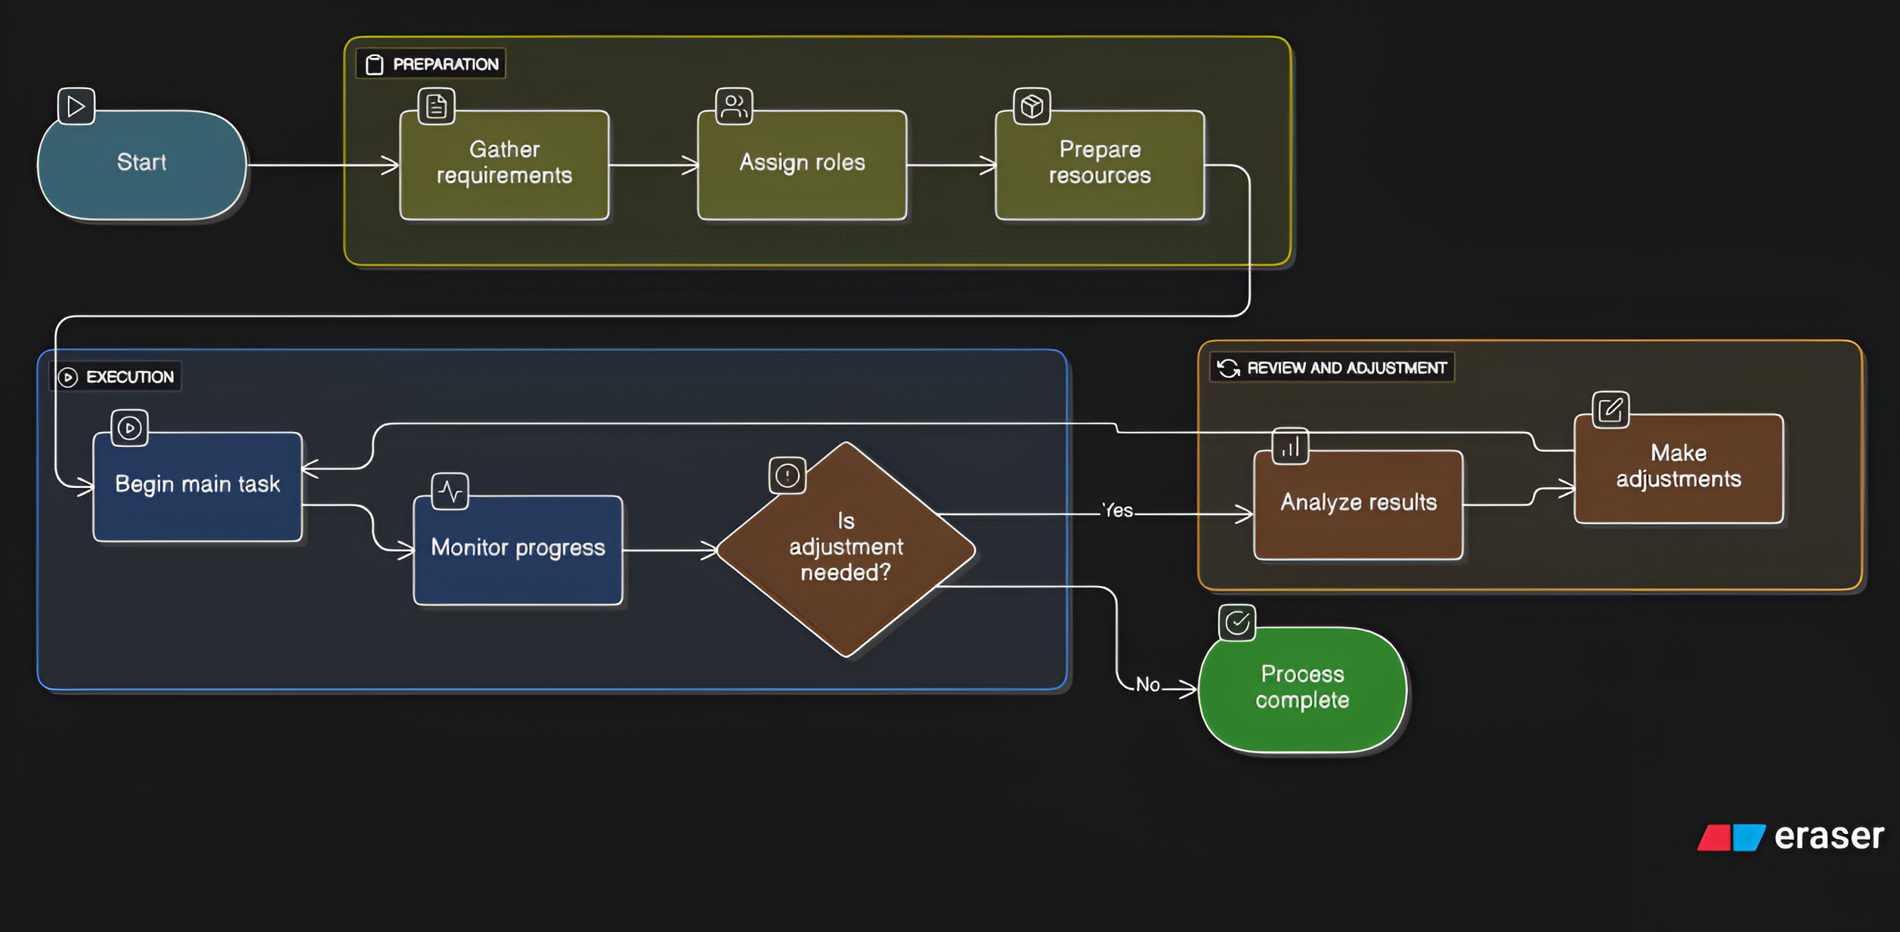


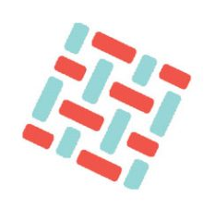
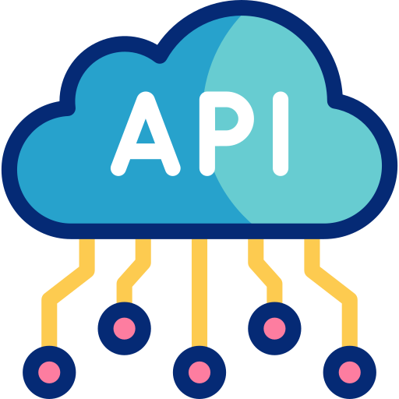







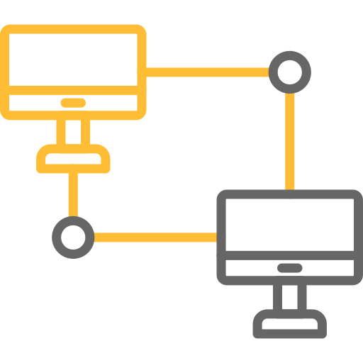
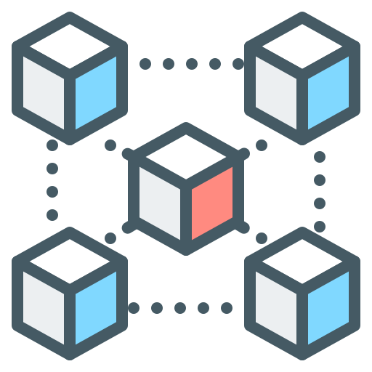



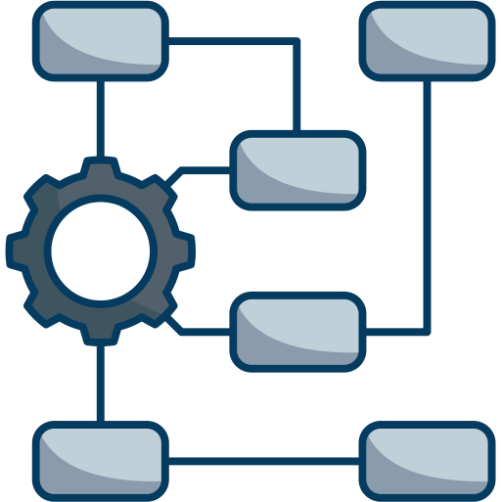
TECHNICAL APPROACH
CREATIVE CARTEL
Technical Stack
Blockchain: Hyperledger Fabric 2.5.x (permissioned, scalable, private channels, CouchDB).
Backend: Node.js + Express + Fabric Node SDK (RESTful APIs, async, unified JS).
Database: PostgreSQL 14+ (hybrid on/off-chain storage for users, herb batches, QR codes, transactions).
Frontend: React (component-based, interactive UI for consumer portal and dashboards).
Containerization: Docker & Docker Compose (consistent environment, easy Fabric setup).
Core Methodology
On-Chain Data: Immutable records for CollectionEvent, QualityTest, ProcessingStep.
Off-Chain Data: Metadata, images, QR mappings, transaction logs.
Chaincode (Smart Contracts – herb-contract.js):
recordCollection(): Logs geo-tagged harvest.
addQualityTest() & addProcessingStep(): Appends events with composite keys.
getHerbJourney(): Retrieves full batch history.
Geo-Tagging: GPS + timestamp via mobile DApp at collection.
QR Code System: Maps product to herbId for consumer journey access.
RESTful APIs: /api/fabric/collect, /api/fabric/herb/:herbId for dashboards.
Workflow: Farmer → Lab → Processor → QR Packaging → Consumer Verification.
Metadata: JSON (FHIR-style) for interoperability.
Validation: Smart contracts enforce geo-fencing, seasonal, and quality rules.

Slide 4




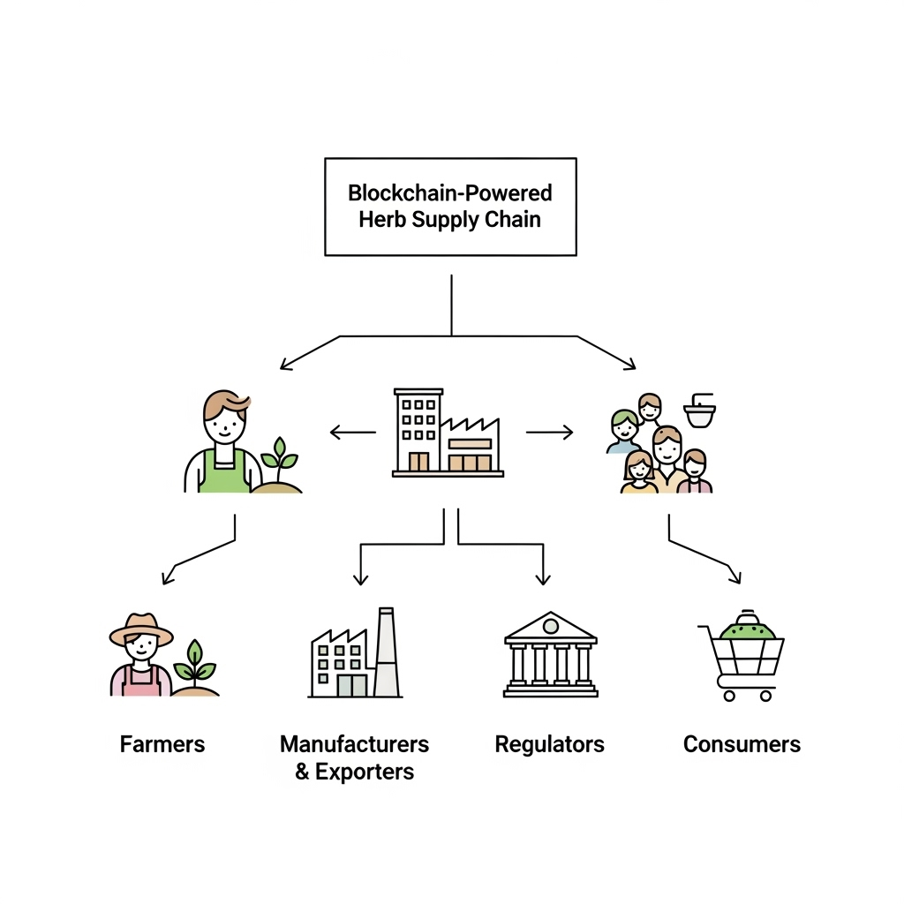

FEASIBILITY AND VIABILITY
CREATIVE CARTEL
Feasibility & Viability
Technically Feasible: Uses mature stack (Hyperledger Fabric, Node.js, PostgreSQL, React, Docker).
Operationally Feasible: Farmer app, lab portal, manufacturer tracking, and consumer QR scan—mirrors real workflow.
Economically Viable: Reduces fraud, builds export trust, and enables premium pricing.
Scalable: Works for local pilots and can expand nationwide with support from AYUSH & cooperatives.
Use Cases
Farm-to-Shelf Traceability: Verify exact origin of herbs.
Regulatory Auditing: Simplifies compliance reporting for AYUSH/global exports.
Anti-Adulteration: Blocks counterfeit/mislabeled herbs.
Supply Chain Efficiency: Real-time inventory + recall management.
Consumer Transparency: QR scan reveals authenticity & sustainability.
Business Potential
₹1 Lakh Crore Export Boost: Builds global trust in Ayurveda.
Brand Equity & Premium Pricing: Verified authenticity = stronger consumer loyalty.
Regulatory Alignment: Automatic compliance helps exports scale.
Farmer Empowerment: Recognition + fair pricing for quality & sustainability.
Challenges & Risks
Adoption Resistance: Farmers, labs may hesitate to adopt tech.
Data Integrity: Wrong inputs = permanent blockchain errors.
Rural Infrastructure: Poor GPS/internet coverage in remote areas.
Integration Barriers: Linking with ERP, government systems.
Scaling Costs: Training, maintenance, and infra at large scale.
Solutions
Training + Incentives: Reward farmers/labs for verified sustainable inputs.
Smart Contract Validation: Auto-checks for location, quality, seasonal rules.
Offline-first DApp: Works without internet, syncs later.
Phased Rollout: Start small (pilot states/herbs), then expand.
Partnerships: Tie-up with AYUSH Ministry, exporters, pharma giants.

Slide 5
IMPACT AND BENEFITS
CREATIVE CARTEL
Social Benefits
Farmer Empowerment: Ensures fair pricing and recognition for quality produce.
Community Trust: Builds confidence in Ayurveda through transparent sourcing.
Digital Inclusion: Trains rural farmers in simple tech tools, bridging the digital divide.
Economic Benefits
Export Growth: Unlocks ₹1 lakh crore market potential with global traceability compliance.
Brand Premium: “Blockchain Verified” enables higher pricing and stronger consumer loyalty.
Supply Chain Efficiency: Reduces fraud, recalls, and improves inventory management.
Educational Benefits
Skill Development: Farmers and stakeholders gain experience in digital tools and blockchain.
Knowledge Sharing: Consumer portals educate buyers on sourcing, quality, and sustainability.
Research & Academia: Platform data supports universities, herbal studies, and innovation.
Technological Benefits
Blockchain Integration: Provides secure, immutable, and scalable traceability.
Cross-Industry Adaptability: Framework applicable to food, pharma, and cosmetics.
IoT-Ready: Supports integration with GPS, soil, and temperature sensors for smart agriculture.
Environmental Benefits
Biodiversity Protection: Prevents over-harvesting of vulnerable species.
Sustainable Practices: Promotes eco-friendly sourcing and responsible farming.
Climate Impact Reduction: Optimized supply chains reduce waste and carbon footprint.
Potential Impact on Target Audience
Farmers & Collectors
Fair compensation & recognition for quality herbs.
Easy-to-use mobile DApp for traceability.
Incentives for sustainable harvesting.
2. Manufacturers & Exporters
Assured raw material quality, reduced adulteration.
Simplified regulatory compliance (AYUSH/global).
Access to premium international markets.
3. Regulators (AYUSH, Govt.)
Full supply chain visibility.
Automatic enforcement of guidelines.
Stronger global positioning of Indian Ayurveda.
4. Consumers
Transparency: Scan QR → see farm-to-shelf journey.
Trust in product authenticity, safety & sustainability.
Justifies premium purchase decision.

Slide 6
RESEARCH AND REFERENCES
CREATIVE CARTEL
References
Feature | Proposed System | HerBChain | MedicLedger | Walmart Food Trust | PharmaChain
Permissioned Blockchain | ✓ | X | ✓ | ✓ | ✓
Hyperledger Fabric | ✓ | X | X (Basic) | ✓ | ✓
Smart Contracts | ✓ | X | ✓ | X | ✓
Standardized Metadata | ✓ | X (Basic) | X | X | ✓
Consumer Portal | ✓ | X | ✓ | X | X (Basic)
RESTful APIs | ✓ | X | X (Basic) | X | ✓
Hybrid ON/OFF Chain | ✓ | X | X | X | ✓
Sustainability | ✓ | X | ✓ | X (Basic) | X
Ayurvedic Specific | ✓ | ✓ | ✓ | X | X
Real-Time Monitoring | ✓ | X | ✓ | X | ✓
Regulatory Compliance | ✓ | X | X | X | ✓
Walmart Case Study: Hyperledger Fabric for Food Supply Chain
https://www.lfdecentralizedtrust.org/case-studies/walmart-case-study
HerBChain: A Blockchain-Based Informative Platform for Quality Assurance in the Herbal Industry (2021)
https://pmc.ncbi.nlm.nih.gov/articles/PMC8572703/
Blockchain Technology in Herbal Medicines: Applications, Trends, and Challenges (2025)
https://www.sciencedirect.com/science/article/abs/pii/S2214786125000257
Resources
AI-Driven Procurement in Ayurveda and Ayurvedic Medicines Supply Chain (2025)
https://www.scirp.org/pdf/ojbm_1534458.pdf
Leveraging Deep Learning and Blockchain for Enhanced Transparency and Traceability in the Indian Herbal Product Supply Chain (2024, with 2025 updates)
https://ieeexplore.ieee.org/document/10581263/
Research on Operation Strategy of Multiple Channels Pharmaceutical Supply Chain Based on Blockchain Traceability (2025)
https://www.nature.com/articles/s41598-025-00727-7

