Slide 1

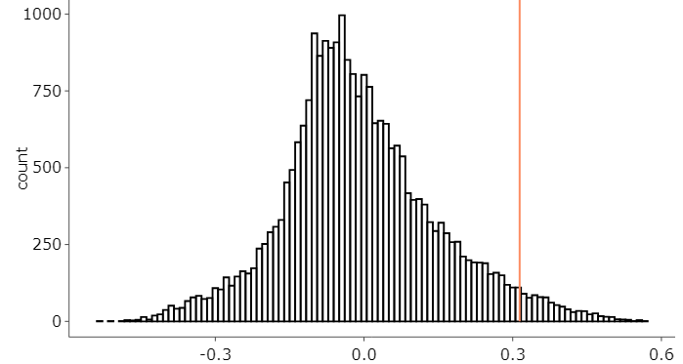
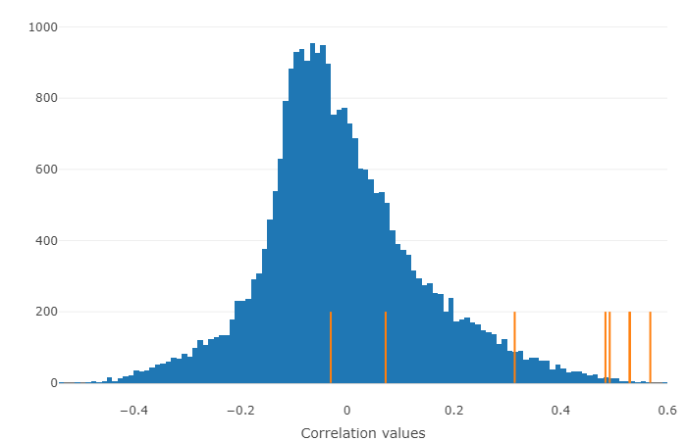
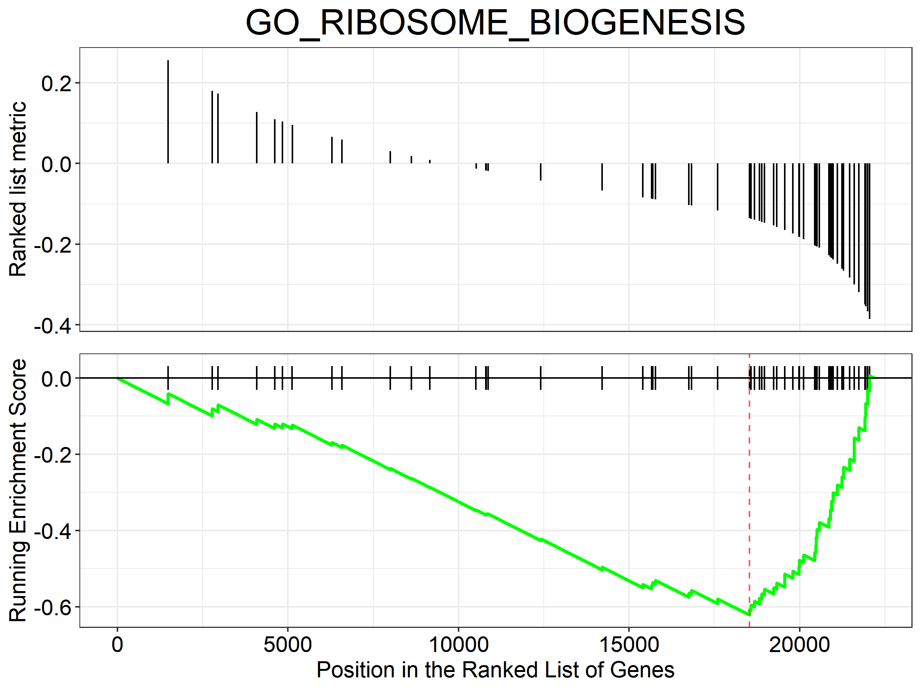
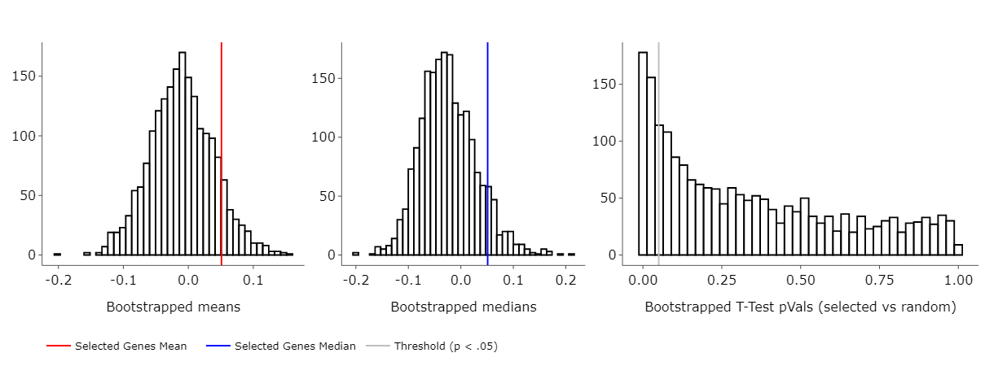
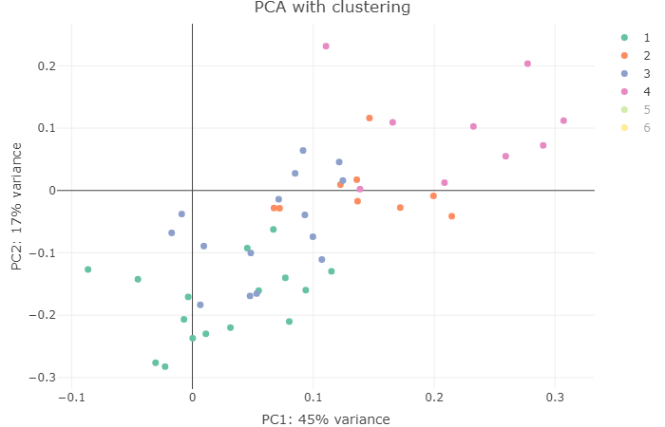
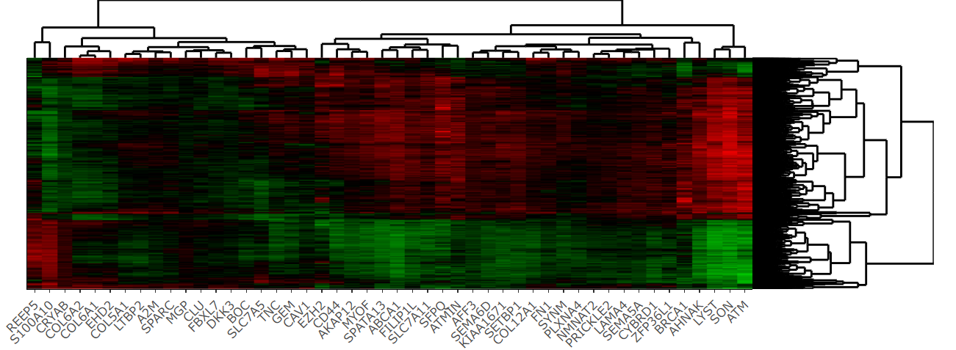
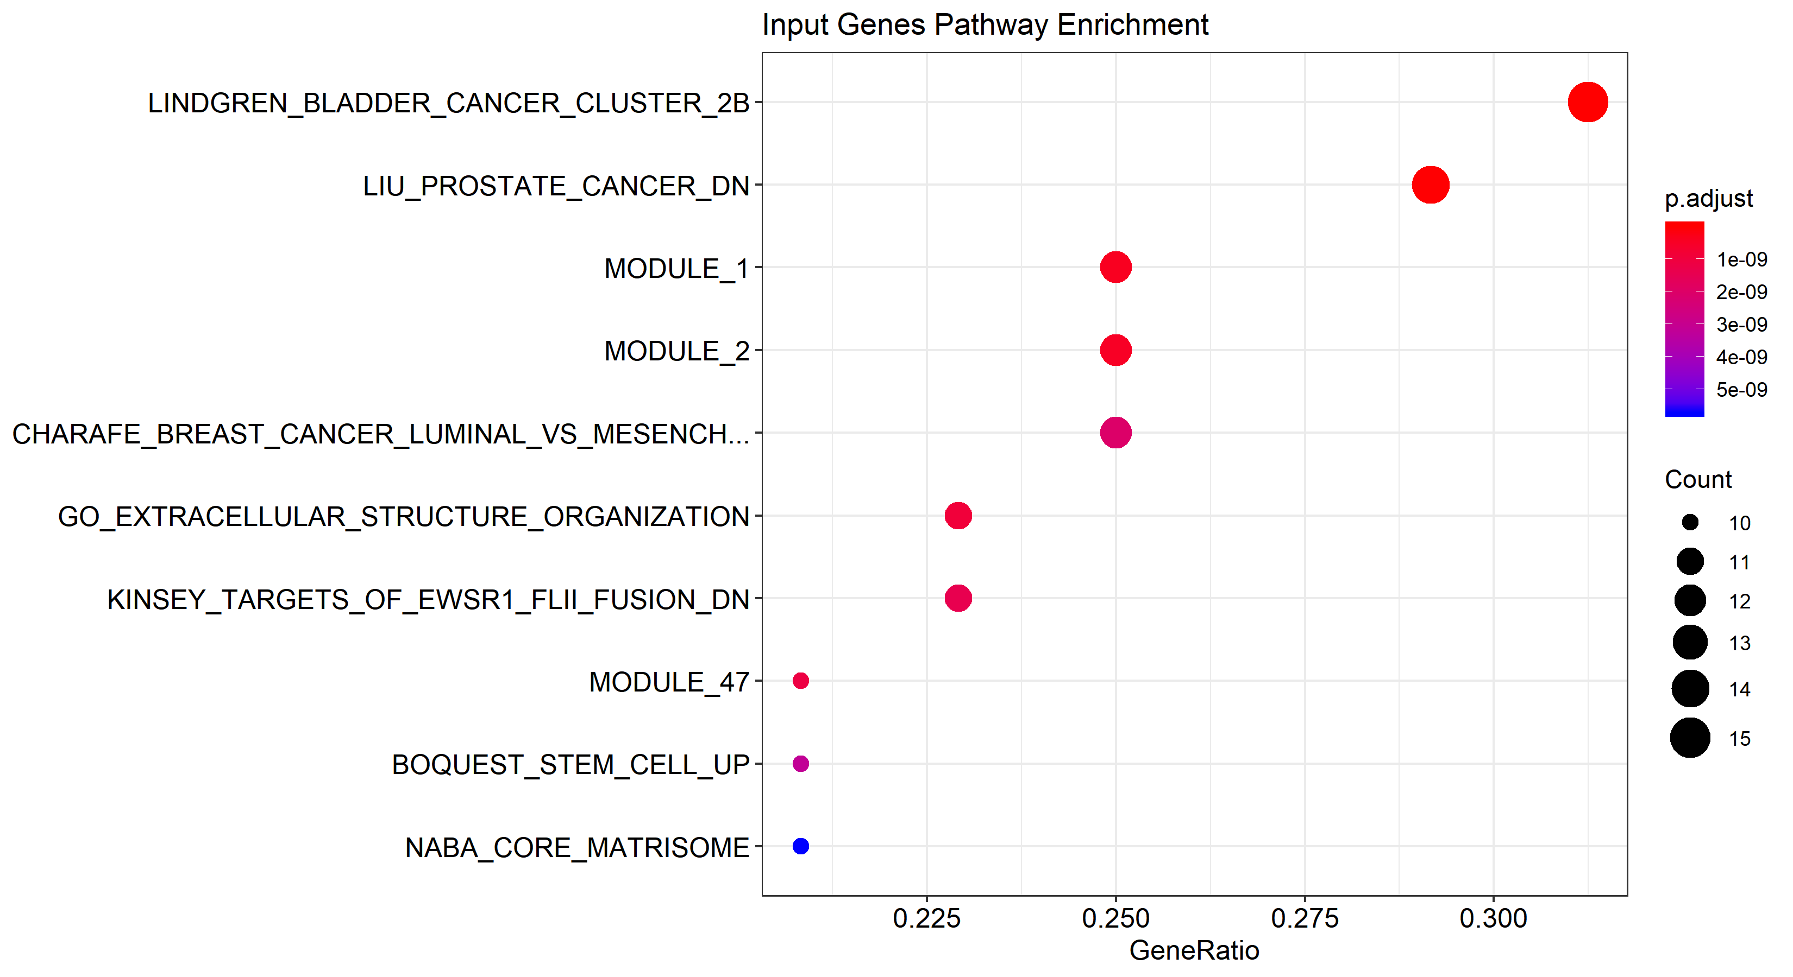
ARCHS4 RNA-Seq data repository
Human tissues
Mouse tissues
Human tumors
Mouse tumors
Gene expression correlations
Single-analysis Mode
Paired-analysis Mode
“ATM”
“ATM vs (BRCA1, EZH2 …)”
correlationAnalyzeR
Topology-analysis Mode
“ATM, BRCA1, EZH2 …” or “BIOCARTA_PROTEASOME_PATHWAY”

