Slide 1

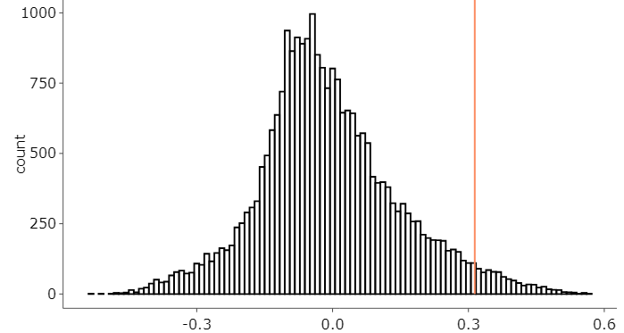
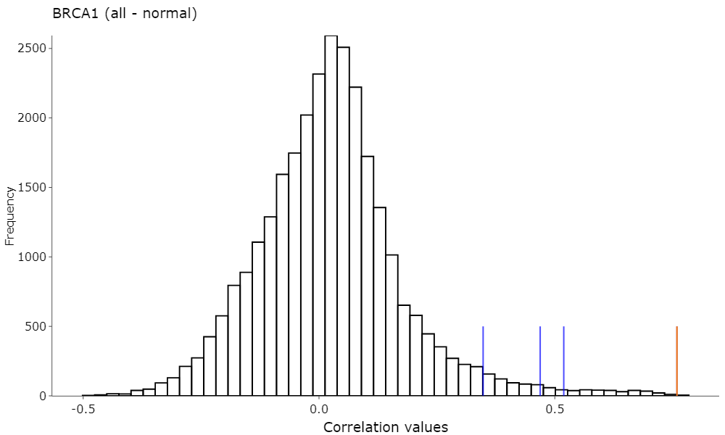
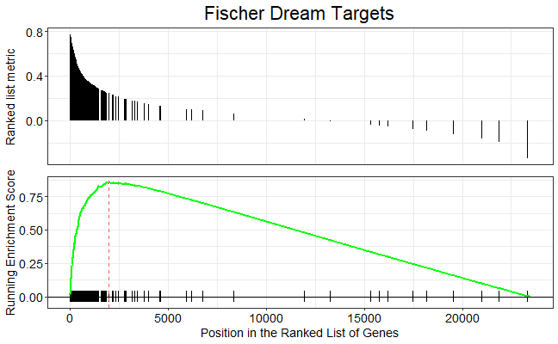
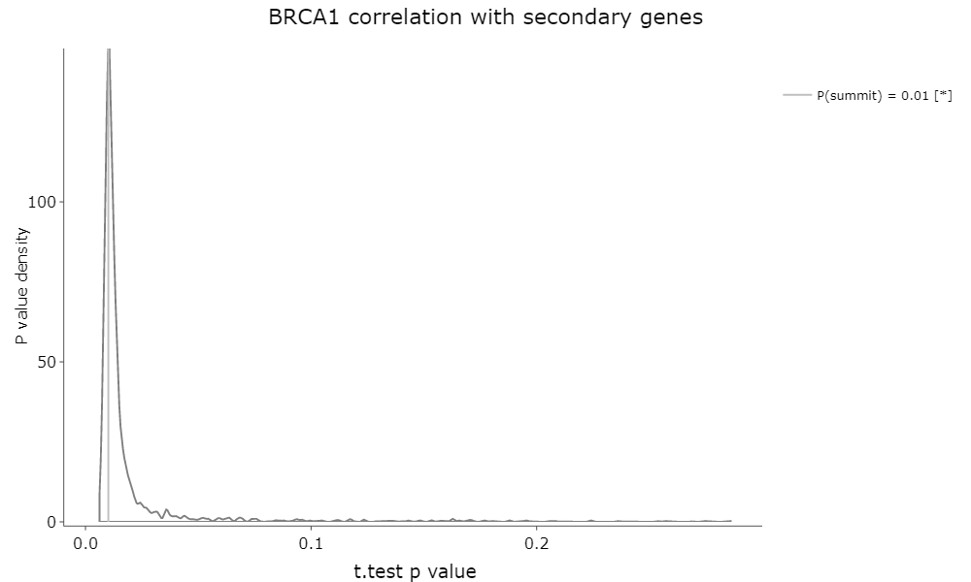
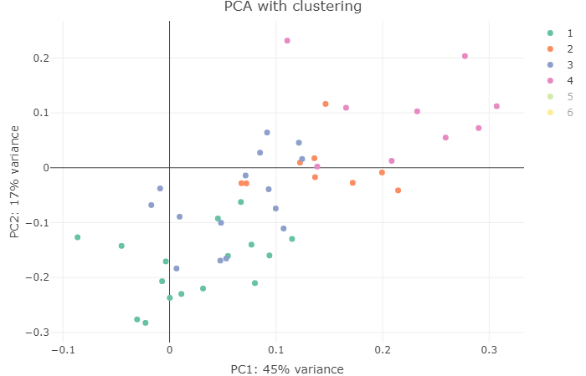
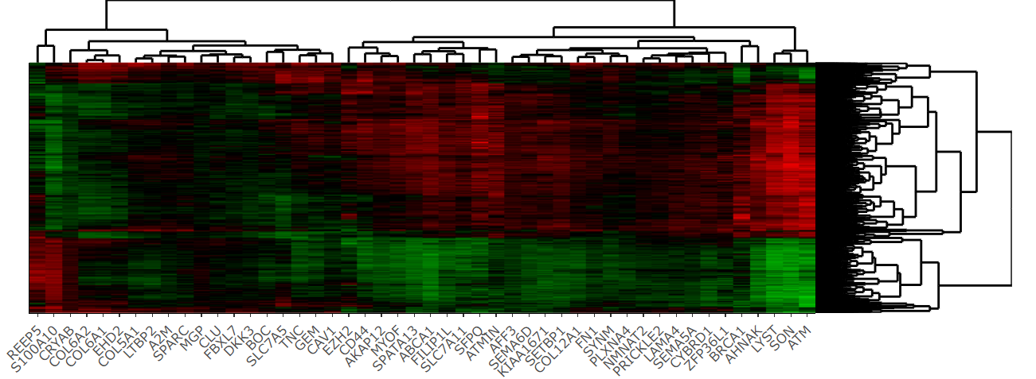
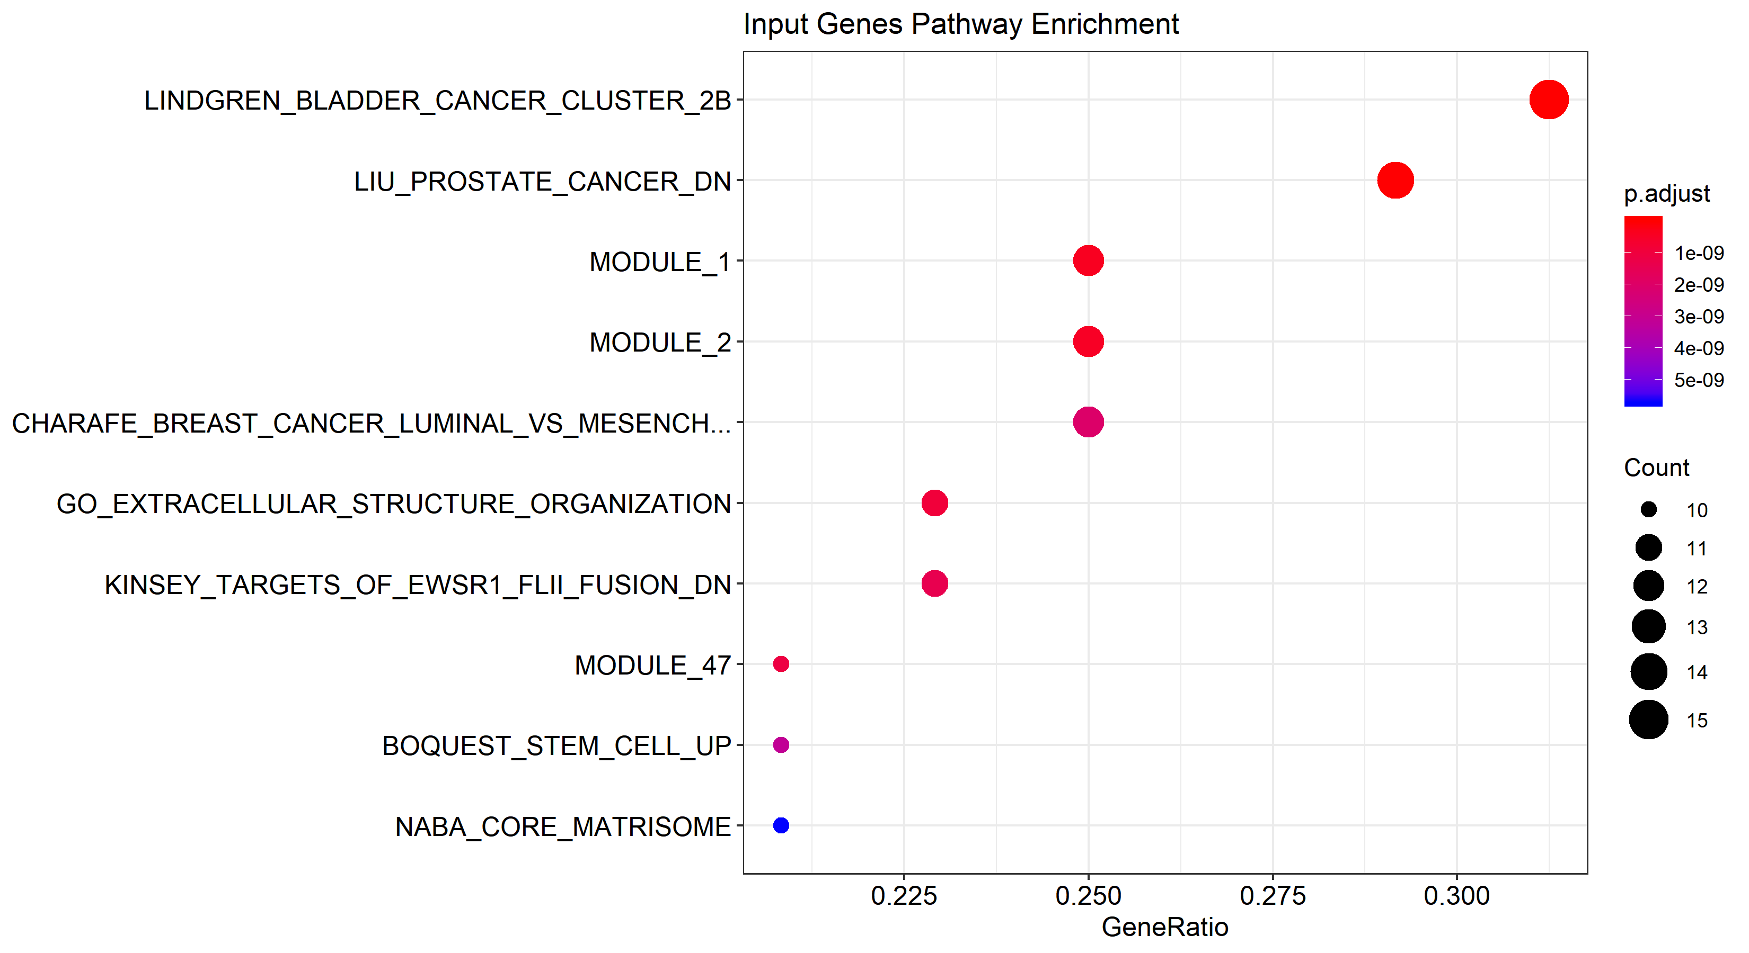
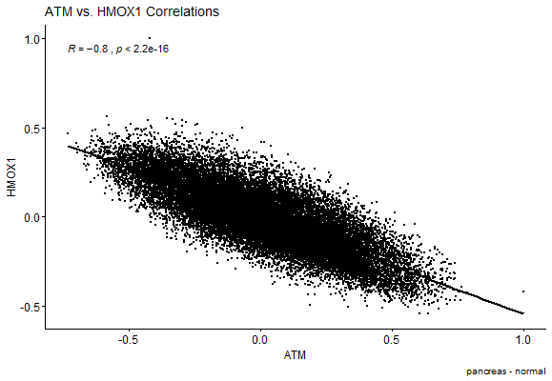
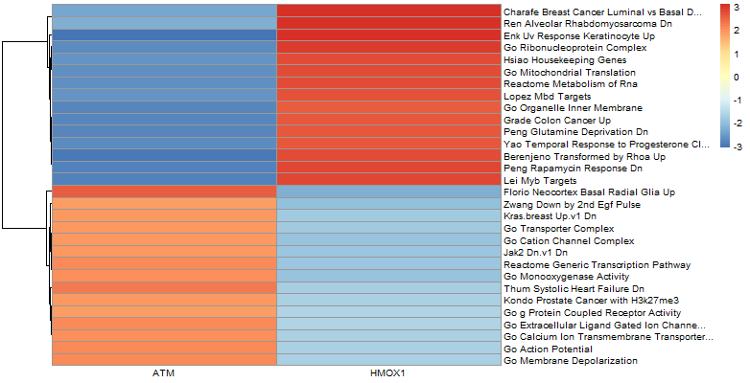
ARCHS4 RNA-Seq data repository
Human tissues
Mouse tissues
Human tumors
Mouse tumors
Gene expression correlations
Single Gene Mode
Gene vs Gene List Mode
“ATM (pancreas-normal)”
“ATM vs (BRCA1, EZH2 …)”
correlationAnalyzeR
Topology Mode
Gene vs. Gene Mode
“ATM, BRCA1, EZH2 …” or “BIOCARTA_PROTEASOME_PATHWAY”
“ATM vs HMOX1”, “ATM (brain-normal vs. brain-cancer)” …

