Slide 1
Chapter 1: Introduction

Slide 2
Chapter 1: Introduction
What Operating Systems Do
Computer-System Organization
Computer-System Architecture
Operating-System Operations

Slide 3
Objectives
Describe the general organization of a computer system and the role of interrupts
Describe the components in a modern, multiprocessor computer system
Illustrate the transition from user mode to kernel mode
Discuss how operating systems are used in various computing environments
Provide examples of free and open-source operating systems

Slide 4
What Does the Term Operating System Mean?
An operating system is “fill in the blanks”
What about:
Car
Airplane
Printer
Washing Machine
Toaster
Compiler
Etc.

Slide 5
What is an Operating System?
Is a (most important) software that manages a computer’s hardware.
A program that acts as an intermediary between a user of a computer and the computer hardware includes the CPU, memory, storage and I/O devices.
A fundamental responsibility of an operating system is to allocate these hardware resources to programs.
Operating system goals:
Execute user programs and make solving user problems easier
Make the computer system convenient to use
Use the computer hardware in an efficient manner

Slide 6
When we say “computers” run operating systems, we don’t just mean traditional desktop PCs and laptops.
The smartphones is a computer, as are tablets, smart TVs, game consoles, smart watches, and Wi-Fi routers.
Other devices, such as your Wi-Fi router, may run “embedded operating systems.” These are specialized operating systems with fewer functions than a typical operating system, designed specifically for a single task—like running a Wi-Fi router, providing GPS navigation, or operating an ATM.

Slide 7
Computer System Structure
Computer system can be divided into four components:
Hardware – provides basic computing resources
CPU, memory, I/O devices, storage
Operating system
Controls and coordinates use of hardware among various applications and users
Application programs – define the ways in which the system resources are used to solve the computing problems of the users
Word processors, compilers, web browsers, database systems, video games
Users
People, machines, other computers

Slide 8
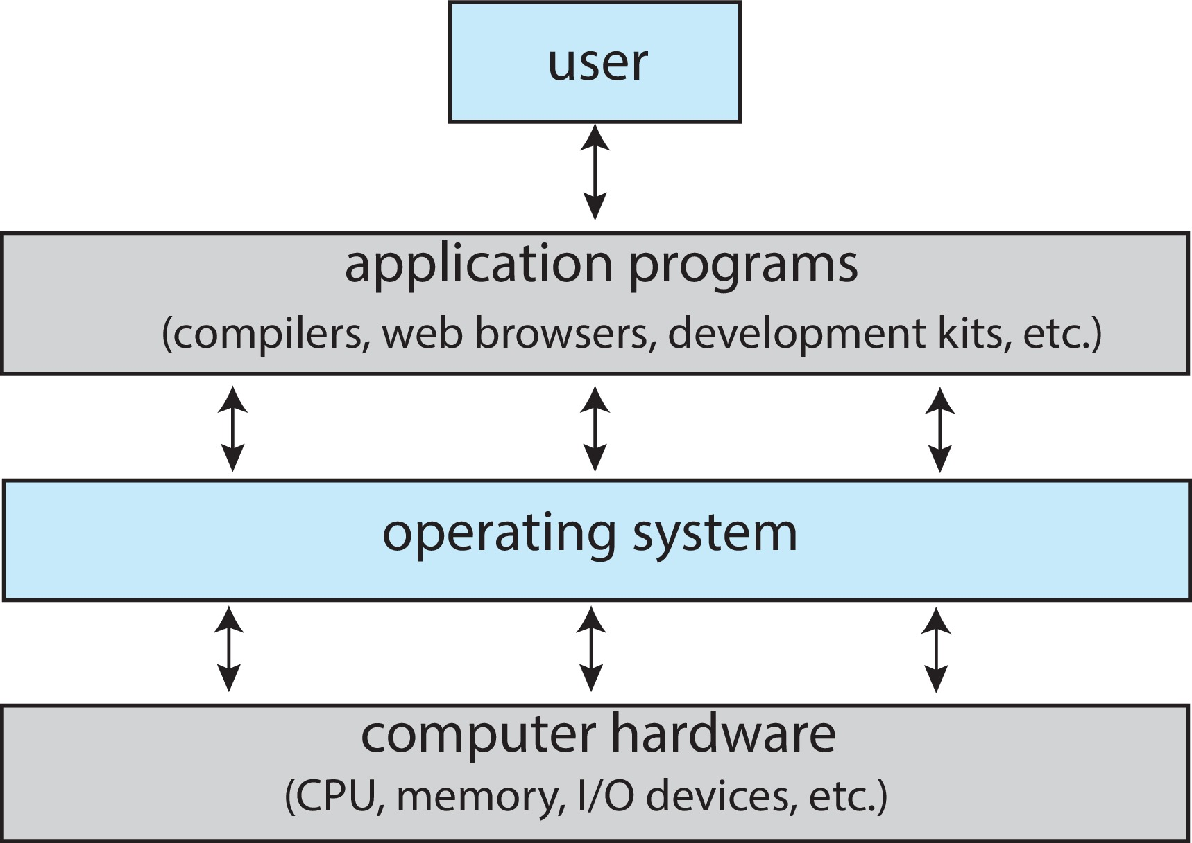
Abstract View of Components of Computer

Slide 9
The Layers in Systems
Applications
Operating Systems
Computer Organization
VLSI
Transistors

Slide 10
OS usage
Hardware Abstraction
turns hardware into something that applications can use
Resource Management
manage system’s resources

Slide 11

A Simple Program
What is the output of the following program?
How is the string displayed on the screen?

Slide 12
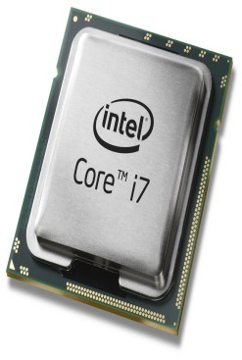
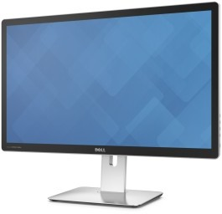
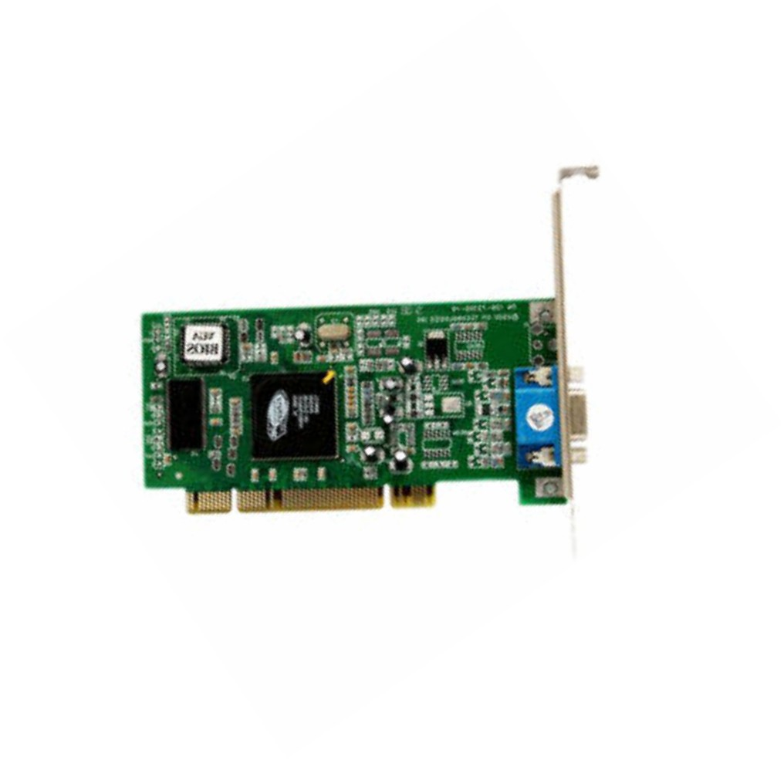
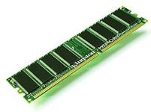
Displaying on the Screen
“Hello World”
“Hello World” +
coordinates, color, depth, etc
Monitor
Processor
Processor Memory
Graphics Card
•
•
Can be complex and tedious Hardware dependent
Without an OS, all programs need to take care of every nitty gritty detail

Slide 13
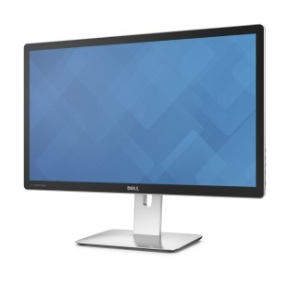
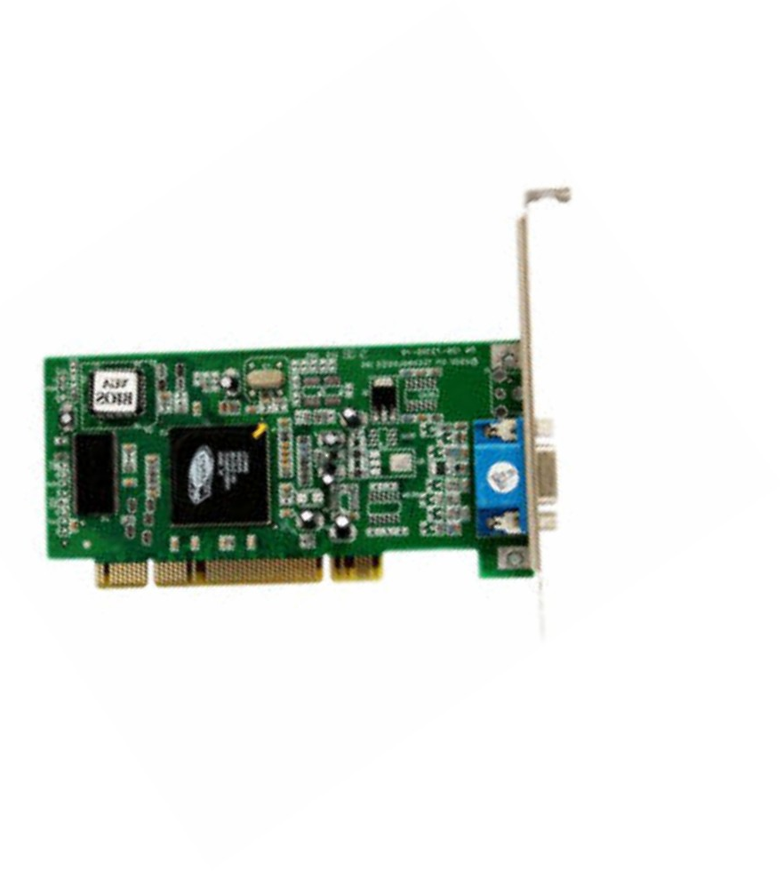
Operating Systems Provide Abstraction
App
system call (write to STDOUT)
Operating System
Device driver
•
Easy to program apps
– No more nitty gritty details for programmers
•
Reusable functionality
– Apps can reuse the OS functionality
•
Portable
– OS interfaces are consistent. The app does not change when hardware changes

Slide 14
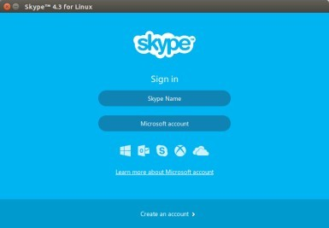
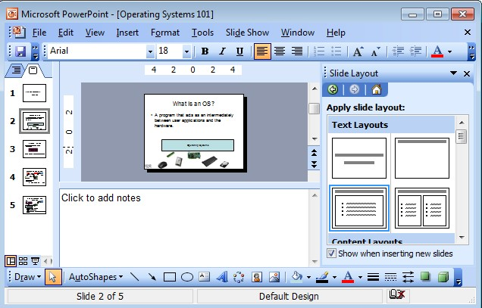
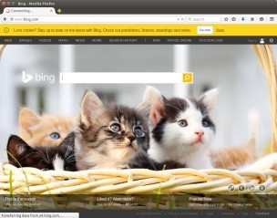
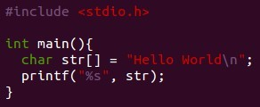

OS as a Resource Manager
Multiple apps but limited hardware
Apps
Operating Systems
A few processors

Slide 15
OS as Resource Manager
OS must manage CPU, memory, network, disk etc…
Resource management
allows multiple apps to share resources
protects apps from each other
Improves performance by efficient utilization of resources

Slide 16
What Operating Systems Do
Depends on the point of view
Users want convenience, ease of use and good performance
Don’t care about resource utilization
But shared computer such as mainframe or minicomputer must keep all users happy
Operating system is a resource allocator and control program making efficient use of HW and managing execution of user programs
Users of dedicate systems such as workstations have dedicated resources but frequently use shared resources from servers
Mobile devices like smartphones and tables are resource poor, optimized for usability and battery life
Mobile user interfaces such as touch screens, voice recognition
Some computers have little or no user interface, such as embedded computers in devices and automobiles
Run primarily without user intervention

Slide 17
Defining Operating Systems
Term OS covers many roles
Because of myriad designs and uses of OSes
Present in toasters through ships, spacecraft, game machines, TVs and industrial control systems
Born when fixed use computers for military became more general purpose and needed resource management and program control

Slide 18
Operating System Definition
No universally accepted definition
“Everything a vendor ships when you order an operating system” is a good approximation
But varies wildly
“The one program running at all times on the computer” is the kernel, part of the operating system
Everything else is either
A system program (ships with the operating system, but not part of the kernel) , or
An application program, all programs not associated with the operating system
Today’s OSes for general purpose and mobile computing also include middleware – a set of software frameworks that provide addition services to application developers such as databases, multimedia, graphics

Slide 19
Overview of Computer System Structure

Slide 20
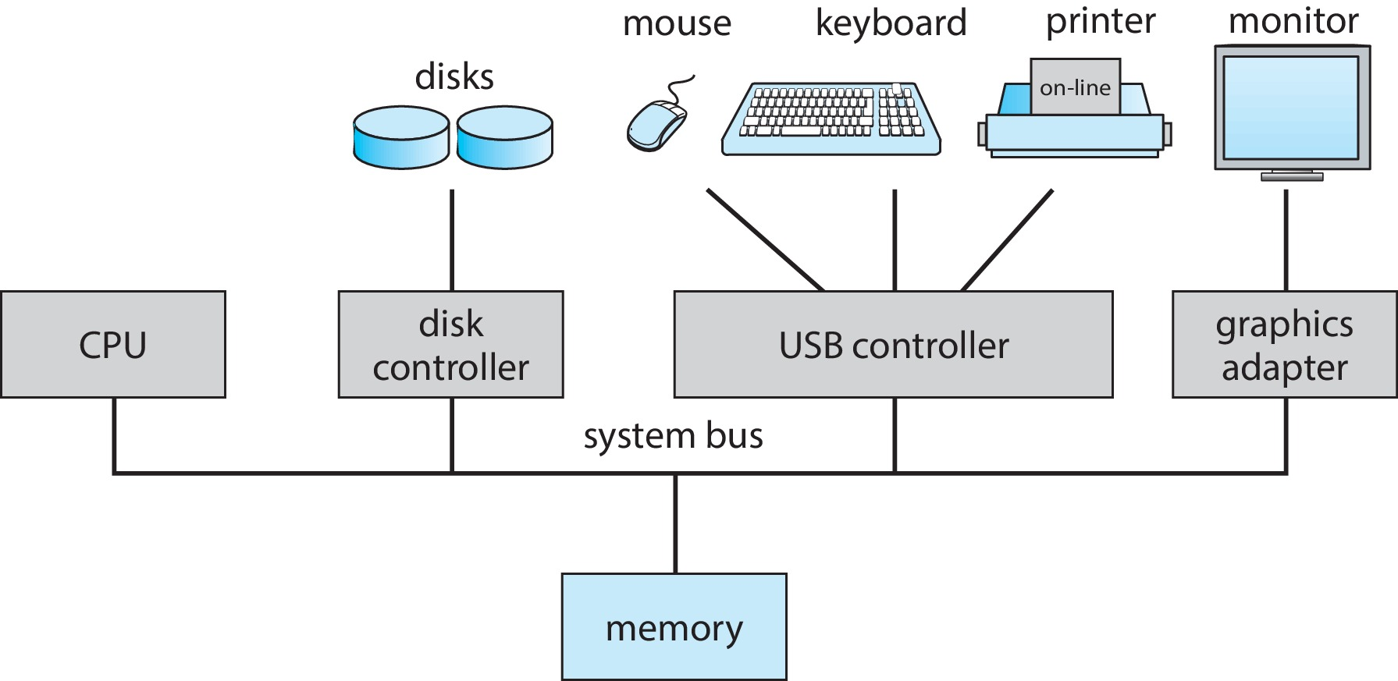
Computer System Organization
Computer-system operation
One or more CPUs, device controllers connect through common bus providing access to shared memory
Concurrent execution of CPUs and devices competing for memory cycles

Slide 21
Computer-System Operation
I/O devices and the CPU can execute concurrently
Each device controller is in charge of a particular device type
Each device controller has a local buffer
Each device controller type has an operating system device driver to manage it
CPU moves data from/to main memory to/from local buffers
I/O is from the device to local buffer of controller
Device controller informs CPU that it has finished its operation by causing an interrupt

Slide 22
Common Functions of Interrupts
Interrupt transfers control to the interrupt service routine generally, through the interrupt vector, which contains the addresses of all the service routines
Interrupt architecture must save the address of the interrupted instruction
A trap or exception is a software-generated interrupt caused either by an error or a user request
An operating system is interrupt driven

Slide 23
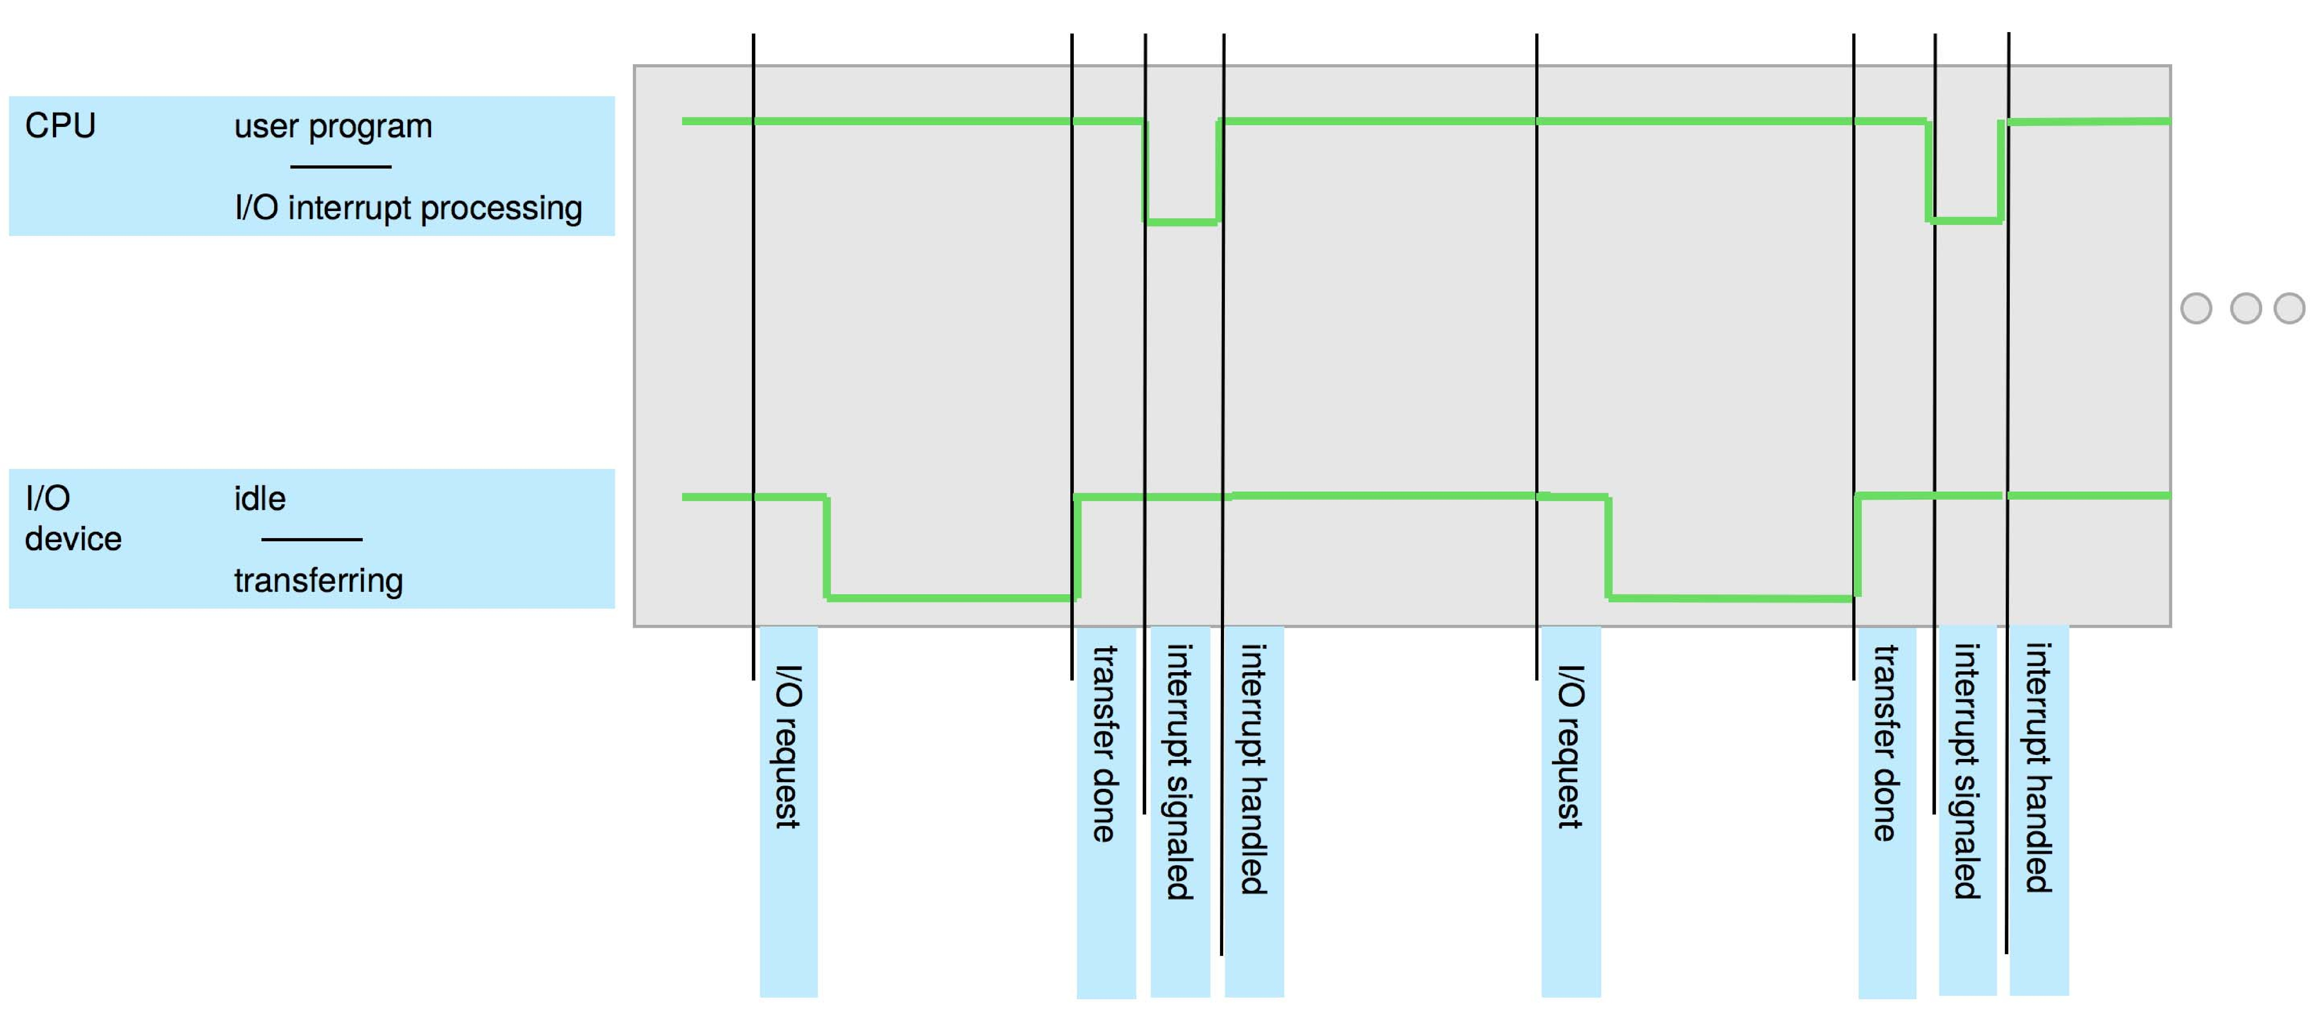
Interrupt Timeline

Slide 24
Interrupt Handling
The operating system preserves the state of the CPU by storing the registers and the program counter
Determines which type of interrupt has occurred:
Separate segments of code determine what action should be taken for each type of interrupt

Slide 25
Interrupt-drive I/O Cycle

Slide 26
I/O Structure
Two methods for handling I/O
After I/O starts, control returns to user program only upon I/O completion
After I/O starts, control returns to user program without waiting for I/O completion

Slide 27
I/O Structure (Cont.)
After I/O starts, control returns to user program only upon I/O completion
Wait instruction idles the CPU until the next interrupt
Wait loop (contention for memory access)
At most one I/O request is outstanding at a time, no simultaneous I/O processing
After I/O starts, control returns to user program without waiting for I/O completion
System call – request to the OS to allow user to wait for I/O completion
Device-status table contains entry for each I/O device indicating its type, address, and state
OS indexes into I/O device table to determine device status and to modify table entry to include interrupt

Slide 28
firmware
Many devices just run “firmware“—a type of low-level software that’s generally programmed directly into the memory of a hardware device. Firmware is usually just a small bit of software designed to do only the absolute basics.
When a modern computer boots up, it loads UEFI firmware from the motherboard. This firmware is low-level software that quickly initializes your computer’s hardware. It then boots your operating system from your computer’s solid-state drive or hard drive. (That solid-state drive or hard drive has its own internal firmware, which handles storing data on the physical sectors inside the drive.)
The line between firmware and an operating system can get a little blurry, too. For example, the operating system for Apple’s iPhones and iPads, named iOS, is often called a “firmware.” The PlayStation 4’s operating system is officially called a firmware, too.
These are operating systems that interface with multiple hardware devices, provide services to programs, and allocate resources among applications. However, a very basic firmware that runs on a TV remote control, for example, isn’t generally called an operating system

Slide 29
Computer Startup
Bootstrap program is loaded at power-up or reboot
Typically stored in ROM or EPROM, generally known as firmware
Initializes all aspects of system
Loads operating system kernel and starts execution

