Slide 1
Selective Intelligence
A Cost-Aware Hybrid NLP–LLM Microservice for Thread-Level Sentiment and Watchlist-Driven Target Stance over Code-Mixed Bangla Social Media, with an MCP-Backed Agentic RAG Insight Layer
B.Sc. in Computer Science and Engineering · Final Defense · August 2026
Bishwajit Kumar Chakraborty
ID : 0242220005101414
Department of CSE · Daffodil International University
SUPERVISED BY
Dr. Sheak Rashed Haider Noori
Professor & Head, Department of CSE, DIU
CO-SUPERVISED BY
Dr. Md Alamgir Kabir
Assistant Professor, Department of CSE, DIU
Department of Computer Science and Engineering · Faculty of Science and Information Technology · Dhaka, Bangladesh

Slide 2
Outline
Roadmap
01
Introduction
the text, the platform, the bill
02
Motivation & Problem Statement
a cost asymmetry worth designing for
03
Objectives
O1 – O4, each checkable against the running system
04
Background Study
Bangla & code-mixed NLP, cascades, RAG, agents
05
Gap Analysis
four gaps, four objectives, one for one
06
Research Methodology
five stages, six gates, eight labellers
07
Results & Analysis
routing, cost split, retrieval, provenance
08
Novelty of the Work
what is new, and what measurement disconfirmed
09
Sample Dataset & Expected Output
50 posts, 10,272 comments, one JSON
10
Web Interface
eleven tabs over a 51-path API
11
Demonstration Video
the system running end to end
12
Conclusion, Limitations & References
what is claimed, and where it stops

Slide 3
Introduction
Chapter 1
The text is not one language
Bangla script, English and romanized Banglish mix inside single comments, with no standard orthography.
Measured over 10,272 comments: 81.4 % Bangla script only, 11.1 % Latin only, 4.6 % both, 2.9 % neither (pure emoji).
One comment in six is where a Bangla-only and an English-only model each read the wrong language.
The upstream platform does not understand it
It scrapes reliably and keys records by stable identifiers — then stores one coarse sentiment per post.
Per-comment sentiment is null on all 10,272 comments; no OCR; no embeddings.
It is a data source, not an analysis layer — which is the gap this microservice fills.
Both obvious answers fail
Send everything to an LLM: accurate, unaffordable — cost scales with comments, not posts, and one viral thread here carries 2,857 comments.
Run only cheap classifiers: affordable, and demonstrably weaker on exactly the code-mixed register that dominates the traffic.
PROBLEM STATEMENT
Given a post together with its embedded comment thread, decide per unit of work how much intelligence that unit deserves, spend the expensive model only where cheap models cannot answer, and prove afterwards — from the system's own counters — where the money went and what produced every label.
50
posts · 25 campaigns
10,272
comments analysed
3.75 %
of comments the platform holds
0
comments labelled upstream

Slide 4
Motivation: a cost asymmetry worth designing for
Chapter 1
Cheap path — 7 small classifier heads
135 – 280 M parameters, batched on CPU
~100 ms per short comment, zero per-token cost
Weak precisely on the romanized register
Expensive path — one 7 B instruction-tuned model
7 – 50 s for a single post-level call, locally served
A Stage-2 batch of 25 comments is a generation call — cost scales with prompt length
Better on code-mixed text, and it is the only labeller that sees the parent post
Two to three orders of magnitude in latency, and a comparable gap in money on a metered backend. A system that decides which items need the expensive path converts an unbounded bill into a bounded one.
Why the decision is hard to make well
A confidence gate is only as good as the estimate feeding it — and an uncalibrated estimate on an unseen language is a guess wearing a number.
FrugalGPT [30], RouteLLM [31] and Hybrid LLM [32] fix the shape of the answer for English single queries.
Why sentiment alone is not the question
Monitoring needs the target of the affect, not only its polarity.
The hard part is the matcher: one entity is written in three scripts, and a watchlist that matches one spelling fails silently — zero mentions looks exactly like an entity nobody discussed.
No published cascade routes a container whose thousands of sub-items each need labelling — so none reports what share of the bill the routing decision actually governs. That unreported quantity is where this project starts.

Slide 5
Objectives
Chapter 1 · § 1.3
O1
Build the analysis service
A horizontally scalable, queue-based microservice that consumes a post-with-details payload, analyses it in its own datastores, and returns one schema-validated JSON document per thread — never writing back to the upstream platform.
closes G1
O2
Make the cascade selective — and measure it
Cheap NLP on every post and every comment; a rule-based router decides post-level spend and, separately, which comments the expensive labellers read. Then report the routing rate, the post/comment call split and the share of spend the gate governs from the system's own counters.
closes G2
O3
Deliver the capability layers the setting needs
An eight-labeller per-comment ensemble in which a labeller that cannot answer abstains; alias-aware watchlist target stance kept in a separate field from sentiment; and an agentic insight layer over MCP tools under budgets, injection hardening and citation verification.
closes G3
O4
Make every claim auditable
Provenance on every label, per-lane cost telemetry, a live per-post trace and a regression suite that fails when a repaired defect returns — with an evidence class attached to every published claim, so the boundary of the evaluation is part of the result.
closes G4

Slide 6
Background Study — Bangla, code-mixing and stance
Chapter 2 · § 2.2
Author(s) | Year | Contribution | Why it matters here
Bhattacharjee et al. [1] | 2022 | BanglaBERT — ELECTRA-style pretraining on 27.5 GB of Bangla | Strongest monolingual Bangla encoder; two of our seven ensemble heads are BanglaBERT derivatives
Islam et al. [2] | 2021 | SentNoB — 15,000 human-annotated noisy Bangla comments | Social-media Bangla is materially harder than curated Bangla; the SentNoB fine-tune is one of our voters
Sazzed [4] | 2021 | Abusive content in a transliterated Bengali–English corpus | Exactly our setting: transliteration, not vocabulary, is the primary source of error
Nezami & Huda [6] | 2024 | Sentiment for code-mixed English–Bangla and Banglish text | Closest published formulation to our comment lane; Banglish is a distinct third bucket
Alam et al. [9] | 2021 | Survey of Bangla NLP tasks and transformer utility | Annotated data, not architecture, is the bottleneck — why our effort goes into the system and its provenance
Kucuk & Can [13] | 2021 | Stance detection: a survey | Stance toward a target and document sentiment are distinct quantities — hence two separate output fields
Patwa et al. [10] | 2020 | SemEval-2020 Task 9 — code-mixed sentiment | Fixes the standard evaluation protocol, and the size of the gap versus monolingual data
Takeaway — the field supplies good models and repeatedly says the same thing: romanized text is where they fail, and labels are the binding constraint.

Slide 7
Background Study — cascades, retrieval and agents
Chapter 2 · § 2.2
Author(s) | Year | Contribution | Why it matters here
Chen, Zaharia & Zou [30] | 2023 | FrugalGPT — LLM cascade with a learned scorer and a budget | The foundational cost-cascade result; we implement the idea with a rule-based gate and measure where the analogy breaks for thread-shaped units
Ong et al. [31] | 2024 | RouteLLM — learning to route from preference data | The routing decision can be learned; named in Chapter 6 as the most valuable single upgrade to our hand-tuned gate
Lewis et al. [34]; Gao et al. [35] | 2020 · 2023 | Retrieval-augmented generation, and its survey | The pattern our insight layer generalises from single-shot retrieval to a tool-using loop
Hou et al. [38] | 2025 | Model Context Protocol — landscape and security threats | The tool-interface standard we adopt, together with the threats that motivated the runner's hardening
Greshake et al. [43] | 2023 | Indirect prompt injection in LLM-integrated applications | Retrieved third-party comment text is adversarial input; hardening is risk reduction, never a solution
Five classes of similar application — and how each one falls short
Commercial listening suites
Complete but closed, English-centric, comments sampled
The upstream platform
Reliable ingestion; comment sentiment null, no OCR
Academic Bangla classifiers
Good models, no system: no ingestion, serving or cost model
General RAG assistants
Retrieve text a user could already read; no injection defence
Cascade / router frameworks
Components, not systems: no ingestion contract, no telemetry

Slide 8
Gap Analysis
Chapter 2 · § 2.3
Gap | Observed in prior work | Obj. | How this project closes it
G1 — No deployable analysis layer for code-mixed Bangla threads | The capabilities sit in classes of system that never meet: platforms ingest and barely analyse; listening suites are closed and English-centric; academic work ships classifiers, not systems. | O1 | One queue-based microservice: ingest the whole stored thread, analyse in its own stores, emit one schema-validated JSON per thread, never write back — the platform's coarse score kept beside the recomputed one.
G2 — Cascades are evaluated on single queries, so the cost of routing a container is unreported | The cost-aware cascade literature [30], [31], [32] routes one query to one model. No published cascade routes a thread whose sub-items each need labelling, so none reports what share of the bill the container-level decision governs. | O2 | The router makes two separate decisions, and the counters report the post- versus comment-level call split. Measured answer: the gate governs only 30 % of calls — a finding that contradicted this project's own initial claim.
G3 — The capability layers an adversarial code-mixed setting needs are missing or unsafe | Fused ensembles hide a member that failed to load; target stance assumes English and a fixed target set; agentic RAG is judged on whether the answer looks right, with no defence against instructions inside retrieved text [43]. | O3 | Eight labellers with explicit abstention and uncertain where nothing read the comment; a versioned, alias-aware watchlist built for the three-script problem; and a runner with untrusted-data delimiters, citation verification and non-answer rejection.
G4 — Systems papers report what a system does, not which claims were checked | An implemented-but-unexercised capability reads exactly like a measured one, and a green test suite reads like a quality claim. Where the evidence stops is left to the reader. | O4 | Every capability carries an evidence class — measured, works-but-unmeasured, unexercised, out of scope — recorded once. The image modality is reported as unexercised; labelling accuracy as a stated scope boundary.
Four gaps, four objectives, one for one — the gap analysis is the specification for Chapter 3.

Slide 9
Research Methodology — how the work was carried out
Chapter 3
Requirement
Analysis
System
Design
Development
Testing
Deployment
Evaluation
& Audit
1. Requirement Analysis
Read the upstream contract for what it does and does not supply; write functional and non-functional requirements against it.
2. System Design
Five decoupled stages over Redis Streams; the router's two decisions separated; DFDs, schemas and the UI drawn before code.
3. Development
Python 3.12 services + React 19 dashboard; four local models; 56,789 lines across 182 files, of which 19,850 are tests.
4. Testing
Contract, regression and datastore layers; the whole chain is one pass-or-fail command in 73 s.
5. Deployment
The same code in three shapes: host processes, Docker Compose and Kubernetes with queue-depth autoscaling.
6. Evaluation & Audit
Six independent audit passes, four measurement studies, and an evidence class attached to every claim.
Stack — PostgreSQL + pgvector (canonical rows and vectors), ClickHouse (analytics events), Redis Streams (queues, cache, progress), object storage (raw payloads and reports); Ollama / vLLM or a cloud API, switchable at runtime.

Slide 10
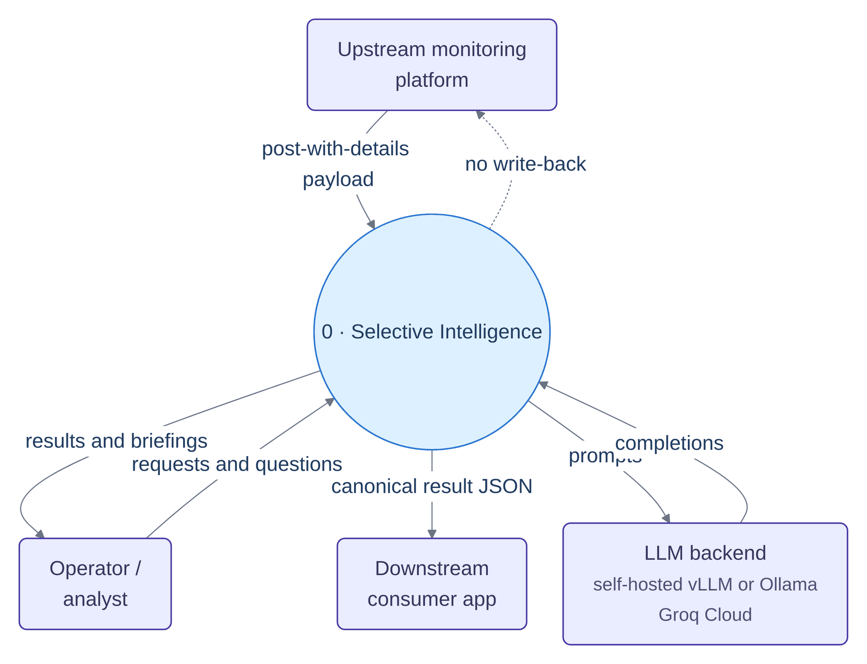
System Architecture
Chapter 3 · § 3.1
A read-only consumer
One pull of the whole payload — post, comments, engagement, reactions, share sample.
Records are keyed by the upstream identifier, so a repeated pull is an upsert, not a duplication.
Nothing is ever written back; the platform's own coarse score is kept only as a displayed baseline.
Its own storage tier
PostgreSQL + pgvector — canonical posts, comments, embeddings, watchlist versions.
ClickHouse — analytics events and per-comment sentiment at query speed.
Redis — five stream queues, the response cache, usage counters and progress events.
Object storage — raw payloads and generated reports.
Two surfaces on top
A 51-path HTTP API generated from the handlers, with authentication marked per route.
An eleven-tab operator dashboard, plus nine agents reachable over MCP.
Context diagram — one read-only pull in, one JSON document out

Slide 11
The five-stage pipeline
Chapter 3 · § 3.2.1
1 · Ingestion
2 · Stage-1 NLP
3 · Router
4 · Stage-2 LLM
5 · Assembler
# | Stage | Reads stream | Principal responsibility
1 | Ingestion | ingestion:queue | Validate against the input schema, normalise Unicode and script tags, hash and deduplicate, create the job row, enqueue one message per post
2 | Stage-1 NLP | nlp:stage1:queue | Cheap analysis of the caption and of every comment; sentence embedding; watchlist string matching; sentiment fusion; a first summary
3 | Router | router:queue | Evaluate the six gates, set the post-level task flags, and separately select the comment set every Stage-2 voter will read
4 | Stage-2 LLM | llm:stage2:queue | Two concurrent lanes: the gated post-level lane and the ungated comment ensemble
5 | Assembler | assembler:queue | Merge both stages, validate against the output schema, fan out to three stores in parallel, reconcile job counters
Four behaviours implemented once in a shared worker base, so they hold at every hop
Consumer groups on start
Replicas split the stream rather than duplicating it.
Cooperative cancellation
Stages ahead of the assembler drop work on a Redis flag — a stop costs one post per stage.
Bounded retry, then dead-letter
The attempt counter rides inside the payload: a re-enqueued message would reset a per-id counter forever.
Replayable progress events
Pub/sub has no backlog, so events are also appended to a capped list and replayed with a monotonic sequence.

Slide 12
The router: two independent decisions
Chapter 3 · § 3.2.2
Decision A — does this post earn post-level LLM work? (six gates, any one sufficient) Decision B — which comments will the Stage-2 labellers read? (eligibility → dedup → top-N)
# | Gate | Fires when | Threshold knob (default)
1 | Low or absent confidence | Stage-1 overall confidence is below the threshold — or is absent entirely | ROUTER_CONFIDENCE_THRESHOLD (0.8)
2 | Post type unknown or weak | The semantic post type is unset, or its confidence is below the threshold | ROUTER_POST_TYPE_CONFIDENCE_THRESHOLD (0.8)
3 | Caller asked for a Stage-2 summary | The request explicitly asks for the better summary model | ROUTER_SUMMARY_ROUTES (false)
4 | Image post with no image verdict | The post carries photographs but the vision stage produced no sentiment | not applicable
5 | High toxicity | The Stage-1 toxicity score exceeds the threshold | ROUTER_TOXICITY_THRESHOLD (0.7)
6 | Long code-mixed text | The caption exceeds the character limit and the script is Banglish or mixed | ROUTER_LONG_TEXT_CHARS (1000)
Decision B — comment selection
Eligibility drops kinds with no text to read: emoji-only, link-only, below a word-token floor.
Deduplication sorts by reactions, ties by original index, collapses identical normalised texts.
Top-N keeps the survivors; the cap defaults to 0 — every unique comment with text.
Made once, read by all eight voters
An earlier design capped inside the LLM stance pass alone — it still ran seven classifiers over the whole thread and left the LLM column empty on exactly the comments every cheap head had voted on.
TWO LESSONS LEARNED THE HARD WAY
An absent confidence routes. In an earlier revision the gate read a field name Stage 1 never emitted: the guard short-circuited on every post, a confidence of exactly zero passed a threshold of 0.65, and the system routed 100 % of posts while every document claimed a single-digit rate. The repair was to make every gate — and the diagnostic log — read through named reader functions, so a rename now fails a test. Gate 3 is off by default, because any single gate firing is sufficient: enabled, it made the router a pass-through and pinned the large-model share at exactly one.

Slide 13
The eight-labeller comment ensemble
Chapter 3 · § 3.2.3
Seven small heads — batched on CPU, no per-token cost
One context-aware LLM stance pass
The only labeller that sees the parent post — and therefore the only one judging stance toward it rather than the comment's own tone.
XLM-R
multilingual
mBERT
sentiment
BanglaBERT
(SentNoB)
BanglaBERT
fine-tune
ModernBERT
Twitter-XLM
sentiment
Emoji &
lexicon rule
Abstention protocol — a labeller that cannot answer is absent from the vote, not present in it with a fabricated neutral. Every comment carries the number of voters that actually spoke; a comment no model read reports as uncertain at zero voters, never as neutral.
Combined polarity over the labellers that spoke
s(c) = ( 1 / nᶜ ) · Σ wᵢ · vᵢ(c)
The sum runs over the nᶜ labellers in V(c) that returned a verdict; vᵢ(c) ∈ {−1, 0, +1}, with the weights renormalised so s(c) stays in [−1, +1] however many labellers abstained.
What the operator sees, per comment
The fused label and the eight per-source verdicts side by side, the agreement fraction, the voter count, the method that actually ran and the comment kind (emoji · short · substantive).
Why eight rather than one — a fused single label makes a member model that failed to load unfalsifiable: it is silently replaced by a default and the reported agreement stops meaning anything. Showing the roster is what makes the number checkable [50].

Slide 14
Watchlist target stance, and the agentic insight layer
Chapter 3 · § 3.2.4 – 3.2.6
Watchlist-driven target stance
An operator-supplied, versioned entity list; the matcher is built for the three-script spelling problem — Bangla script, several inconsistent romanizations, and English.
Per-entity verdicts land in a field kept separate from document sentiment, and are never summed or charted with it.
Zero additional LLM calls — matched entities ride inside a prompt that is already being sent.
A target matching zero comments is logged as the probable coverage bug it almost certainly is.
Nine agents over eighteen typed MCP tools
Three Model Context Protocol servers [38] expose the system's own structured analytics — not raw text — as typed tools.
Agents run a ReAct-style loop [36] under per-run tool and token budgets, outside the per-post path.
Briefing, stance, theme, anomaly and comparison agents all read the same persisted analysis the dashboard shows.
The runner is hardened against failure modes observed in live runs — each one now pinned by a regression test
Untrusted-data delimiters
Tool results are wrapped, with forged delimiters neutralised before the model sees them [43].
Citation verification
Every citation is checked against what the model was actually shown, not against the corpus.
Non-answer rejection
Four distinct shapes of answer-that-answers-nothing are detected and refused.
Repeat-call and budget guards
Byte-identical repeat tool calls are refused; every run is bounded in tools and tokens.
WHAT THE HARDENING IS, AND IS NOT
A briefing that quoted invented tables was caught by this layer and is reported in the walkthrough: the agent had retrieved nothing, and the run record proved it. Groundedness and citation accuracy are hardened and tested, but not scored — they sit at works, unmeasured in the evidence ledger, and the scoring programme is future work F7.

Slide 15
Results — verification of the whole chain
Chapter 4 · § 4.2.2
1,420
Python tests
96
dashboard unit tests
138
security tests · 8 suites
73 s
whole chain, one command
51
documented API paths
Three layers, because the failures that dominated this project are not failures a person notices by looking
Contract tests
Assert that the JSON crossing every boundary validates against its schema — and several grep the source to assert structural invariants: that every worker checks the cancellation flag, that the dashboard reads only fields the API returns, that the autoscaler manifests name exactly the streams the workers create. They fail on a rename, which is their purpose.
Regression tests
Pin every defect found in the six audit passes, so a repaired defect that returns fails the build. Eight distinct agent-runner failure modes and four silent-degradation defects each have one.
Datastore tests
Run against throwaway PostgreSQL and Redis containers started per session, so a default run can never damage a developer's environment; two heavier suites sit behind explicit markers.
Access control is tested separately from function, because the two fail differently: token issue and verification, the hashed API-key store, single-use streaming tickets, cross-tenant reads, the fail-closed residency policy and prompt-injection containment — against both the permitted and the refused case in each.
A green suite is not a quality claim — and this report does not use it as one. These are correctness and contract tests; what they buy is that a claim in this report which stopped being true would break a test.

Slide 16
Results — routing behaviour
Chapter 4 · § 4.2.4
Posts routed for post-level LLM work, by Stage-1 engine
Quantity | Keyword stub | As shipped
Posts routed for post-level work | 32 of 43 (74 %) | 7 of 43 (16 %)
Post-level calls | 124 (15.3 %) | 22 (4.2 %)
Comment-level calls | 689 (84.7 %) | 507 (95.8 %)
· Stage-1 labelling — all 43 posts, the gate cannot reduce it | 368 | 368
· Stage-2 comment stance — routed posts only | 321 | 139
Total calls per corpus run | 813 | 529
Share of all calls the gate governs | 54.7 % | 30.4 %
READING THE CHART
Identical router code, identical corpus, identical thresholds — only the Stage-1 engine differs. The keyword stub confidently types 27 of 43 posts and escalates the remaining 74 %; the LLM Stage 1 types 42 of 43 and escalates 16 %. So the routing rate measures Stage-1 quality, not cost efficiency — a rising rate should be alerted on as a quality regression.
The gate selects the right posts
The 7 routed posts hold 3,404 of the 8,713 comments that reach a model — the gate escalates the large, contentious threads, which a routing rate quoted on its own cannot show.
One earlier estimate was off by 6×
Filtering emoji-only comments was expected to save ~17 % of the comment bill. They are 2.8 % of the corpus; the 17 % was the share taking the fast path. Still correct to filter — but not a cost lever.

Slide 17
Results — where the large-model calls actually go
Chapter 4 · § 4.2.4
Share of spend the gate governs
γ = C_gated / ( C_gated + C_comment )
C_gated counts the calls the gate releases; C_comment counts the per-comment calls, which run for every post whether the gate routed it or not.
Measured: γ = 0.304 as shipped, γ = 0.547 under the keyword baseline.
The middle pair of bars is the finding
Stage-1 comment labelling runs for every post whether the gate routed it or not, so it is identical in both configurations — the routing gate cannot reduce it at all.
THE PROJECT'S OWN HEADLINE CLAIM WAS WRONG, TWICE OVER
It was wrong in fact — two rules read field names Stage 1 never emitted, one read a placeholder Stage 2 fills, and one compared a language value against a marker stored elsewhere: net, one rule always fired and three could never fire. It was wrong in framing — even a correctly functioning gate governs a minority of spend once every comment is labelled.
The claim that survives
Cheap NLP filters which comments and which posts deserve a large model. Both halves matter — and the second is now the bigger one.
The transferable lesson
When the routed unit contains many sub-items that each need work, routing the container is not the cost lever. The published cascades route single queries, so they never meet this.

Slide 18
Results — retrieval evaluation
Chapter 4 · § 4.2.5
recall@10 before and after real embeddings
recall@10 stratified by query-to-target lexical overlap
Configuration | recall@10 (hash) | recall@10 (real) | MRR@10 | nDCG@10
vector (dense only) | 0.1875 | 0.6250 | 0.2869 | 0.3667
lexical (full text fused with trigram) | 0.3750 | 0.7500 | 0.6503 | 0.6748
chunk (dense over passage chunks) | not measured | 0.6562 | 0.3014 | 0.3846
hybrid (dense fused with lexical) | 0.5312 | 0.8750 | 0.6108 | 0.6759
chunked (chunk fused with full text and trigram) | not measured | 0.8750 | 0.6482 | 0.7041
Three findings
Hash vectors were indistinguishable from chance — ten random posts of fifty score 0.20 by construction.
Chunking improves ranking, not recall here: only 14 of 50 posts exceed 600 characters.
The lexical arm's jump was a bug fix: the query builder conjoined every term, so the full-text half matched zero rows — covered by a passing test.
32 known-item queries, one marked relevant post each, k = 10, 50-post corpus. Lower bounds: every other on-topic post counts as a miss, and the decisive bucket holds 8 queries — the direction is consistent; the set is too small to call it.

Slide 19
Results — label provenance and ensemble coverage
Chapter 4 · § 4.2.6
What the measurement found
Measured over all 10,272 comments in the repository's default configuration. The larger slice is partly a fourteen-word emoji-and-lexicon rule and mostly a deterministic function of a hash of the first fifty characters. It is reproducible, and it is not sentiment.
Before provenance was recorded, the same run reported 8,513 model inferences in a configuration where zero models had been loaded.
Four reporting mechanisms — now permanent parts of the output contract
method
names the engine that actually ran, per comment
kind
distinguishes emoji · short · substantive text
provenance block
per post: what share of labels were model inferences
voters that spoke
beside every label and agreement figure
The remedy was not to hide the slice but to label it — which makes the accurate statement available: 28.7 % of labels are model output, with the remainder itemised. With the full ensemble roster provisioned, that figure is 100 %.
Quantity | All-cheap baseline | Shipped hybrid | LLM-everywhere
Posts routed for post-level LLM work | 32 of 43 (74 %) | 7 of 43 (16 %) | 43 of 43, by definition
Total LLM calls per corpus run | 813 | 529 | not run — bounded below by 1/post + 1/comment batch
Independent verdicts per analysed comment | 1 | up to 8, with abstention | 1
Can the output state what produced each label? | no | yes | trivially — one producer

Slide 20
Novelty of the Work
Contribution
A cascade that reports what its gate is worth
The router makes two separate decisions, and the system publishes γ — the share of spend the gate governs — from its own counters. No published cascade routes a container of sub-items, so none reports this quantity at all.
Abstention instead of a fabricated default
Eight independent verdicts per comment with the roster shown side by side; a comment no model read is uncertain at zero voters, never neutral. It makes the reported agreement falsifiable.
Alias-aware target stance for three scripts
Operator-supplied, versioned watchlist; per-entity verdicts at zero additional model calls, in a field kept separate from sentiment — and a zero-match target is logged as the coverage bug it probably is.
Agents over the system's own analytics, hardened
Nine agents, eighteen typed MCP tools, three servers — with untrusted-data delimiters, forged-delimiter neutralisation, citation verification against what the model was shown, and non-answer rejection.
Provenance on every value, evidence class on every claim
Twenty-eight capabilities each recorded once as measured, works-but-unmeasured, unexercised or out of scope — so no claim rests on a stronger basis than the ledger records.
A disconfirmation reported as a result
The project's own headline claim did not survive measurement, and the report says so. The generalisable finding — silent successes, not wrong answers, are what break systems of this shape — came out of that.
Twenty-one of twenty-three capability rows in the feature comparison are Yes where the four comparable classes of system are No, Partial or Not applicable. The two rows that are not — the image modality and labelling accuracy — are the ones that qualify the rest, and they are carried at their evidence class throughout the report rather than quietly dropped.

Slide 21
Sample Dataset — the working corpus
Chapter 4 · § 4.2.1
Property | Value
Posts | 50, across 25 monitoring campaigns
Media type | 37 photo-with-text, 7 photo-only, 6 text-only
Posts with a caption | 43 of 50 — the other 7 have a null caption and no reachable image
Caption length | median 245 characters, maximum 5,427; 14 of 50 exceed 600
Publication window | 29 April to 19 May 2026
Comments shipped in the payload | 10,272
Comments the platform reports | 274,126 → corpus coverage 3.75 %
Stored comments per post | minimum 87, median 98, maximum 2,857
Comment reactions | mean 3.97, maximum 946; 64.1 % have zero
Emoji-only comments (pipeline's own kind classifier) | 2.8 %
Threading | 0 comments carry a parent id, yet 1,111 report a non-zero reply count
Post reactions · shares | 794,373 · 93,903
Image references | 69 across 44 posts — all relative object-storage keys, objects absent
Script composition of the 10,272 comments
Three consequences, stated up front
The comment sample is not random. It is the platform's engagement-ordered set, so what the data supports is a claim about the most-engaged N comments per post — and that is the phrasing the report uses.
Post sentiment is a text measurement. No image bytes are reachable, so the vision term has never carried a value; fusion renormalises over the terms that did.
The 7 caption-less posts stay in. They carry 1,307 comments; excluding them measured a population the running system never processes.
Five posts exceed 100 % coverage — up to 112 stored comments against a reported 42, which cannot be replies inflating the numerator because no comment carries a parent id. The pipeline clamps coverage to 1.0 and raises an explicit anomaly flag rather than rendering an impossible figure.

Slide 22
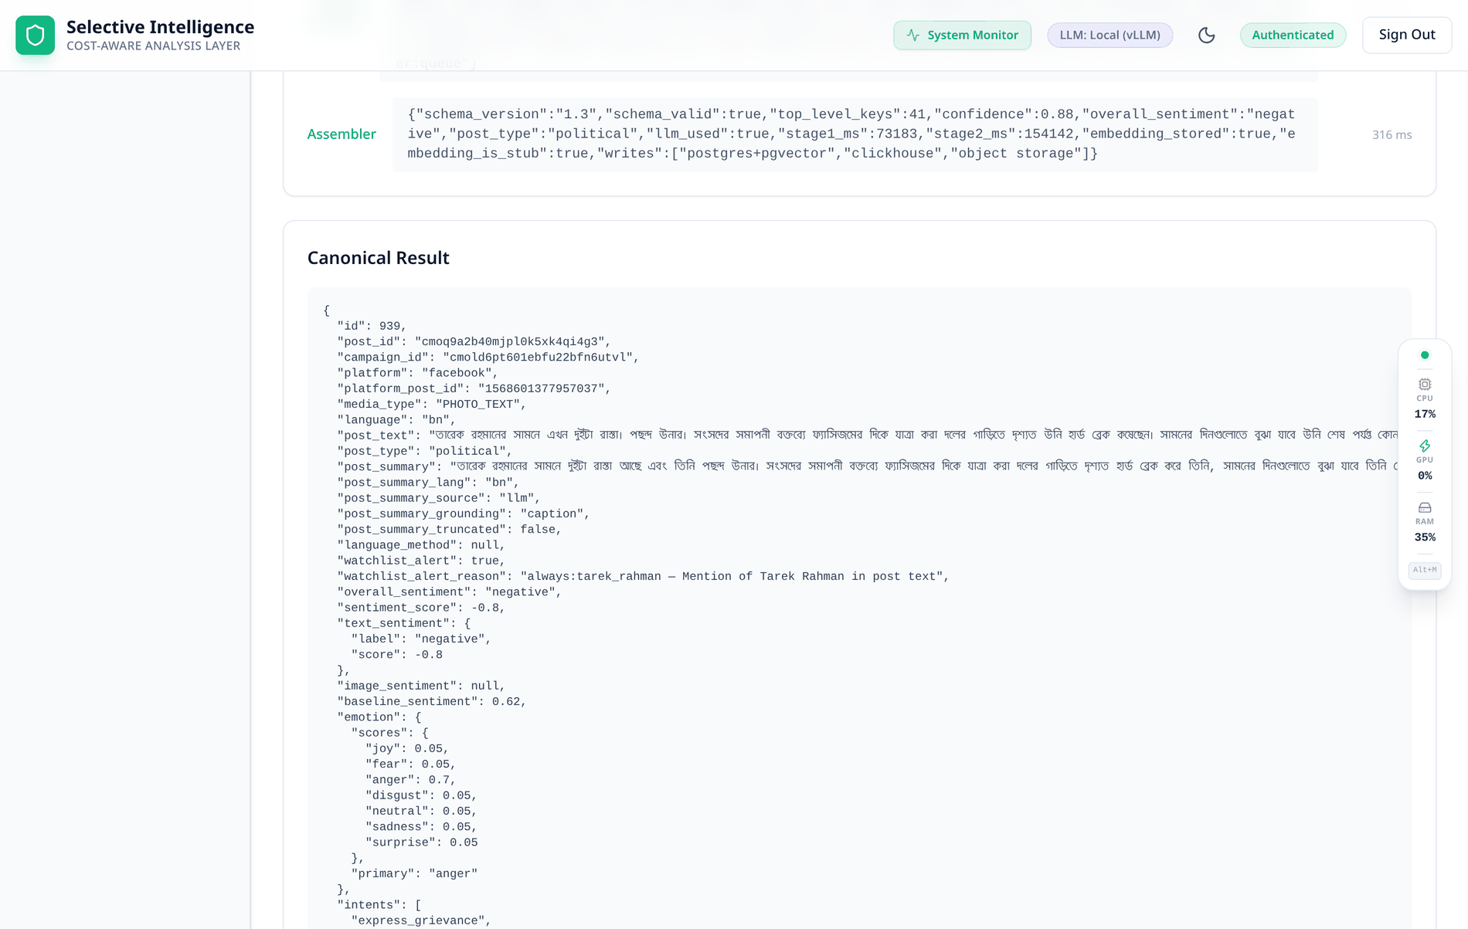
Expected Output — one document per thread
Chapter 4 · § 4.3.1
What the document carries
Post block — fused sentiment with its confidence, semantic post type, topics, entities, summary and insight.
Comment array — per comment: fused label, agreement, voters that spoke, the eight per-source verdicts, method and kind.
Target stance — per watchlist entity, in its own field, never summed with sentiment.
Router decision — the branch taken and every reason string that fired.
Provenance and coverage — inferred share, comment coverage, and any anomaly flags raised.
The contract, enforced
Validated against the output schema before it is written, then fanned out to PostgreSQL, ClickHouse and object storage in parallel — with the job counters reconciled from the rows that actually landed.
The upstream platform's own coarse score is preserved beside the recomputed one, never overwritten — so a consumer can always see both, and the analysis layer stays auditable against its source.
The canonical result document for one post, as the API returns it

Slide 23
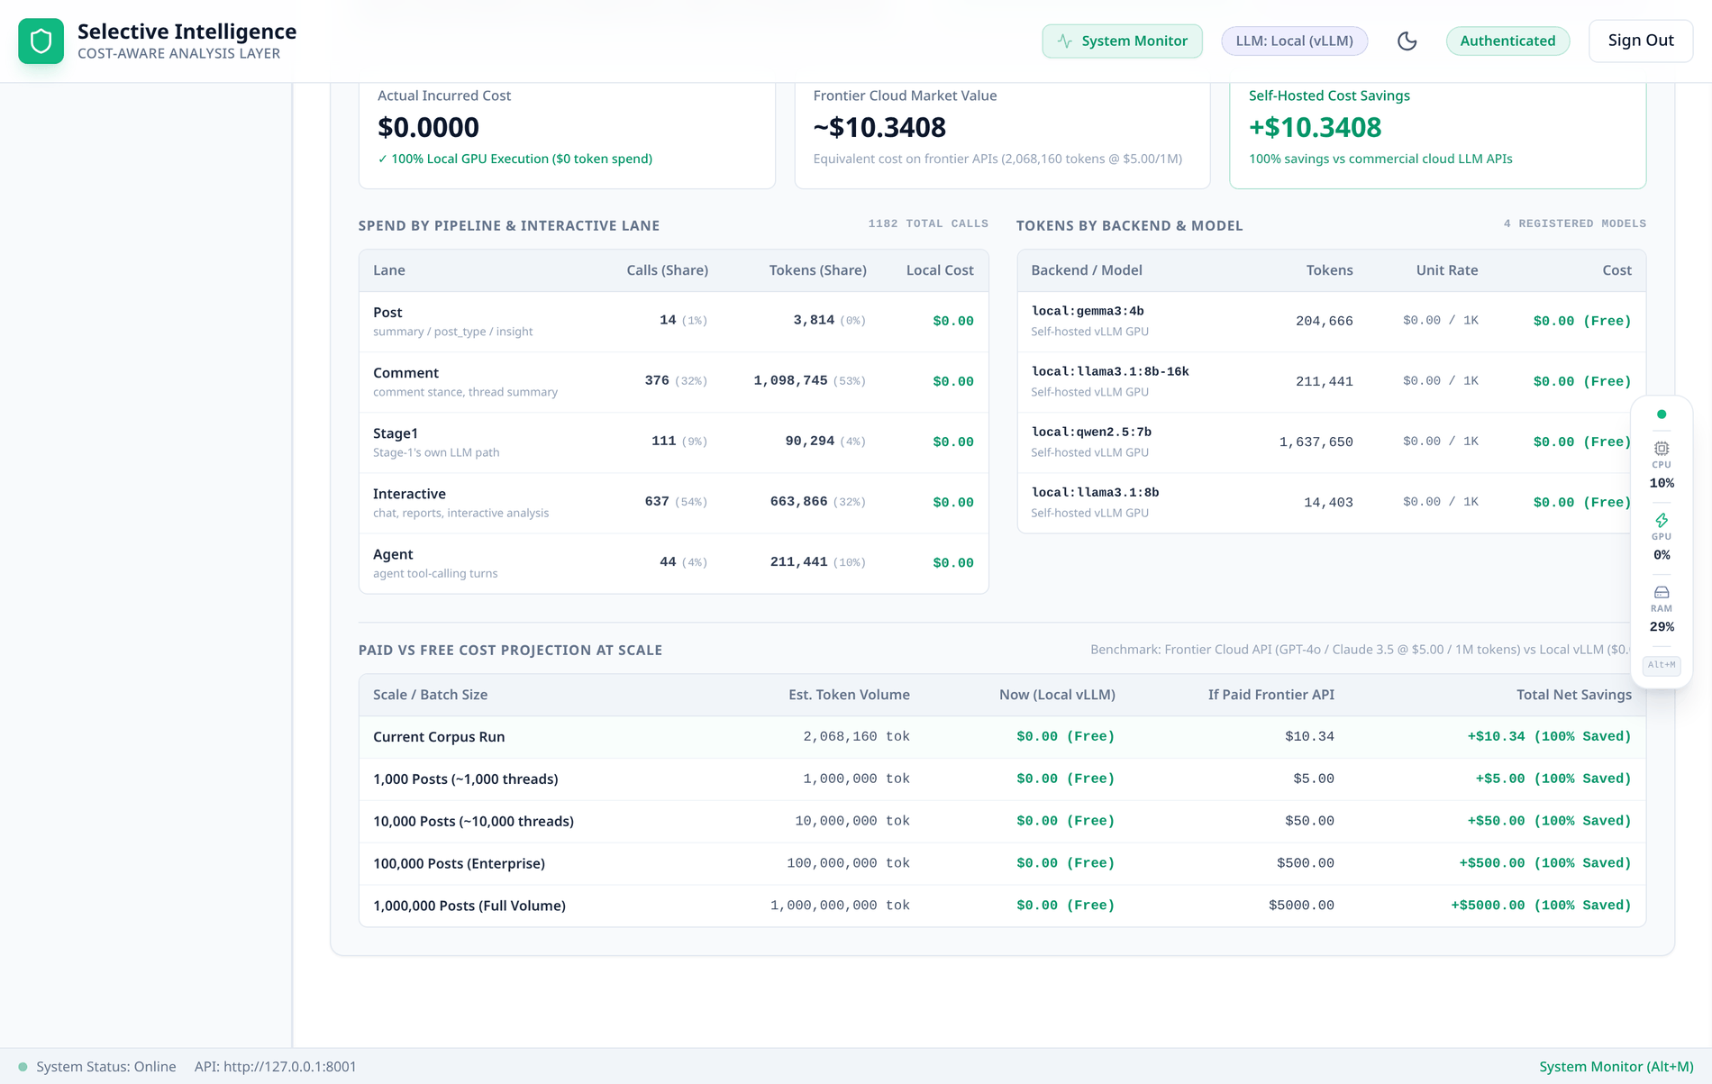
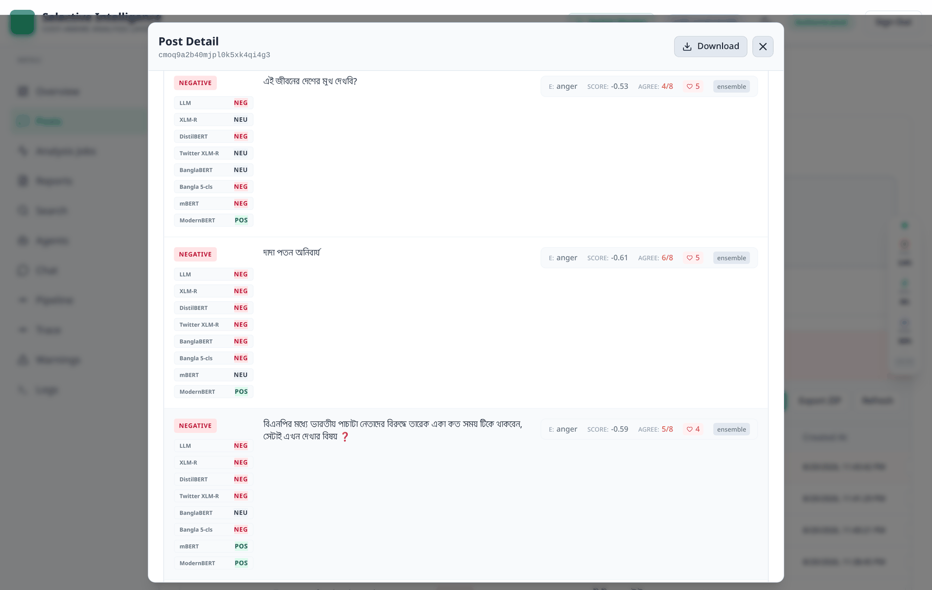
Web Interface — corpus, comments and the bill
Chapter 4 · § 4.3.1
Overview
Posts
Jobs
Reports
Search
Agents
Chat
Pipeline
Trace
Warnings
Logs
Token economics — spend by lane, by model, and projected
The eight-labeller ensemble, per comment, side by side
THE SAME FINDING, FROM A SECOND SOURCE
In the run shown, five lanes divide 941 calls — post 10, comment 284, Stage-1 83, interactive 523, agent 41. By tokens the comment lane takes 49 % and the interactive lane 35 %, while the post lane — the only one the router's gate governs — takes under one percent. That is § 4.2.4's finding arrived at from the usage ledger instead of the router's counters.

Slide 24
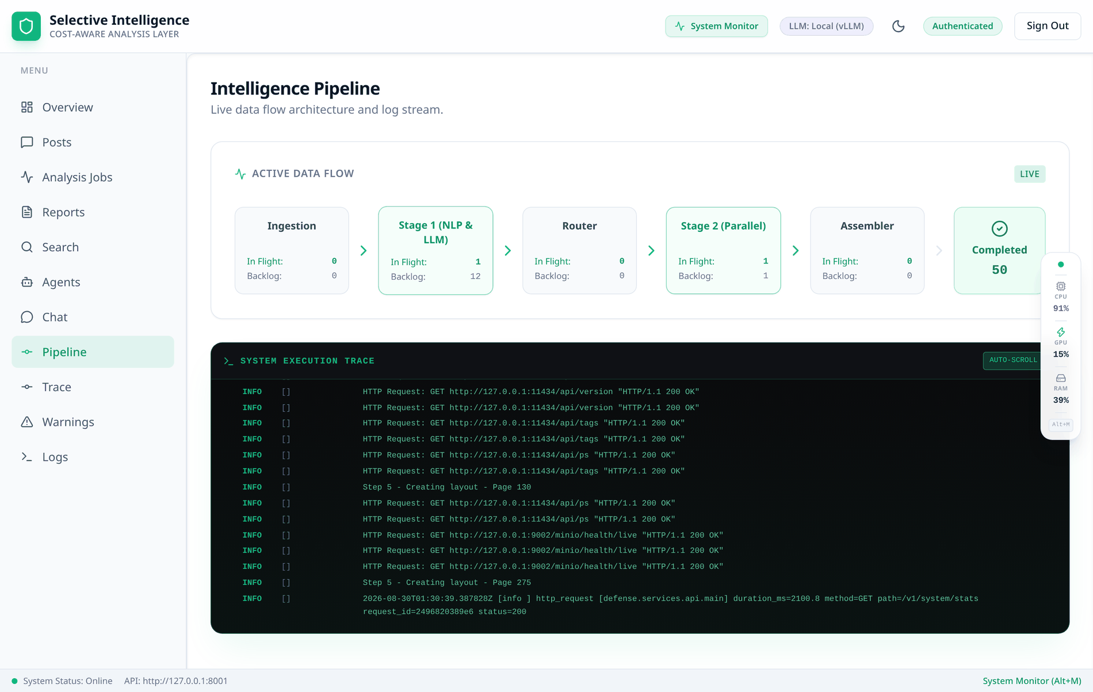
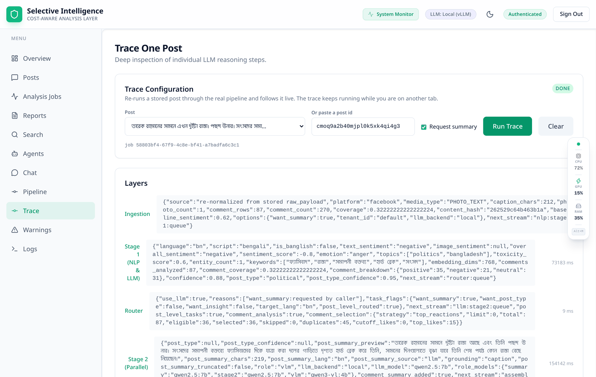
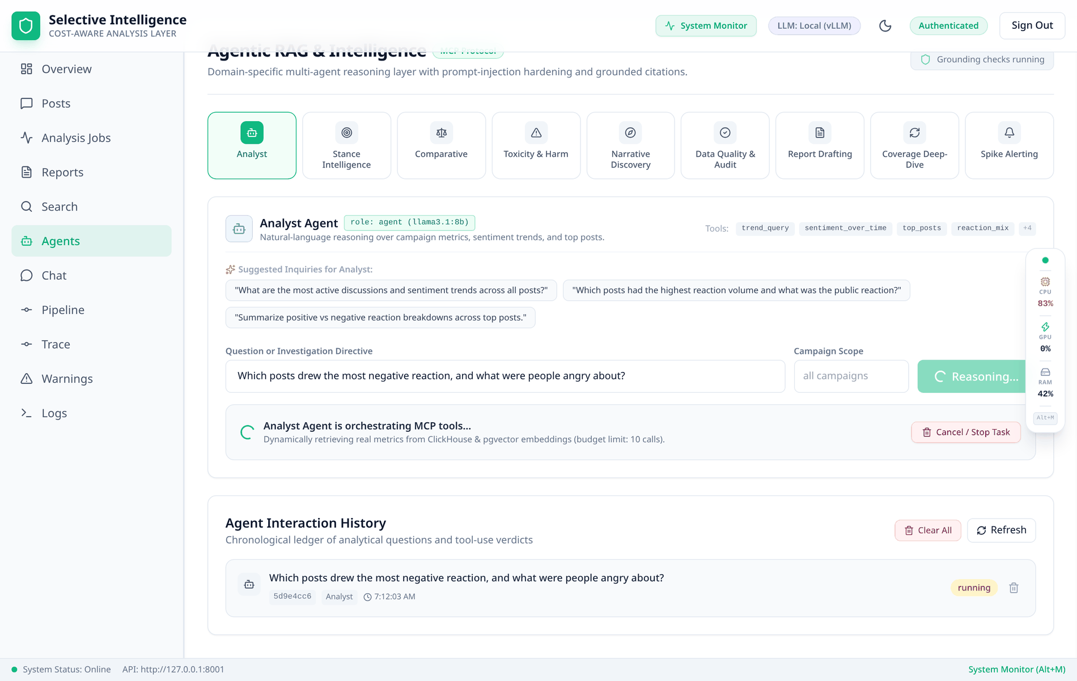
Web Interface — running it, watching it, asking it
Chapter 4 · § 4.3.1
Pipeline — live queue depths and per-stage throughput
Trace — one post's five stages as they happen
Agents — a run with its tool calls and citations
One command, eleven processes
The orchestrator syncs dependencies, starts four datastores, creates the ClickHouse tables, verifies the encoder produces real vectors rather than hash stubs, resets the consumer groups and launches eleven host processes.
A fabrication, caught in the act
The Chat tab is where a briefing that quoted invented tables was caught: the agent had retrieved nothing, and the run record in Redis proved it. The guard is now code.
Two operational gaps, recorded not hidden
The event stream has a five-minute server-side ceiling, after which Trace reports the run as failed while the pipeline finishes correctly; the monitoring stack ships a correct scrape and no provisioned dashboards.
Every capture is the running system on the development tier with the corpus loaded — nothing here is a mock-up; where a panel shows a number, that number is what the system computed.

Slide 25
Demonstration Video
Live system
selective-intelligence — end-to-end demonstration
What the recording walks through
One command brings up four datastores and eleven processes, with the encoder preflight visible.
Ingest the 50-post payload; the job appears with its counters.
Pipeline tab: queue depths move stage by stage as the thread is analysed.
Trace one post: ingestion → Stage-1 → router decision and its reason strings → Stage-2 → assembler.
Posts tab: open a thread and read the eight per-source verdicts, voters and abstentions on one comment.
Warnings: a watchlist target with per-entity stance, and a zero-match target flagged.
Search in both modes, then an agent run with its tool calls and verified citations.
Economics: the five lanes, and the post lane at under one percent of tokens.
Place the demonstration video here
PowerPoint ▸ Insert ▸ Video ▸ This Device… — then size the video to this frame and delete this placeholder group.
RECORDING CONDITIONS
Recorded on the development tier of the deployment figure, with the corpus of § 4.2.1 already loaded — the same configuration every screenshot in Chapter 4 was taken from.

Slide 26
Conclusion
Chapter 6 · § 6.1
THE QUESTION THIS PROJECT ASKED
Given a post together with its comment thread, in a setting that mixes Bangla script, English and romanized Banglish — can a system decide per unit of work how much intelligence that unit deserves, spend the expensive model only where cheap models cannot answer, and prove afterwards where the money went and what produced every label?
The answer is yes — and not in the way the project originally believed.
What was built
A five-stage, queue-decoupled microservice, measured rather than asserted.
A six-gate router making two decisions — post-level spend, and comment selection.
Eight labellers per comment with explicit abstention.
Alias-aware watchlist stance at zero extra calls, and nine agents over eighteen typed MCP tools.
What was measured
16 % of posts route under the shipped engine, against 74 % for a keyword baseline —
yet the gate governs only 30 % of large-model calls, because 85–96 % of calls are comment-level and comment labelling runs for every post regardless.
Hybrid retrieval reaches 0.8750 recall@10 where hash-seeded vectors score 0.1875.
What transfers to the next system
The consequential failures here were not wrong answers but silent successes: a gate reporting plausible behaviour with four of six rules inert; a retrieval arm matching zero rows under a passing test; a server discarding 11,000 prompt tokens and reporting only what it evaluated.
The engineering response is the deliverable's real content — named reader functions, single-source constants, provenance on every value, abstention instead of a default vote, and an evidence class on every published claim.
56,789
lines of Python · 182 files
19,850
of them tests
1,420 + 96
Python + dashboard tests
73 s
whole verification chain

Slide 27
Limitations, and the work that closes them
Chapter 6 · § 6.2 – 6.3
Six limitations — five constrain the evidence, the sixth is a scope decision
Future work, ordered by value per unit of effort
L1
The corpus is small and its comment sample is biased — 50 posts, one platform, a three-week window; 10,272 comments are an engagement-ordered 3.75 % slice.
F1
Adjudicate the gold set — the bottleneck; everything else is fast. Two annotators, a 500-comment overlap and Cohen's κ, then 2–3 k comments stratified by bucket and kind.
L2
The multimodal claim is unexercised: 44 of 50 posts carry images, but the 69 object keys have no objects.
F2
Benchmark rather than build — score the seven heads, the LLM stance pass and the Stage-1 baseline, reporting macro-F1 per language bucket.
L3
Retrieval is measured against a machine-derived query set — no human relevance judgement, one relevant post per query.
F3
Turn the cascade into a measured trade-off — sweep the confidence threshold, and plot the comment-cap lever as a second curve.
L4
Scale is code-complete and unbenchmarked: no multi-replica run has been timed in a cluster.
F4
Validate the watchlist separately — mention detection (recall matters: a missed alias is invisible) apart from stance agreement.
L5
The agent layer's answers are unmeasured — the runner is hardened and tested; groundedness is not scored.
F5
Learn the routing decision instead of hand-tuning it [31] — possible only after F1.
L6
Labelling accuracy is out of scope. The sampler and scorer ship; the gold file holds zero adjudicated labels, deliberately — labels seeded from a model in this repository would measure its agreement with itself.
F6
Make the image modality real, or delete its weight. A weight that has never been anything but zero is not defensible.
F7
Score the agent layer — groundedness, citation accuracy, answer relevance and tool-use correctness [44]–[47].
F1 – F4 would take the project from a demonstrable engineering result to a defensible empirical one — an estimated three to four weeks, dominated almost entirely by annotation.

Slide 28
References
IEEE style
[1] A. Bhattacharjee et al., “BanglaBERT: Language model pretraining and benchmarks for low-resource language understanding evaluation in Bangla,” in Findings of the ACL: NAACL 2022, 2022, pp. 1318–1327.
[2] K. I. Islam, S. Kar, M. S. Islam, and M. R. Amin, “SentNoB: A dataset for analysing sentiment on noisy Bangla texts,” in Findings of the ACL: EMNLP 2021, 2021, pp. 3265–3271.
[4] S. Sazzed, “Abusive content detection in transliterated Bengali-English social media corpus,” in Proc. 5th Workshop on Computational Approaches to Linguistic Code-Switching, 2021, pp. 125–130.
[6] M. A. Nezami and M. N. Huda, “Public sentiment identification in social media for code-mixed English-Bangla and Banglish text analysis with machine learning,” in Proc. IVPAI 2024, SPIE, 2024.
[9] F. Alam et al., “A review of Bangla natural language processing tasks and the utility of transformer models,” arXiv:2107.03844, 2021.
[10] P. Patwa et al., “SemEval-2020 Task 9: Overview of sentiment analysis of code-mixed tweets,” in Proc. 14th Workshop on Semantic Evaluation, 2020, pp. 774–790.
[13] D. Küçük and F. Can, “Stance detection: A survey,” ACM Computing Surveys, vol. 53, no. 1, pp. 1–37, 2021.
[17] P. Kralj Novak, J. Smailović, B. Sluban, and I. Mozetič, “Sentiment of emojis,” PLOS ONE, vol. 10, no. 12, e0144296, 2015.
[22] N. Reimers and I. Gurevych, “Sentence-BERT: Sentence embeddings using Siamese BERT-networks,” in Proc. EMNLP-IJCNLP, 2019, pp. 3980–3990.
[30] L. Chen, M. Zaharia, and J. Zou, “FrugalGPT: How to use large language models while reducing cost and improving performance,” arXiv:2305.05176, 2023.
[31] I. Ong et al., “RouteLLM: Learning to route LLMs with preference data,” arXiv:2406.18665, 2024.
[32] D. Ding et al., “Hybrid LLM: Cost-efficient and quality-aware query routing,” arXiv:2404.14618, 2024.
[34] P. Lewis et al., “Retrieval-augmented generation for knowledge-intensive NLP tasks,” arXiv:2005.11401, 2020.
[36] S. Yao et al., “ReAct: Synergizing reasoning and acting in language models,” arXiv:2210.03629, 2022.
[38] X. Hou, Y. Zhao, S. Wang, and H. Wang, “Model Context Protocol (MCP): Landscape, security threats, and future research directions,” arXiv:2503.23278, 2025.
[39] G. V. Cormack, C. L. A. Clarke, and S. Büttcher, “Reciprocal rank fusion outperforms Condorcet and individual rank learning methods,” in Proc. SIGIR ’09, 2009, pp. 758–759.
[41] K. Järvelin and J. Kekäläinen, “Cumulated gain-based evaluation of IR techniques,” ACM TOIS, vol. 20, no. 4, pp. 422–446, 2002.
[43] K. Greshake et al., “Not what you've signed up for: Compromising real-world LLM-integrated applications with indirect prompt injection,” in Proc. AISec ’23, 2023, pp. 79–90.
[44] L. Zheng et al., “Judging LLM-as-a-judge with MT-Bench and Chatbot Arena,” arXiv:2306.05685, 2023.
[46] S. Es, J. James, L. Espinosa-Anke, and S. Schockaert, “RAGAS: Automated evaluation of retrieval augmented generation,” arXiv:2309.15217, 2023.
[50] T. G. Dietterich, “Ensemble methods in machine learning,” in Multiple Classifier Systems, LNCS vol. 1857. Springer, 2000, pp. 1–15.
The full reference list carries 50 sources in IEEE format; the twenty-one above are the ones this presentation cites directly.

Slide 29
Thank you
Questions and discussion
Bishwajit Kumar Chakraborty · ID 0242220005101414 · Department of CSE, Daffodil International University
Supervised by Dr. Sheak Rashed Haider Noori · Co-supervised by Dr. Md Alamgir Kabir
“Cheap NLP filters which comments and which posts deserve a large model — and the system proves afterwards, from its own counters, where the money went and what produced every label.”

