Slide 1





Universal Mobile Telecommunications System (UMTS)

Slide 2
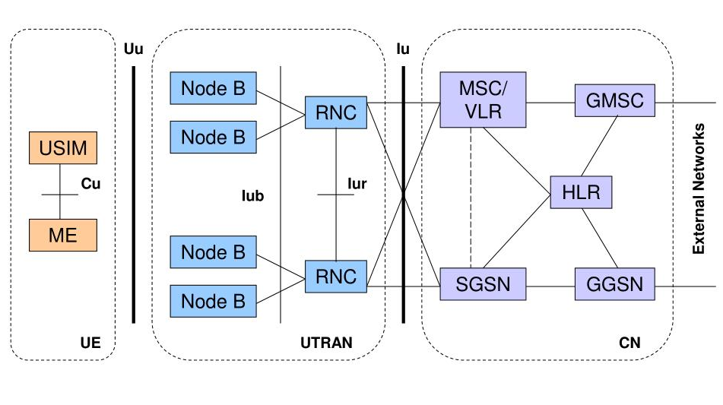
UMTS Architecture

Slide 3










Advantages of UMTS
Energy-efficient data transfers
Better battery life for IoT devices
High-speed information exchange
Delivery of small packets of information to a destination
Purpose-built for cell phones and industrial modems

Slide 4
Disadvantages of UMTS
It is more expensive than GSM.
Universal Mobile Telecommunication System has poor video experience.
Universal Mobile Telecommunication System still not broadband.

Slide 5
Current and Future state of UMTS
UMTS (Universal Mobile Telecommunications System) is a 3G wireless technology standard that has been widely deployed globally. However, its prominence has been declining in recent years due to the emergence of faster and more efficient technologies such as 4G LTE and 5G.

Slide 6
Thank You Everyone
Presented By,
Team 404_Not_found
Bishwajit Chakraborty(1414)
Shah Alam(1409)
Arafat(1415)

