Slide 1

Ripple Carry Adder:
Introduction
The ripple carry adder is a fundamental building block in digital circuits. It performs binary addition, a basic operation used in numerous applications.

Slide 2

Principle of Operation
1
Input Stage
The adder takes two binary numbers as input and a carry-in bit.
2
Full Adder Block
Each full adder block performs the sum and carry calculation for one bit position.
3
Carry Propagation
The carry-out from each full adder is rippled to the next stage, hence the name 'ripple carry'.
4
Output Stage
The final sum and carry-out bits are the output of the adder.

Slide 3
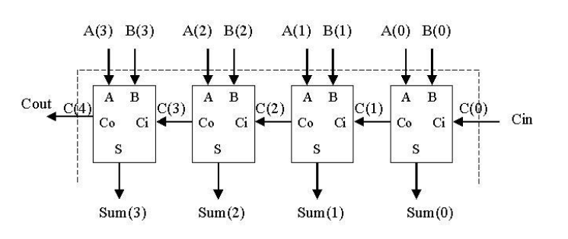
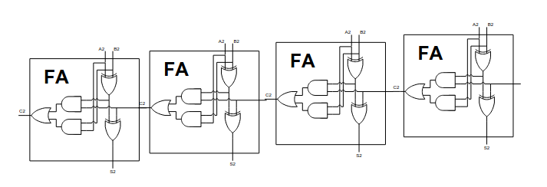
Implementation Techniques
Technology
Description
Discrete Logic Gates
Using individual logic gates (AND, OR, XOR) to construct the full adder blocks.
Integrated Circuits (ICs)
Using pre-designed ICs, such as 74LS83, which contain multiple full adder blocks.
Field-Programmable Gate Arrays (FPGAs)
Flexible implementation using configurable logic blocks and interconnects.

Slide 4
Advantages of Ripple Carry Adder
1
Simplicity
2
Cost-Effectiveness
3
Flexibility
It's relatively easy to understand and implement using basic logic gates.
It requires fewer components compared to other adder designs.
It can be easily modified to handle different bit lengths.
Disadvantages of Ripple Carry Adder
1
Speed Limitations
2
Limited Performance
The carry signal propagates through the adder sequentially, resulting in a delay proportional to the number of bits. This makes it slower for larger numbers.
As the number of bits increases, the delay becomes significant, affecting the overall performance of the circuit.

Slide 5
Negative Number Representation
Computers use a variety of methods to represent negative numbers. Understanding these representations is crucial for understanding how computers perform arithmetic operations.
Sign and magnitude
1’s complement
2’s complement

Slide 6
One's Complement Representation
One's complement representation inverts all the bits of the positive representation to get the negative representation. This method involves flipping each bit from 0 to 1 and vice-versa.
Positive Representation
One's Complement
The original binary representation of a number.
Inversion of all bits in the positive representation.
10101011 ------> 01010100

Slide 7
Two's Complement Representation
Two's complement representation is the most widely used method for representing negative numbers in computers. It's obtained by inverting all bits of the positive representation and adding 1.
Positive
One's Complement
The original binary representation of a number.
Invert all the bits of the positive representation.
Two's Complement
Add 1 to the one's complement.
171
10101011 ------> 01010100
01010100 + 1 = 01010101
85

Slide 8
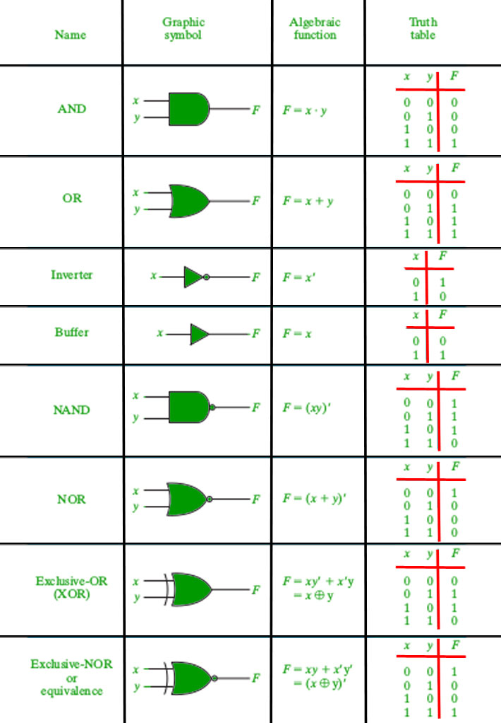
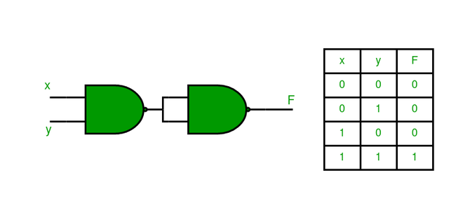
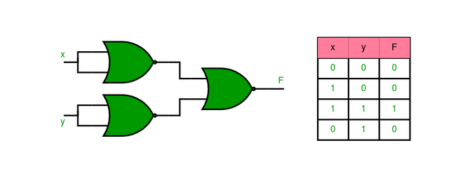
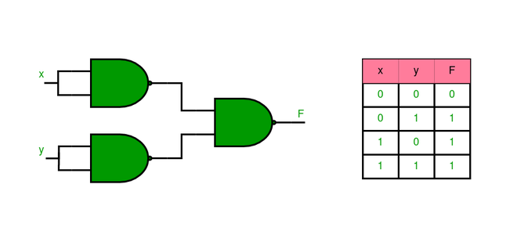
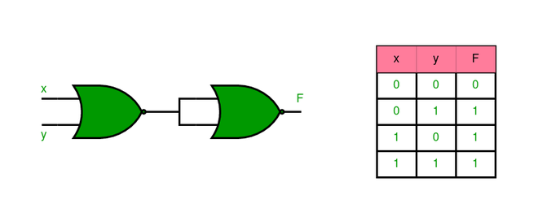
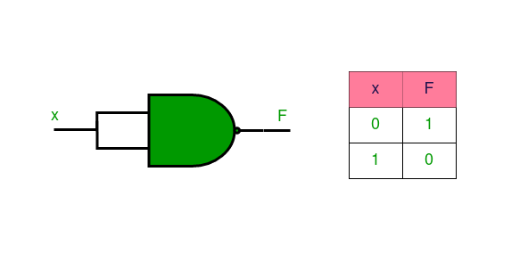
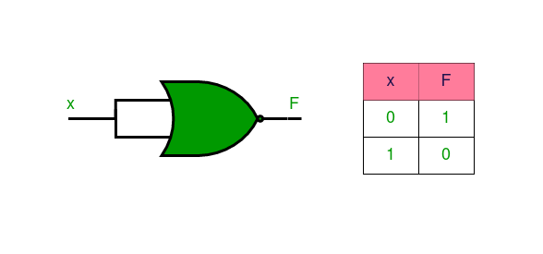

Slide 9
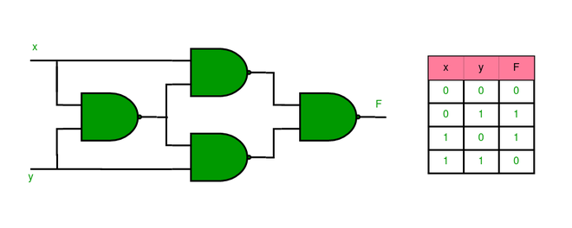
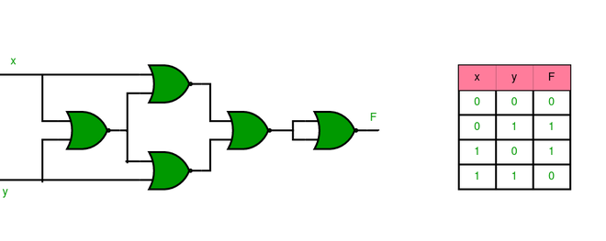
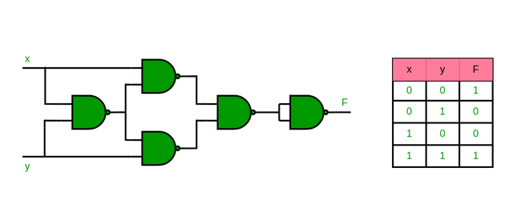
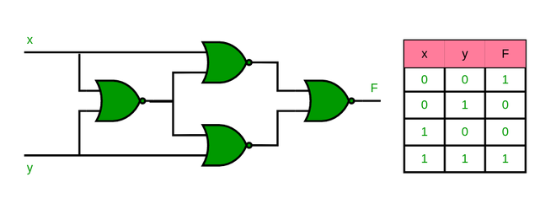
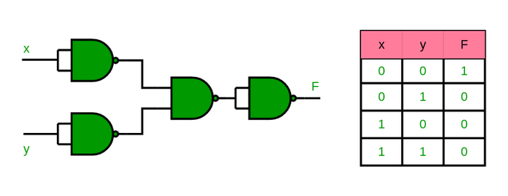
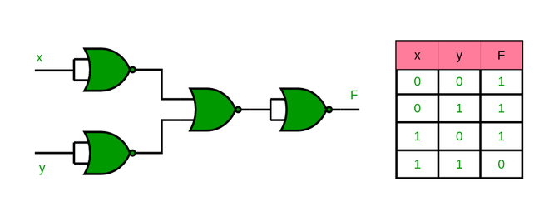
Logic Gates

