Slide 1
SmartCode
A platform of IT persons

Slide 2
For a fresher man it is too hard to find guidelines , resources and communicate with other students . For a wish thinker or a graduate the problem is the platform of sharing ideas or teaching others the topics in which he is good at.
Create a platform for students so that they can learn , create , share ideas and communicate
with students of other universities all over the country(world).

Slide 3
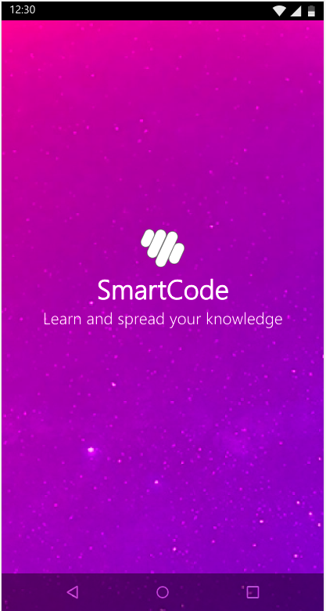
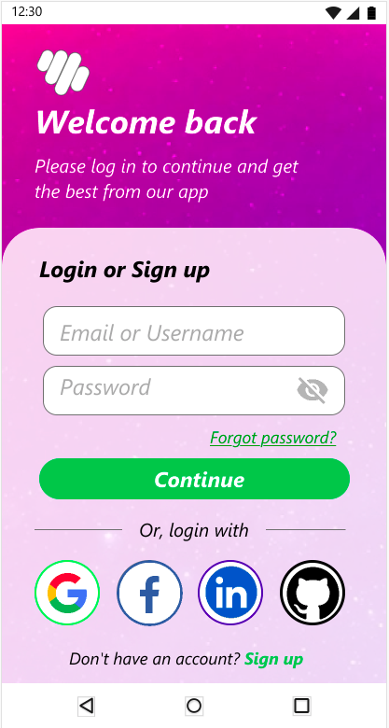
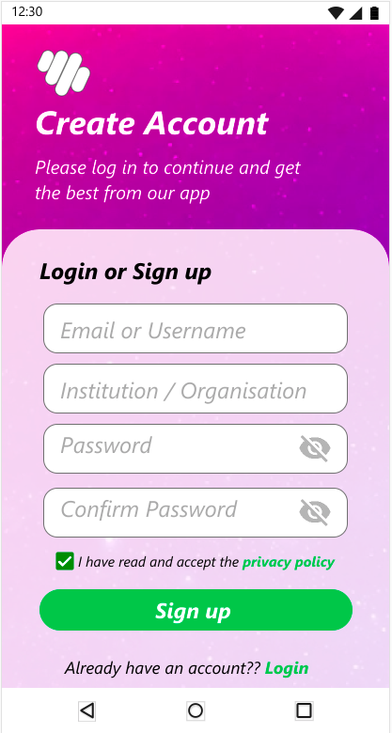
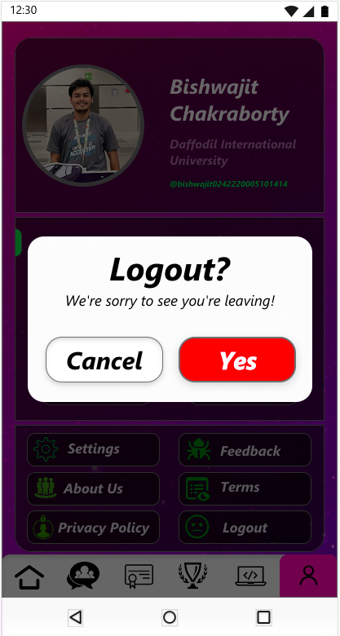

Slide 4
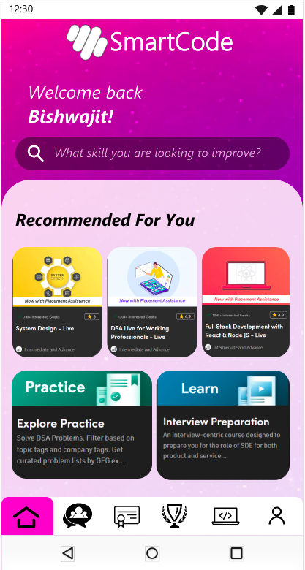
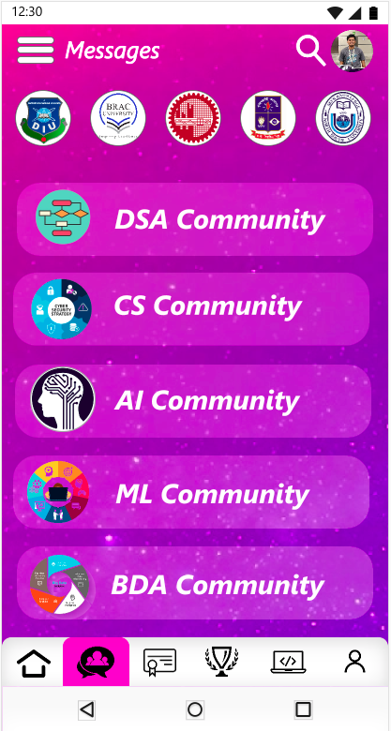
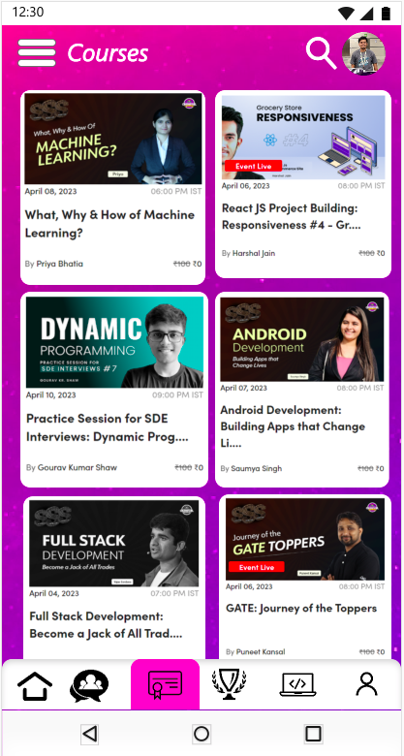

Slide 5
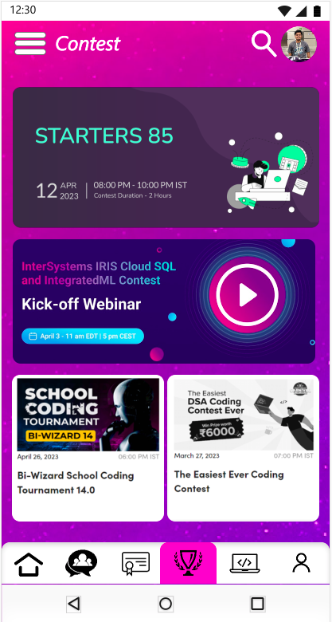
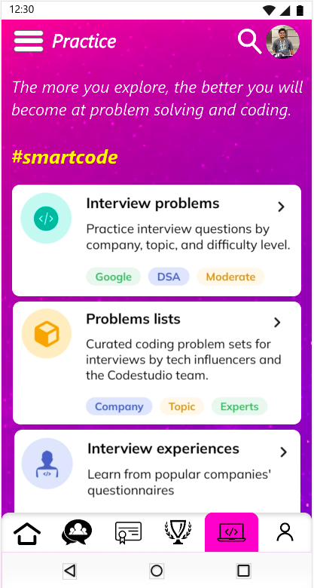
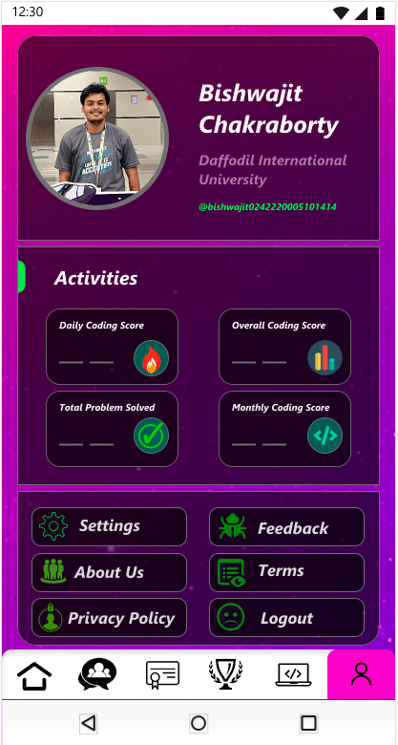

Slide 6
Software Interfaces
Software used | Description
Operating system | Flutter Support all modern os
Database | To store users Chats, Courses, Results and so on
Flutter | To implement the project we have chosen Flutter framework based on Dart language for its more interactive support.
Software project model | Agile model

Slide 7
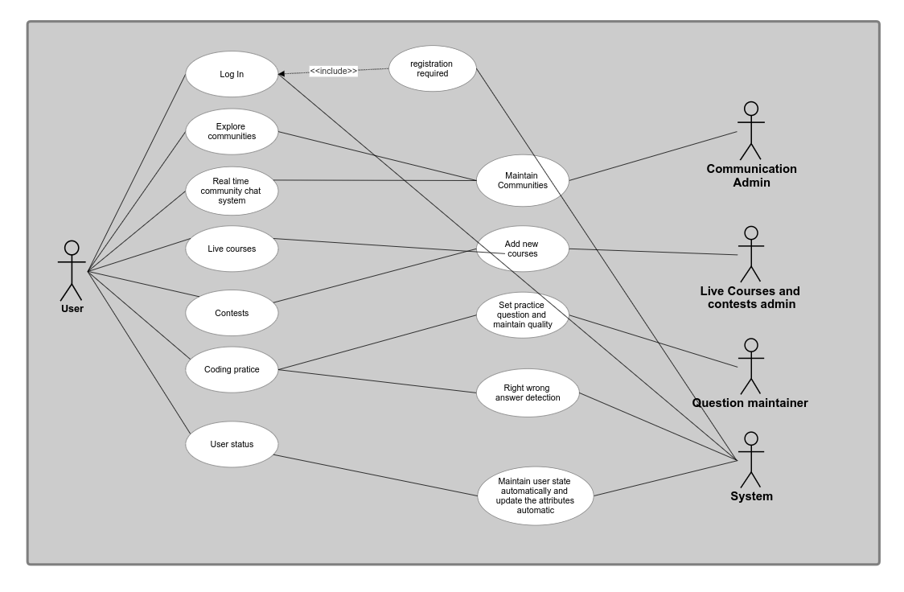
Use case Diagram

Slide 8
THANK YOU
Bishwajit Chakraborty Id:0242220005101414

