Slide 1

Automated Task Reminder and Tracking Application
Presented by: Bishwanath Kumam
Institution: Amity University | Department: Btech cse

Slide 2

Problem Statement: The Pitfalls of Manual Task Management
Manual task management, prevalent in academic and professional settings, often leads to significant inefficiencies and missed opportunities. This project addresses the critical need for a more reliable system.
Missed Deadlines: Human error in tracking due dates results in frequent oversight and submission failures.
Poor Organization: Inconsistent methods for recording tasks lead to disarray and difficulty in prioritizing workloads.
Lack of Centralization: Scattered notes and digital files make a comprehensive overview of pending tasks challenging.
Inefficient Prioritization: Without a clear system, critical tasks may be overlooked in favor of less urgent ones.

Slide 3
Objectives of the Project: Enhancing Productivity and Reliability
Automate Task Tracking
Provide Timely Reminders
To develop a system that automatically logs, categorizes, and monitors tasks, reducing manual effort and potential errors.
To implement a robust notification system that alerts users to upcoming deadlines and critical task milestones.
Improve Overall Productivity
Ensure Data Integrity
To empower users with tools that streamline their workflow, allowing them to focus on execution rather than administration.
To create a secure and reliable platform for storing and managing task-related information.

Slide 4

MODULES IMPLEMENTED:
User Authentication & Profile Module:
Task Management Module:
Handles user registration, login, OTP verification, session management, and profile image upload/removal.
Allows users to create, update, delete, view, and mark tasks as completed with priority and status tracking.
Dashboard & Task Analytics Module:
Task Management Module:
Displays task statistics such as total, pending, completed, and overdue tasks for better productivity insights.
Sends task reminders and reports via email, including CSV file attachments for task data export.

Slide 5



Technology Stack: Robust Foundations for a Scalable Solution
Backend:
Frontend:
Spring Boot (MVC Architecture)
Unit, Mockito Scheduler,Mysql
Thymeleaf templates HTML / CSS / JavaScript
Development Tools:
Additional Utilities:
CSV (OpenCSV), Java Email API
IntelliJ IDEA, GitHub

Slide 6

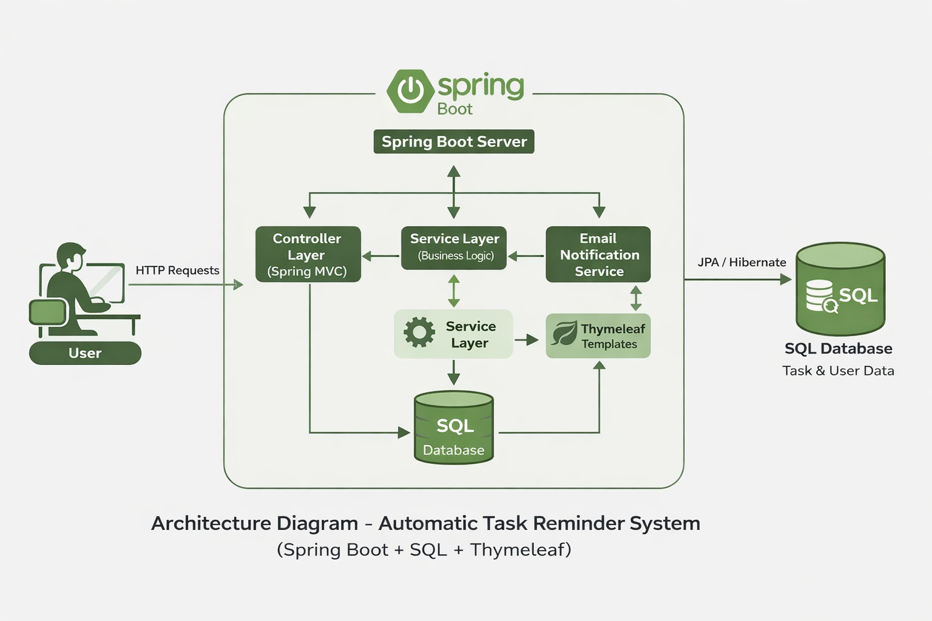
System Architecture: A Structured Approach (MVC)
Database (MySQL)
User
Stores and retrieves persistent data
Initiates actions via UI
MVC Interaction Flow
Backend (Spring Boot)
Frontend (Thymeleaf)
Handles requests and business logic
Renders views and sends requests
The application adopts a Model-View-Controller (MVC) architectural pattern, ensuring a clear separation of concerns and enhancing maintainability and scalability.
User Interaction: Users interact with the application through the web browser.
Frontend (View): Thymeleaf templates render the user interface, displaying task information and capturing user input.
Backend (Controller & Model): Spring Boot handles business logic, processes requests from the frontend, and manages data interactions with the database.
Database (Model): MySQL stores all task-related data, user profiles, and application configurations.

Slide 7
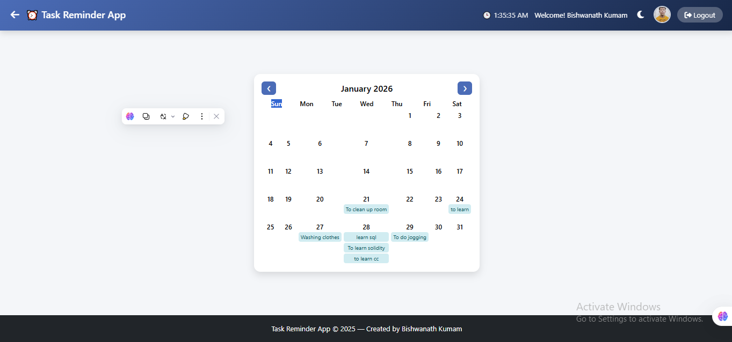
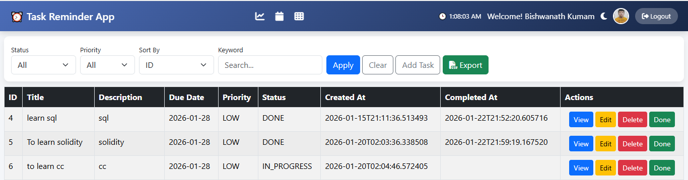

Key Features: Empowering Efficient Task Management
Comprehensive Task Management
Users can create, edit, delete, and view tasks with details such as due dates, priority levels, and descriptions. Status tracking (e.g., pending, in progress, completed) is also included.
1
Automated Email Reminders
The system dispatches email notifications to users before task deadlines, ensuring timely completion and reducing the risk of oversight.
2
CSV Report Generation
3
Users can export their task data into a CSV format, facilitating further analysis, record-keeping, and integration with other tools.

Slide 8
Challenges & Learnings: Navigating Development Hurdles
1
Database Optimization
Ensuring efficient query performance and data integrity for large datasets required careful indexing and schema design.
Secure Email Integration
2
Implementing a reliable and secure email sending mechanism while adhering to SMTP protocols and user privacy concerns.
Robust Error Handling
3
Developing comprehensive error management across frontend and backend to provide a seamless user experience.
Thymeleaf and Spring Boot Synergy
4
Mastering the integration between server-side rendering with Thymeleaf and Spring Boot's powerful backend capabilities.

Slide 9

Future Enhancements: Expanding Capabilities and Reach
Advanced Reminder Mechanisms: Incorporating SMS notifications, in-app alerts, and customizable reminder frequencies.
Mobile Application Development: Creating native iOS and Android applications for on-the-go task management.
Cloud Expansion: Deploying the application on cloud platforms (e.g., AWS, Azure) for enhanced scalability and availability.
Team Collaboration Features: Allowing multiple users to share tasks, assign responsibilities, and track team progress.
Calendar Integration: Seamlessly syncing tasks with popular calendar applications like Google Calendar or Outlook.

Slide 10

Thank You

