Slide 1

Apocalypse
Presentation By : Bishwas Shrestha

Slide 2
Introductions
Apocalypse, A 2d game windows operating system based on an android game .
Basic game concept
In Apocalypse, player has to stop enemies from reaching the end using their heroes collecting coins stopping enemies. Defeating enemies are rewarded with coins.
Particular heroes has their own area of damage and damage per second.
Powerful heroes cost more coins.
Powerful heroes has skills boost.

Slide 3
Problem statements
001
003
006
Game for entertainment purpose.
Demonstrating unique skills in designing.
Expand modification in video games in support of diverse users.
Promotes cognitive flexibility.
Cognitive : process of acquiring knowledge and understanding through thought, experience and personal perception and judgement

Slide 4
Objectives
To develop a game for entertainment purpose.
To demonstrate unique skills in designing, emerging as well as project management
To expand modified video games in support of diverse users.

Slide 5
System Analysis
Non – functional requirements
Functional requirements
Scalability: Modification and upgrade can be done in future.
Security: No special permission are needed to execute the file.
Usability: Efficiency to use because help and tips rooms are developed for user to get idea of the game.
GUI: User friendly interface are built for easier understanding including menu screen and help screen.
Logs List: Create a list of error log if game crashes or unable to execute.
Portable: Since the game does not require a lot of storage it is portable and can be shared though storage devices.

Slide 6
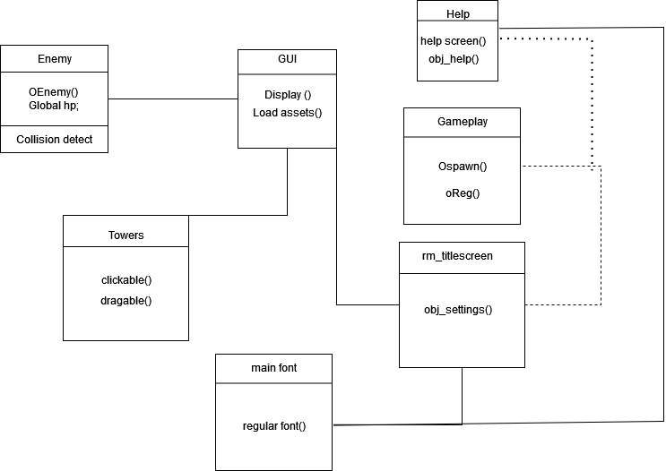
Object modeling class diagram

Slide 7
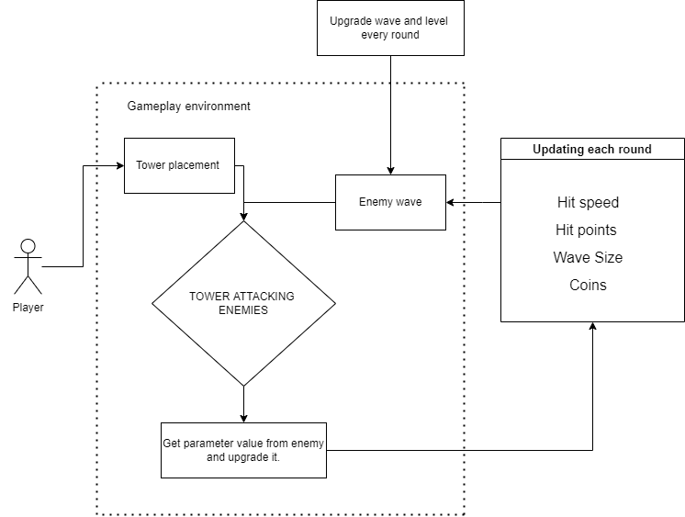
Activity diagram

Slide 8
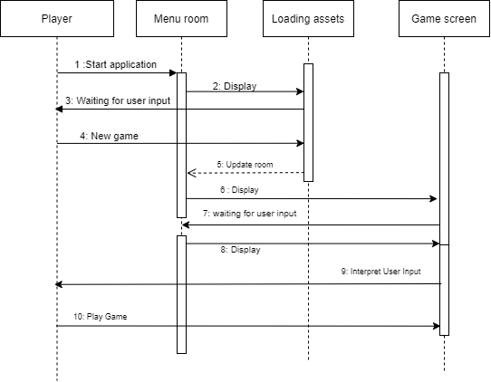
Dynamic Modelling: State & Sequence Diagram

Slide 9
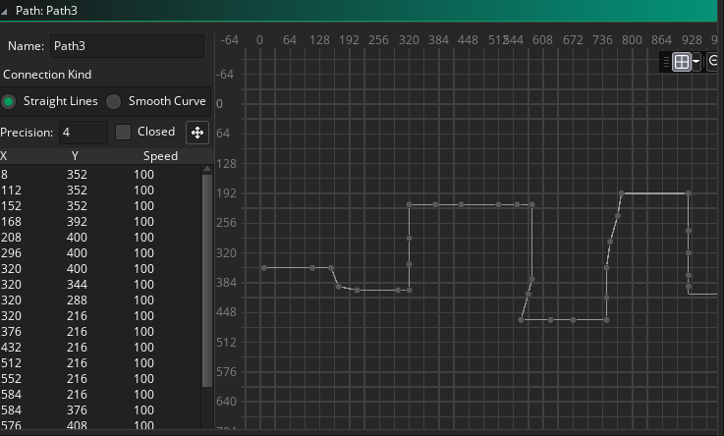
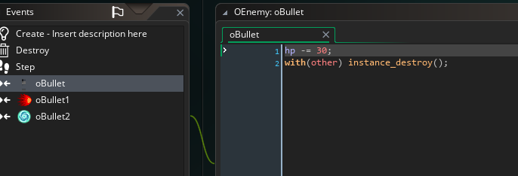
Working mechanism
Algorithms
Flow field algorithm
Collision handling

Slide 10



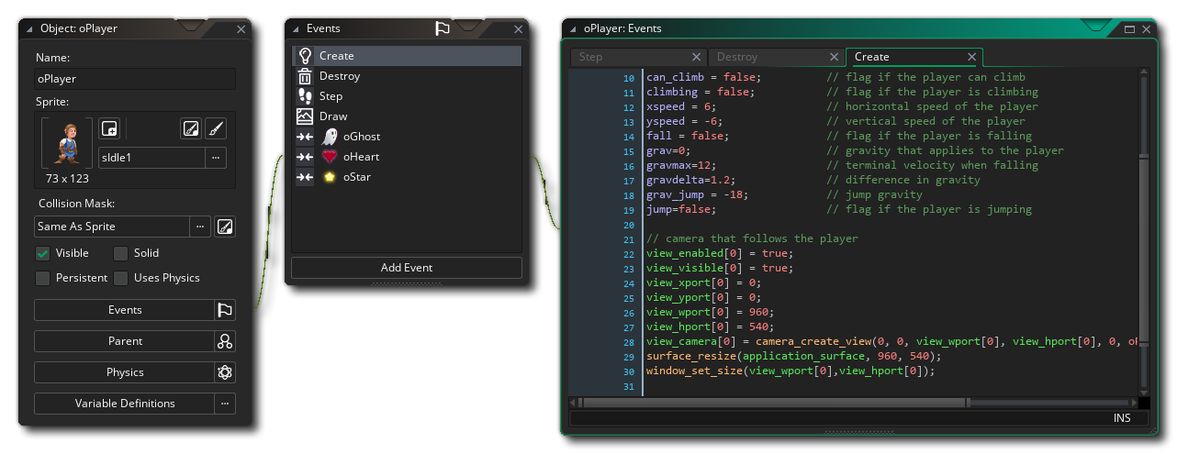

Implementation
Tools used
Tiled
Sublime text
GML scripting language
JavaScript
Game maker editor

Slide 11
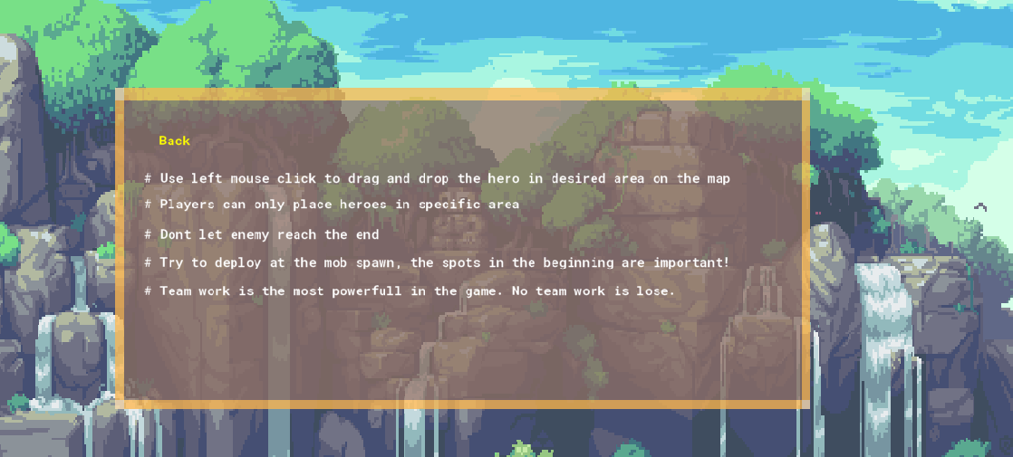
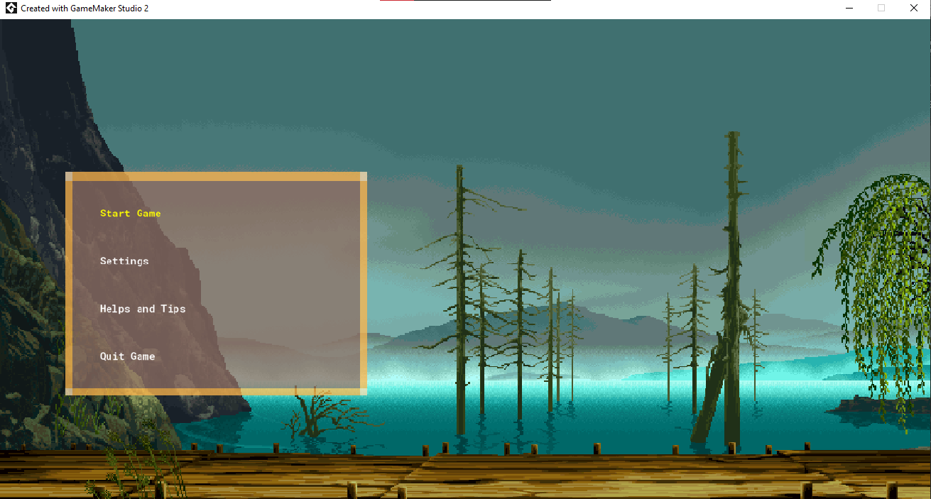
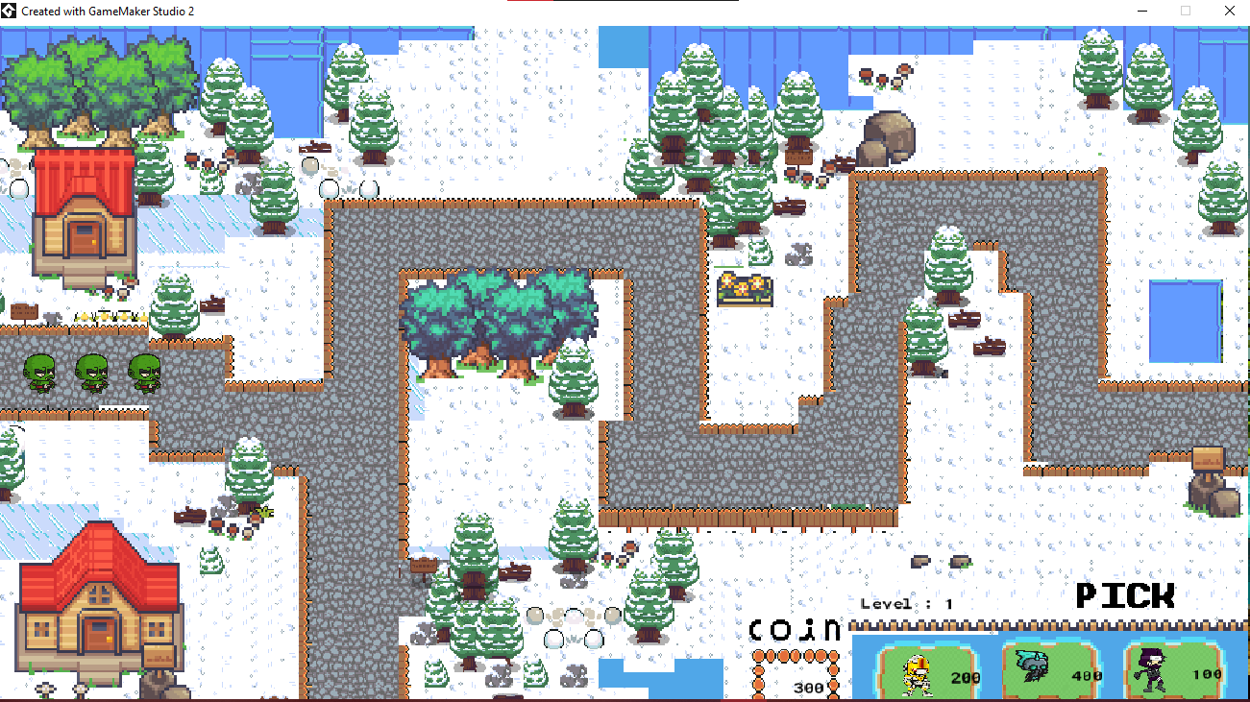
Testing
Help and tips
Main menu
Gameplay

Slide 12
Thank you!
Do you have any questions?
002

