Slide 1
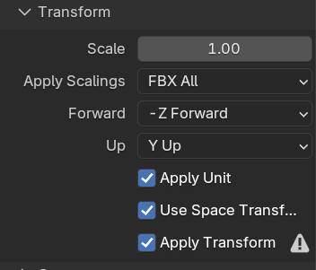
Blender
Blender Export Settings (for FBX)

Slide 2

Prefabs
Turrets
World Model
Preview Model
Layer : Default
Layer : UI3D
Tag : Turret
Tag : Default

Slide 3
Lighting
Baked
Real-Time
Rendering Layer Mask
Default
Light Layer 1

Slide 4
Stats System
Float Value
CharacterStat
List<StatModifier> statModifiers

Slide 5


#
MyAction(Input)
MyPlayerData
ItemDatabase
InventoryData
TouchManager
#
MobileCameraController
Singletton
#
#
#
ActionMapManager
Player
ShopManager
#
BuildManager
Damage
Money
Xp
#
UIManager
#
#
ScreenButton
HUDManager
#
WaveSpawner
#
Enemy
HUD Canvas
Shop Canvas
Build Canvas

