Slide 1

Models for Metamath
Mario Carneiro
25 July 2016
http://us2.metamath.org:88/model/model.pdf
http://us2.metamath.org:88/model/model.pptx

Slide 2



Metamathematics
In the beginning, we have the universe of discourse
In set theory, these are the sets themselves, or the elements of a model
$$ℤ$$
$$V_{ω}$$
$$π$$
Universe

Slide 3




Metamathematics
In the beginning, we have the universe of discourse
In set theory, these are the sets themselves, or the elements of a model
The object logic contains variables and well formed formulas over the universe
All formulas use variables, $∀,=,∈$
$$v_{1}∈v_{2}$$
$$v_{0}$$
Object logic
$$∀v_{0} v_{0}=v_{0}$$
Universe

Slide 4

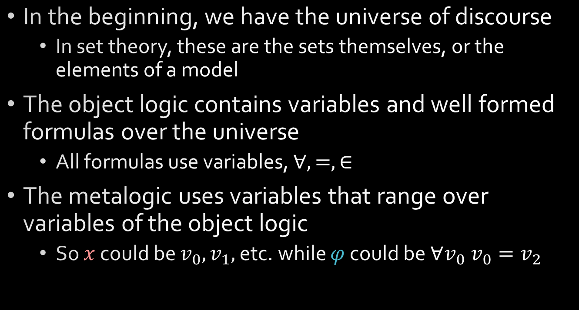


Metamathematics
$$x∈y$$
$$z$$
$$∀x φ$$
Metalogic
In the beginning, we have the universe of discourse
In set theory, these are the sets themselves, or the elements of a model
The object logic contains variables and well formed formulas over the universe
All formulas use variables, $∀,=,∈$
The metalogic uses variables that range over variables of the object logic
So $x$ could be $v_{0},v_{1},$ etc. while $φ$ could be $∀v_{0} v_{0}=v_{2}$
Object logic
Universe

Slide 5
Metamathematics
Metamath
Metalogic
FOL handles the relationship between the object logic and the universe
Metamath handles the relationship between the metalogic and the object logic
Metamath does not model the universe!
How to axiomatize?
Object logic
Universe
FOL

Slide 6


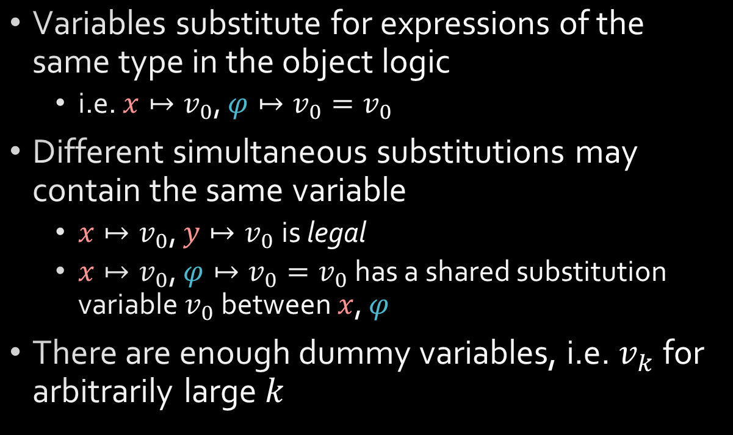


Properties of a metavariable
$$x∈y$$
$$z$$
$$∀x φ$$
Metalogic
Variables substitute for expressions of the same type in the object logic
i.e. $x↦v_{0}$, $φ↦v_{0}=v_{0}$
Different simultaneous substitutions may contain the same variable
​$x↦v_{0}$, $y↦v_{0}$is legal
​$x↦v_{0}$, $φ↦v_{0}=v_{0}$ has a shared substitution variable $v_{0}$ between $x$, $φ$
There are enough dummy variables, i.e. $v_{k}$ for arbitrarily large $k$
$$v_{1}∈v_{2}$$
$$v_{0}$$
Object logic
$$∀v_{0} v_{0}=v_{0}$$
Universe

Slide 7
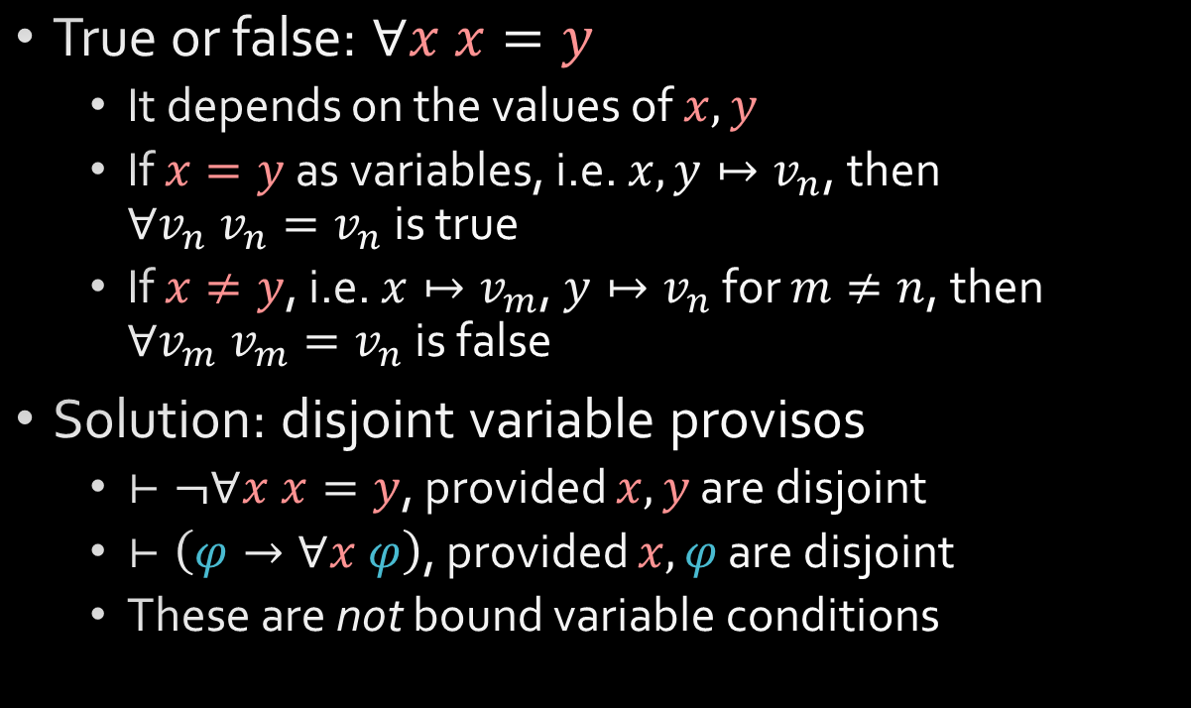
Properties of a metavariable
$$x∈y$$
$$z$$
$$∀x φ$$
Metalogic
True or false: $∀x x=y$
It depends on the values of $x,y$
If $x=y$ as variables, i.e. $x,y↦v_{n}$, then $∀v_{n} v_{n}=v_{n}$ is true
If $x≠y$, i.e. $x↦v_{m}$, $y↦v_{n}$ for $m≠n$, then $∀v_{m} v_{m}=v_{n}$ is false
Solution: disjoint variable provisos
$⊢¬∀x x=y$, provided $x,y$ are disjoint
$⊢\left(φ→∀x φ\right)$, provided $x,φ$ are disjoint
These are not bound variable conditions
$$v_{1}∈v_{2}$$
$$v_{0}$$
Object logic
$$∀v_{0} v_{0}=v_{0}$$
Universe

Slide 8
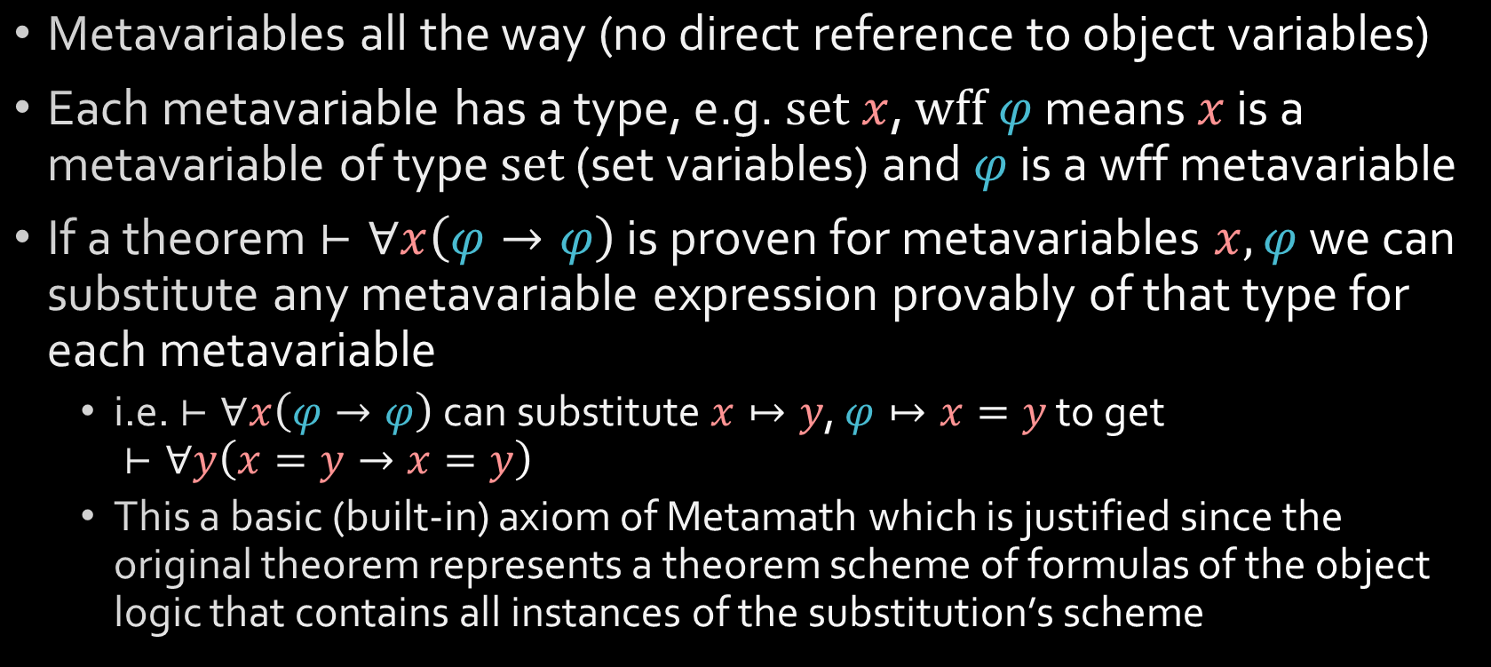
Metamath
Metavariables all the way (no direct reference to object variables)
Each metavariable has a type, e.g. $set x$, $wff φ$ means $x$ is a metavariable of type $set$ (set variables) and $φ$ is a wff metavariable
If a theorem $⊢∀x\left(φ→φ\right)$ is proven for metavariables $x,φ$ we can substitute any metavariable expression provably of that type for each metavariable
i.e. $⊢∀x\left(φ→φ\right)$ can substitute $x↦y$, $φ↦x=y$ to get $⊢∀y\left(x=y→x=y\right)$
This a basic (built-in) axiom of Metamath which is justified since the original theorem represents a theorem scheme of formulas of the object logic that contains all instances of the substitution’s scheme

Slide 9
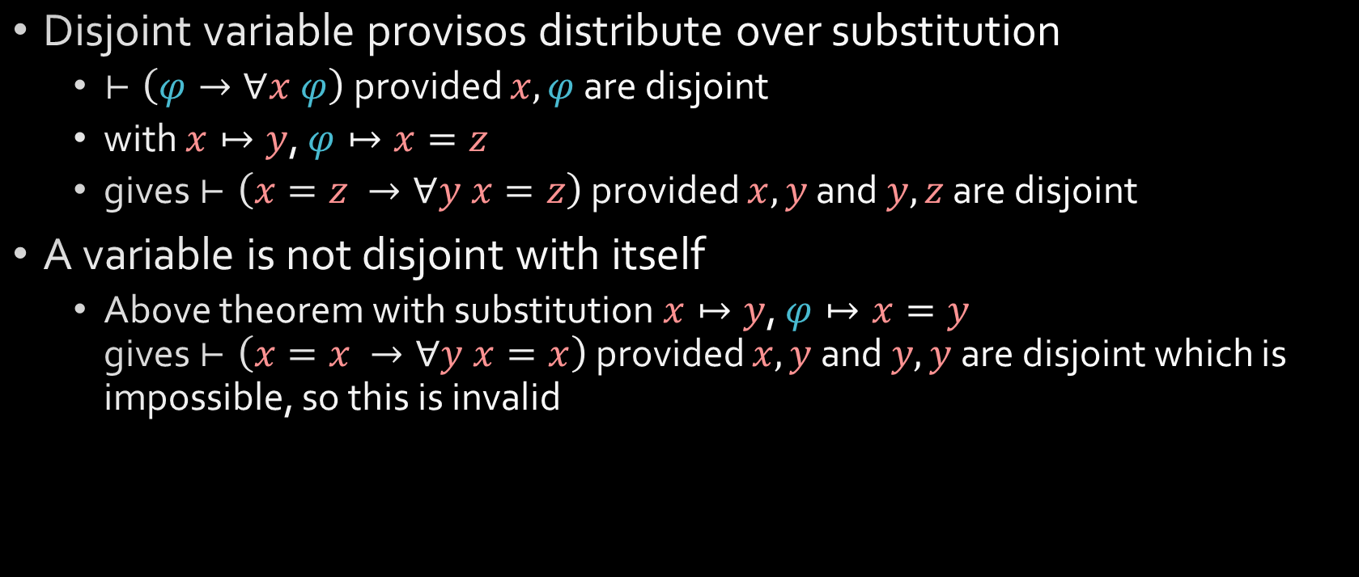
Metamath
Disjoint variable provisos distribute over substitution
$⊢\left(φ→∀x φ\right)$ provided $x,φ$ are disjoint
with $x↦y$, $φ↦x=z$
gives $⊢\left(x=z →∀y x=z\right)$ provided $x,y$ and $y,z$ are disjoint
A variable is not disjoint with itself
Above theorem with substitution $x↦y$, $φ↦x=y$ gives $⊢\left(x=x →∀y x=x\right)$ provided $x,y$ and $y,y$ are disjoint which is impossible, so this is invalid

Slide 10
Grammars and trees
For speed/historical reasons, expressions are strings, not trees
AKA Metamath is a string rewriting system
Cute example: Hofstadter’s MIU system is valid Metamath
…but I don’t like strings, they are hard to reason with
Under what conditions is Metamath isomorphic to a tree-based substitution system?
Solution: Detect the grammar

Slide 11
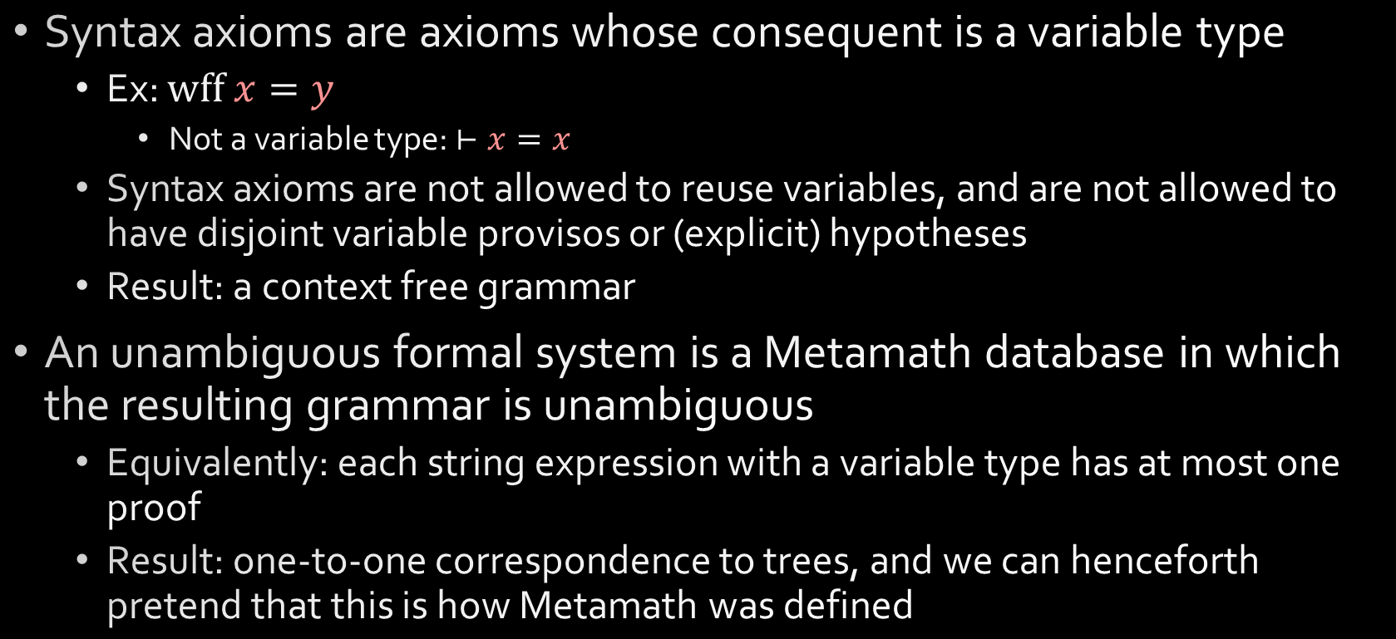
Grammars and trees
Syntax axioms are axioms whose consequent is a variable type
Ex: $wff x=y$
Not a variable type: $⊢x=x$
Syntax axioms are not allowed to reuse variables, and are not allowed to have disjoint variable provisos or (explicit) hypotheses
Result: a context free grammar
An unambiguous formal system is a Metamath database in which the resulting grammar is unambiguous
Equivalently: each string expression with a variable type has at most one proof
Result: one-to-one correspondence to trees, and we can henceforth pretend that this is how Metamath was defined

Slide 12
Models
$$x∈y$$
$$z$$
$$∀x φ$$
Metalogic
Return to the original picture
$$v_{1}∈v_{2}$$
$$v_{0}$$
Object logic
$$∀v_{0} v_{0}=v_{0}$$
Universe

Slide 13
Models
$$x∈y$$
$$z$$
$$∀x φ$$
Metamath
Return to the original picture
A model is a space that acts like the object logic over a universe
No requirement that the universe exists
It only has to satisfy the properties expected by Metamath
Models for string systems: read the paper
$$v_{1}∈v_{2}$$
$$v_{0}$$
Model
$$∀v_{0} v_{0}=v_{0}$$

Slide 14
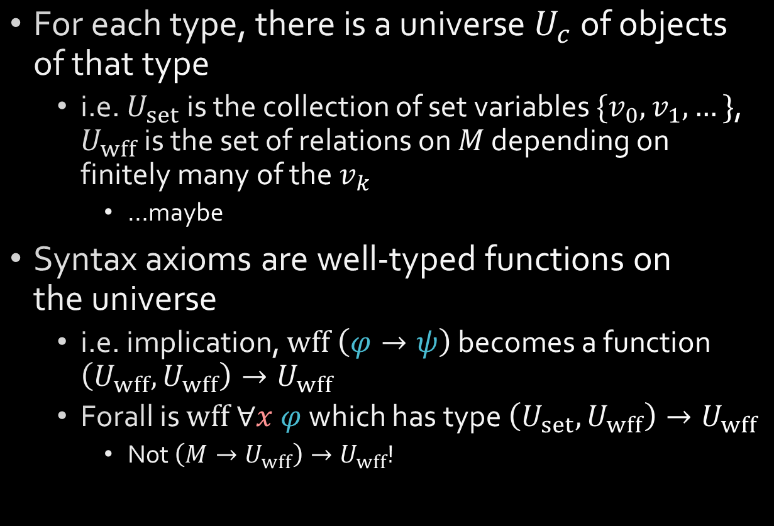
Models
$$x∈y$$
$$z$$
$$∀x φ$$
Metamath
For each type, there is a universe $U_{c}$ of objects of that type
i.e. $U_{set}$ is the collection of set variables $\{v_{0},v_{1},…\}$, $U_{wff}$ is the set of relations on $M$ depending on finitely many of the $v_{k}$
…maybe
Syntax axioms are well-typed functions on the universe
i.e. implication, $wff \left(φ→ψ\right)$ becomes a function $\left(U_{wff},U_{wff}\right)→U_{wff}$
Forall is $wff ∀x φ$ which has type $\left(U_{set},U_{wff}\right)→U_{wff}$
Not $\left(M→U_{wff}\right)→U_{wff}$!
$$v_{1}∈v_{2}$$
$$v_{0}$$
Model
$$∀v_{0} v_{0}=v_{0}$$

Slide 15
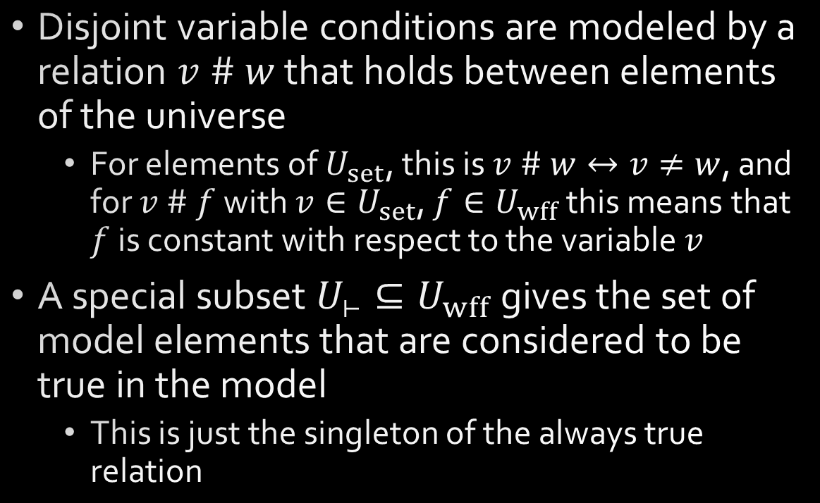
Models
$$x∈y$$
$$z$$
$$∀x φ$$
Metamath
Disjoint variable conditions are modeled by a relation $v \# w$ that holds between elements of the universe
For elements of $U_{set}$, this is $v \# w↔v≠w$, and for $v \# f$ with $v∈U_{set}$, $f∈U_{wff}$ this means that $f$ is constant with respect to the variable $v$
A special subset $U_{⊢}⊆U_{wff}$ gives the set of model elements that are considered to be true in the model
This is just the singleton of the always true relation
$$v_{1}∈v_{2}$$
$$v_{0}$$
Model
$$∀v_{0} v_{0}=v_{0}$$

Slide 16
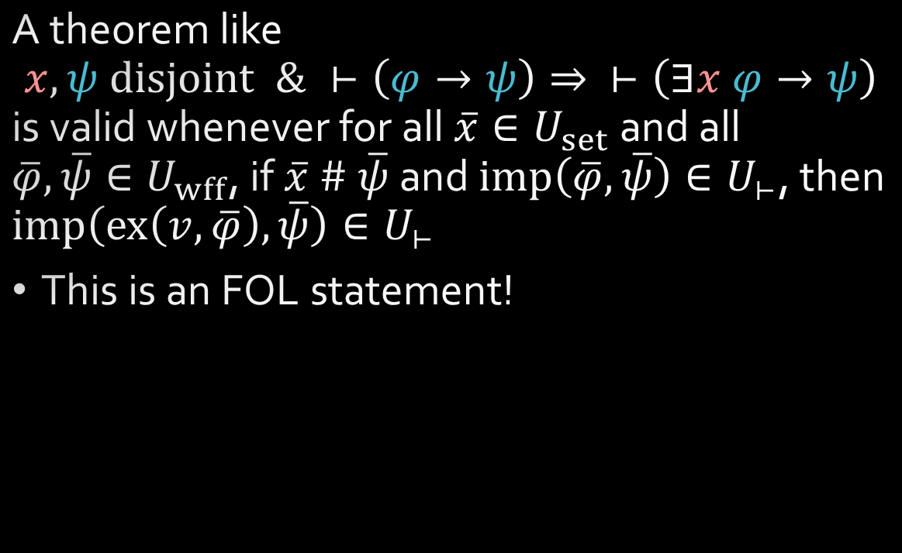
Models
$$x∈y$$
$$z$$
$$∀x φ$$
Metamath
A theorem like $$x,ψ disjoint \& ⊢\left(φ→ψ\right)⇒ ⊢\left(∃x φ→ψ\right)$$ is valid whenever for all $\overline{x}∈U_{set}$ and all $\overline{φ},\overline{ψ}∈U_{wff}$, if$\overline{x} \# \overline{ψ}$ and $imp\left(\overline{φ},\overline{ψ}\right)∈U_{⊢}$, then $imp\left(ex\left(v,\overline{φ}\right),\overline{ψ}\right)∈U_{⊢}$
This is an FOL statement!
$$v_{1}∈v_{2}$$
$$v_{0}$$
Model
$$∀v_{0} v_{0}=v_{0}$$

Slide 17
It all works out
Soundness
There is a model for set.mm, assuming that ZFC has a model
Converse?
Godel completeness
A theorem is true iff it is true in every model
What about disjoint variables and hypotheses?
Independence proofs of set.mm axioms
Conservative extensions of a theory, what happens to the model
The category of models and model homomorphisms

Slide 18
It all works out
Soundness
There is a model for set.mm, assuming that ZFC has a model
Converse?
Godel completeness
A theorem is true iff it is true in every model
What about disjoint variables and hypotheses?
Independence proofs of set.mm axioms
Conservative extensions of a theory, what happens to the model
The category of models and model homomorphisms

Slide 19
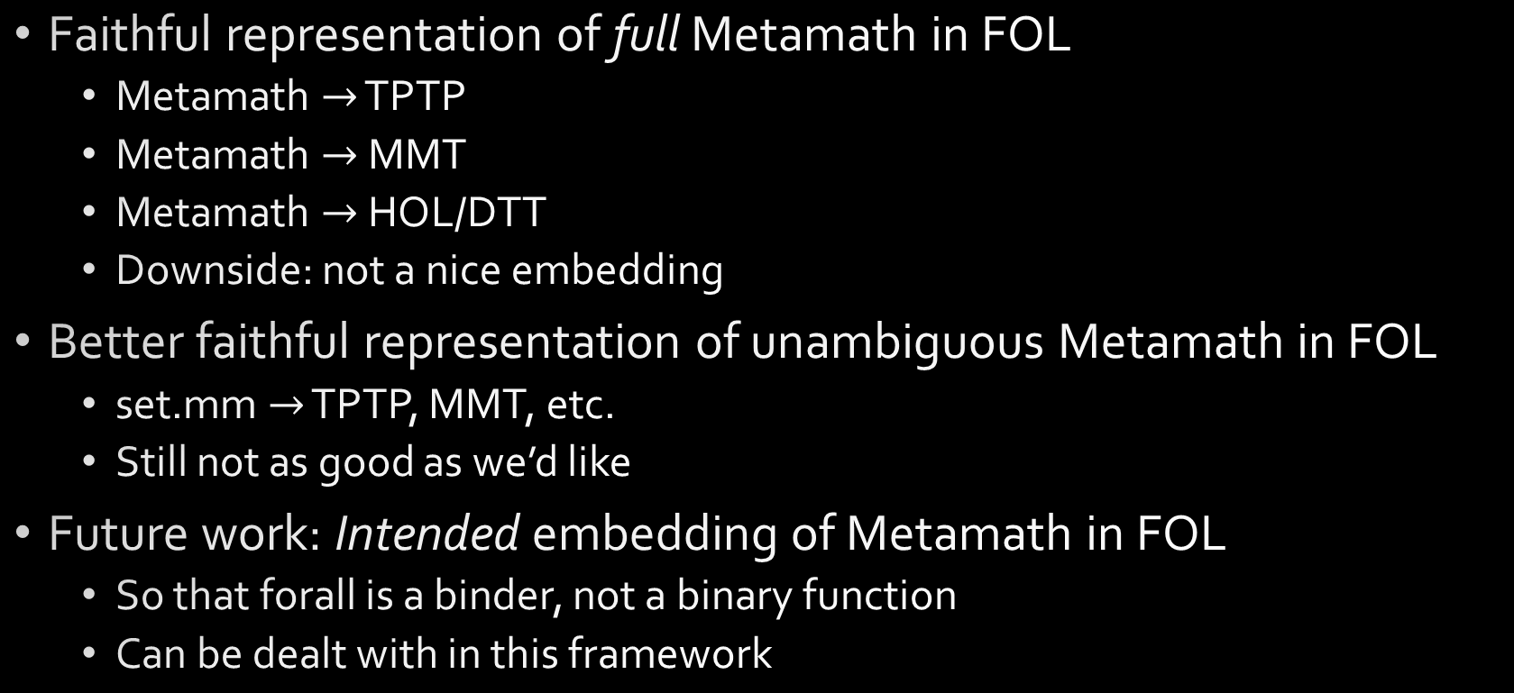
What’s the point
Faithful representation of full Metamath in FOL
Metamath $→$ TPTP
Metamath $→$ MMT
Metamath $→$ HOL/DTT
Downside: not a nice embedding
Better faithful representation of unambiguous Metamath in FOL
set.mm $→$ TPTP, MMT, etc.
Still not as good as we’d like
Future work: Intended embedding of Metamath in FOL
So that forall is a binder, not a binary function
Can be dealt with in this framework

Slide 20
Questions

