Slide 1

Natural Deduction in the Metamath Proof Language
Mario Carneiro
July 1, 2014

Slide 2
What is Metamath?
A computer language for writing mathematical proofs
A program to verify proofs in the Metamath language
A library of completed proofs
Almost 20000 proofs exist in set.mm, the main collection of proofs based primarily on ZFC set theory
Covers introductory material in set theory, category theory, real analysis, number theory, algebra, topology, linear algebra, lattice theory, etc.

Slide 3
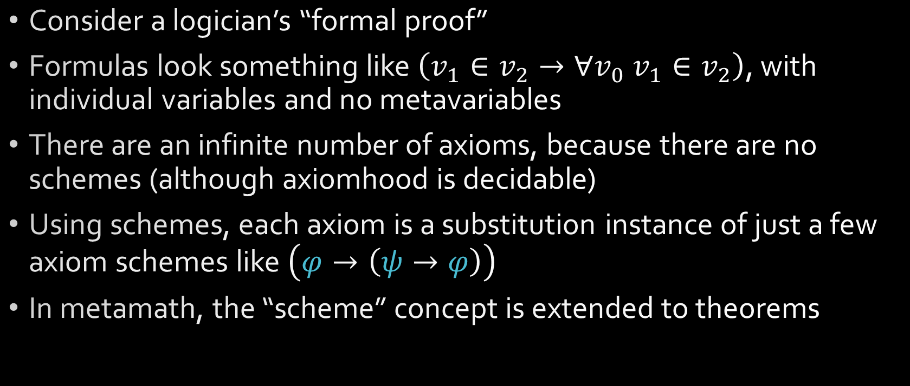
How does it work?
Consider a logician’s “formal proof”
Formulas look something like $\left(v_{1}∈v_{2}→∀v_{0} v_{1}∈v_{2}\right)$, with individual variables and no metavariables
There are an infinite number of axioms, because there are no schemes (although axiomhood is decidable)
Using schemes, each axiom is a substitution instance of just a few axiom schemes like $\left(φ→\left(ψ→φ\right)\right)$
In metamath, the “scheme” concept is extended to theorems

Slide 4
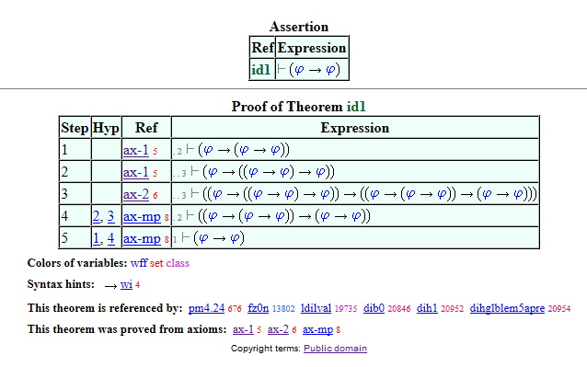
How does it work?
Each step of a proof uses metavariables
The result of the proof is a theorem scheme, which can be substituted in later theorems
1-1 correspondence of proof steps to logician’s “formal proof”

Slide 5
Advantages
Conceptually simple foundations
Core verifier is very small (one independent verifier is ≈300 lines of python)
Fast proof verification (≈6 sec to verify ≈20000 proofs)
Axioms are user-specified, so it is not tied to any particular logical foundation
Each proof in the Proof Explorer lists the axioms that were used to prove it, so it is possible to, say, track AC usage in a proof

Slide 6
Comparison to Mizar
Proofs are in the form of formulas, not natural language
Steps are much smaller in scope
Similar to C versus assembly
Possible target for “compilation” from higher level languages
Simple open source verifier, public domain proofs
Follows QED philosophy: open source means independent verification
No concept of “exported theorems”
All theorems have globally unique labels and are accessible by any later proof
Hilbert-style proof system (every step of a proof is a theorem)

Slide 7
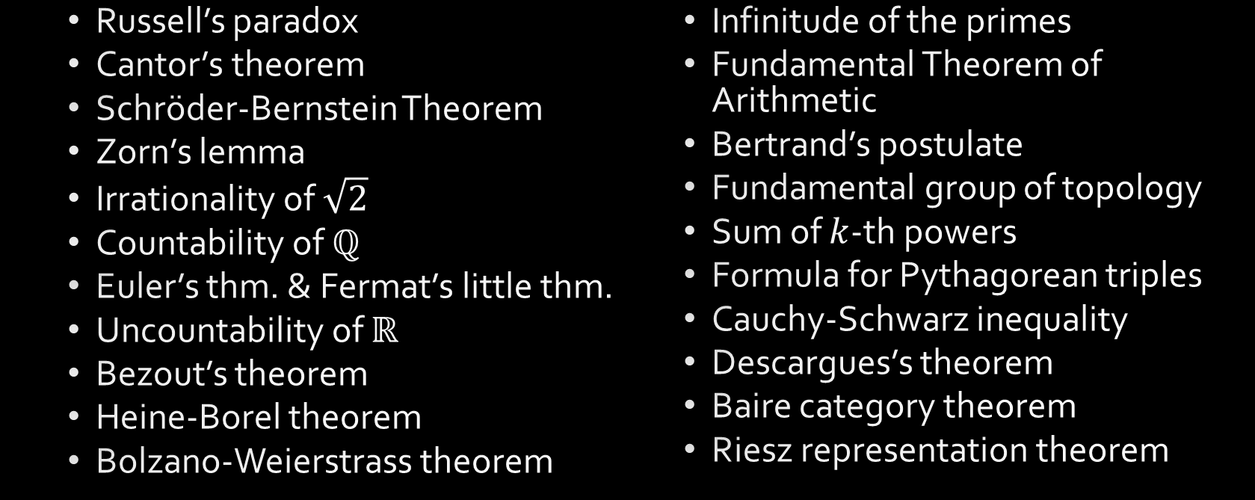
Some important theorems
The following theorems have been formalized in set.mm:
Russell’s paradox
Cantor’s theorem
Schröder-Bernstein Theorem
Zorn’s lemma
Irrationality of $\sqrt{2}$
Countability of $ℚ$
Euler’s thm. & Fermat’s little thm.
Uncountability of $ℝ$
Bezout’s theorem
Heine-Borel theorem
Bolzano-Weierstrass theorem
Infinitude of the primes
Fundamental Theorem of Arithmetic
Bertrand’s postulate
Fundamental group of topology
Sum of $k$-th powers
Formula for Pythagorean triples
Cauchy-Schwarz inequality
Descargues’s theorem
Baire category theorem
Riesz representation theorem

Slide 8
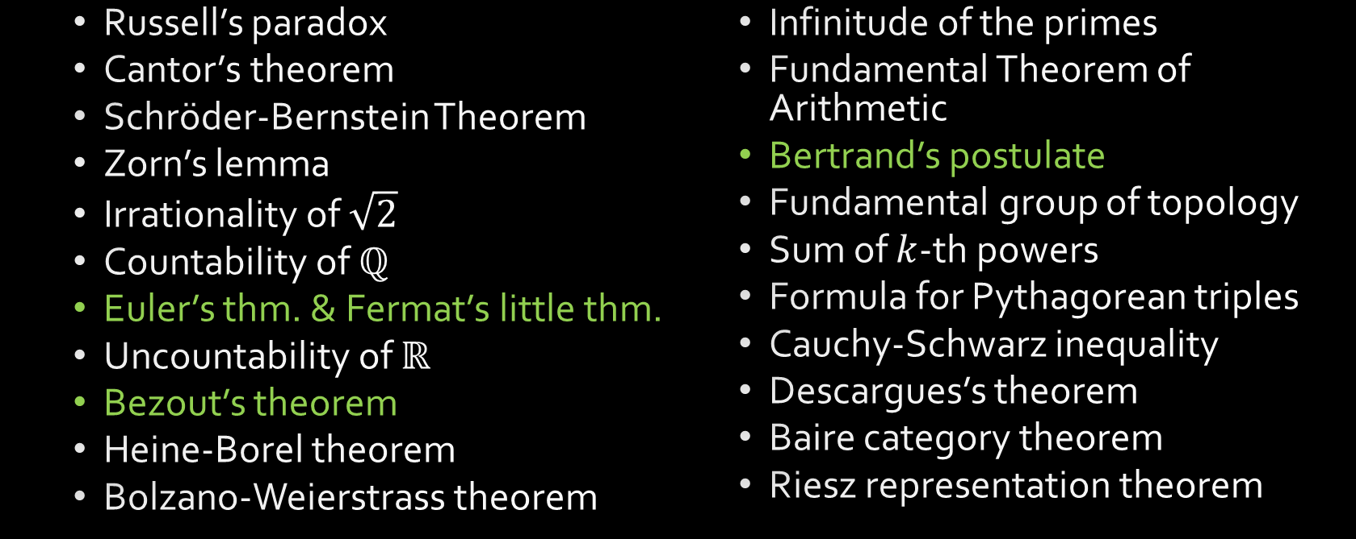
Some important theorems
The following theorems have been formalized in set.mm:
Russell’s paradox
Cantor’s theorem
Schröder-Bernstein Theorem
Zorn’s lemma
Irrationality of $\sqrt{2}$
Countability of $ℚ$
Euler’s thm. & Fermat’s little thm.
Uncountability of $ℝ$
Bezout’s theorem
Heine-Borel theorem
Bolzano-Weierstrass theorem
Infinitude of the primes
Fundamental Theorem of Arithmetic
Bertrand’s postulate
Fundamental group of topology
Sum of $k$-th powers
Formula for Pythagorean triples
Cauchy-Schwarz inequality
Descargues’s theorem
Baire category theorem
Riesz representation theorem

Slide 9
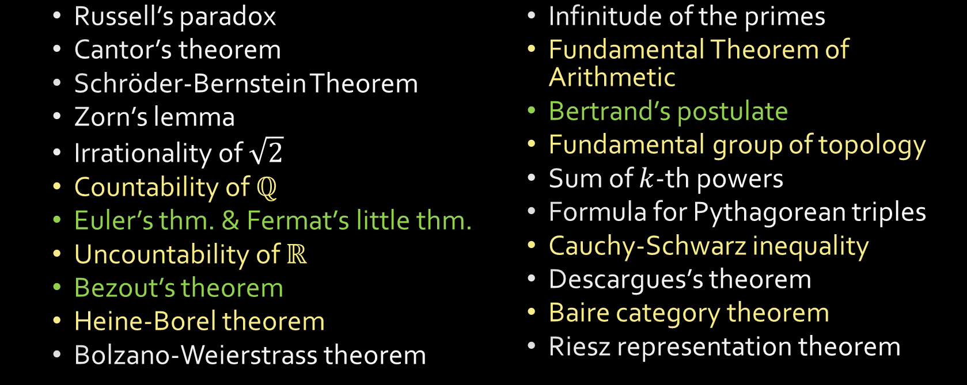
Some important theorems
The following theorems have been formalized in set.mm:
Russell’s paradox
Cantor’s theorem
Schröder-Bernstein Theorem
Zorn’s lemma
Irrationality of $\sqrt{2}$
Countability of $ℚ$
Euler’s thm. & Fermat’s little thm.
Uncountability of $ℝ$
Bezout’s theorem
Heine-Borel theorem
Bolzano-Weierstrass theorem
Infinitude of the primes
Fundamental Theorem of Arithmetic
Bertrand’s postulate
Fundamental group of topology
Sum of $k$-th powers
Formula for Pythagorean triples
Cauchy-Schwarz inequality
Descargues’s theorem
Baire category theorem
Riesz representation theorem

Slide 10
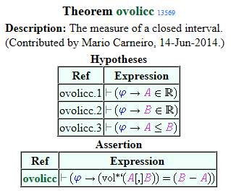
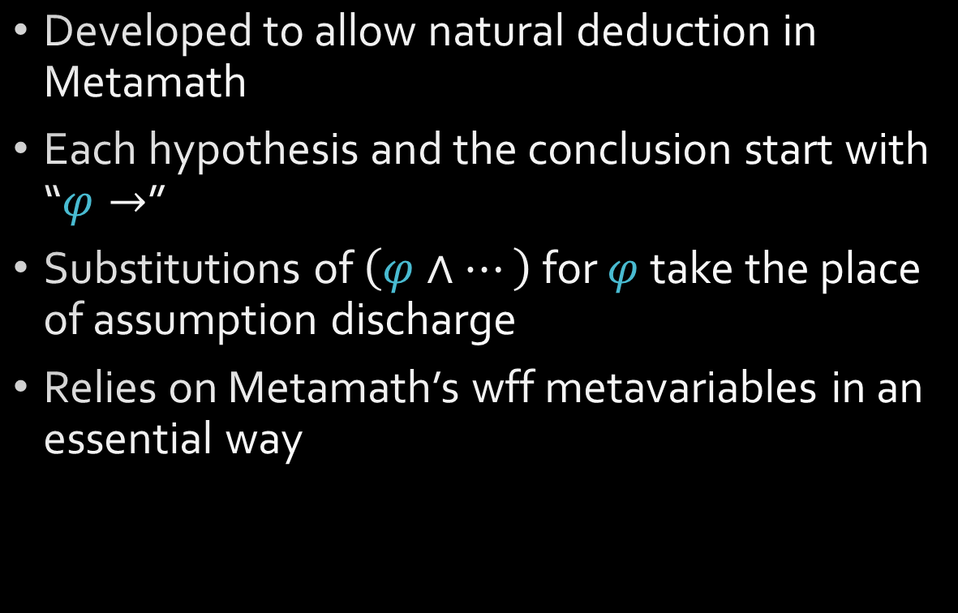
Deduction proofs
Developed to allow natural deduction in Metamath
Each hypothesis and the conclusion start with “$φ→$”
Substitutions of $\left(φ∧…\right)$ for $φ$ take the place of assumption discharge
Relies on Metamath’s wff metavariables in an essential way

Slide 11
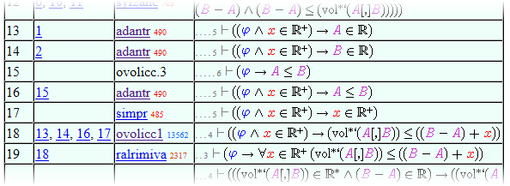
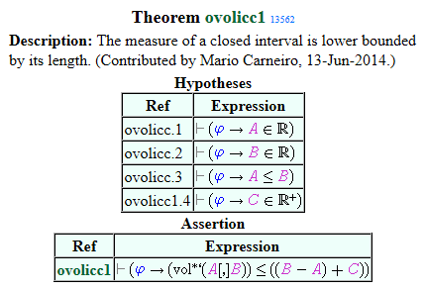
Deduction proofs

Slide 12
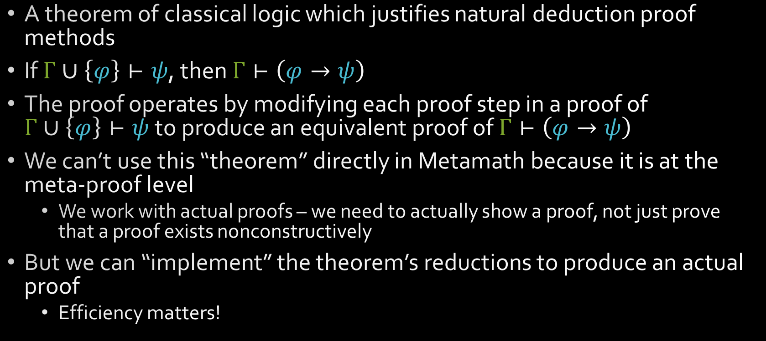
Deduction Theorem
A theorem of classical logic which justifies natural deduction proof methods
If $Γ∪\left\{φ\right\}⊢ψ$, then $Γ⊢\left(φ→ψ\right)$
The proof operates by modifying each proof step in a proof of $Γ∪\left\{φ\right\}⊢ψ$ to produce an equivalent proof of $Γ⊢\left(φ→ψ\right)$
We can’t use this “theorem” directly in Metamath because it is at the meta-proof level
We work with actual proofs – we need to actually show a proof, not just prove that a proof exists nonconstructively
But we can “implement” the theorem’s reductions to produce an actual proof
Efficiency matters!

Slide 13
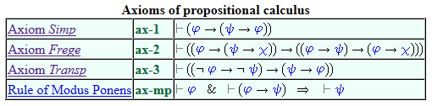
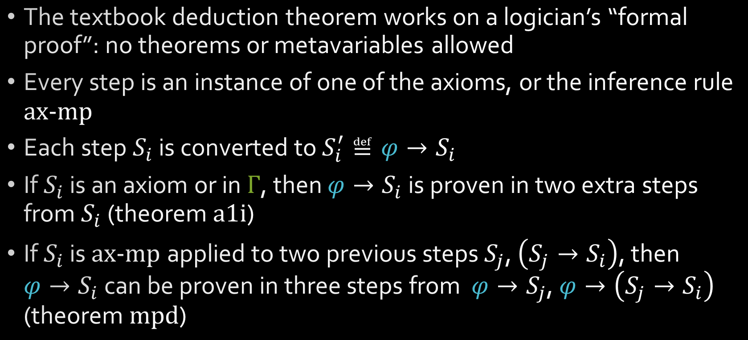
Deduction Theorem
The textbook deduction theorem works on a logician’s “formal proof”: no theorems or metavariables allowed
Every step is an instance of one of the axioms, or the inference rule ax-mp
Each step $S_{i}$ is converted to $S_{i}^{′}≝φ→S_{i}$
If $S_{i}$ is an axiom or in $Γ$, then $φ→S_{i}$ is proven in two extra steps from $S_{i}$ (theorem a1i)
If $S_{i}$ is ax-mp applied to two previous steps $S_{j}$, $\left(S_{j}→S_{i}\right)$, then $φ→S_{i}$ can be proven in three steps from $φ→S_{j}$, $φ→\left(S_{j}→S_{i}\right)$ (theorem mpd)

Slide 14
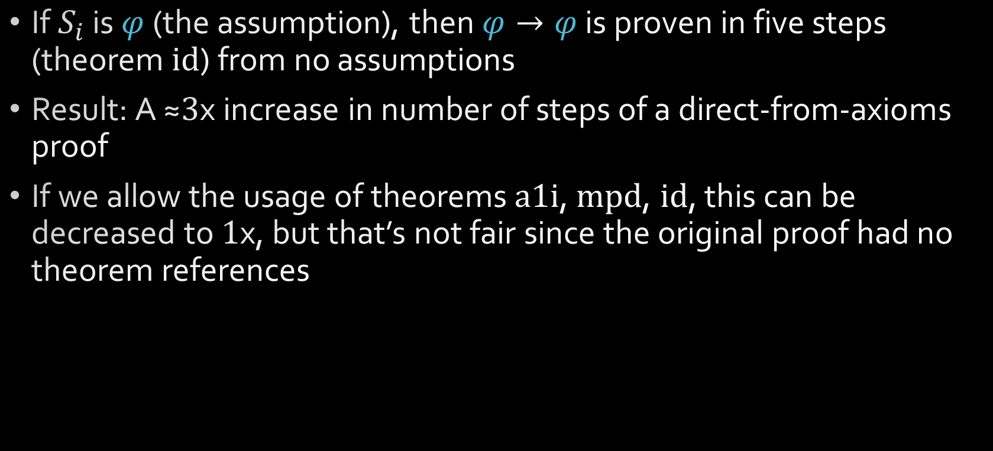
Deduction Theorem
If $S_{i}$ is $φ$ (the assumption), then $φ→φ$ is proven in five steps (theorem id) from no assumptions
Result: A ≈$3$x increase in number of steps of a direct-from-axioms proof
If we allow the usage of theorems a1i, mpd, id, this can be decreased to $1$x, but that’s not fair since the original proof had no theorem references

Slide 15
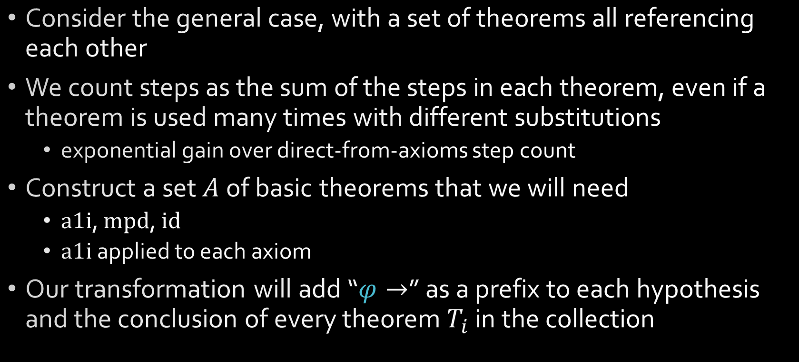
Deduction Theorem, v2
Consider the general case, with a set of theorems all referencing each other
We count steps as the sum of the steps in each theorem, even if a theorem is used many times with different substitutions
exponential gain over direct-from-axioms step count
Construct a set $A$ of basic theorems that we will need
a1i, mpd, id
a1i applied to each axiom
Our transformation will add “$φ→$” as a prefix to each hypothesis and the conclusion of every theorem $T_{i}$ in the collection

Slide 16
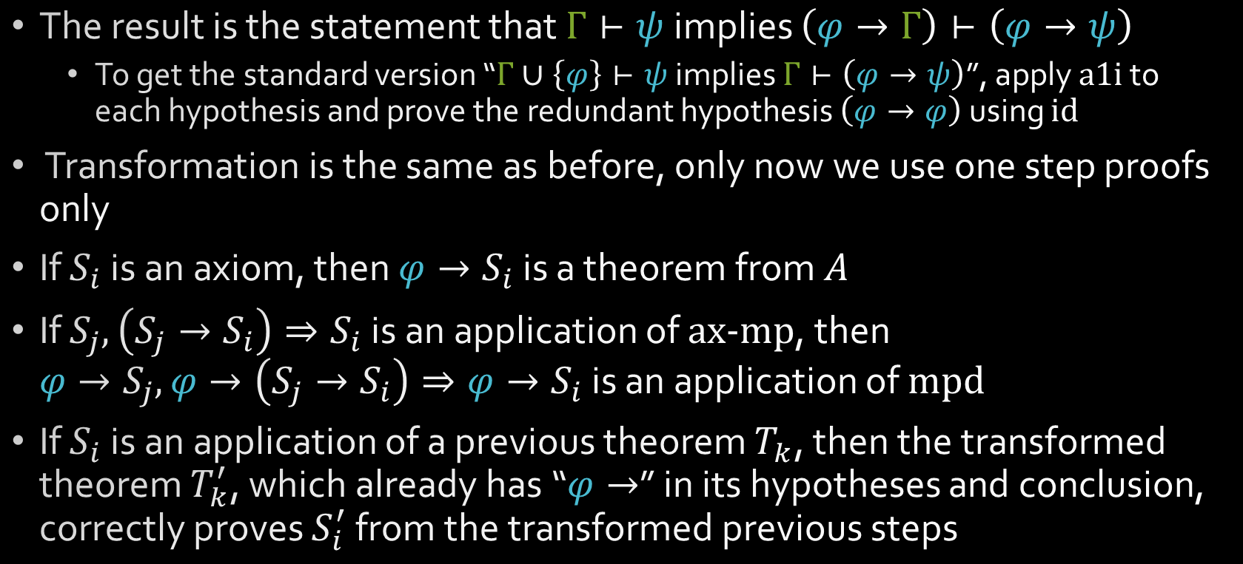
Deduction Theorem, v2
The result is the statement that $Γ⊢ψ$ implies $\left(φ→Γ\right)⊢\left(φ→ψ\right)$
To get the standard version “$Γ∪\left\{φ\right\}⊢ψ$ implies $Γ⊢\left(φ→ψ\right)$”, apply a1i to each hypothesis and prove the redundant hypothesis $\left(φ→φ\right)$ using id
Transformation is the same as before, only now we use one step proofs only
If $S_{i}$ is an axiom, then $φ→S_{i}$ is a theorem from $A$
If $S_{j},\left(S_{j}→S_{i}\right)⇒S_{i}$ is an application of ax-mp, then $φ→S_{j},φ→\left(S_{j}→S_{i}\right)⇒φ→S_{i}$ is an application of mpd
If $S_{i}$ is an application of a previous theorem $T_{k}$, then the transformed theorem $T_{k}^{′}$, which already has “$φ→$” in its hypotheses and conclusion, correctly proves $S_{i}^{′}$ from the transformed previous steps

Slide 17
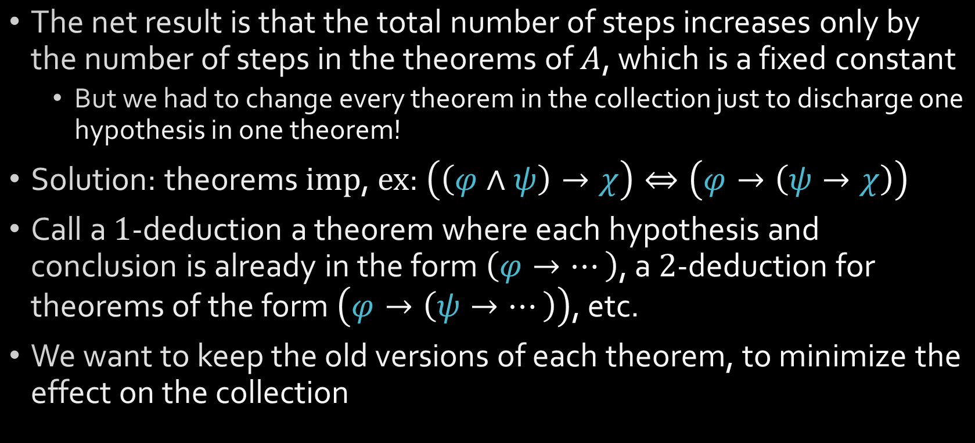
Deduction Theorem, v2
The net result is that the total number of steps increases only by the number of steps in the theorems of $A$, which is a fixed constant
But we had to change every theorem in the collection just to discharge one hypothesis in one theorem!
Solution: theorems imp, ex: $\left(\left(φ∧ψ\right)→χ\right)⇔\left(φ→\left(ψ→χ\right)\right)$
Call a $1$-deduction a theorem where each hypothesis and conclusion is already in the form $\left(φ→…\right)$, a $2$-deduction for theorems of the form $\left(φ→\left(ψ→…\right)\right)$, etc.
We want to keep the old versions of each theorem, to minimize the effect on the collection

Slide 18
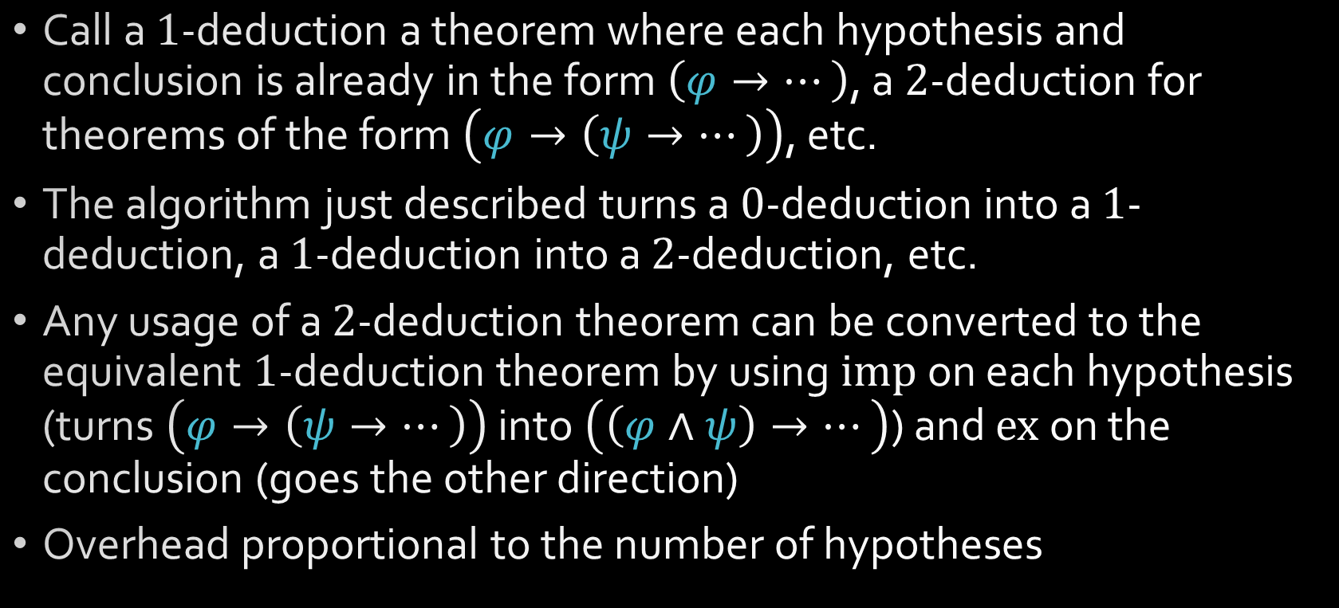
Multiple application
Call a $1$-deduction a theorem where each hypothesis and conclusion is already in the form $\left(φ→…\right)$, a $2$-deduction for theorems of the form $\left(φ→\left(ψ→…\right)\right)$, etc.
The algorithm just described turns a $0$-deduction into a $1$-deduction, a $1$-deduction into a $2$-deduction, etc.
Any usage of a $2$-deduction theorem can be converted to the equivalent $1$-deduction theorem by using imp on each hypothesis (turns $\left(φ→\left(ψ→…\right)\right)$ into $\left(\left(φ∧ψ\right)→…\right)$) and ex on the conclusion (goes the other direction)
Overhead proportional to the number of hypotheses

Slide 19
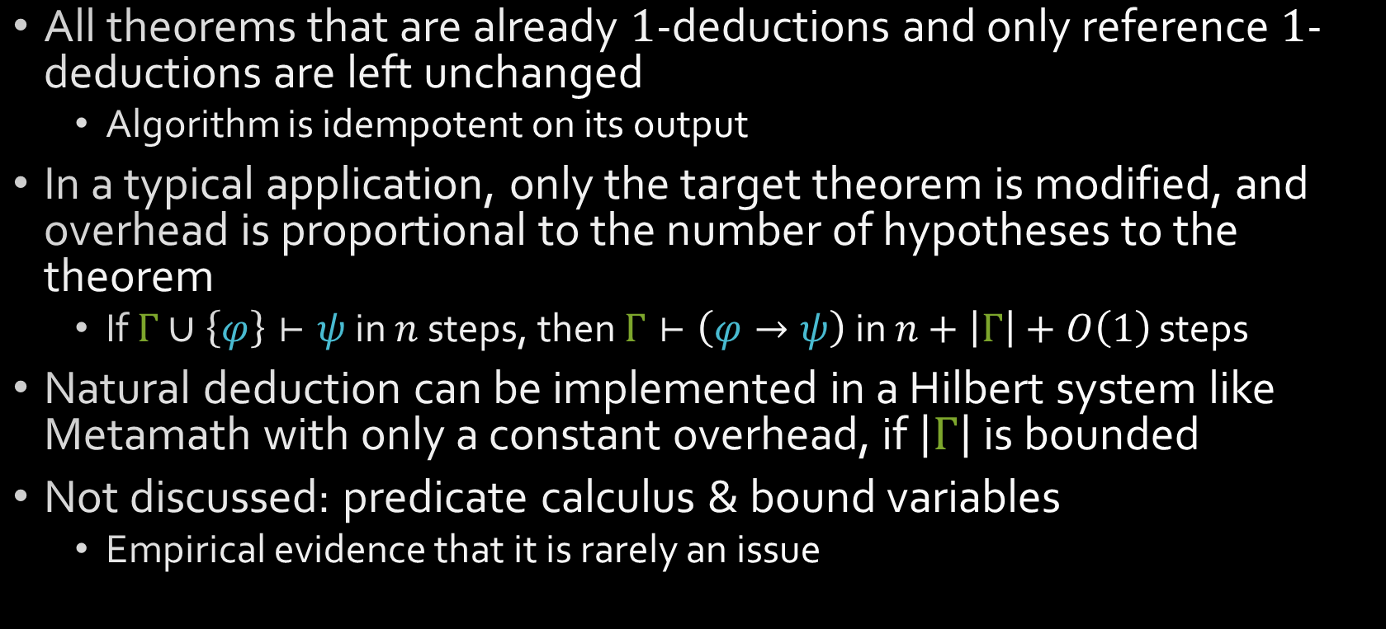
Conclusion
All theorems that are already $1$-deductions and only reference $1$-deductions are left unchanged
Algorithm is idempotent on its output
In a typical application, only the target theorem is modified, and overhead is proportional to the number of hypotheses to the theorem
If $Γ∪\left\{φ\right\}⊢ψ$ in $n$ steps, then $Γ⊢\left(φ→ψ\right)$ in $n+\left|Γ\right|+O\left(1\right)$ steps
Natural deduction can be implemented in a Hilbert system like Metamath with only a constant overhead, if $\left|Γ\right|$ is bounded
Not discussed: predicate calculus & bound variables
Empirical evidence that it is rarely an issue

Slide 20
Questions

