Slide 1

Formalization of the prime number theorem and Dirichlet’s theorem
Mario CARNEIRO
25 July 2016

Slide 2
Metamath
A computer language for representing mathematical proofs
The Metamath spec is two pages, one verifier exists in 75 lines of Mathematica
Eight independent verifiers exist in eight different languages
Two proof assistants (MM-PA and mmj2) with another (smm3) in development
(Tomorrow I will talk about the theoretical underpinnings of Metamath)
A project to formalize modern mathematics from a simple foundation
Main database is set.mm (ZFC set theory)
Over 28000 proofs, 500K lines, 29M file

Slide 3
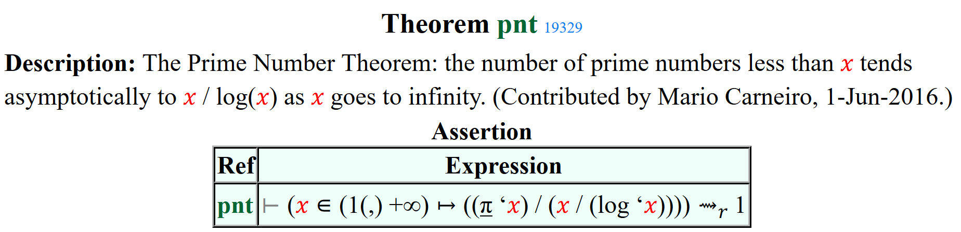
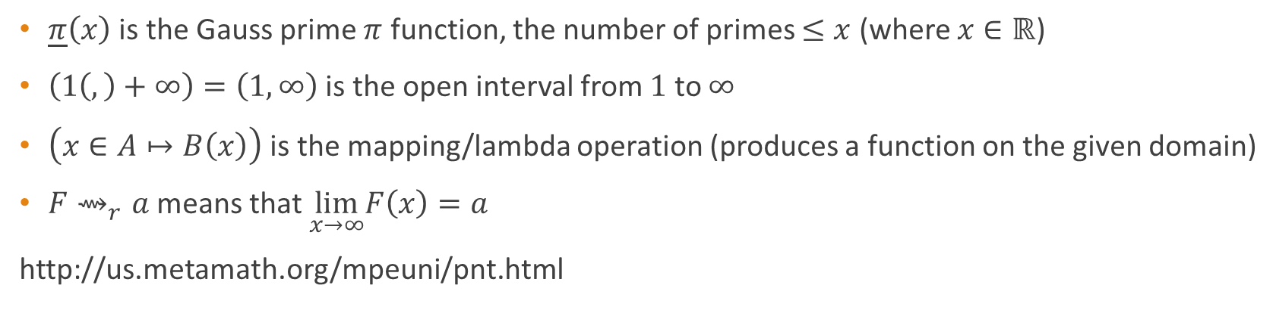
The prime number theorem
$\underline{π}\left(x\right)$ is the Gauss prime $π$ function, the number of primes $≤x$ (where $x∈ℝ$)
$\left(1\left(,\right)+∞\right)=\left(1,∞\right)$ is the open interval from $1$ to $∞$
$\left(x∈A↦B\left(x\right)\right)$ is the mapping/lambda operation (produces a function on the given domain)
$F⇝_{r}a$ means that $\lim_{x→∞}F\left(x\right)=a$
http://us.metamath.org/mpeuni/pnt.html

Slide 4
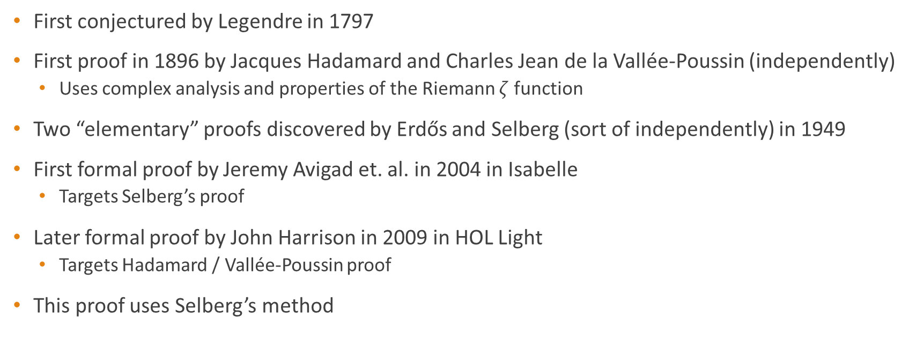
The prime number theorem
First conjectured by Legendre in 1797
First proof in 1896 by Jacques Hadamard and Charles Jean de la Vallée-Poussin (independently)
Uses complex analysis and properties of the Riemann $ζ$ function
Two “elementary” proofs discovered by Erdős and Selberg (sort of independently) in 1949
First formal proof by Jeremy Avigad et. al. in 2004 in Isabelle
Targets Selberg’s proof
Later formal proof by John Harrison in 2009 in HOL Light
Targets Hadamard / Vallée-Poussin proof
This proof uses Selberg’s method

Slide 5
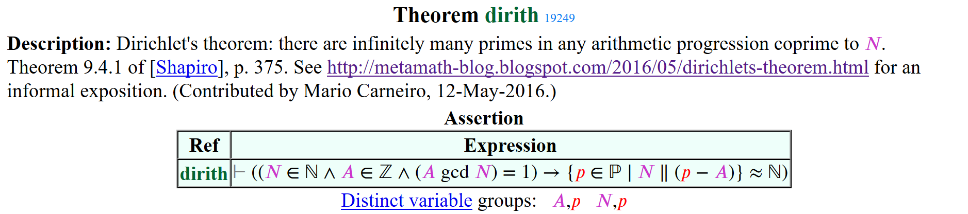
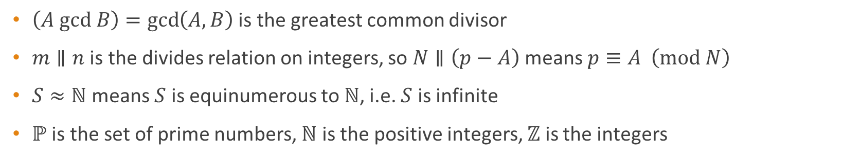
Dirichlet’s theorem
$\left(A gcd B\right)=\gcd\left(A,B\right)$ is the greatest common divisor
$m∥n$ is the divides relation on integers, so $N∥\left(p−A\right)$ means $p≡A \left(mod N\right)$
$S≈ℕ$ means $S$ is equinumerous to $ℕ$, i.e. $S$ is infinite
$ℙ$ is the set of prime numbers, $ℕ$ is the positive integers, $ℤ$ is the integers

Slide 6

Dirichlet’s theorem
Partial proof (case $A=1$) by Euler
First complete proof by Dirichlet in 1837
First formal proof by John Harrison in 2010 in HOL Light

Slide 7
Why these two?
Similar subject, some common theorems
Same proof style (asymptotic approximation of finite sums)
Both are Metamath 100 formalization targets (Freek Wiedijk)
Currently 58 out of 100 proven

Slide 8
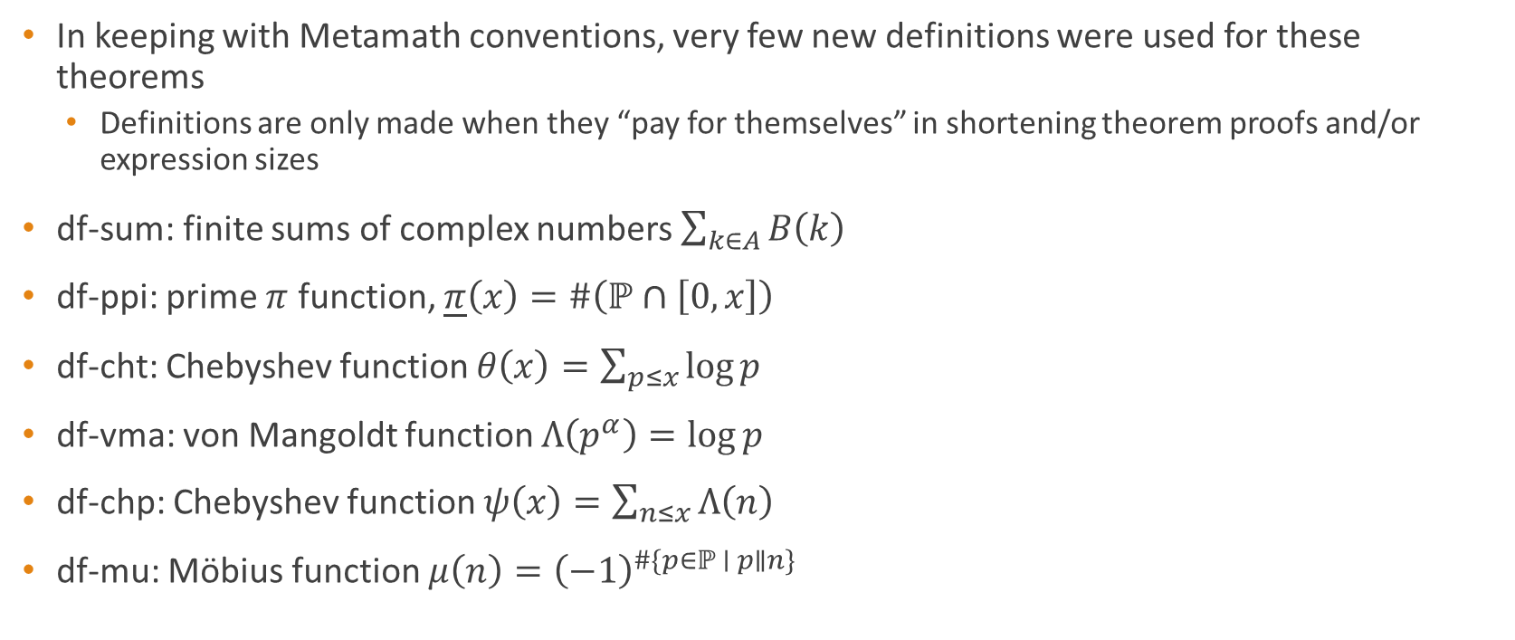
Definitions used
In keeping with Metamath conventions, very few new definitions were used for these theorems
Definitions are only made when they “pay for themselves” in shortening theorem proofs and/or expression sizes
df-sum: finite sums of complex numbers $\sum_{k∈A}{B\left(k\right)}$
df-ppi: prime $π$ function, $\underline{π}\left(x\right)=\#\left(ℙ∩\left[0,x\right]\right)$
df-cht: Chebyshev function $θ\left(x\right)=\sum_{p≤x}{\log{p}}$
df-vma: von Mangoldt function $Λ\left(p^{α}\right)=\log{p}$
df-chp: Chebyshev function $ψ\left(x\right)=\sum_{n≤x}{Λ\left(n\right)}$
df-mu: Möbius function $μ\left(n\right)={\left(−1\right)}^{\#\{p∈ℙ ∣ p∥n\} }$

Slide 9
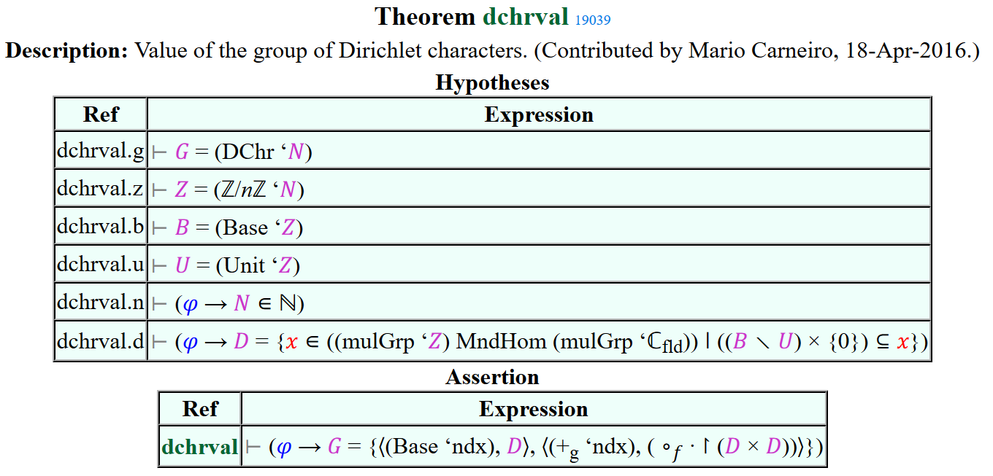

Definitions used
In keeping with Metamath conventions, very few new definitions were used for these theorems
Definitions are only made when they “pay for themselves” in shortening theorem proofs and/or expression sizes
df-dchr: Group of Dirichlet characters
df-o1: Set of eventually bounded functions $f\left(x\right)=O\left(1\right)$
df-lo1: Set of eventually upper bounded functions $f\left(x\right)≤O\left(1\right)$

Slide 10
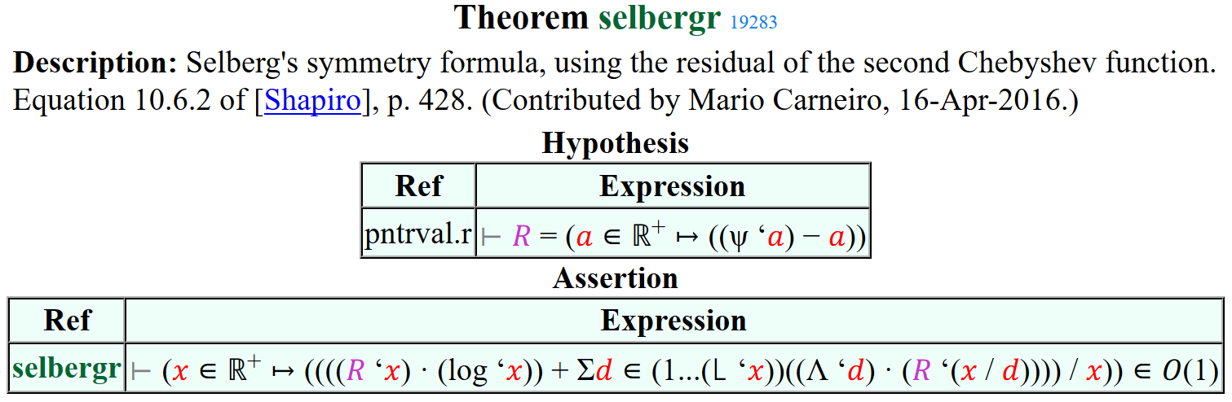
Definitions used
A trick: Temporary definitions

Slide 11
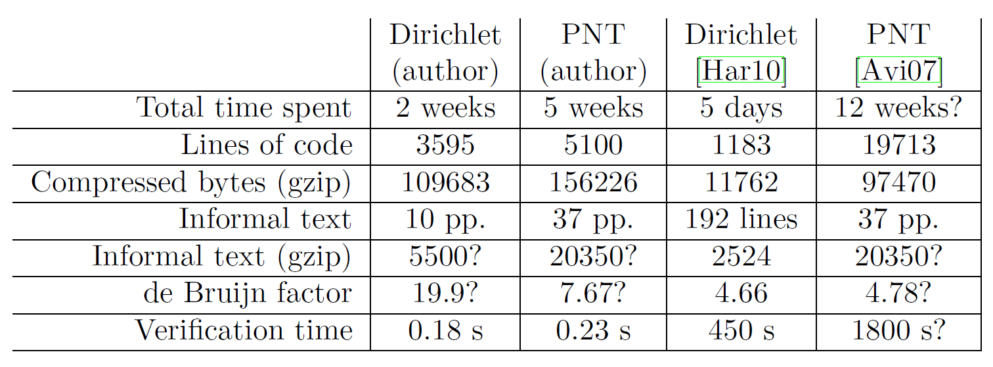
Statistics & Comparison
Dirichlet: 55 theorems, PNT: 83 theorems
Dirichlet: 8992 proof steps, PNT: 35549 proof steps
Both proofs were done over a seven week period
de Bruijn factors 19.9, 7.67 are higher than usual
proofs not proof scripts
Verification is thousands of times faster
New verifier smm3 can verify set.mm in 0.54 s

Slide 12
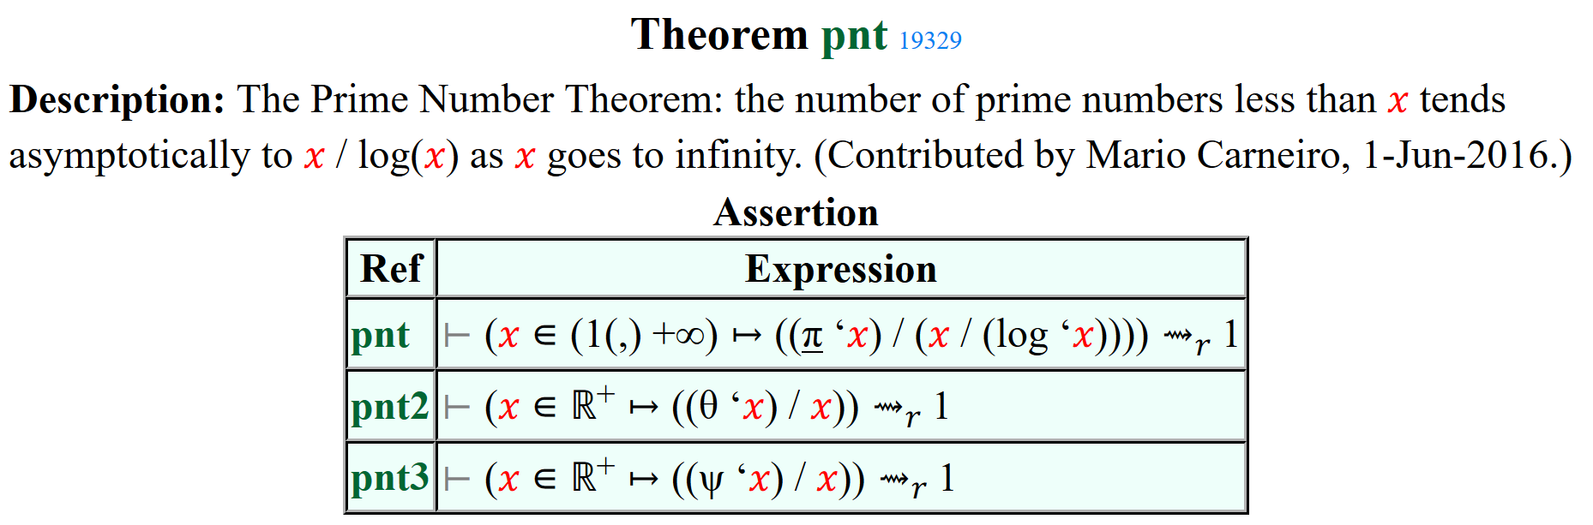
Highlights

Slide 13
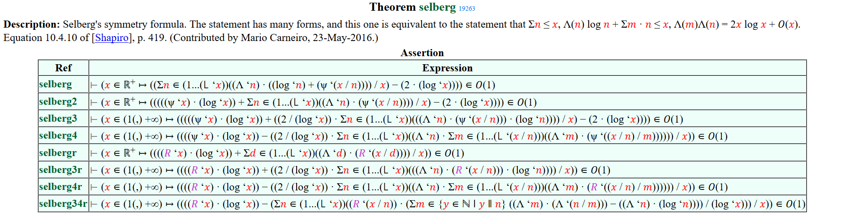
Highlights

Slide 14
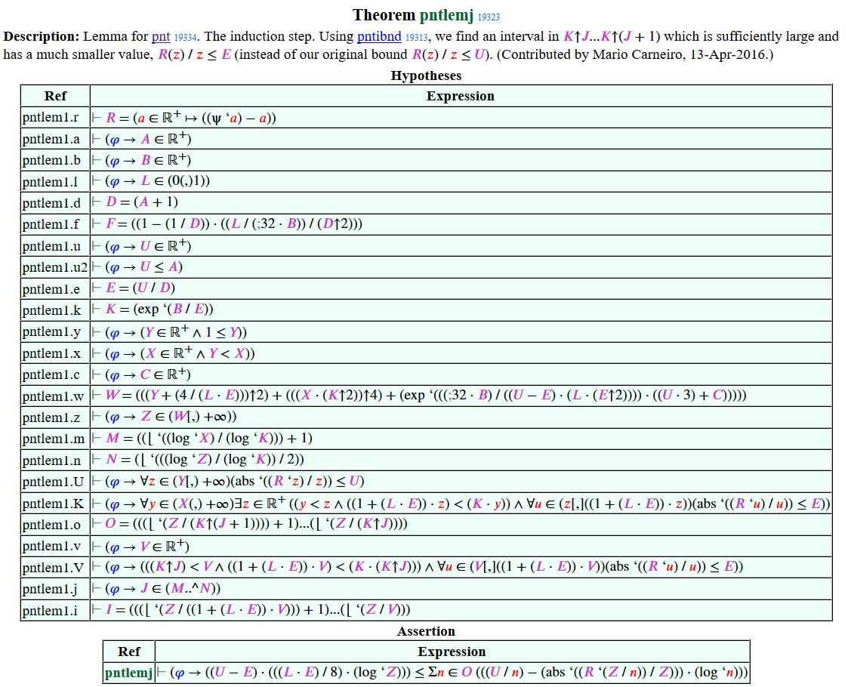
Highlights

Slide 15
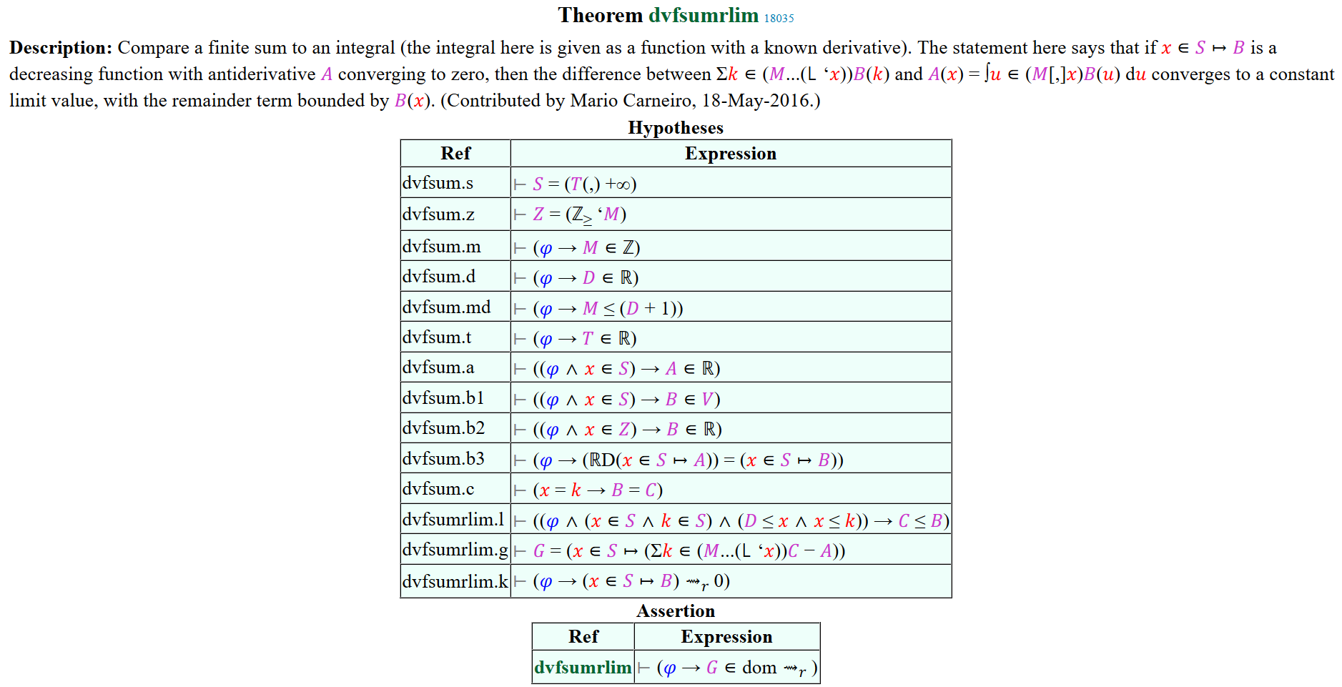
Highlights

Slide 16
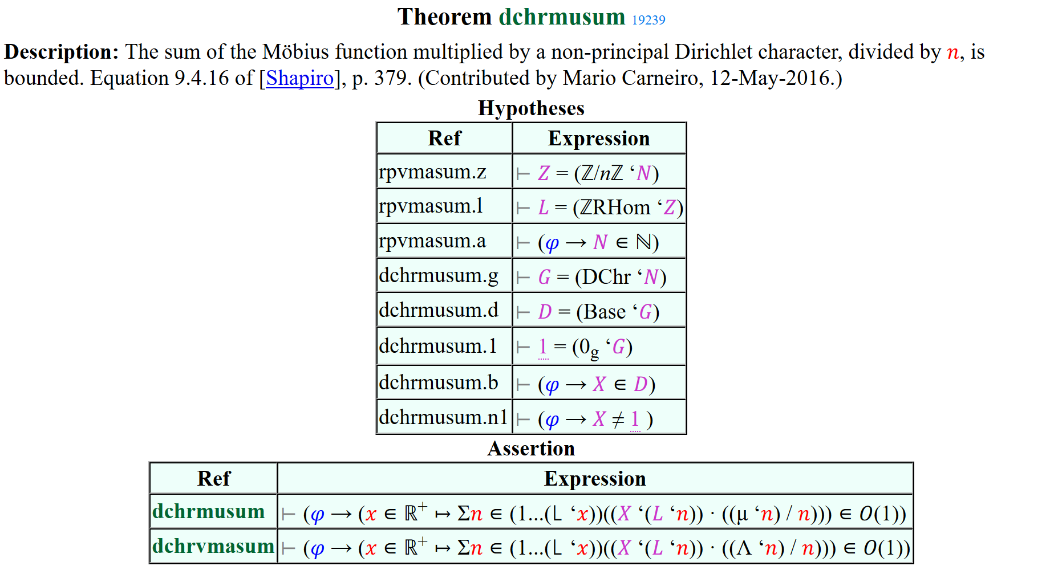
Highlights

Slide 17
Questions

