Slide 1

Arithmetic in Metamath Case Study: Bertrand’s Postulate
Mario CARNEIRO
24 July 2015

Slide 2
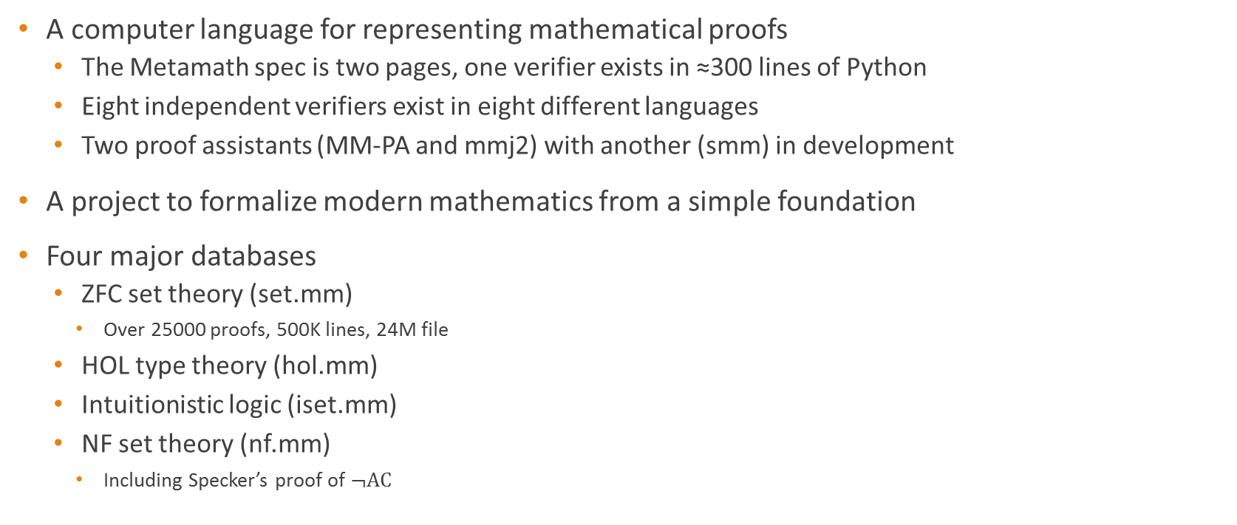
What is Metamath?
A computer language for representing mathematical proofs
The Metamath spec is two pages, one verifier exists in ≈300 lines of Python
Eight independent verifiers exist in eight different languages
Two proof assistants (MM-PA and mmj2) with another (smm) in development
A project to formalize modern mathematics from a simple foundation
Four major databases
ZFC set theory (set.mm)
Over 25000 proofs, 500K lines, 24M file
HOL type theory (hol.mm)
Intuitionistic logic (iset.mm)
NF set theory (nf.mm)
Including Specker’s proof of $¬AC$

Slide 3

Metamath 100
A project to prove the “Formalizing 100 Theorems” list tracked by Freek Wiedijk
Currently 55 theorems proven (one short of Isabelle)
New since last year: (in chronological order)
Divergence of Harmonic series
Lagrange subgroup theorem
Number of Combinations
Divisibility by 3
Lagrange four-square thm
Factor and Remainder thms
Basel problem
Divergence of inverse primes
Fundamental thm of Calculus
Mean value theorem
Fundamental thm of Algebra
Sum of angles in a triangle
Solutions to Pell’s equation
Liouville’s theorem
Sylow’s theorem
Wilson’s theorem
Erdős-Szekeres theorem
Derangements formula
Leibniz’ series for $π$
Konigsberg Bridge problem
Birthday problem
Ramsey’s theorem
Solution to a Cubic
Solution to a Quartic
GCH implies AC (Wednesday)
Ptolemy’s theorem
Law of Cosines
Quadratic reciprocity
Sums of two squares
Arithmetic/Geometric means

Slide 4
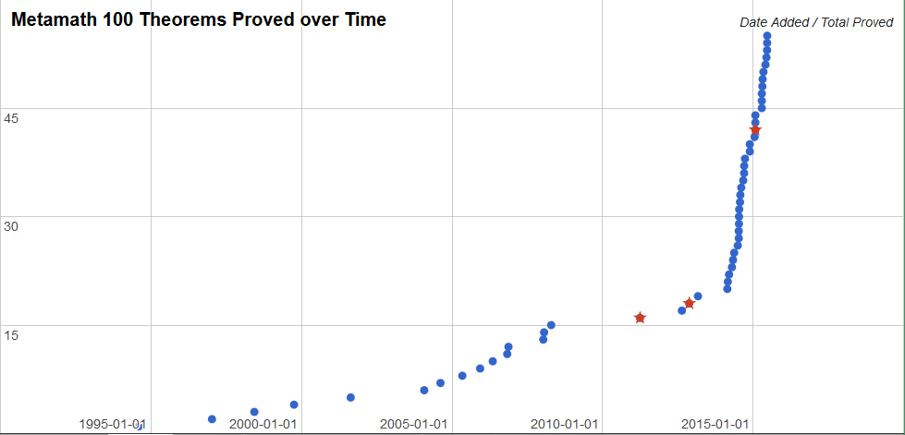
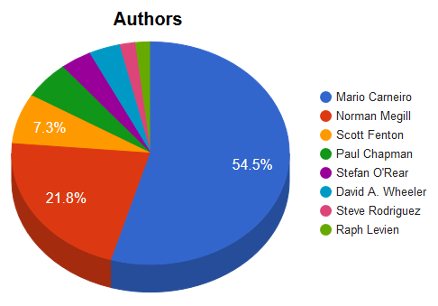
Metamath 100
Quartic Formula
Cubic Formula
Birthday Problem
Bertrand’s Postulate

Slide 5
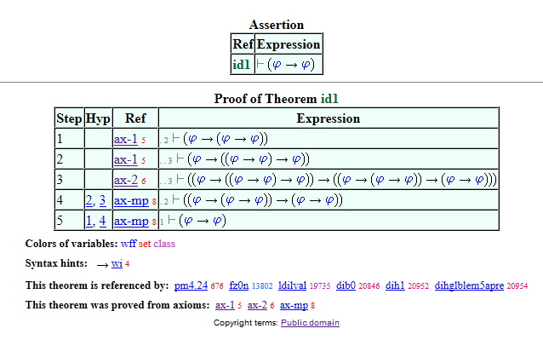
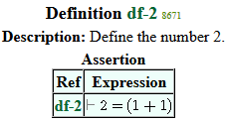
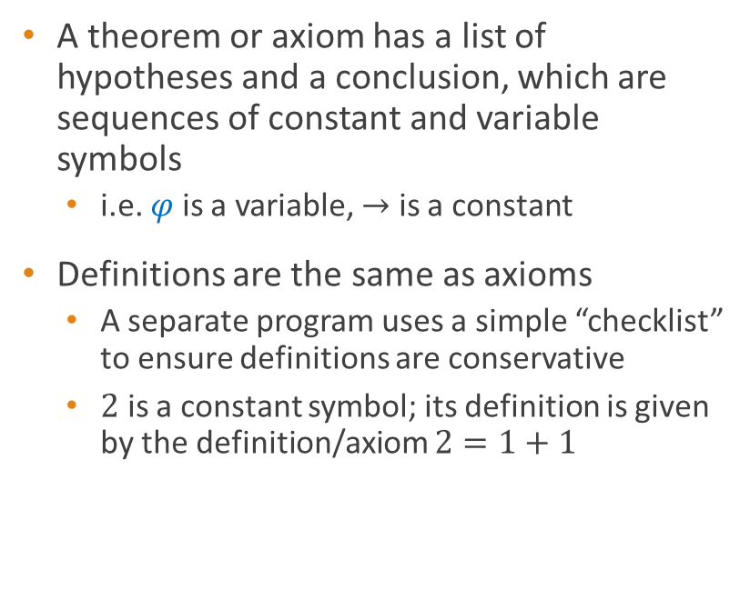
How does it work?
A theorem or axiom has a list of hypotheses and a conclusion, which are sequences of constant and variable symbols
i.e. $φ$ is a variable, $→$ is a constant
Definitions are the same as axioms
A separate program uses a simple “checklist” to ensure definitions are conservative
$2$ is a constant symbol; its definition is given by the definition/axiom $2=1+1$

Slide 6
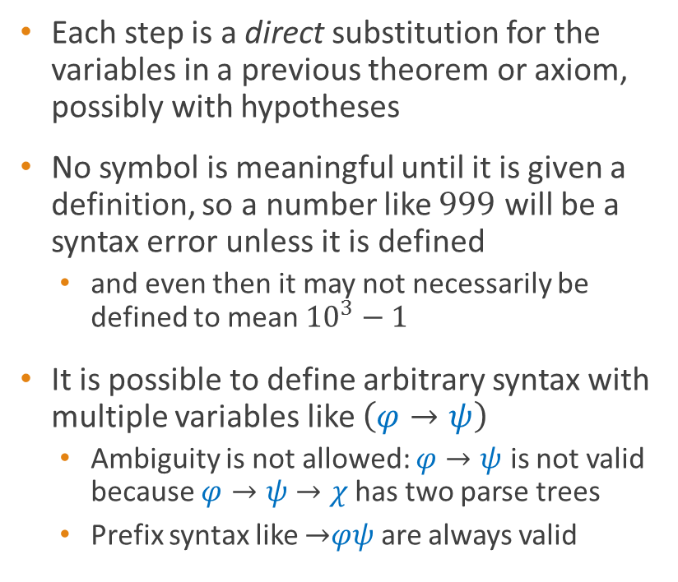
How does it work?
Each step is a direct substitution for the variables in a previous theorem or axiom, possibly with hypotheses
No symbol is meaningful until it is given a definition, so a number like $999$ will be a syntax error unless it is defined
and even then it may not necessarily be defined to mean ${10}^{3}−1$
It is possible to define arbitrary syntax with multiple variables like $\left(φ→ψ\right)$
Ambiguity is not allowed: $φ→ψ$ is not valid because $φ→ψ$ $→χ$ has two parse trees
Prefix syntax like $→$​$φψ$ are always valid

Slide 7
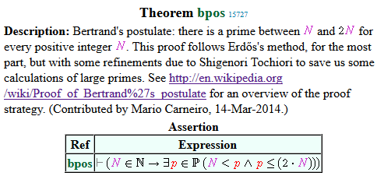
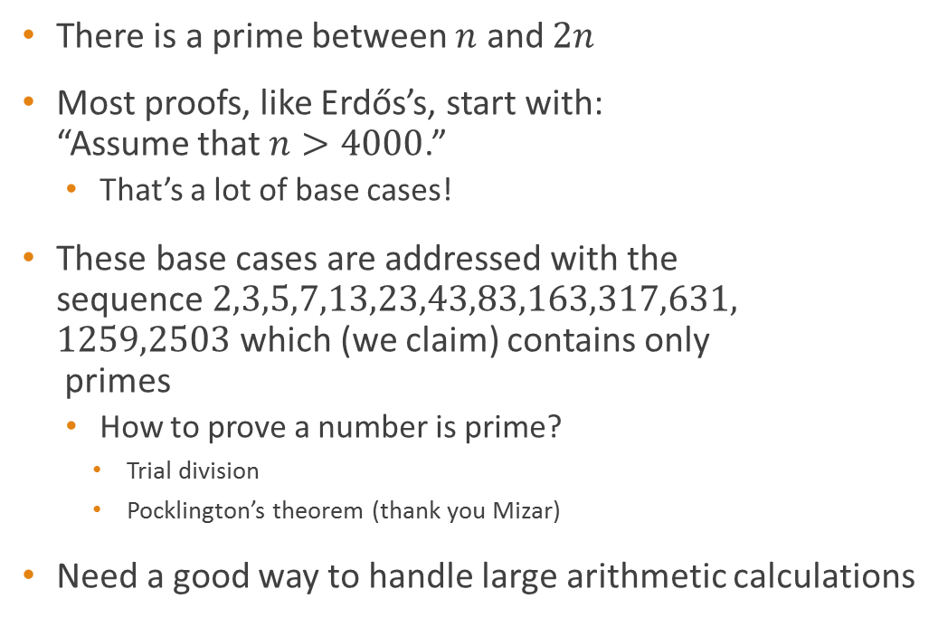
Bertrand’s Postulate
There is a prime between $n$ and $2n$
Most proofs, like Erdős’s, start with: “Assume that $n>4000$.”
That’s a lot of base cases!
These base cases are addressed with the sequence $2,3,5,7,13,23,43,83,163,317,631,$ $1259,2503$ which (we claim) contains only primes
How to prove a number is prime?
Trial division
Pocklington’s theorem (thank you Mizar)
Need a good way to handle large arithmetic calculations

Slide 8
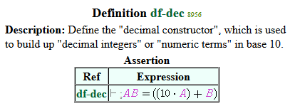

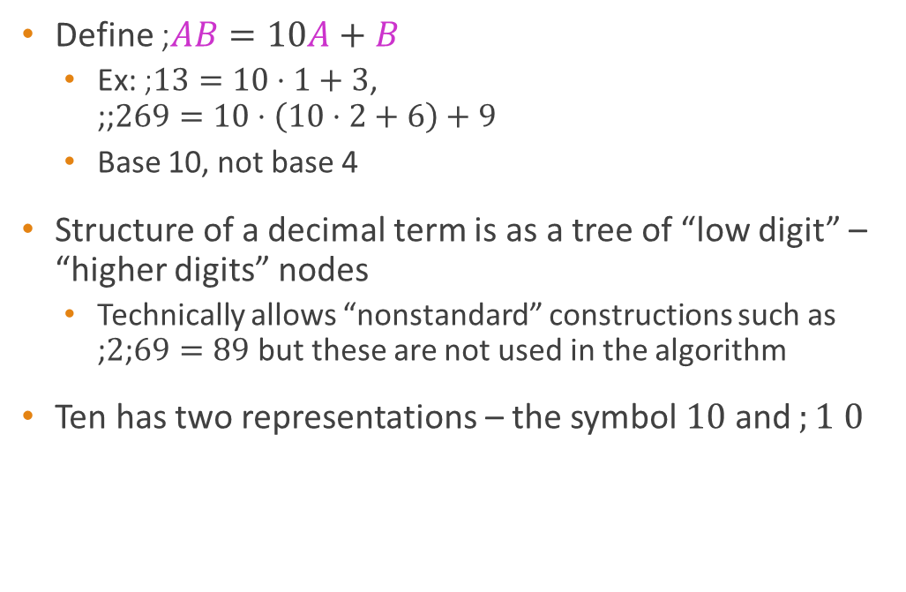
The decimal operator
Define ;$AB=10A+B$
Ex: ;$13=10⋅1+3$, ;;$269=10⋅\left(10⋅2+6\right)+9$
Base 10, not base 4
Structure of a decimal term is as a tree of “low digit” – “higher digits” nodes
Technically allows “nonstandard” constructions such as ;$2$;$69=89$ but these are not used in the algorithm
Ten has two representations – the symbol $10$ and $;1$ $0$

Slide 9
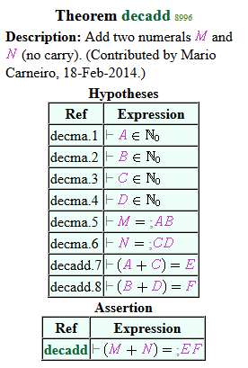
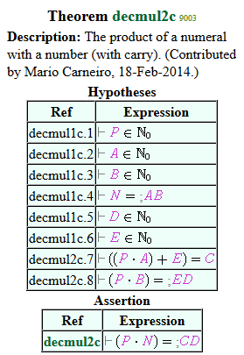

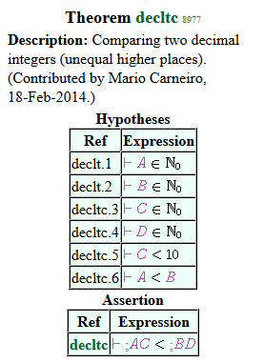

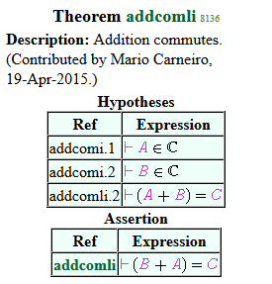
Building blocks

Slide 10
Building blocks
We can recurse over the tree (list) structure of a term
The basic algorithms for addition and multiplication can be defined recursively over the structure
Algorithms like Karatsuba require splitting the input digit string in half, which cannot be done in one step but can be done with a helper theorem in O(n) steps
Asymptotics similar to list operations in Lisp
Similar techniques can be applied to store many data structures, like graphs (see konigsberg)

Slide 11
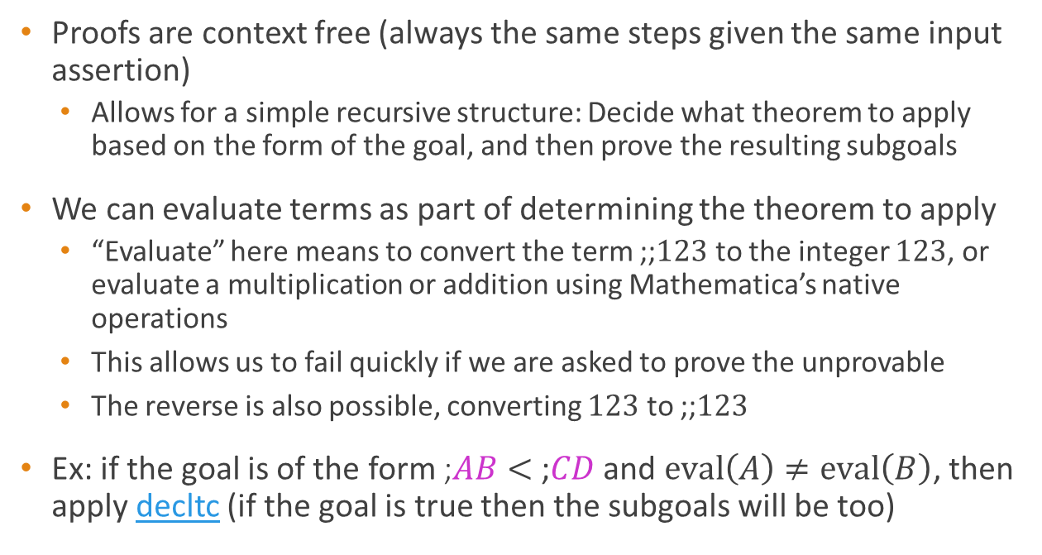
The algorithm
Proofs are context free (always the same steps given the same input assertion)
Allows for a simple recursive structure: Decide what theorem to apply based on the form of the goal, and then prove the resulting subgoals
We can evaluate terms as part of determining the theorem to apply
“Evaluate” here means to convert the term ;;$123$ to the integer $123$, or evaluate a multiplication or addition using Mathematica’s native operations
This allows us to fail quickly if we are asked to prove the unprovable
The reverse is also possible, converting $123$ to ;;$123$
Ex: if the goal is of the form ;$AB<$ ;$CD$ and $eval\left(A\right)≠eval\left(B\right)$, then apply decltc (if the goal is true then the subgoals will be too)

Slide 12
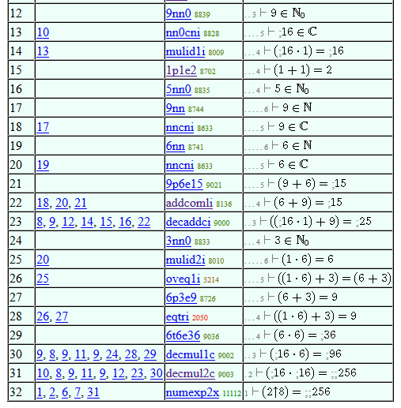
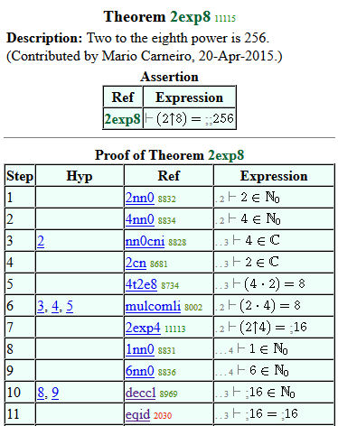
The result
2exp8 $p |- ( 2 ^ 8 ) = ; ; 2 5 6 $=
( c2 c5 cdc c6 c1 c4 c8 2nn0 4nn0 nn0cni c9 1nn0 6nn0 9nn0 cmul co nncni c3
2cn caddc 4t2e8 mulcomli 2exp4 deccl eqid mulid1i 1p1e2 5nn0 9nn 6nn 9p6e15
addcomli decaddci 3nn0 oveq1i 6p3e9 eqtri 6t6e36 decmul1c decmul2c numexp2x
mulid2i ) AABCZDCEDCZFGHIFAGFIJSUAUBUCEDVCDVDKVDEDLMUDZLMVDUEZMNEDBAVDEOPKL
MNVDVDVEJUFUGUHKDEBCKUIQDUJQZUKULUMEDKDDRVDMLMVFMUNEDOPZRTPDRTPKVHDRTDVGVBU
OUPUQURUSUTVA $.

Slide 13
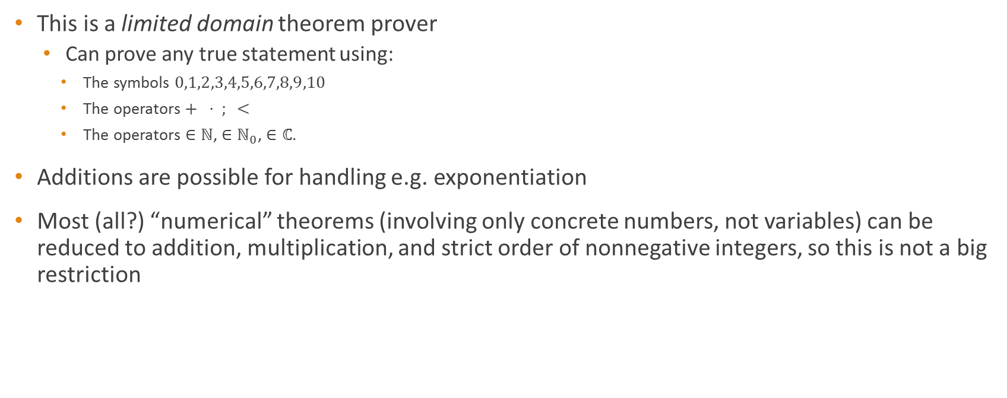
Limitations
This is a limited domain theorem prover
Can prove any true statement using:
The symbols $0,1,2,3,4,5,6,7,8,9,10$
The operators$+ ⋅ ; <$
The operators $∈ℕ$, $∈ℕ_{0}$, $∈ℂ$.
Additions are possible for handling e.g. exponentiation
Most (all?) “numerical” theorems (involving only concrete numbers, not variables) can be reduced to addition, multiplication, and strict order of nonnegative integers, so this is not a big restriction

Slide 14
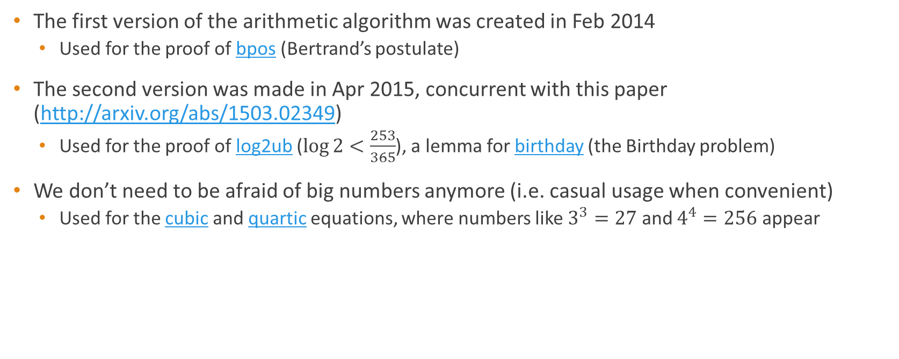
Success stories
The first version of the arithmetic algorithm was created in Feb 2014
Used for the proof of bpos (Bertrand’s postulate)
The second version was made in Apr 2015, concurrent with this paper (http://arxiv.org/abs/1503.02349)
Used for the proof of log2ub ($\log{2}<\frac{253}{365}$), a lemma for birthday (the Birthday problem)
We don’t need to be afraid of big numbers anymore (i.e. casual usage when convenient)
Used for the cubic and quartic equations, where numbers like $3^{3}=27$ and $4^{4}=256$ appear

Slide 15
Why did it take so long?
Metamath, like many formal systems, is geared toward abstract math
Most abstract math does not need numbers larger than 10
Computers are comfortable with bigger numbers than humans
Automation in Metamath is in its infancy
This is the first Metamath theorem prover which produces complete proofs
Metamath does have a step search of depth up to around 3
Much more is planned, and current work on the new smm proof assistant promises “user scripts” like HOL proof programs

Slide 16
Flyspeck
Flyspeck is Tom Hales’ recently completed project to prove the Kepler Conjecture in HOL Light and Isabelle
Is it feasible to port Flyspeck to Metamath?
Not yet
A Metamath proof verifies in linear time, but the proofs are longer
The length of a Metamath proof is proportional to the running time of a HOL Light proof
How to optimize for Metamath
No searches: you already know the answer!
Metamath proves NP-hard problems in polynomial time (cf. Luís “offline oracles”)
Spend more time making the proofs shorter
Round all numbers to the minimum needed to establish an inequality

Slide 17
Questions

