Slide 1
Rental-Car E-Commerce
Documentation:
Objective:
The goal of this project was to integrate an external API into the Rental-Car E-Commerce website, ensuring that car data from the external API is fetched and displayed in the frontend using Sanity.io as the backend.

Slide 2
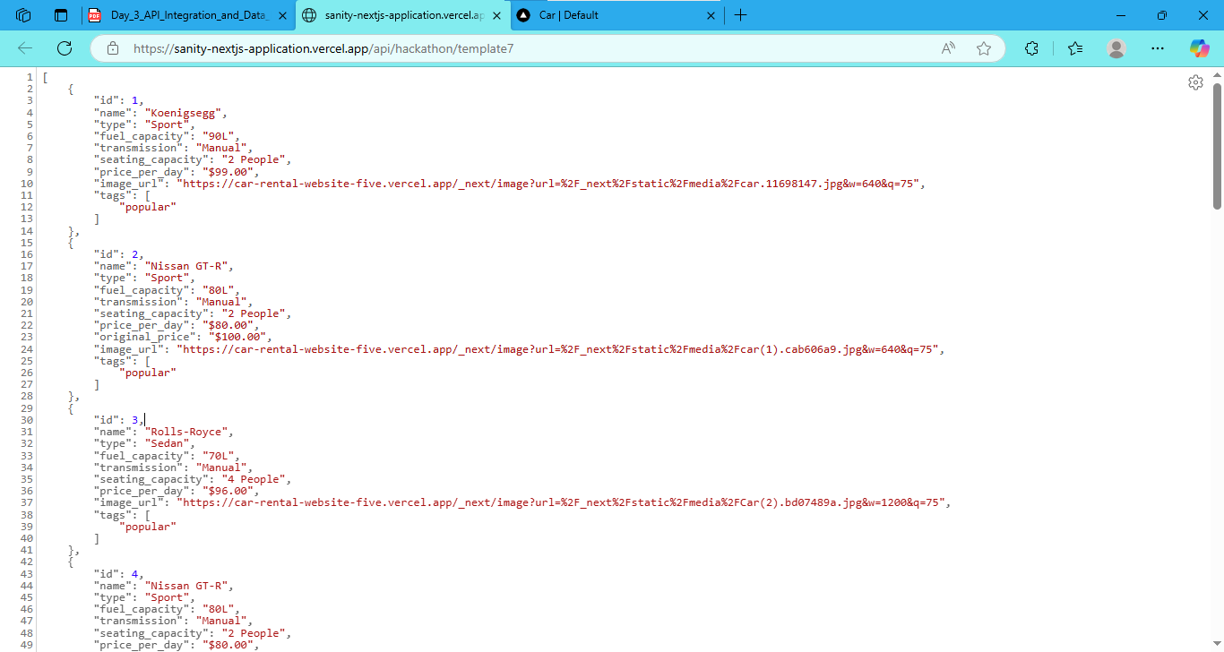
Step 1: API Integration process
External API Setup:
Initially, I used an external car API to collect car-related data such as name, brand, fuel capacity, transmission, seating capacity, price per day, tags, and image URLs as shown below in the picture.

Slide 3
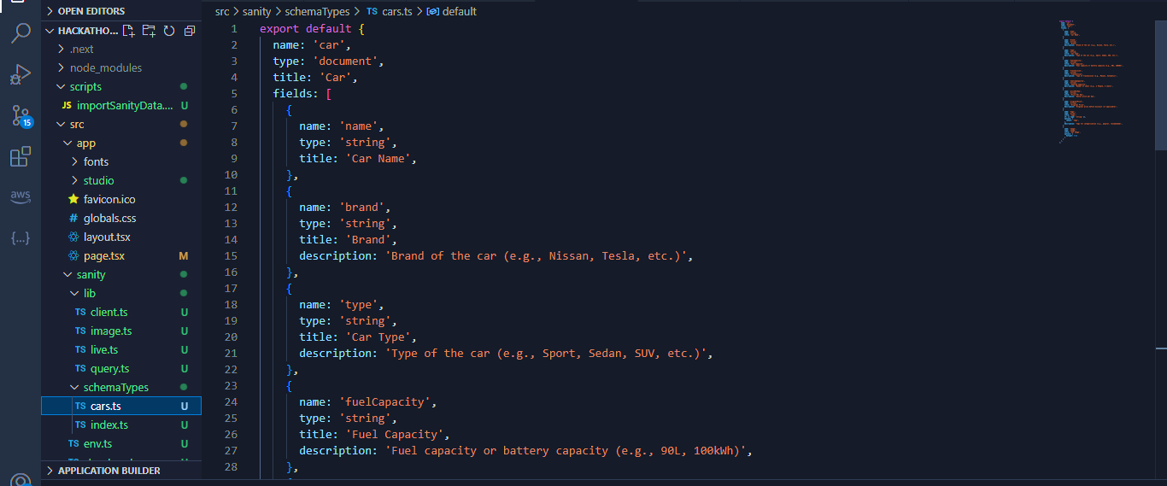
Data Injection into Sanity:
1) Create Schema: I created a schema in Sanity Studio to define the structure of the car data, such as name, brand, fuel capacity, transmission, seating capacity, price per day, tags, and image URLs.

Slide 4
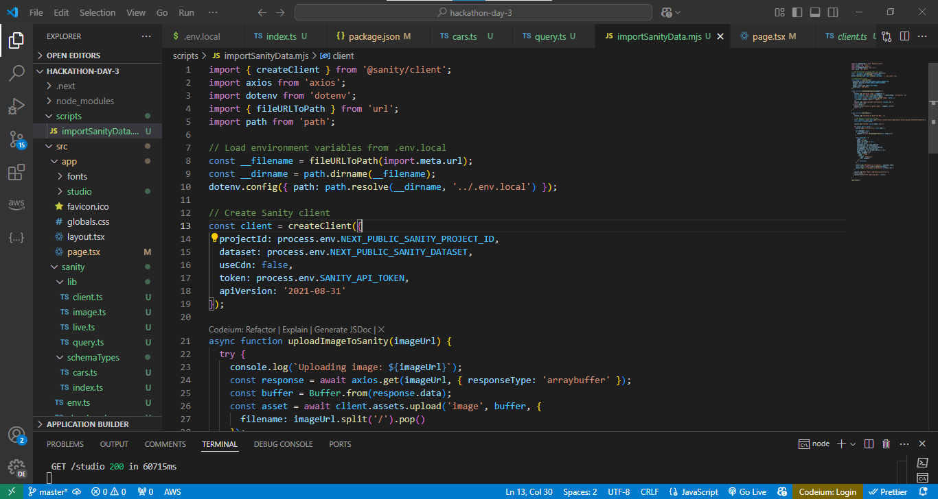
Create a Script Folder:
2) Inside the project, I created a folder named scripts to organize the data injection process.
3) Create Data Import File:In the scripts folder, I created a file (e.g., import Data.ts) to write the script for importing the external car data into Sanity.
4) Write the Code :In the import Data.ts file, I used an HTTP client (e.g., Axios) to fetch the car data from the external API. Then, I used the Sanity client to insert the fetched data into the corresponding Sanity schema fields.

Slide 5
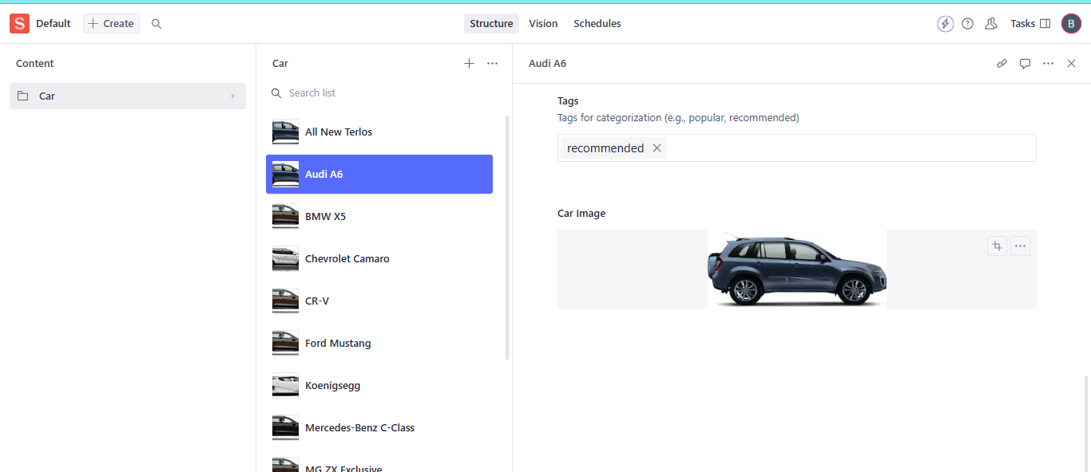
5. Run the Import Command: Finally, I run the npm run import data command to trigger the import process and inject the data into Sanity.

Slide 6
Step:2
Data Fetching into Frontend:
To get the car data from Sanity and show it on the frontened, I created a file called query.ts inside the lib folder. In this file, I used the Sanity client to fetch the car data by writing a query. Using the client.fetch() method, I pulled the data from Sanity and made it available on the homepage. The data is then displayed as car cards on the homepage, showing information like the car's name, brand, fuel capacity, transmission, and more as shown in the picture below.

Slide 7
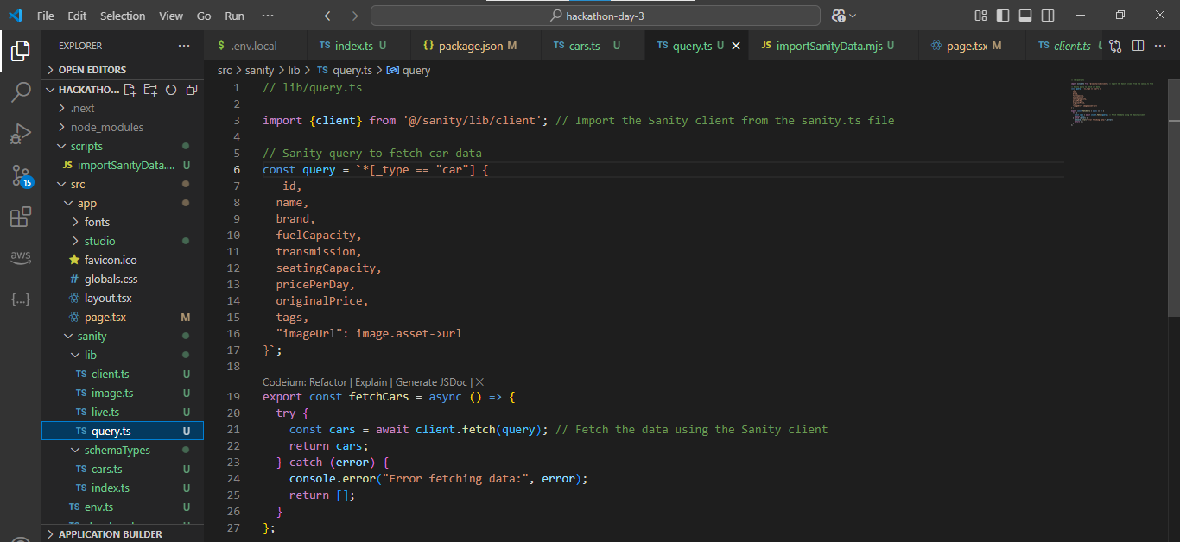
query.ts file

Slide 8
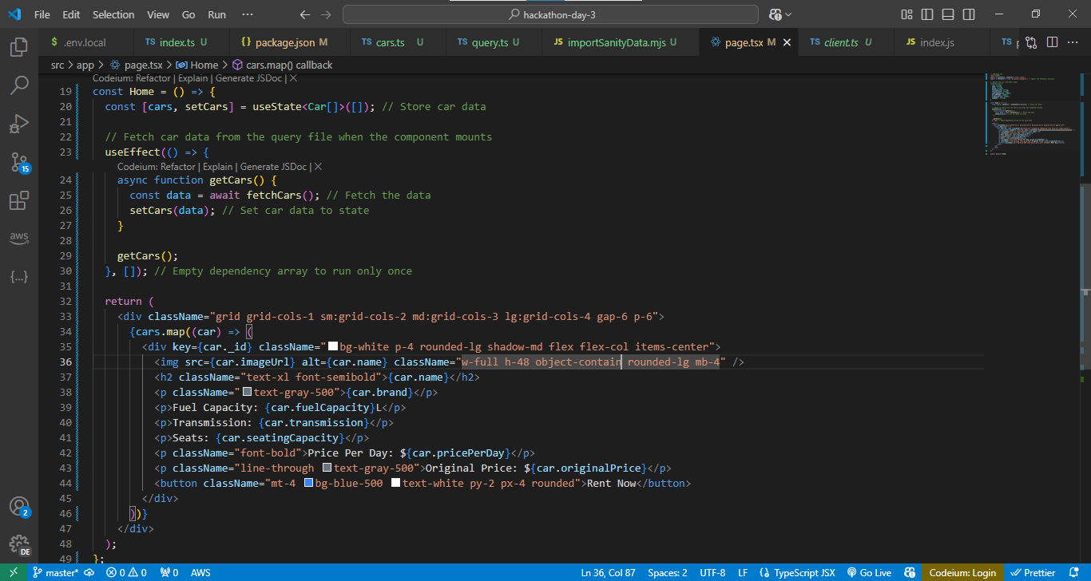
Fetching data to homepage.

Slide 9
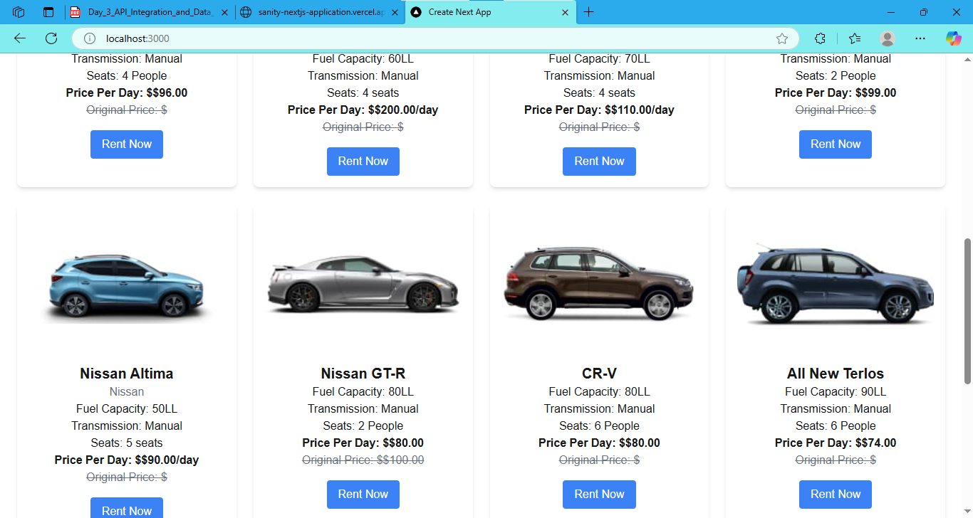
FINALLY DATA FETCH IN TO FRONTENED!
prepared by: Bisma Naeem Giaic student

