Slide 1


Fraudulent Transaction:
Detection & Prevention

Slide 2
Department of Computer Sciences
GOVT. ISLAMIA COLLEGE FOR WOMEN COOPER ROAD LAHORE
Affiliated with Lahore College for Women University
Presenters
2121110019 Bismah Rehman
2121110022 Eman Masood
2121110030 Hira Riaz
2121110043 Laiba Sheikh
Supervisor: Ms. Nadia

Slide 3
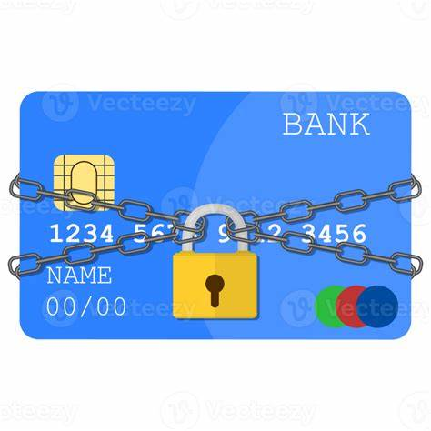
Introduction-Fraudulent Transaction
Every day, millions of people use credit cards for payments, but fraudsters are also finding new ways to steal money.
Credit card fraud leads to huge financial losses for banks and users.
Traditional fraud detection systems rely on fixed rules, which often fail to detect new fraud techniques.
This project aims to use machine learning to make fraud detection smarter, faster, and more accurate.

Slide 4
Problem Statement
Credit card fraud is increasing as online transactions become more common.
Existing fraud detection methods aren’t efficient in detecting new types of fraud.
There’s a need for a system that can automatically learn from fraud patterns and detect fraud in real time.
Need for real-time, accurate, and efficient fraud detection systems.
How can machine learning help detect fraud more effectively?

Slide 5
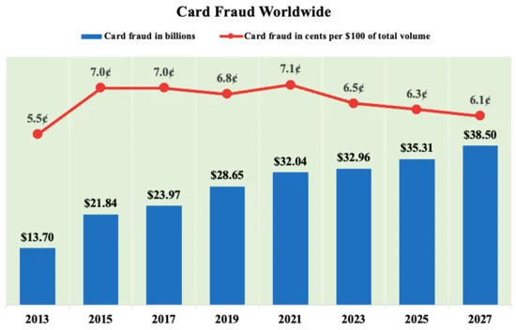

Slide 6
Objectives
Develop a machine learning-based fraud detection system.
Improve accuracy and reduce false positives/negatives.
Use multiple datasets for better fraud detection.
Compare different ML algorithms and select the best-performing model.
Reduce false alarms, so legitimate transactions are not blocked.

Slide 7
Literature Review
Traditional Methods:
Rule-based systems (predefined conditions).
Signature-based methods (fixed fraud patterns).
Modern Approaches:
Machine learning models trained on past fraud patterns.
Deep learning for more advanced detection.
Can analyze patterns and detect suspicious transactions automatically.
Key Findings
AI-based fraud detection is more accurate and efficient than traditional methods.
Feature | Traditional Methods | Machine Learning
Fixed Rules | ✅ | ❌
Learns from Data | ❌ | ✅
Real-time Detection | ❌ | ✅

Slide 8
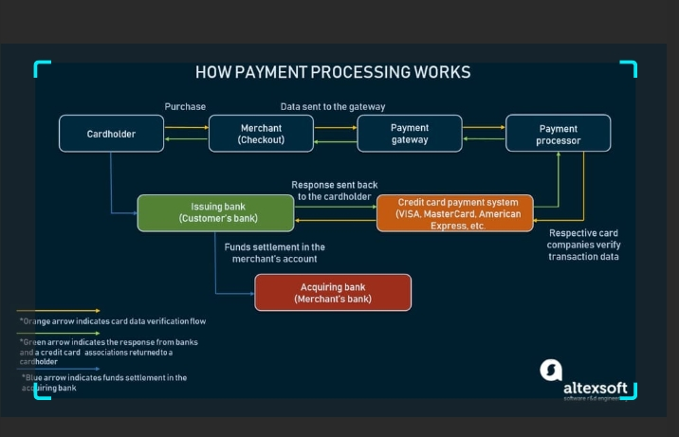
How system work

Slide 9
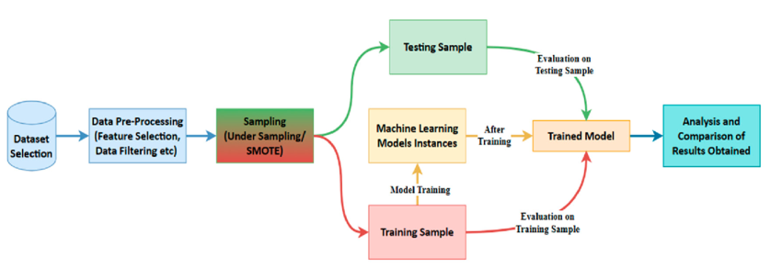
Methodology

Slide 10
Dataset Used:
Kaggle's Credit Card Fraud Detection Dataset (https://www.kaggle.com/code/youssefelbadry10/credit-card-fraud-detection/input).
We used a publicly available dataset from Kaggle with real credit card transactions.
The dataset is highly imbalanced (only a few fraud cases among thousands of normal transactions).

Slide 11
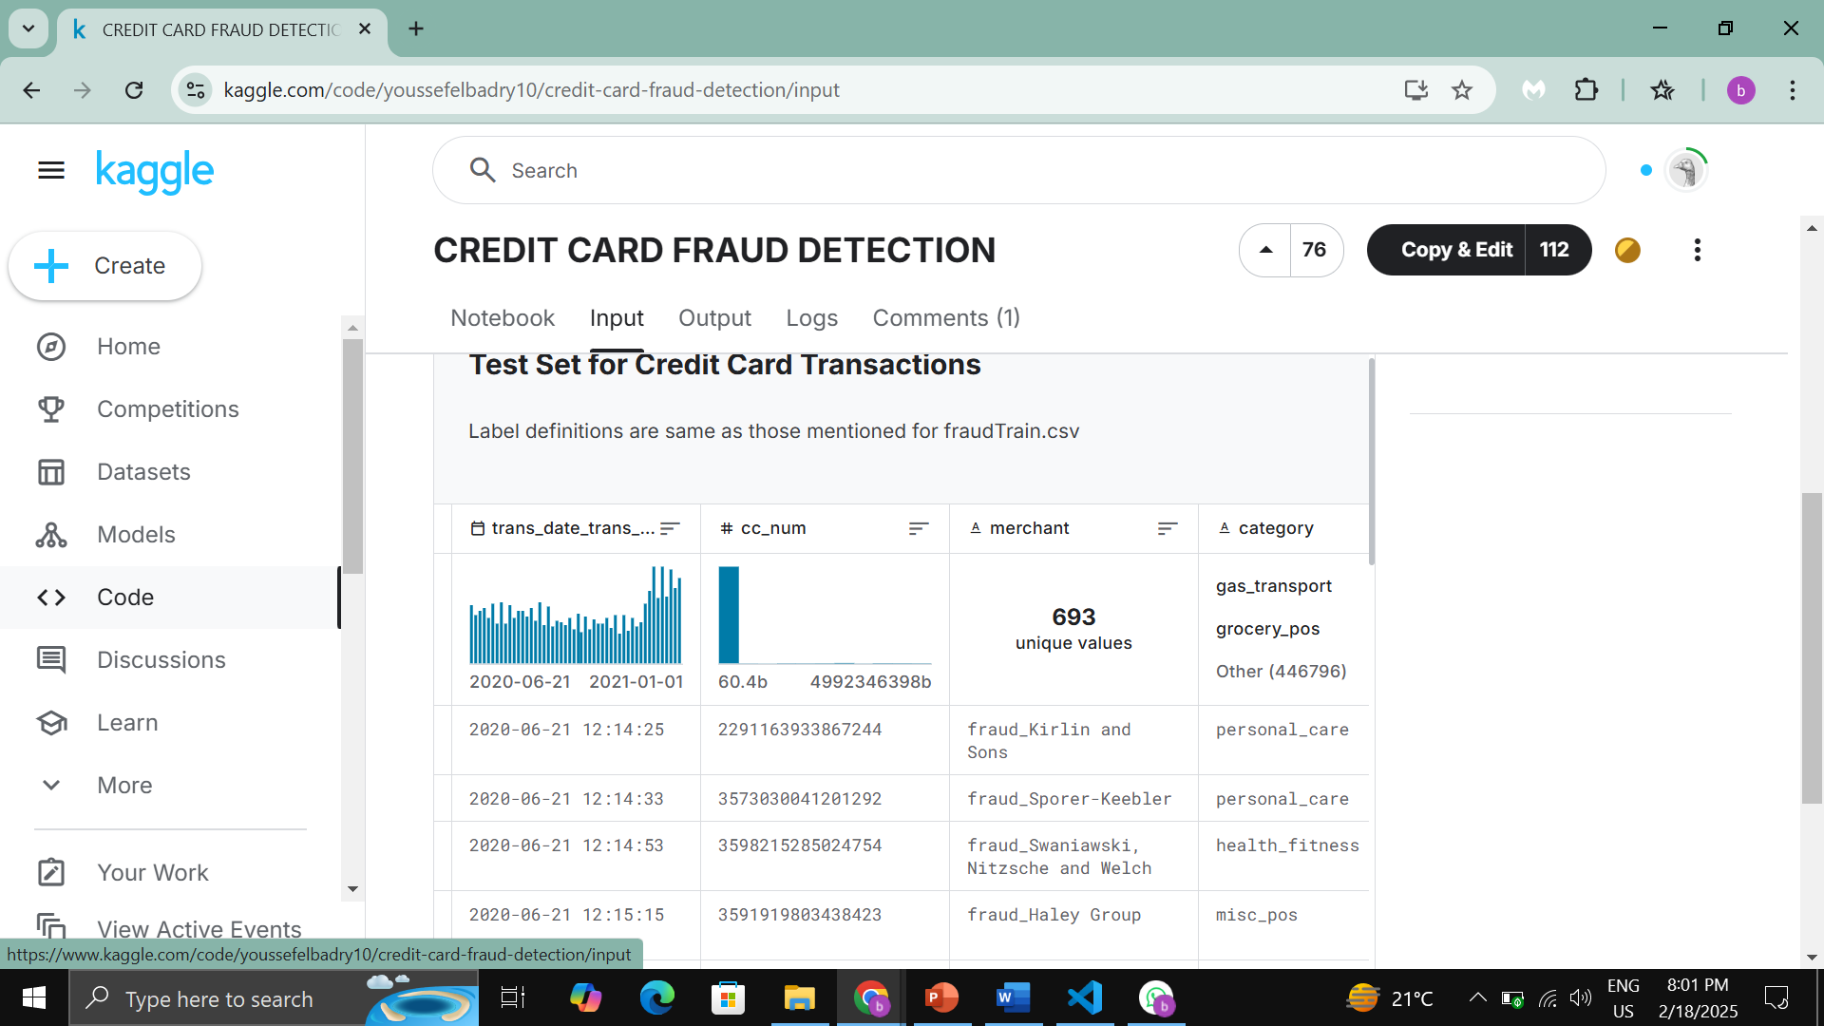

Slide 12
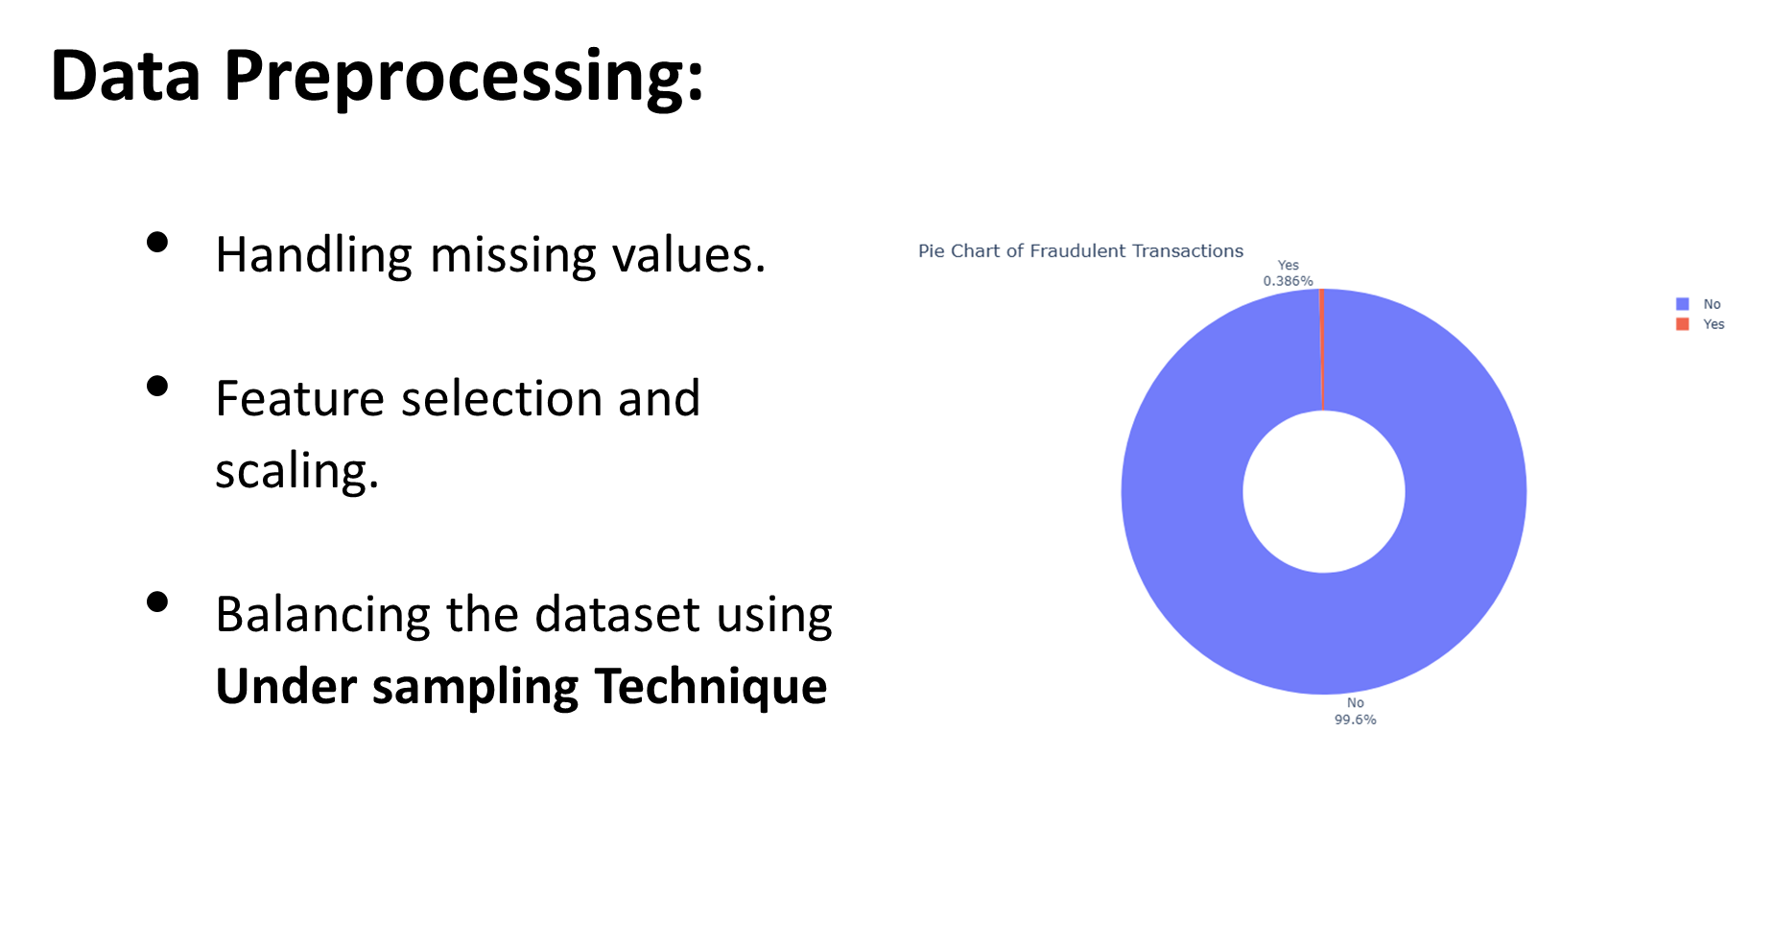

Slide 13
Algorithms Used:
Decision Tree
Logistic Regression
XG Boost
01
02
07
02
Algorithm
03
06
03
Gradient Boosting
06
Neural Networks
04
05
04
05
Support Vector Machine
Isolation Forest

Slide 14
Implementation
Tools & Technologies Used
Programming language: Python
Libraries: Pandas, Sklearn, Seaborn, Matplotlib
Data Processing: Google Colab Notebook
Steps in Implementation:
Data collection & cleaning.
Feature selection & engineering.
Training ML models.
Model evaluation using performance metrics.
Deploying as an API or web app.

Slide 15
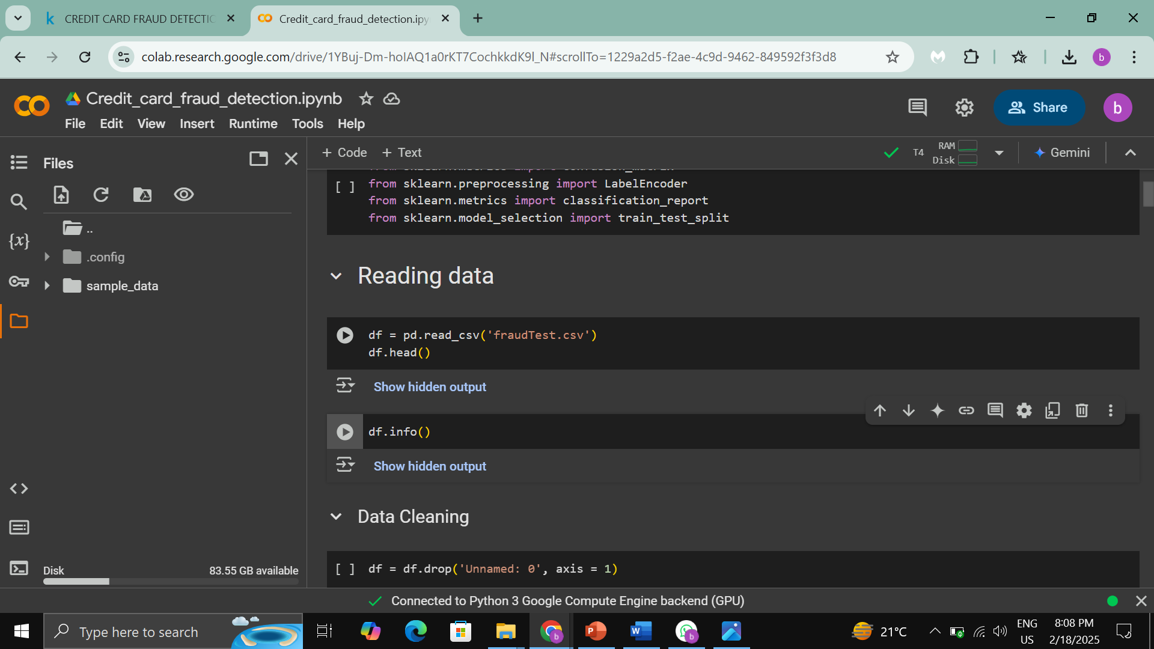

Slide 16
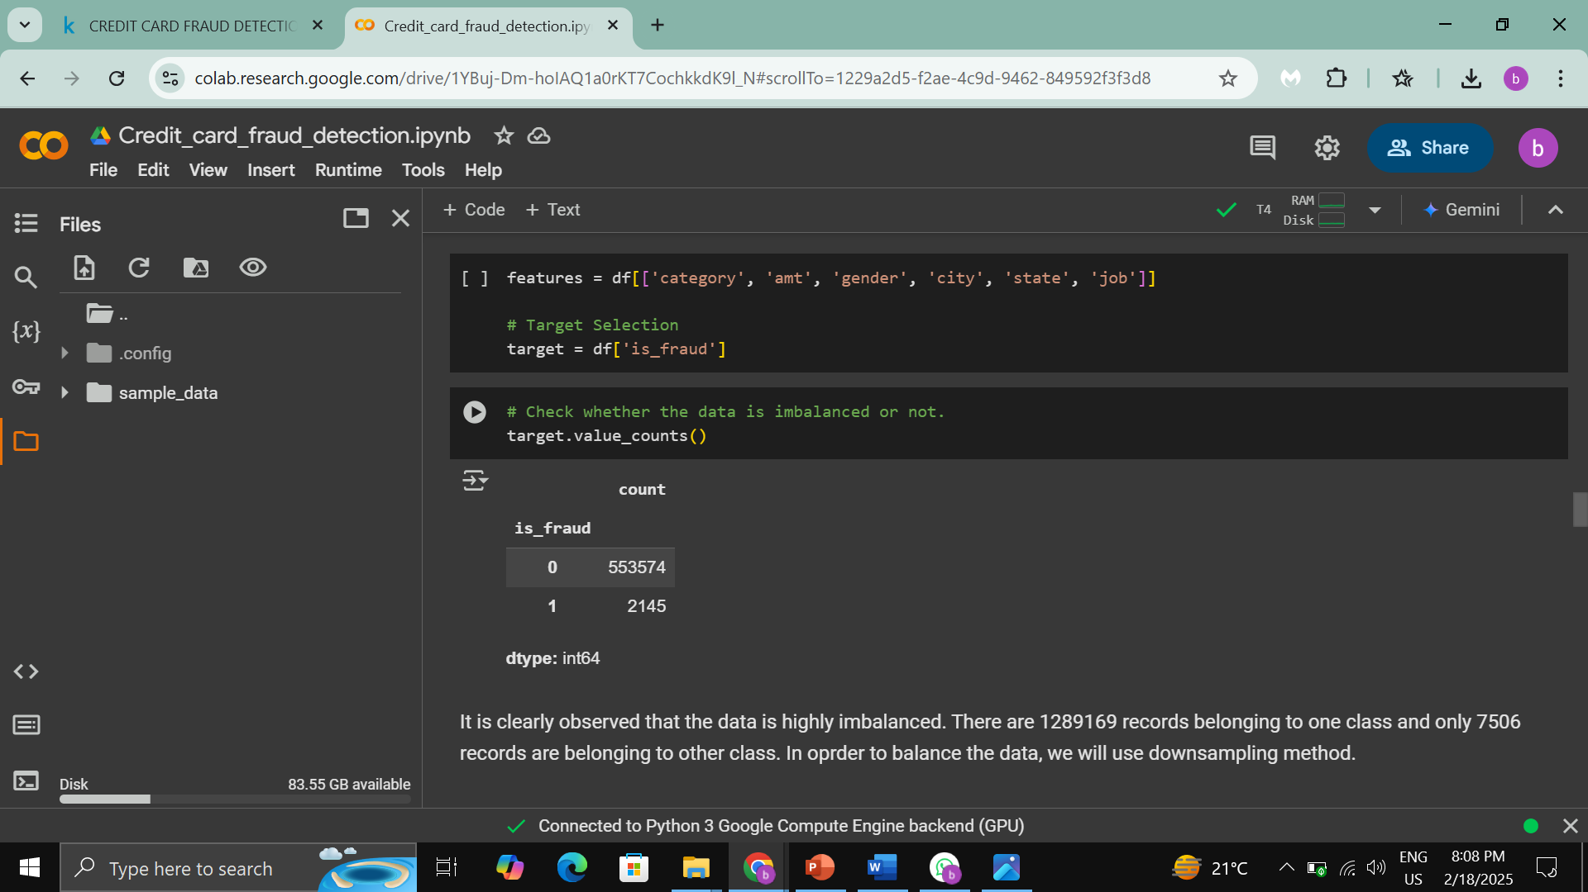

Slide 17
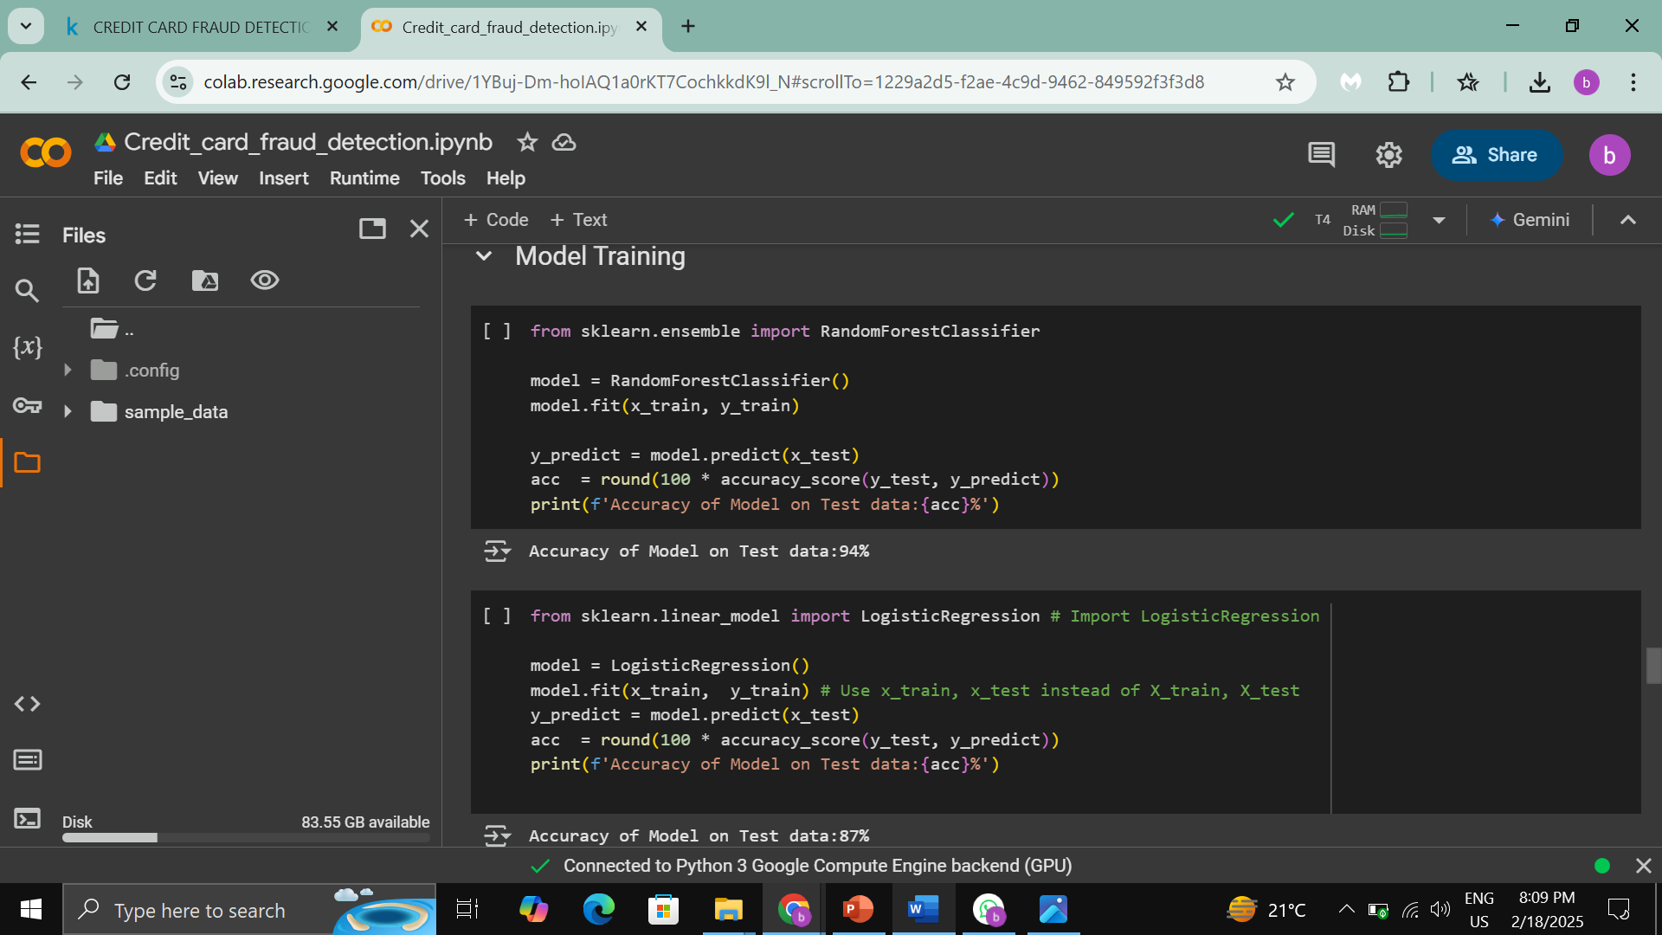
Model Training & Evaluation

Slide 18
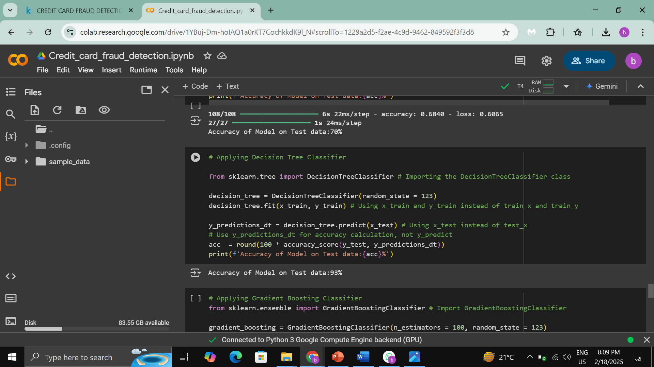

Slide 19
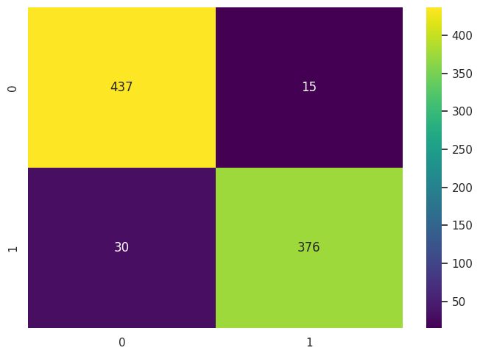
Performance Metrics Used:
Accuracy: Measures overall correctness.
Precision & Recall: Balance between fraud detection and false alarms.
F1-score: Harmonic mean of precision & recall.

Slide 20
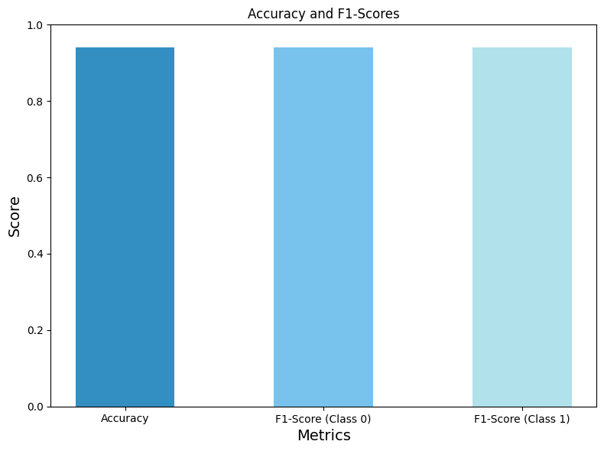
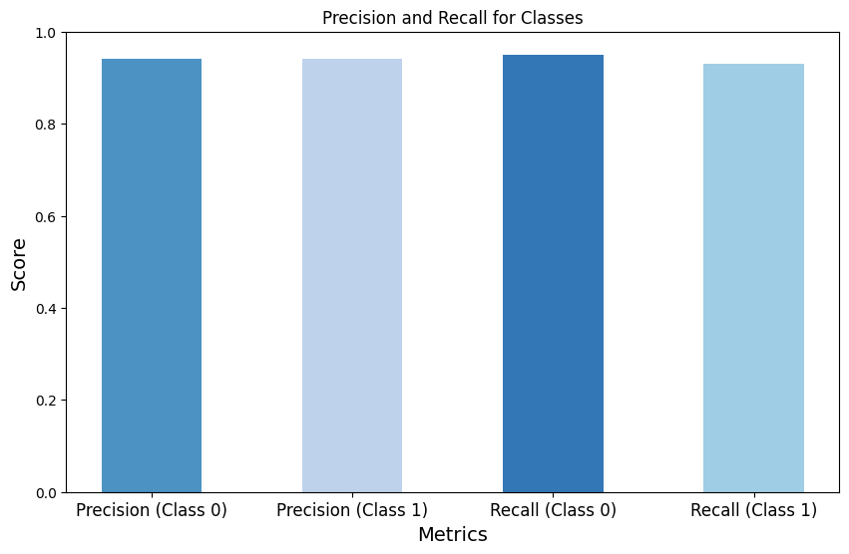

Slide 21
Results & Findings
Machine learning improves fraud detection accuracy.
Random Forest performed best.
Handling imbalanced data improved detection.
This system can help banks detect fraud in real time and prevent financial losses.

Slide 22
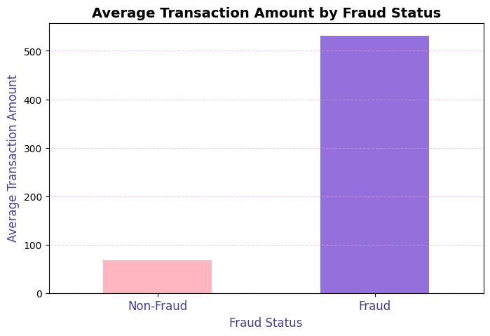

Slide 23
Challenges & Limitations
Fraud cases are rare → difficult to train the model properly.
Computational power → complex models like Neural Networks take more time to process.
False Positives → Some real transactions may be flagged as fraud.
Real-time detection → Needs further optimization

Slide 24
Future Work
Improve the system with Deep Learning.
Make fraud detection real-time.
Integrate behavioral analysis to detect fraud based on user habits.
Deploy as a web or mobile app for banks and customers.

Slide 25
Conclusion
Credit card fraud is a growing issue, and traditional methods are not effective.
Machine Learning can significantly improve fraud detection and reduce false alarms.
The best-performing models were Neural Networks and Random Forest.
In the future, this system can be used in real-time banking applications to stop fraud before it happens.

Slide 26
