Slide 1

ML-DRIVEN STOCK PRICE PREDICTION AND MARKET INSIGHTS
Submitted in partial fulfilment of the
Requirements of the degree
Of
Bachelor of technology
In
Computer Science & Engineering
By:
Binal Singh(26/CSE1/2020)
Bismanpal Singh Anand(27/CSE1/2020)
Chanpreet Singh(29/CSE1/2020)
Jagjot Singh Chandel(57/CSE1/2020)
Under the guidance of:
Mrs. Jasleen Kaur
Department of Computer Science & Engineering
Guru Tegh Bahadur Institute of Technology
Guru Gobind Singh Indraprastha University
Dwarka, New Delhi
Year 2020-2024
1

Slide 2
1
Objective
﻿Table Of Contents
2
Introduction
3
Methodology
4
LSTM Algorithm
5
Output
6
References
7
Conclusion
2

Slide 3

Objective
Project Objectives: Developing a Stock Prediction Model with Enhanced User Experience
This project has multiple objectives. First, we aim to create a reliable and effective stock prediction model through the LSTM algorithm. This requires preprocessing historical stock data, training the LSTM model, and deploying it to offer real-time prediction.
3

Slide 4
Introduction
This project combines machine learning (ML) and web development technologies to create a platform for end-to-end stock prediction. The Long Short-Term Memory (LSTM) algorithm is used to train the ML model on historical stock data, providing real-time and reliable stock forecasts. A chatbot is also integrated into the application, acting as a virtual assistant to provide real-time insights and facilitate user engagement. This project aims to showcase the synergy of advanced ML techniques in the realm of stock prediction.
4

Slide 5
Methodology-1
LSTM Alogrithm
To train the LSTM model for stock price prediction, pre-processed historical stock data is used. The model's ability to learn and remember patterns over extended sequences of data is crucial. The training process involves exposing the model to historical stock prices, optimizing its internal parameters over time through backpropagation and gradient descent algorithms. Careful attention is given to hyperparameter tuning and validation strategies to refine the model's predictions.
5

Slide 6
Methodology-2
User Interface
The interface is designed for clarity, responsiveness, and interactivity. Streamlit, a Python library, adds an interactive layer to the application, allowing users to explore historical trends, manipulate parameters, and visualize model outputs in real-time.
6

Slide 7
LSTM Algorithm
LSTM, or Long Short-Term Memory, is a specialized type of recurrent neural network (RNN) designed for processing sequential data like stock prices. Its key advantage lies in addressing the challenge of learning long-term dependencies.
Key Features:
Forget Gate: Discards irrelevant past information.
Input Gate: Updates the cell state with new relevant information.
Cell State: Stores long-term dependencies.
Output Gate: Produces the final output based on the relevant information.
Benefits:
Long-Term Dependencies: Effectively captures relationships in data over extended sequences.
Context Preservation: Maintains memory of past information crucial for accurate predictions.
Suitability for Time Series: Particularly effective for time-dependent tasks like stock price prediction.
7

Slide 8
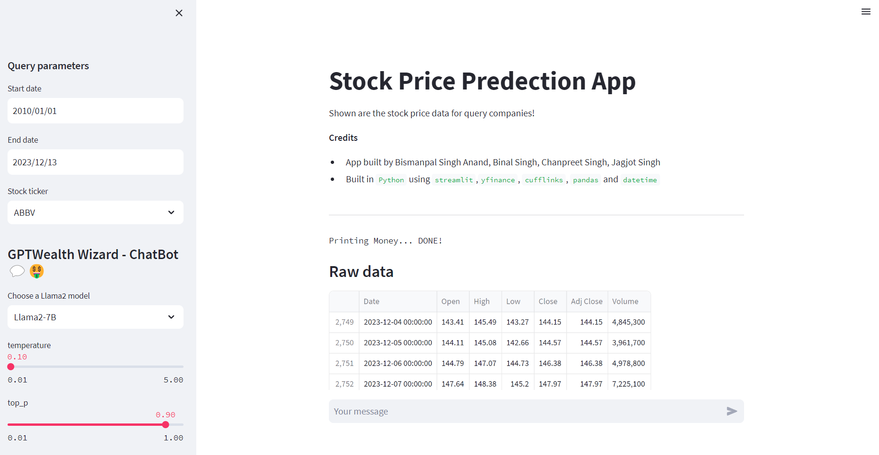
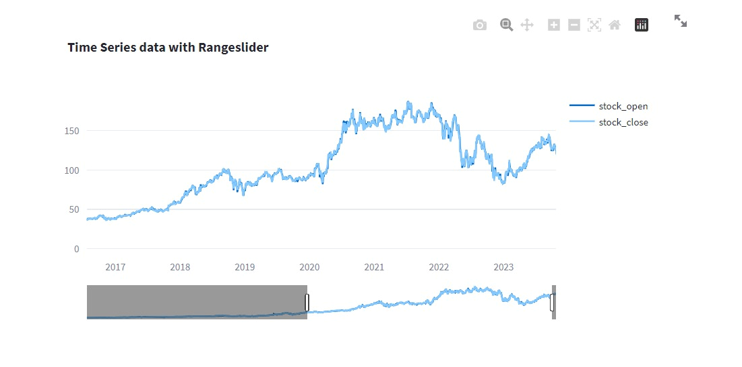
Output
8

Slide 9
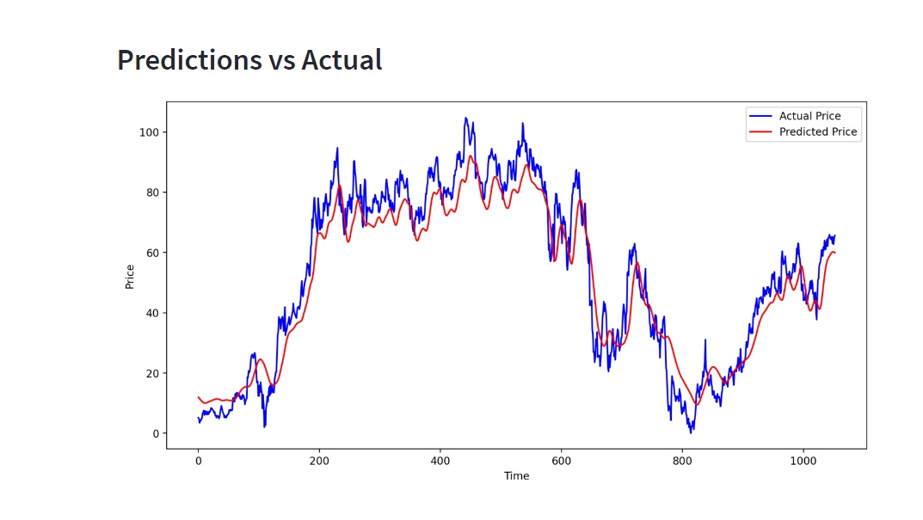
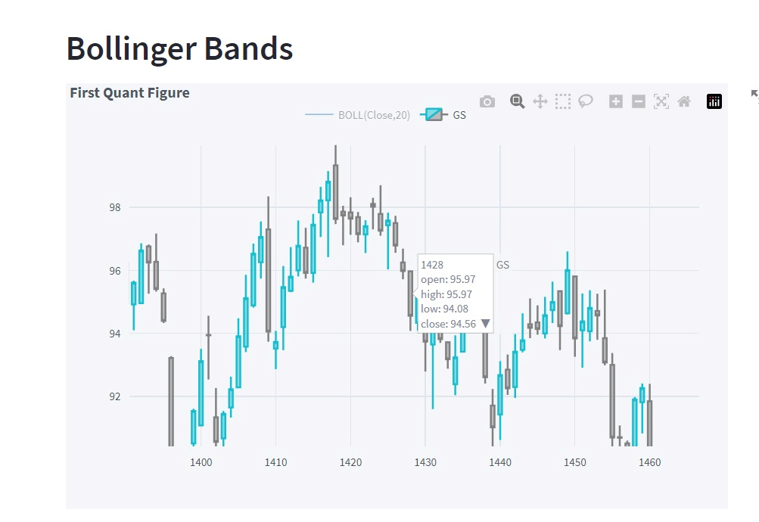
Output
9

Slide 10
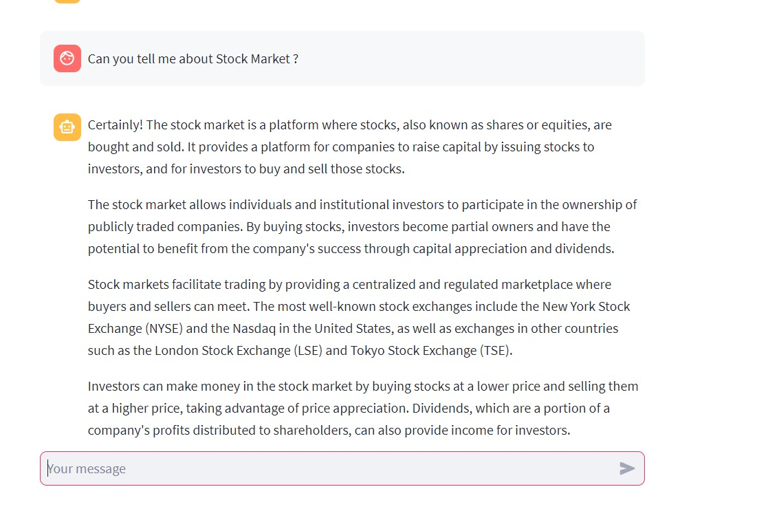
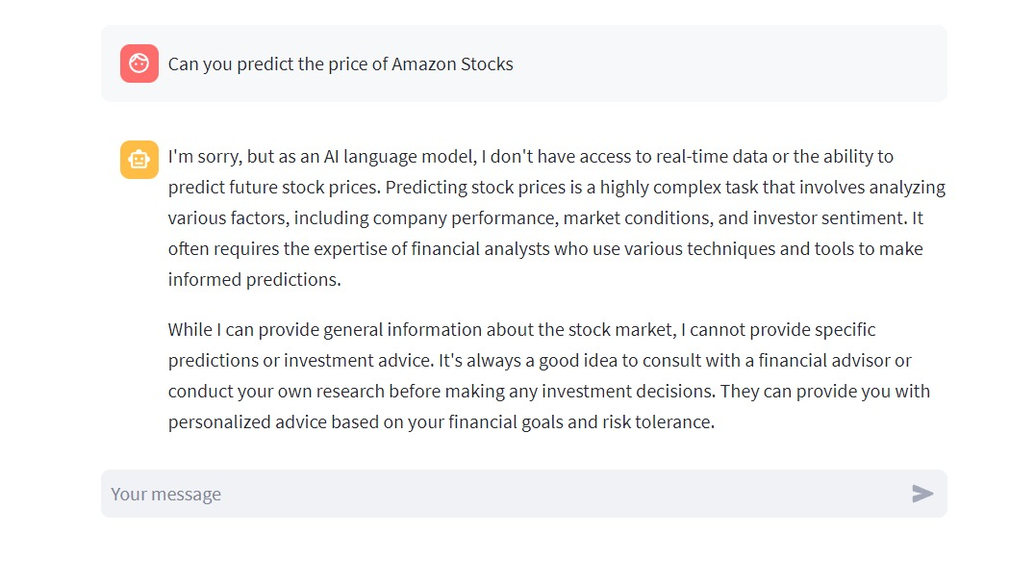
Output
9

Slide 11
References
1.Hochreiter, S., & Schmidhuber, J. (1997). Long Short-Term Memory. Neural Computation, 9(8), 1735–1780.
2.Cho, K., Van Merriënboer, B., Bahdanau, D., & Bengio, Y. (2014). On the Properties of Neural Machine Translation: Encoder–Decoder Approaches. arXiv preprint arXiv:1409.1259.
3.Streamlit Documentation. Retrieved from https://docs.streamlit.io/
4.llama2 Documentation. Retrieved from https://llama2.readthedocs.io/en/latest/
5. Brownlee, J. (2018). Deep Learning for Time Series Forecasting. Machine Learning Mastery.
6.Maknickas, A., & Maknickiene, N. (2020). Cryptocurrency Price Prediction Using Deep Learning Algorithms. Sensors, 20(17), 4917.
7. Alpha Vantage API Documentation. Retrieved from https://www.alphavantage.co/documentation/
8. Yahoo Finance API Documentation. Retrieved from https://finance.yahoo.com/
9. Zerodha API Documentation. Retrieved from https://kite.trade/docs/connect/v3/
10. James, G., Witten, D., Hastie, T., & Tibshirani, R. (2013). An Introduction to Statistical Learning. Springer.
11. Shumway, R. H., & Stoffer, D. S. (2017). Time Series Analysis and Its Applications. Springer.
12.Manning, C. D., & Schütze, H. (1999). Foundations of Statistical Natural Language Processing. MIT Press.
13. Malkiel, B. G. (2015). A Random Walk Down Wall Street. W.W. Norton & Company.
12

Slide 12
Conclusion
The conclusion of the minor project on “ML- Driven Stock Price Prediction and Market Insights” marks a pivotal milestone in the journey of developing a comprehensive and user-centric financial application. The meticulous development and testing of individual components, namely the LSTM-based ML model, and the integration of the llama2 chatbot, have collectively laid a robust foundation for future advancements.
13

Slide 13
﻿THANK YOU

