Slide 1

Presented By
Group Name: Team #1
Piyush Anand (001567678)
Bismita Behera (002127782)
Mohit Malani (001568891)

Slide 2
OBJECTIVE
Ecosystem
Transparent
Dynamic
Design robust system to bridge Hospital and Organ Donor and other key players
Automate workflow process to eliminate ownership confusion causing delay
System can scale to grow as more Organization are partnered
SCALABLE
USER Friendly
Loss of sales by not offering wholesale medical supplies
Simple and Easy to use and adaptable

Slide 3
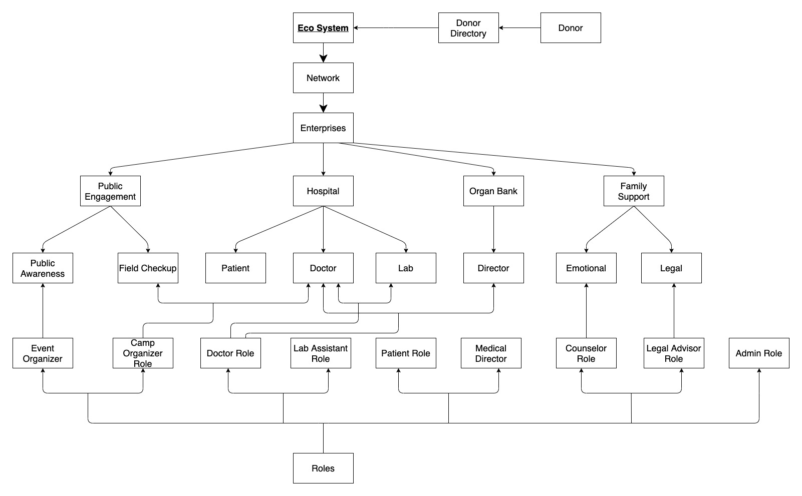
ARCHITECTURE

Slide 4
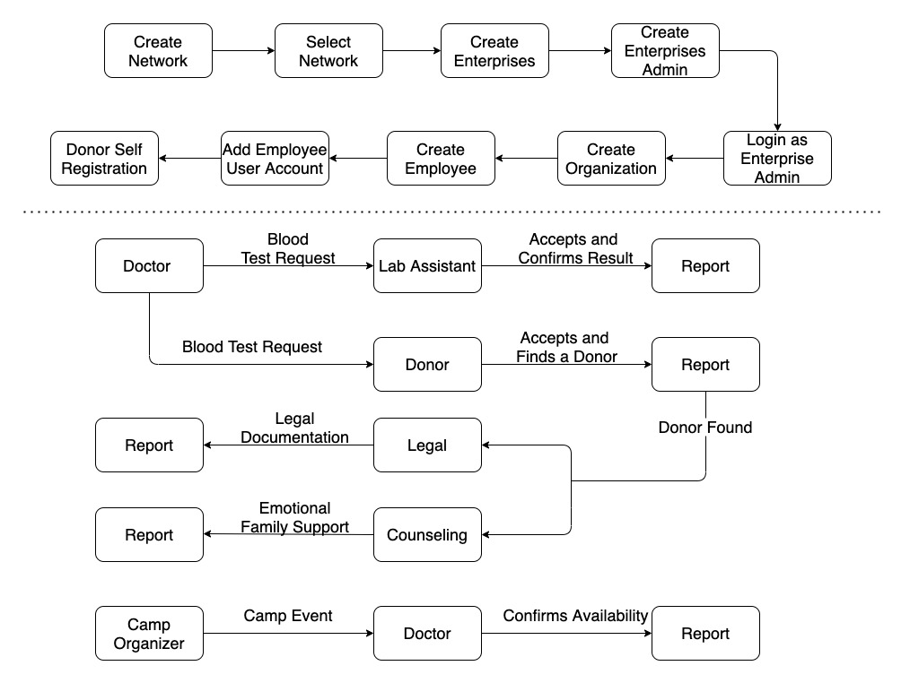
WORKFLOW

Slide 5
DEMO
Existing
Established network with multiples enterprises, organization and users along with enrolled donors
GOING FORWARD
Create request and walk through of the workflow and system features

Slide 6

Thank you

