Slide 1


Slide 2
SonarQube
SonarQube is an open-source platform developed by SonarSource for continuous inspection of code quality.
Sonar does static code analysis, which provides a detailed report of bugs, code smells, vulnerabilities, code duplications.
It supports 30+ major programming languages through built-in rulesets and can also be extended with various plugins.

Slide 3
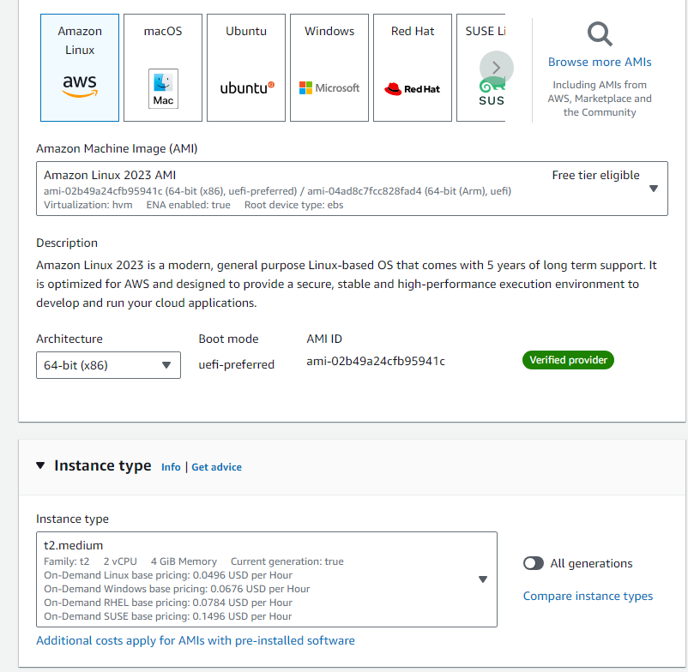
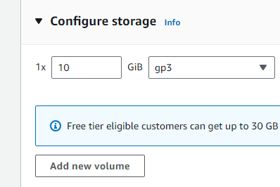
Jenkins
Sonar
Integration
Launch a new instance with configuration as:

Slide 4
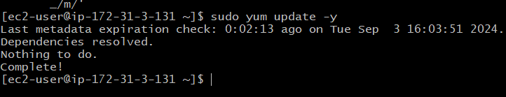
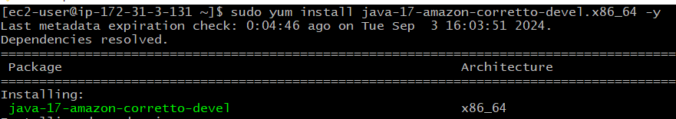
Setup
1. Update the machine.
2. Install Java 17

Slide 5
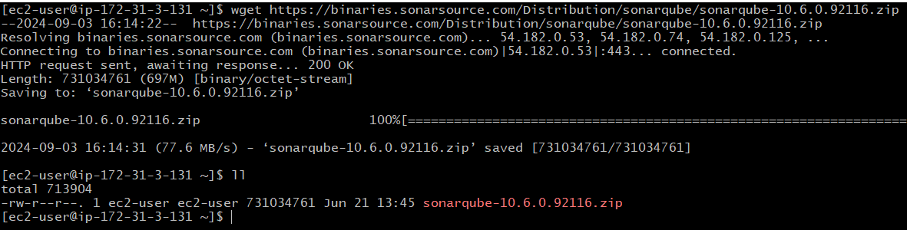
Setup
3. Download SonarQube from:
https://www.sonarsource.com/products/sonarqube/downloads/success-download-community-edition/
As:
wget https://binaries.sonarsource.com/Distribution/sonarqube/sonarqube-10.6.0.92116.zip

Slide 6
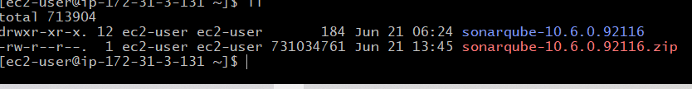
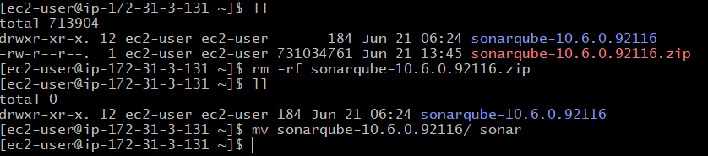
Setup
3. Unzip it as: unzip sonarqube-10.6.0.92116.zip
4. Rename the file to sonar

Slide 7
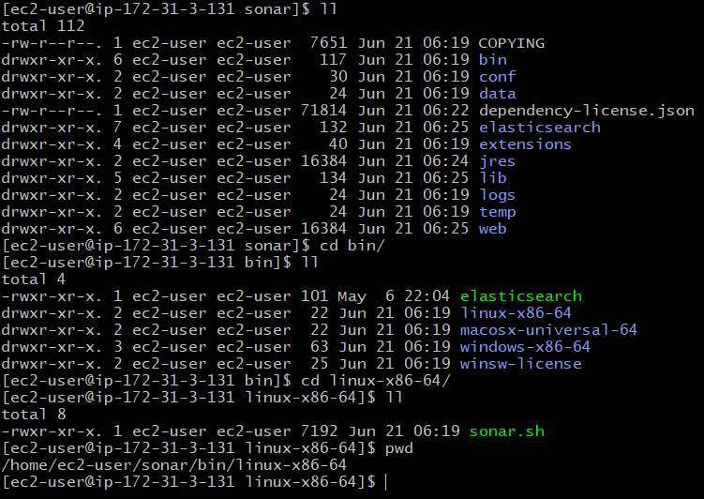
Setup
3. Run the sonar.sh file from - /home/ec2-user/sonar/bin/linux-x86-64

Slide 8
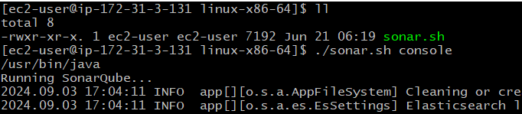
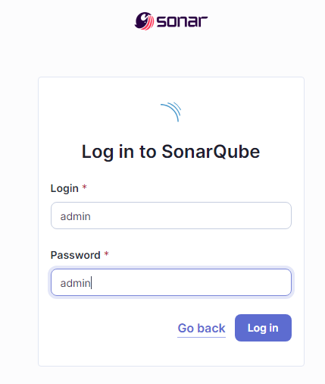
Setup
./sonar.sh console → to run sonar qube and check logs
Check the sonar status on port 9000
which is the default port for sonar

Slide 9
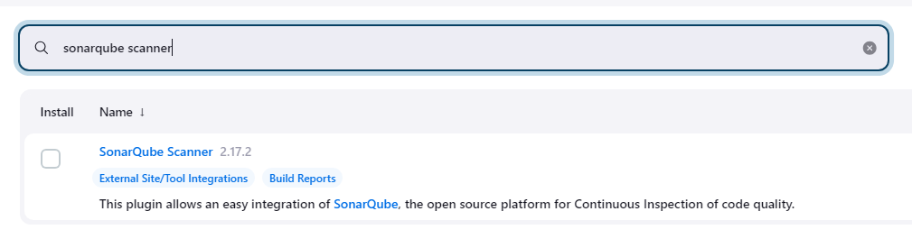
Setup on Jenkins
Install sonarqube scanner plugin on Jenkins

Slide 10
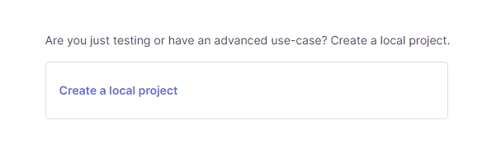
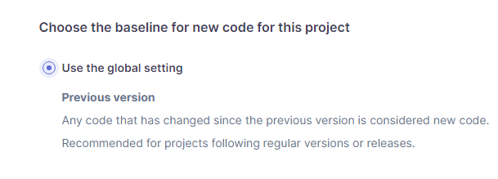
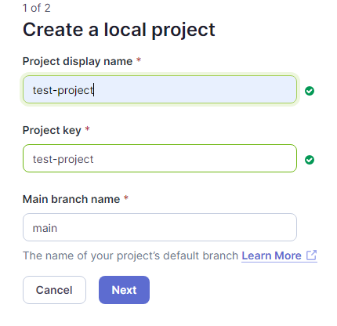
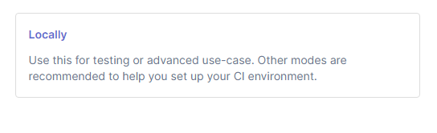
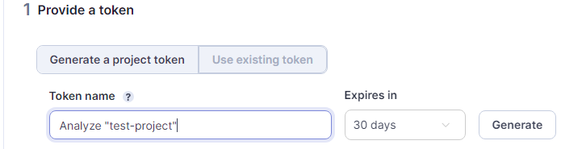
Create a project on Sonar Qube

Slide 11
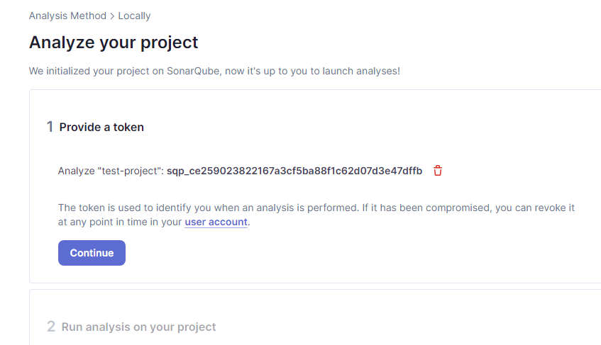
Create a project on Sonar Qube

Slide 12
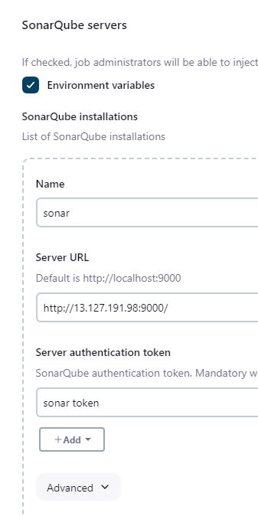
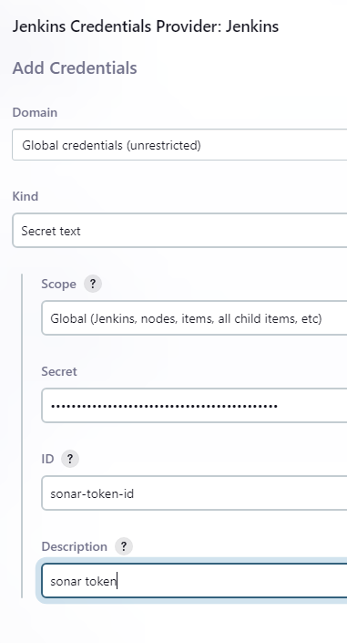

Setup On Jenkins

Slide 13
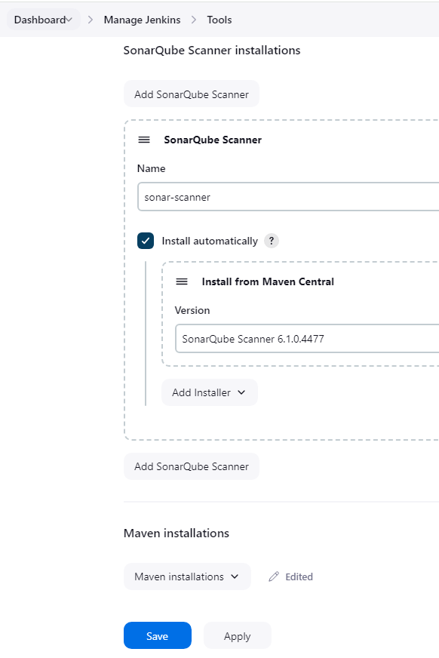
Setup On Jenkins

Slide 14
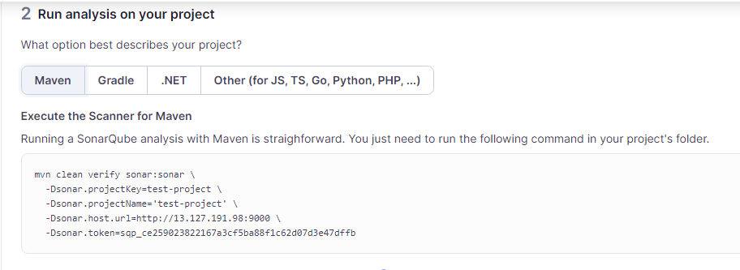
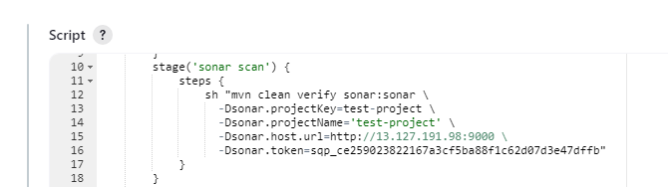
On Sonar Server

Slide 15
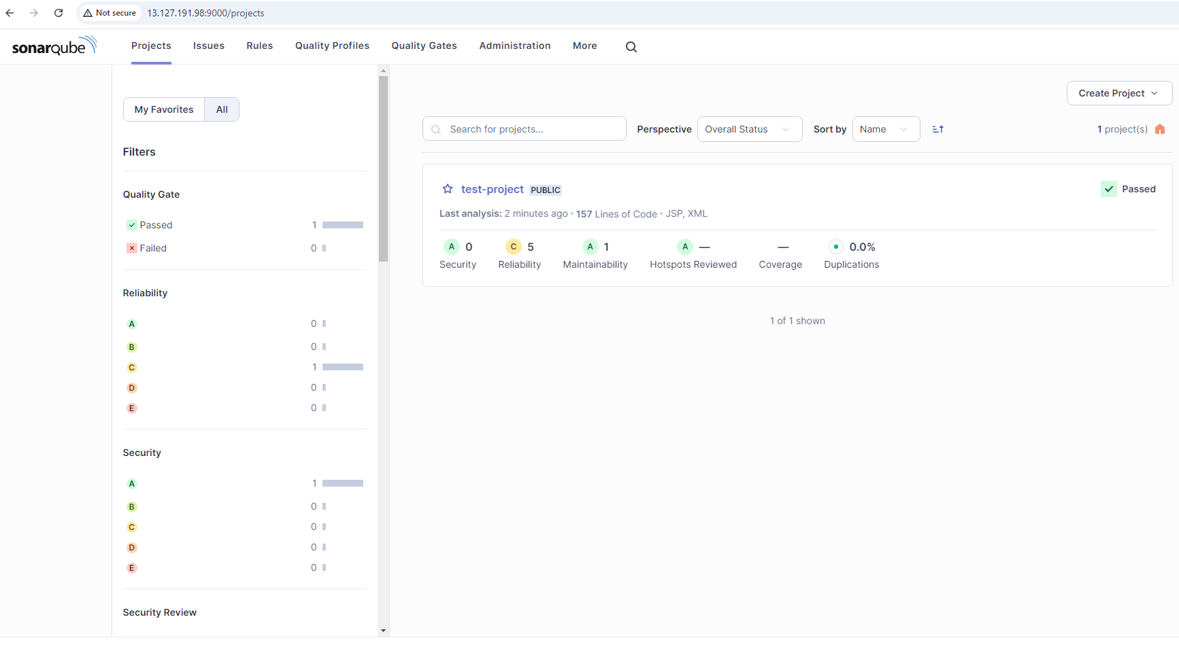
Check the Output On Sonar Server

