Slide 1

GTA_AI
Антонио Милев
Телерик Арсов

Slide 2
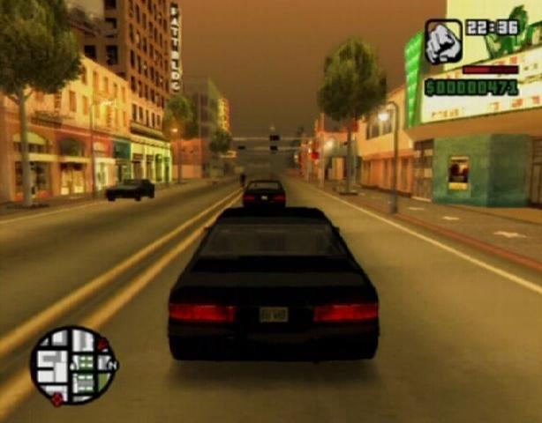
What is it?
An AI that can drive in GTA: San Andreas. Pretty simple.
Turns out it isn’t that simple at all…

Slide 3


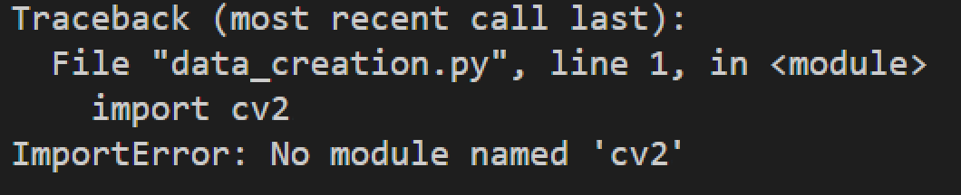
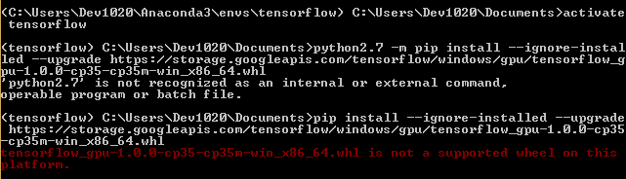
Setting up
Expectations
Reality
Being able to run everything was
actually quite the challenge and that alone gave us a lot of insight on how complicated some stuff can be.

Slide 4
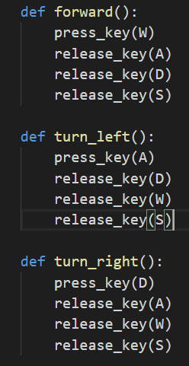
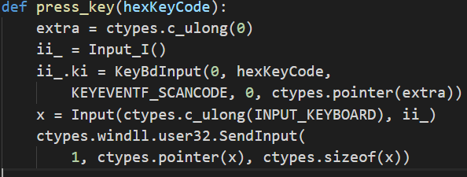
Driving with image processing
Sending input
Not such an easy task because we need to send it to the game not the console. Using the user32.dll we are able to do this and send the input to OS.
We’ve creating a couple
of functions to simulate
the different manoeuvres
we use in driving.

Slide 5
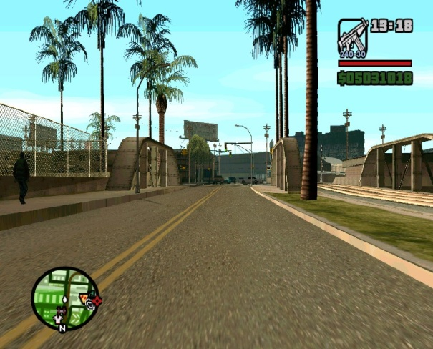
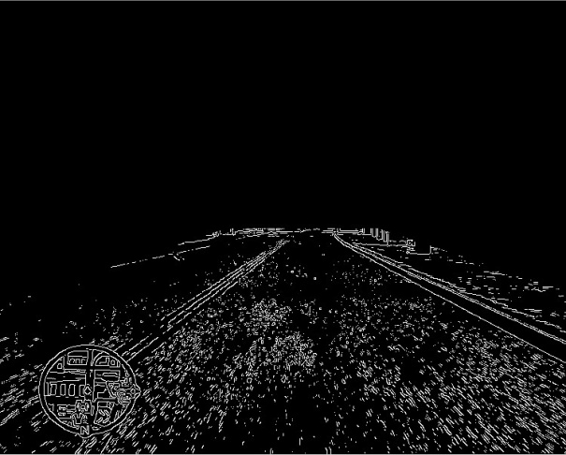
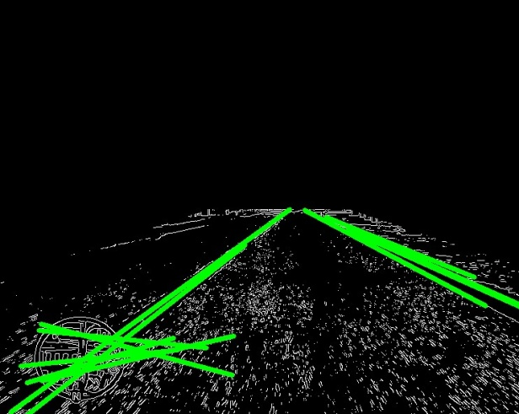
Driving with image processing
Recognizing the road
(1)
(2)
(3)
A very often used method in OpenCV is the line detection:
First we have to apply a Canny Edge filter to our original image (1).
We also apply a region of interest so that we can focus specifically on the road. That’s how we end up with (2)
Then we just have to apply Hough Lines filter to get the final result. Tweaking a couple of parameters when can get different amount of lines, remove shorter edges etc.
Now we can use the array of lines to determine our actions.

Slide 6
Driving with image processing
Determine action - There are a lot of logics you could implement using the lines. We came up with two ways which seem to work equally well:
Using the two clearest lines – checking if the two clearest lines are on the same side of the screen then we should turn to the other side. If they are on both sides we should just continue forward. This simple method actually works surprisingly well.
Getting general line direction – here we iterate all the lines and get their average slope and then depending on it we decide what to do.
However more unique situations will be hard to handle by this type of AI so we continued by trying a machine learning approach

Slide 7


The Machine Learning Way
What we used:
Collecting data with –
The Framework –
The Model – AlexNet convolutional neural network

Slide 8
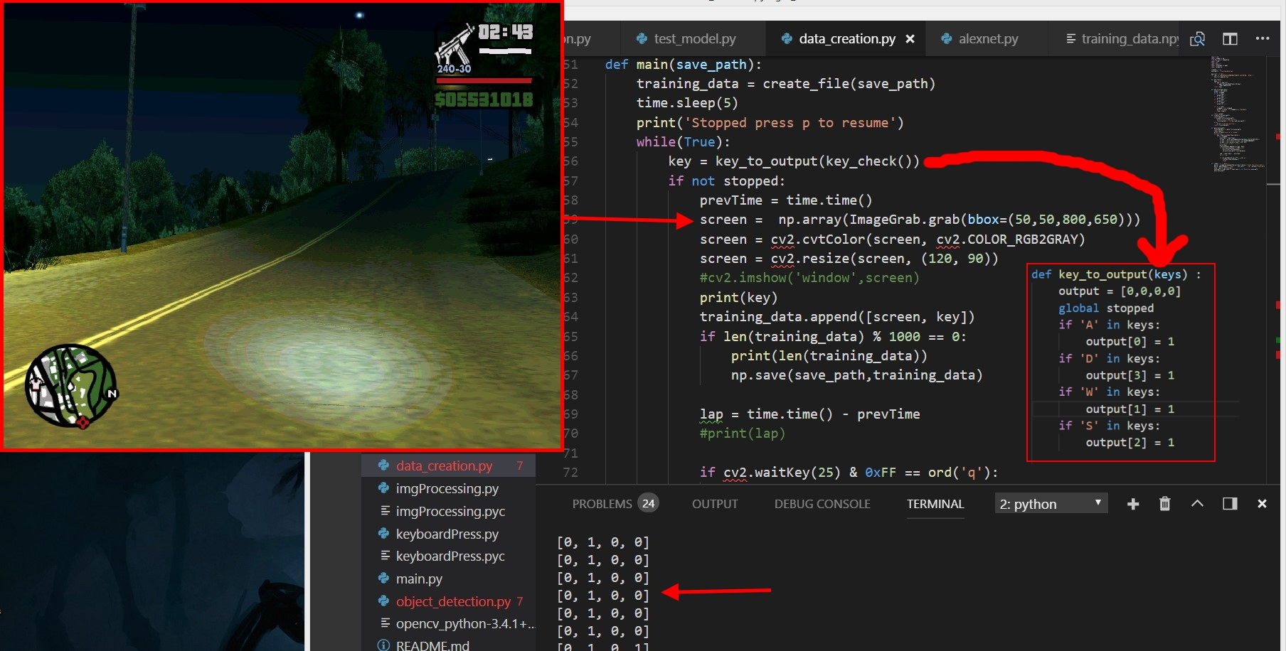
The Machine Learning Way
Collecting the data – driving... lots of driving
Converting input
Capturing screen
Saving
The choice I’ve
made

Slide 9

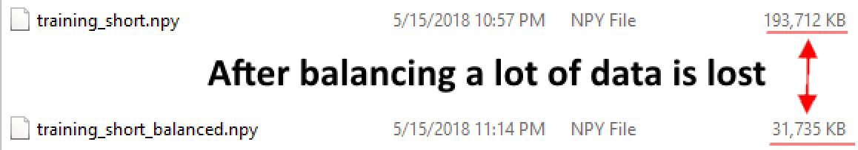
The Machine Learning Way
Balancing the data
Most of the times you can’t just use the raw data. Because of us
saving the data in many ways (e.g. one-hot arrays, small arrays for
a couple of keys, big ones for more actions) except the
normalization we also had to make some convertions to
make them all the same.
Left Forward Right
In the end we should get an equal amount of left, forward and right choices.

Slide 10
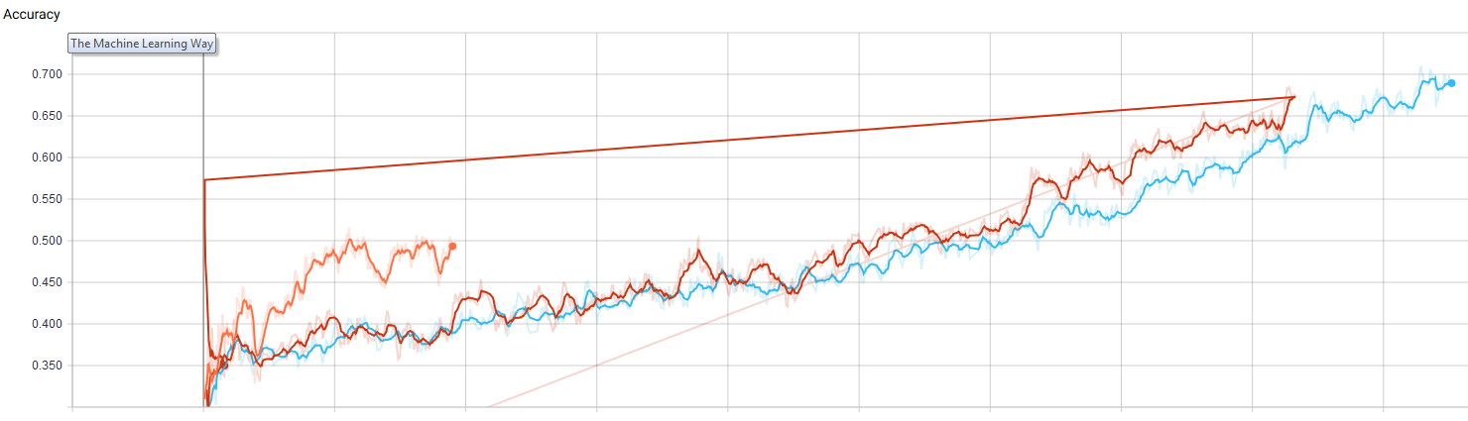
The Machine Learning Way
Training the model
- Not balanced small data. Looks like it trains well but it actually isn’t because most of the entries are the same.
- Bigger balanced data. Trains slower but better. (That red line shows because we ran it twice by mistake)
- Again bigger balanced data.
Ideally we’ll have a lot more data but we just didn’t have the time to record it. But we can see that the accuracy grows so with bigger data it would work a lot better.

Slide 11
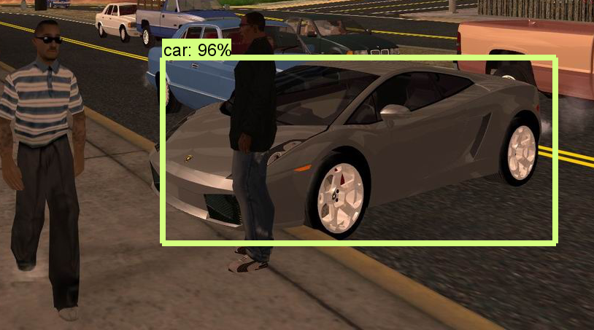
More Features
Finding way to car – theoretically the AI could finds it’s way to a car using one of the pre-trained Tensorflow models for object recognition. Due to hardware limitation (like not being able to run TF on GPU) that takes a lot of time to process but at least we managed to run it with OpenCV and detect cars specifically.

