Slide 1




Code Reviewer & Auto fixer-Agent System
Aditya Thawaria
Biswaranjan
Nayak
Chirag
Jagtap
Shubham
Patil
BHARAT TANK
TITLE
END

Slide 2
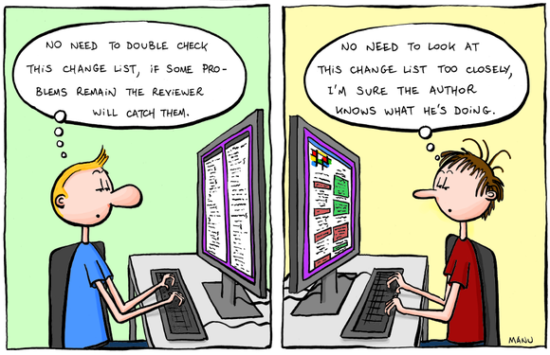
BACKGROUND OF
THE STUDY
MOTIVATION
OBJECTIVES
ABSTRACTION
TITLE
END

Slide 3
Code Reviewer & Auto fixer-Agent System
BACKGROUND OF
THE STUDY
MOTIVATION
This project presents an AI-based, language-agnostic automated code review and auto-fixing system that helps identify bugs, code smells, and inefficient coding practices. By combining static code analysis with AI-driven reasoning, the system provides clear explanations and suggested fixes, reducing manual review effort. The solution is deployed on a Linux-based cloud platform, improving scalability, code quality, and developer productivity.
OBJECTIVES
TITLE
END

Slide 4



BACKGROUND OF
THE STUDY
Manual code review is time-consuming, inconsistent, and heavily dependent on human expertise.
MOTIVATION
Developers, especially beginners, struggle to identify syntax, logical, and coding standard issues, leading to poor code quality.
OBJECTIVES
Existing tools lack intelligent automation for comprehensive code review, auto-fixing, and meaningful explanations, creating a need for an AI-based solution.
TITLE
END

Slide 5

BACKGROUND OF
THE STUDY
To automatically analyze source code and identify syntax, logical, and coding standard issues using AI techniques.
MOTIVATION
To generate accurate fixes and optimized code suggestions with clear explanations for developers.
OBJECTIVES
To improve code quality, reduce manual review effort, and enhance developer productivity and learning.
TITLE
END

Slide 6
INNOVATION
PROJECT TOOLS
PROCEDURAL FRAMEWORK
METHODOLOGY
TITLE
END

Slide 7
Hybrid AI-Based Code Analysis: Combines static analysis with AI reasoning for accurate bug detection and code review.
Language-Agnostic Design: Enables analysis across multiple programming languages without language-specific dependency.
Explainable Auto-Fixing System: Provides human-readable explanations along with automated code fix suggestions.
INNOVATION
PROJECT TOOLS
PROCEDURAL FRAMEWORK
TITLE
END

Slide 8
Frontend:-
HTML, CSS, JavaScript
React.js (for interactive UI)
Backend:-
Python
Flask / DJANGO(API development)
AI / Code Analysis:-
Large Language Models (LLMs) for code review
Static Code Analysis techniques
Rule-based and ML-based bug detection
Database:-
PostgreSQL / MongoDB (store code, results, logs)
Cloud Deployment
Cloud Platform: AWS / Google Cloud / Microsoft Azure
Containerization: Docker
Hosting: Cloud VM / App Engine / ECS
Storage: Cloud Object Storage
CI/CD (optional): GitHub Actions
INNOVATION
PROJECT TOOLS
PROCEDURAL FRAMEWORK
TITLE
END

Slide 9
User Submits Source Code
Web Interface
Backend API Server
Code Parsing Agent
INNOVATION
PROJECT TOOLS
Code Review Agent
Auto-Fix Agent
Explanation Agent
Database
PROCEDURAL FRAMEWORK
REVIEWED CODE
TITLE
END

Slide 10
ALGORITHM
AND DOCUMENTATION
ALGORITHMS
DOCUMENTATION
TITLE
END

Slide 11
ALGORITHMS
START → User enters message → Frontend captures input → HTTP POST request to Django →
Django parses JSON → Prompt constructed for LLM → Request sent to Ollama API →
Llama 3.1 model processes prompt → AI generates response → Django sends JSON response →
Frontend displays output → END
ALGORITHMS
DOCUMENTATION
TITLE
END

Slide 12
The proposed Code Reviewer & Auto-Fixer system demonstrates the effectiveness of automating code review and bug-fixing processes, significantly reducing reliance on human reviewers. By leveraging AI agents, the system provides fast, consistent, and accurate feedback, which is particularly beneficial for beginners and large development teams.
👤 User → 💻 UI → ⚙️ Django → 🧠 Sentient Engine → 🤖 Llama Model → 📤 Response
ALGORITHMS
DOCUMENTATION
View Full Technical Documentation(Click here)
(Methods • Algorithms • Architecture • References)
TITLE
END

Slide 13
SUMMARY
RESEARCH PAPERS REFERNCE &
SUMMMARY
REFERNCES
TITLE
END

Slide 14
The Code Reviewer & Auto-Fixer – Agent System successfully demonstrates how AI can enhance the software development process by automating code review and bug fixing. It provides fast, accurate, and consistent feedback, reduces dependency on human reviewers, and helps improve code quality while supporting learning for beginners. The modular agent-based design ensures scalability and maintainability, and cloud deployment allows accessibility from anywhere. Overall, the project showcases the practical application of AI in real-world coding environments, making software development more efficient, reliable, and developer-friendly.
SUMMARYS
REFERNCES
TITLE
END

Slide 15
Meta AI – Llama Model
https://ai.meta.com/llama/
SUMMARYS
Ollama Documentation
https://ollama.com/
REFERNCES
Django Documentation
https://docs.djangoproject.com/
TITLE
END

Slide 16
THANK YOU!!

