Slide 1


Inventory Management System
Wongpiwat Sa Ngiam – 2883857
Uday Shankar Boddupalli - 2868122
Biswadeep Mazumder. - 2860920

Slide 2
INTRODUCTION
The Inventory Management System is a cloud-based web application tailored for small to medium-sized businesses to efficiently manage their inventory.
It simplifies inventory tracking, order processing, and supplier management while providing actionable insights through data visualization.
Project Link: https://github.com/BiswadeepMazumder/InventoryManagement.git

Slide 3
Functionality
Helps to Track the inventory items that are running low in stock.
Helps user to identify the correct items for re stocking.
Helps user to micromanage Suppliers and their supplies.
Gives user an overall view of the all the orders.

Slide 4
PROJECT ARCHITECHTURE
The Inventory Management System adopts the
’Model-View-Controller’ (MVC)
architectural style for the backend and follows a
’component-based’
architecture for the frontend.

Slide 5
Tools for Development
Backend:
.NET 8 Framework.
Entity Framework Core 7.
SQL Server Management Studio for database management.
Frontend:
Next.js
Node.js for running the frontend.
Development Tools:
Visual Studio Code for coding.
Postman/Swagger/Insomnia for API testing.
Git for version control.

Slide 6
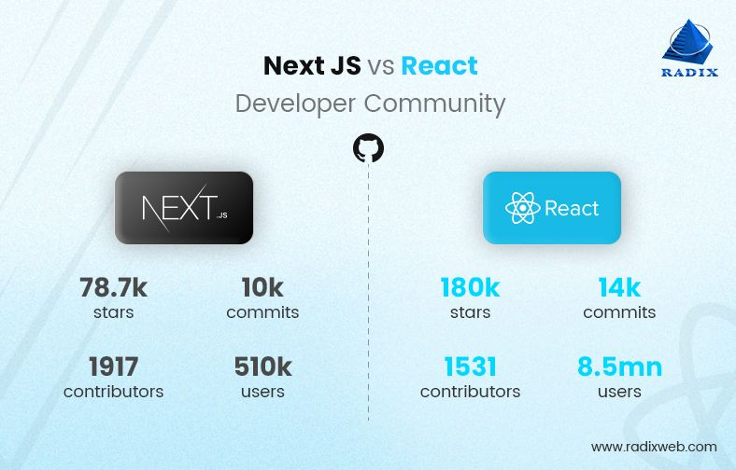
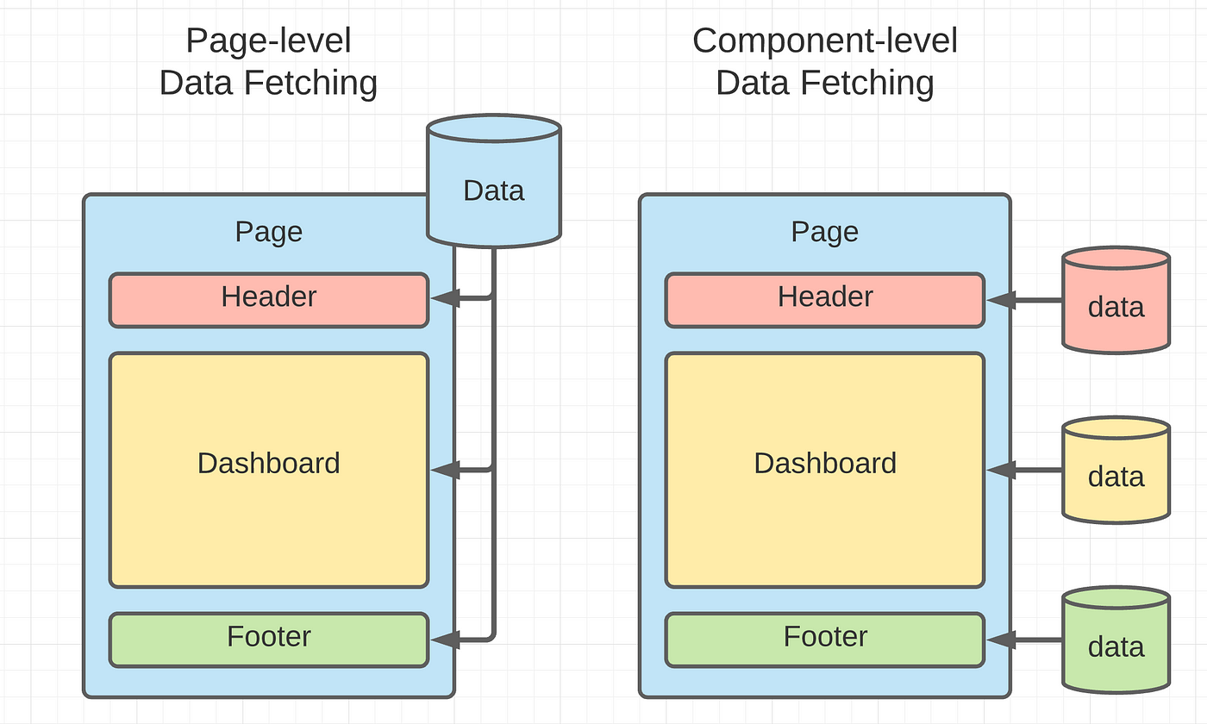
Front End

Slide 7

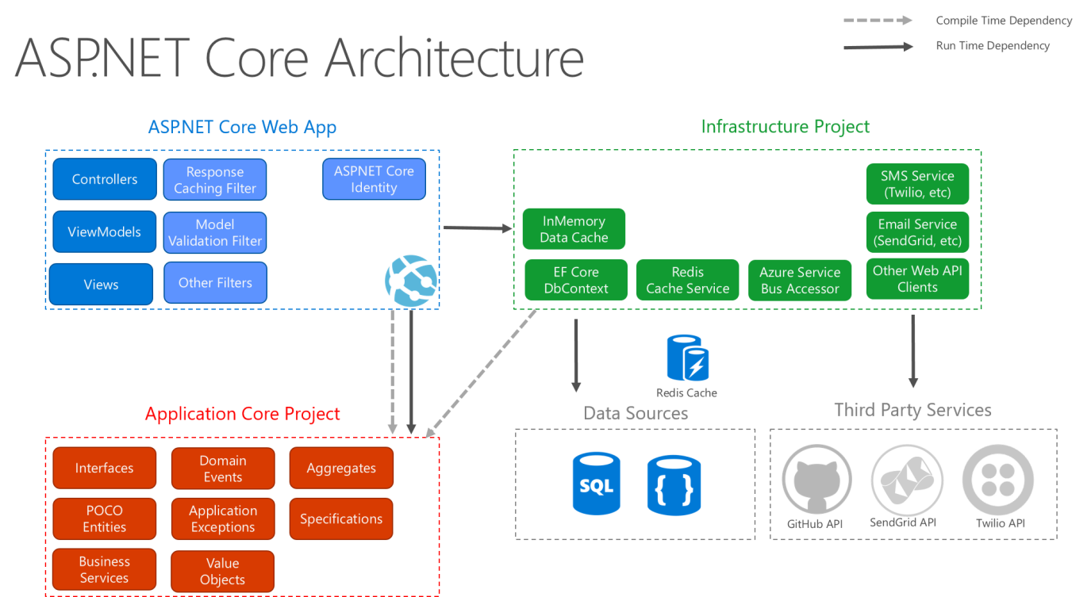

Slide 8
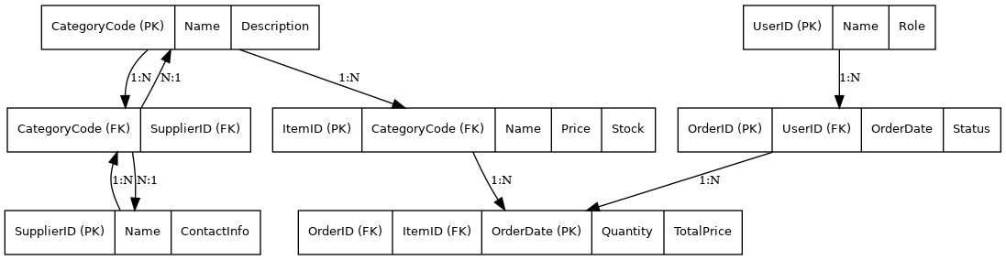
ENTITY RELATION MAPPING

Slide 9
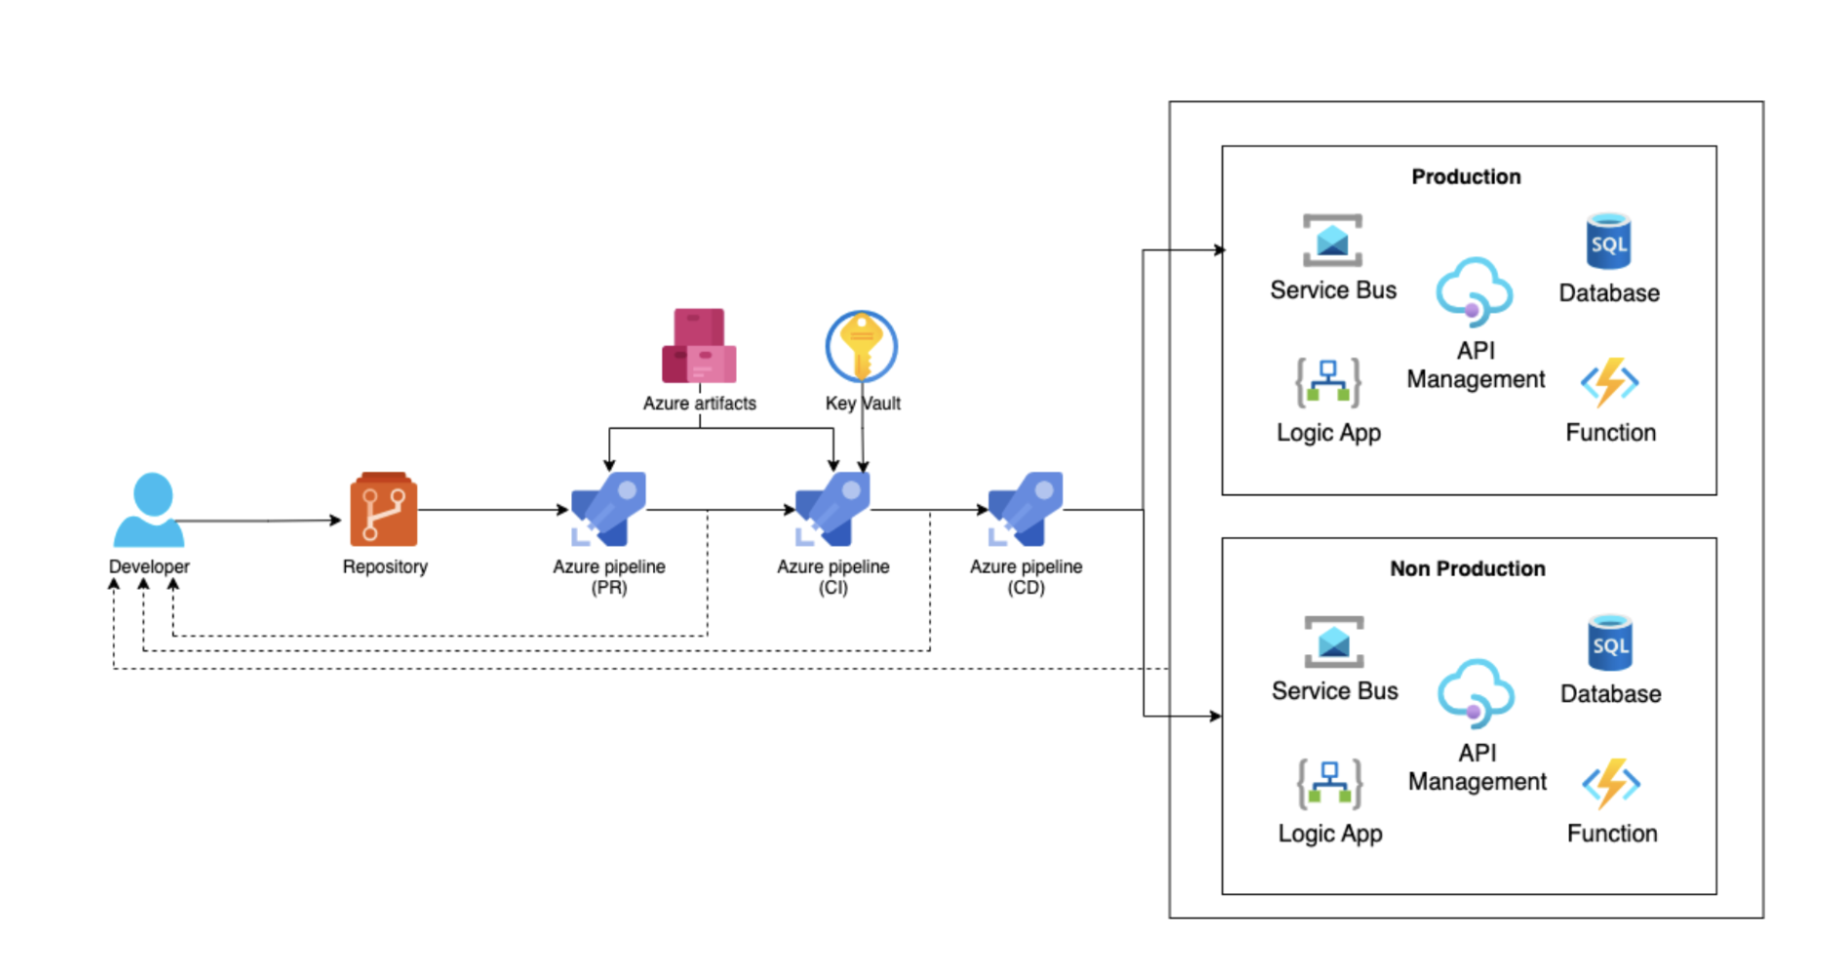
Deployment

Slide 10
Demonstration

Slide 11
Future Plans
Sales System Integration:
AI-Driven Features:
Enhanced Reporting and Analytics:

Slide 12
THANK YOU ANY QUESTIONS ?

