Slide 1


Software Quality Assurance Cleveland state university
Biswadeep Mazumder 2860920
Kevin Panchal 2871507

Slide 2




How did we choose this project?
What is an open-source
Software with publicly accessible source code for modification and distribution.
Technologies Used
E-commerce industry is growing day by day.
Every business needs an online presence and this essential.
Open-source platform makes it cost-effective.
Hands on opportunity on Manual testing.
Provides valuable insights for business decision-making.

Slide 3
O b j e c t I v e
Familiarize yourself with the software and its purpose.
Define test scenarios and identify testing techniques to be used.
Create a test plan and test cases based on the scenarios.
Execute the test cases and document the results.

Slide 4
F u n c t I o n a l i t I e s
LOGIN
CREATE ACCOUNT
FORGOT PASSWORD
SEARCH PRODUCTS
FILTER PRODUCTS
SHARE PRODUCT
ADD PRODUCTS TO WISHLIST
ADD PRODUCTS TO CART
CHECKOUT
FILL USER DETAILS
NOTIFY USER ON ORDER PLACEMENT
CONTACT US

Slide 5
T e s t I n g M e t h o d
Manual testing identifies defects not caught by automated testing.
Early detection of issues prevents critical problems in development.
Manual testing allows for a more thorough evaluation of the webpage.

Slide 6
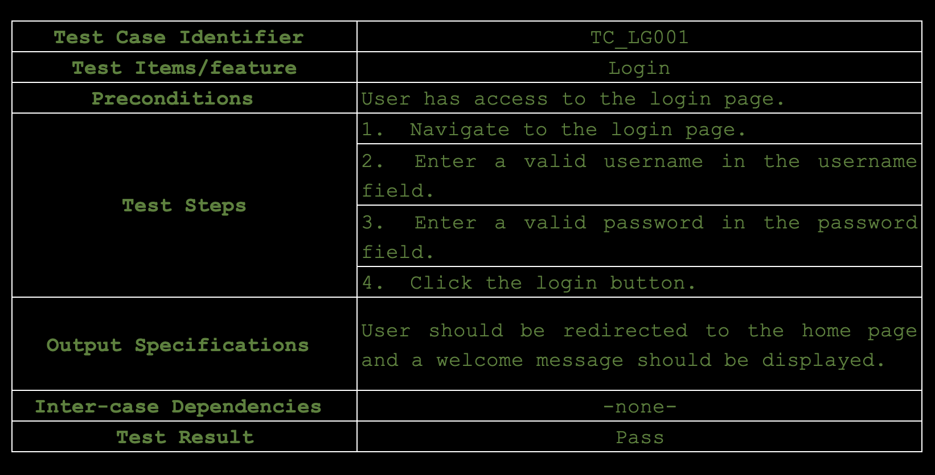
T e s t c a s e s

Slide 7
T e s t I n g d e m o
https://demo.prestashop.com/#/en/front
Testing is conducted on the demo website of prestashop.
This website is solely to test the new changes before being pushed to production.

Slide 8
Total test cases
D e f e c t c o u n t s
Defects Identified
15
6

Slide 9
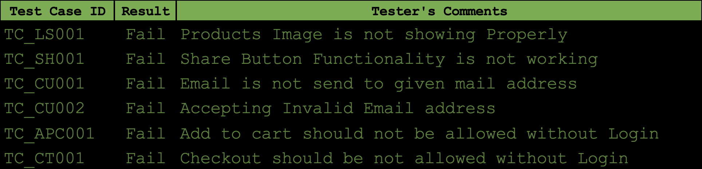
D e f e c t r e p o r t

Slide 10
C o n c l u s I o n
Successful testing verified that the open-source e-commerce platform met functional requirements and was of satisfactory quality.
Valuable insights and feedback were gained from the testing process, which can be used to improve the software by the development team.
The testing process was an essential step in ensuring the software was fit for purpose and could meet the needs of its users.
The e-commerce platform is now ready for deployment and use by customers, thanks to the successful testing process.

Slide 11
L e a r n m o r e
About the Project:
https://devdocs.prestashop-project.org/
About the code:
https://github.com/PrestaShop/PrestaShop
About Manual Testing:
- https://www.toolsqa.com/software-testing/manual-testing/

Slide 12
Any Questions ?
Thank You everyone for attending our presentation

