Slide 1

An Intelligent CPU Scheduler Simulator
(SCHEDSIM)
A powerful tool built with Flutter & Dart to simulate various CPU scheduling algorithms.

Slide 2
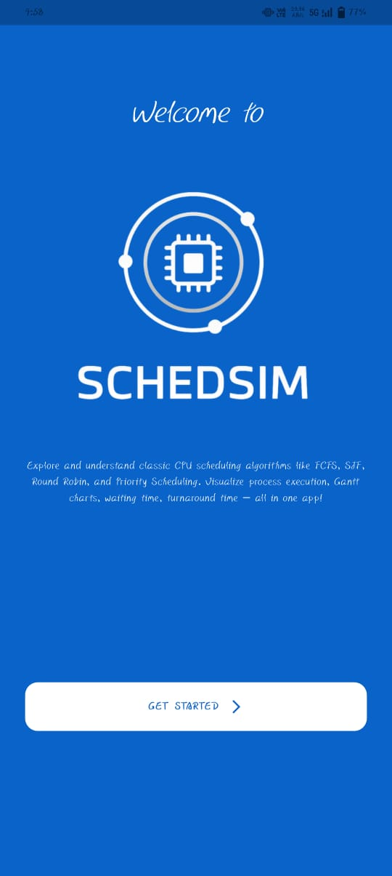



Project Overview
Built with Flutter & Dart
Simulates Key Algorithms
Modern, cross-platform development for seamless experience.
FCFS, SJF, SRTF, RR, MLQ, Priority scheduling methods.
Visualizes Performance
Displays Gantt charts, context switching, and performance metrics.

Slide 3
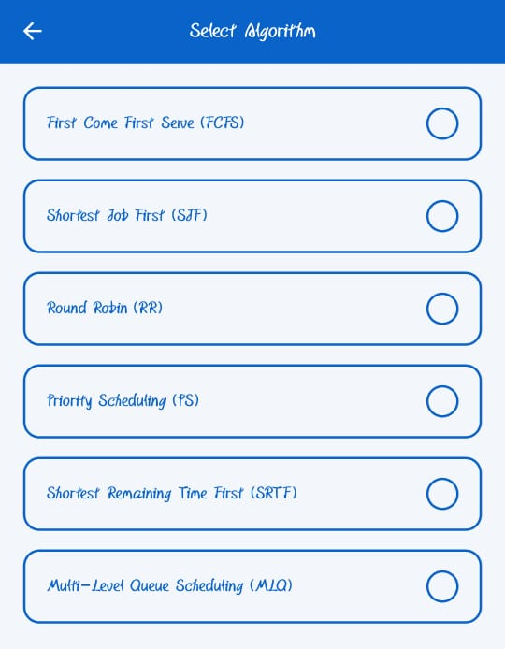
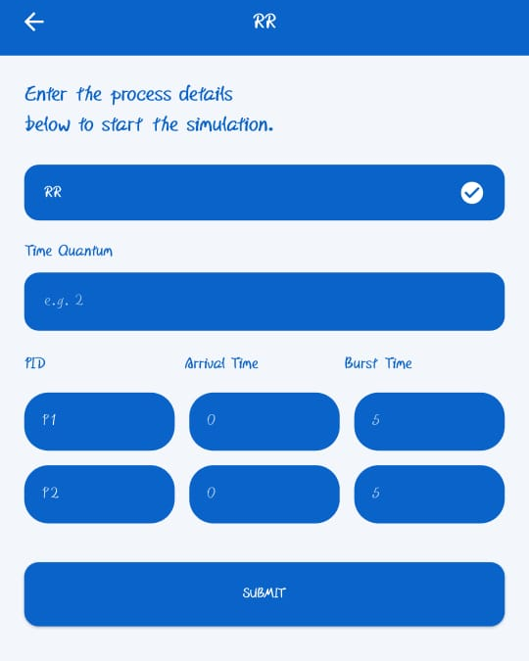
Backend: The Brains Behind the Simulation
Our backend is the core engine, implementing all CPU scheduling algorithms and handling complex calculations.
Algorithm Implementation
Manages FCFS, SJF, SRTF, RR, MLQ and Priority scheduling logic.
Data Processing
Handles PID, Arrival Time, Burst Time, and Priority for each process.
Performance Metrics
Computes execution order, waiting time, and turnaround time.
Gantt Chart Data
Generates structured data for visual representation on the frontend.

Slide 4

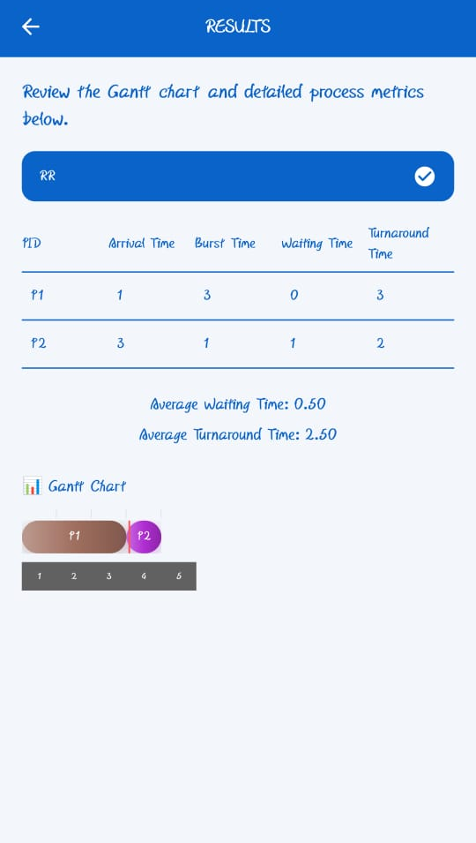

Backend Architecture: How It Works
The backend is structured into key components that work together to deliver accurate simulations.
Process Model
PID, AT, BT, Priority
Simulation Pipeline
Output Generator
Scheduling Engine
Timeline, Metrics
FCFS, SJF, SRTF, RR, MLQ, Priority
This modular design ensures efficient processing and clear separation of concerns.

Slide 5

Backend Workflow: From Input to Output
User Inputs Processes
Initial data entry for process parameters.
Algorithm Selected
User chooses the desired scheduling algorithm.
Backend Processes Data
Loads and processes the list of user-defined processes.
Algorithm Execution
The chosen algorithm runs, creating the execution timeline.
Metrics Calculation
Waiting and turnaround times are calculated.
Results to Frontend
Processed data is sent to the UI for display.

Slide 6





Frontend: The User Interface
The Flutter UI provides an intuitive interface for user interaction and result visualization.
Intuitive UI
Built with Flutter for a responsive and engaging user experience.
User Inputs
Allows users to easily input process parameters.
Visual Displays
Clearly shows Gantt charts, waiting, and turnaround times.
Custom Widgets
Utilizes custom UI components for enhanced functionality.

Slide 7
Frontend Structure: Components
The frontend is composed of several key UI components designed for clarity and ease of use.
1
2
3
Algorithm Dropdown
Process Input Table
Simulate Button
Select desired CPU scheduling algorithm.
Enter process details like PID, arrival, and burst times.
Initiate the simulation process.
4
5
Gantt Chart Widget
Results Panel
Visual representation of process execution over time.
Displays calculated waiting and turnaround times.

Slide 8

Gantt Chart Rendering: Visualizing Time
The frontend efficiently renders the Gantt chart, translating backend data into a clear visual timeline.
The Gantt chart is dynamically built using Flutter widgets, where each process's execution is represented by a colored bar.
Crucially, the frontend is responsible only for drawing the data; all complex calculations and timeline generation are handled by the backend.

Slide 9
Frontend Workflow: User Interaction
Select Algorithm
1
User chooses a scheduling method.
Input Data & Simulate
2
Enters process details and clicks "Simulate".
Backend Returns Data
3
Timeline and metrics are sent back to the UI.
UI Renders Results
4
Gantt chart bars and performance metrics are displayed.
Save/Load JSON
5
Option to save or load simulation configurations.

Slide 10
Summary: A Complete Simulation Solution
Backend
Frontend
The powerful computation engine, handling all algorithms and metrics.
The intuitive visualization interface, presenting results clearly.
Together
A comprehensive OS scheduling simulator, built for clarity and understanding.

