Slide 1
StockVision:Quantitative-Portfolio-Rebalancing-Stock-Price-Predictiont
Name | Reg no.
Biswajit Behera | 21BPS1216
Guided by: Dr. SIVAKAMI R
Team No.: 1099

Slide 2
Introduction
Project Overview
Title: StockVision: Leveraging Stock Market Prediction and Optimal Portfolio Management
Objective: Improve investment decision-making through machine learning and big data analytics.
Challenges:
Inefficient portfolio rebalancing automation and risk factor identification.
Absence of sentiment analysis integration in current tools.
Lack of accuracy in existing prediction tools.
Lack of IPO pricing prediction models.

Slide 3
Problem Statement
Risk Factor Analysis for Stock Market Predictions: Develop a tool to analyze and predict stock market trends by identifying key risk factors from daily news and market data.
Automated Portfolio Management Using Risk Factors: Create a predictive portfolio rebalancing system that dynamically adjusts allocations based on identified risk factors for optimal performance.
Sentiment Integration for Market Mood Detection: Integrate sentiment analysis to interpret daily news and social media trends, enabling accurate detection of market mood and its impact on stock movements.
IPO Pricing Prediction and Suggestions: Design a model to predict IPO pricing and performance by incorporating sentiment analysis, market trends, and risk assessments, offering actionable insights.

Slide 4
Background Of The Problem
Lack of Accuracy and Reliability in Current Tools:
The existing tools and solutions for portfolio management and asset allocation optimisation lack the necessary accuracy and reliability.
Portfolio Rebalancing(Automation):
The key problem is to automate the process of restoring a portfolio's target asset allocation when market fluctuations cause deviations.
The goal is to ensure an optimal balance between risk and return.
Absence of Sentiment Analysis and News Integration(Sentiment Analysis):
Current portfolio management tools do not incorporate sentiment analysis or daily stock market news to enhance their decision-making capabilities.
Absence of IPO Analysis:
Current tools lack accurate IPO pricing predictions and analysis, missing crucial market signals that can inform investment strategies for new public offerings, which can lead to missed opportunities or poor investment decisions in IPOs.
Lack of Trend Duration Indicators:
The current tools do not provide clear indications or target values on how long a particular market trend is likely to continue.
Inadequate Risk Factor Identification:
The existing solutions do not effectively highlight the potential risk factors before making predictions or recommendations.

Slide 5
Research Objectives
Improve Financial Decision-Making with Multi-Factor AI Analysis 🔹 Design a hybrid AI model that combines technical indicators, sentiment scores, and risk analysis to provide data-driven investment recommendations. 🔹 Implement a user-friendly dashboard that delivers real-time stock market insights, alerts, and risk assessments.
Ensure Ethical AI Implementation in Financial Markets 🔹 Address bias in AI trading models by integrating fairness constraints and ethical compliance measures. 🔹 Ensure data privacy and regulatory adherence (GDPR, SEC guidelines) in stock prediction and portfolio management AI applications.
Enhance Portfolio Management Through Automated Rebalancing 🔹 Develop an adaptive portfolio management system that dynamically adjusts asset allocation based on risk factors, volatility, and sentiment trends. 🔹 Utilize Markowitz Model & Reinforcement Learning to optimize returns while minimizing risks in investment strategies.

Slide 6
Research Objectives
Risk Factor Analysis for Market Predictions: Develop tools that analyze and highlight key risk factors using daily stock news and sentiment analysis, aiding in accurate market trend forecasting.
Sentiment-Driven Market Mood Detection: Utilize sentiment analysis to extract and interpret stock market trends from news and social media, enabling informed investment decisions.
Automated Portfolio Rebalancing: Create a dynamic portfolio rebalancing system that automates adjustments based on risk factor analysis to maintain an optimal risk-return balance.
IPO Pricing Prediction Model: Design a robust model to predict IPO pricing and performance by integrating sentiment analysis, market trends, and risk assessments for precise and actionable forecasting.

Slide 7
Research Challenges
Data Quality and Availability:
The availability of clean, reliable, and up-to-date financial data is limited. Historical data may contain noise, missing values, or inconsistencies that can affect prediction accuracy(especially in IPOs).
Sentiment Analysis Complexity:
Analyzing unstructured data from diverse sources like news and social media is challenging. Issues such as sarcasm, cultural context, and ambiguous language can mislead sentiment models.
Market Volatility and Unpredictability:
Stock markets are highly volatile, influenced by unpredictable external factors (e.g., geopolitical events or sudden regulatory changes), making it difficult to maintain model accuracy.
Algorithm Scalability and Efficiency:
Implementing machine learning models that handle large-scale data and generate real-time predictions requires significant computational resources and optimization.

Slide 8
Proposed System
Why StockVision?
Bridges the gap between traditional stock market prediction models and AI-powered risk analysis.
Utilises a multi-source approach, integrating technical analysis, news sentiment, and portfolio optimisation.
Automates financial decision-making, reducing human errors in stock investments.
Real-World Significance
Big Data in Finance – Growing demand for AI-driven financial predictions and Risk Analysis.
Automatic Portfolio Rebalancing Trading Trends – AI-led trading strategies are increasingly adopted by hedge funds.
IPO Market Trends – More investors rely on data-driven IPO price forecasting.

Slide 9
Proposed System
Overview of StockVision 🔹 StockVision integrates AI, sentiment analysis, and portfolio automation to enhance stock market predictions and investment strategies. 🔹 The system combines financial data, news sentiment, and deep learning models to deliver actionable insights for investors.
Key Features & Functionalities.
Sentiment Analysis Module: Extracts bullish or bearish market sentiment from news, social media, and financial reports.
Automated Portfolio Rebalancing: Dynamically adjusts asset allocation based on market risks and sentiment scores.
IPO Pricing Prediction: Uses historical IPO data, investor sentiment, and financial indicators for valuation forecasting.

Slide 10
Proposed System
Modules & Their Functions
1. Sentiment Analysis Module 🔹 Extracts and analyzes market sentiment from financial news, social media, and economic reports. 🔹 Uses Natural Language Processing (NLP) and Machine Learning (ML) models to classify sentiments as bullish, bearish, or neutral.
2. Stock Prediction Module 🔹 Uses time-series forecasting models (LSTM, RNN) to predict short-term and long-term stock price trends. 🔹 Incorporates technical indicators (moving averages, RSI, MACD) and sentiment data for improved accuracy.
3. Portfolio Rebalancing Module 🔹 Dynamically adjusts asset allocation based on market risk, volatility, and sentiment trends. 🔹 Implements Markowitz Portfolio Theory and Reinforcement Learning to optimize returns.
4. IPO Pricing Predictor Module 🔹 Predicts IPO pricing and post-listing performance based on historical data, investor sentiment, and market trends. 🔹 Uses regression models, deep learning, and hybrid ML techniques for valuation analysis.

Slide 11
Proposed System
Algorithms & Functionalities
1. Machine Learning & Deep Learning Models 🔹 LSTM (Long Short-Term Memory): Captures time-series dependencies for stock trend forecasting. 🔹 RNN (Recurrent Neural Networks): Handles sequential stock data for short-term predictions. 🔹 CNN (Convolutional Neural Networks): Enhances pattern recognition in financial data.
2. Sentiment Analysis Techniques 🔹 Transformer Models: Understand financial text sentiment. 🔹 VADER (Valence Aware Dictionary & sEntiment Reasoner): Scores positive, negative, and neutral sentiments. 🔹 Hybrid AI Models: From News and stock indicators for sentiment-based predictions.
3. Portfolio Optimization Models 🔹 Markowitz Modern Portfolio Theory: Balances return vs. risk. 🔹 Reinforcement Learning (Q-Learning): Adjusts investment strategy dynamically.

Slide 12
Proposed System
Data Collection Approaches & Strategies
1. Sources of Data 🔹 Stock Market Data: Collected from Yahoo Finance API, Alpha Vantage, and Google Finance. 🔹 Sentiment Data: Extracted from news websites (Bloomberg, Reuters), Twitter, Reddit, and stock forums. 🔹 Historical IPO Data: Obtained from SEC filings, IPO prospectuses, and financial databases.
2. Data Processing & Cleaning 🔹 Missing Value Handling: Uses mean imputation and interpolation to fill gaps in stock datasets. 🔹 Sentiment Data Preprocessing: Tokenization, stemming, stopword removal. 🔹 Feature Engineering: Extracting key indicators (e.g., volatility index, price-to-earnings ratio).
3. Advantages of the Approach
Combines multiple data sources (historical prices, sentiment, and risk factors) for better accuracy.
Real-time data fetching improves prediction speed and trading efficiency.
Handles structured (stock data) & unstructured (news sentiment) inputs.
4. Limitations & Ethical Issues
Data Noise: Sentiment models may misinterpret sarcasm and financial jargon.
Regulatory Constraints: Privacy laws (GDPR, SEC) restrict web scraping of financial discussions.
Market Manipulation Risks: AI-driven trading may influence stock prices unfairly.

Slide 13
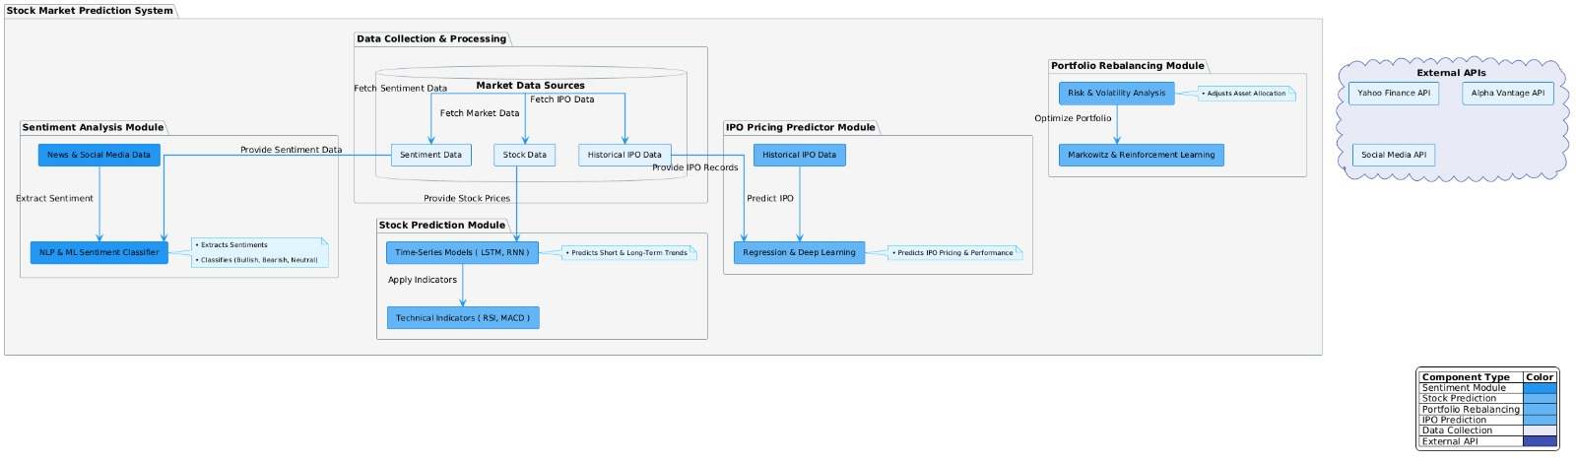
Proposed System
Dig:-System Diagram

Slide 14
Proposed System
A) Stock Price Prediction and Sentiment analysis Module
A.i) Functionality:
Uses historical stock data and technical indicators to forecast trends.
Predict the sentiments of the overall Stock Market
Use sentiment analysis to predict the mood of the market and Predict the GMP of IPOs.
A.ii) Algorithms Used:
LSTM (Long Short-Term Memory):
Captures temporal dependencies in stock data.
Handles sequences effectively for trend prediction.
For sequential sentiment analysis of news and social media posts.
RNN (Recurrent Neural Networks): Supports time-series forecasting with high accuracy.
Gated Recurrent Unit (GRU):
Purpose: A type of Recurrent Neural Network (RNN) designed for sequential data like time series or text.
Key Features: Uses gates (update and reset) to control the flow of information, helping to handle long-term dependencies better than basic RNNs.

Slide 15
Proposed System
A) Stock Price Prediction and Sentiment analysis Module
A.i) Algorithms Used:
Reinforcement Learning: Reinforcement Learning is a type of machine learning where an agent learns to make decisions by interacting with an environment to maximize cumulative rewards over time.

Slide 16
Proposed System
B) Portfolio Rebalancing Automation Module
Functionality:
Continuously evaluates portfolio performance and adjusts allocations dynamically.
Algorithms Used:
Markowitz Model: Optimizes portfolio for maximum return with minimal risk.
Rebalancing Strategy: Monitors deviations from target allocation and triggers adjustments.
C) IPO Pricing Predictor Module
Functionality:
Predicts IPO pricing using historical data, sentiment analysis, and market trends.
Algorithms Used:
Data Representation: Convert historical IPO data (price fluctuations, volatility, volume, market conditions) into a structured format.
Feature Extraction: CNN filters identify crucial price movement patterns.
Pattern Matching: The model compares new IPO trends to past successful IPOs.
Prediction: It forecasts short-term gains (first week or month post-IPO) based on historical patterns.
Output: Predicted IPO prices with risk assessments.

Slide 17
Explanation of Module
1) Financial news sentiment analysis with Google Analytics data and LSTM-based stock movement prediction.
✅ Step 1: Extract Financial News Data from Google Analytics
Use the Google Analytics API to fetch news engagement data (page views, session duration, bounce rate, etc.).
✅ Step 2: Apply Hugging Face Sentiment Analysis
Use Hugging Face’s financial sentiment model to classify news headlines as Positive, Neutral, or Negative.
✅ Step 3: Tokenization & Sequence Processing
Convert headlines into numerical sequences using Tokenizer.
Pad sequences to ensure uniform input size for LSTM.
✅ Step 4: Prepare Features for Stock Prediction
Combine sentiment scores with stock price movements and Google Analytics engagement metrics as input features.

Slide 18
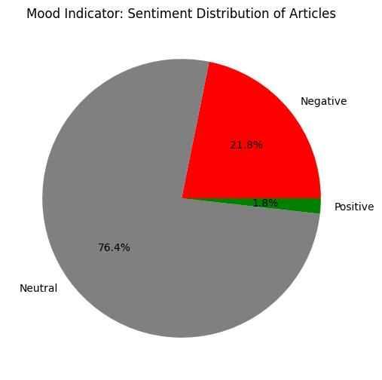
Implementation Output
Fig:- Sentiment Analysis

Slide 19
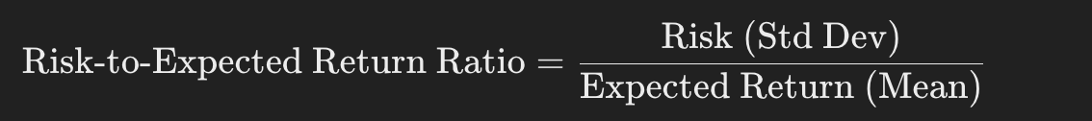
Explanation of Module
2) Risk-to-Expected Return Ratio Analysis with Advanced Risk Metrics
✅1. Risk & Expected Return Calculation:
Expected Return: Mean return of each company's stock.
Risk (Volatility): Standard deviation of stock returns.
✅ 2. Advanced Risk Metrics Used:
Moving Averages
Closing Price Comparison
Volume Movement Analysis
Daily Return Analysis

Slide 20
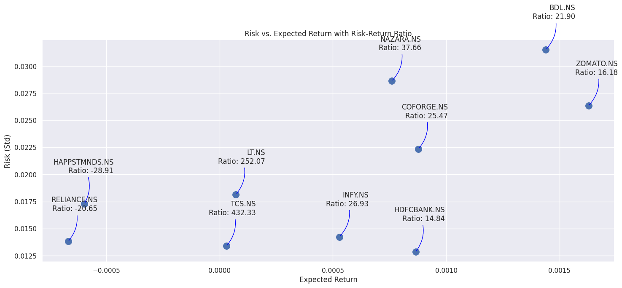
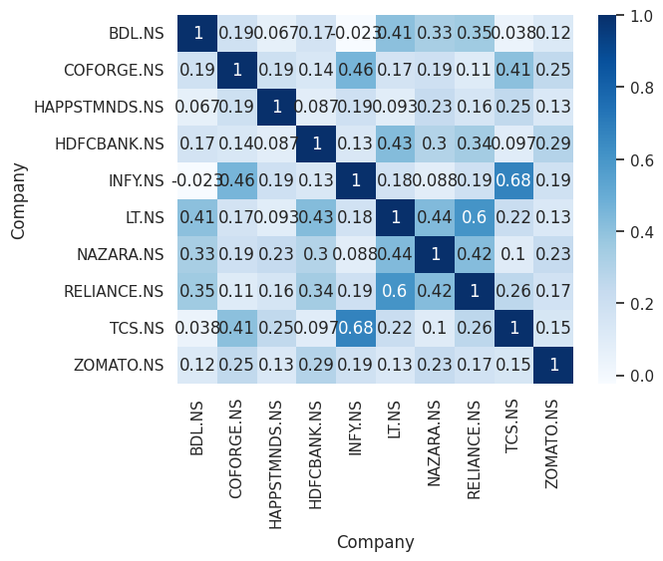
Implementation Output
Fig:- Risk to Return Analysis

Slide 21
Explanation of Module
3. Portfolio Risk Management Using Risk and Sentiment Analysis
Risk Analysis
Risk-to-Expected Return Ratio: Evaluates each stock's risk (volatility) relative to its expected return.
Users are categorized into:
High Risk: Stocks with high volatility but higher expected returns.
Neutral Risk: Stocks with moderate volatility and returns.
Low Risk: Stocks with low volatility and stable returns.
Sentiment Analysis
Sentiment scores from Hugging Face's sentiment model categorize financial news into Positive, Neutral, and Negative.
Positive sentiment may indicate bullish trends while Negative sentiment may signal market downturns.
Portfolio Management Strategy
Based on the combination of risk and sentiment analysis, users are advised to:
High Risk: Target stocks with high return potential but increased volatility.
Neutral Risk: Choose stocks with a balanced risk-return ratio and neutral sentiment.
Low Risk: Favor stable stocks with consistent returns and positive sentiment.

Slide 22
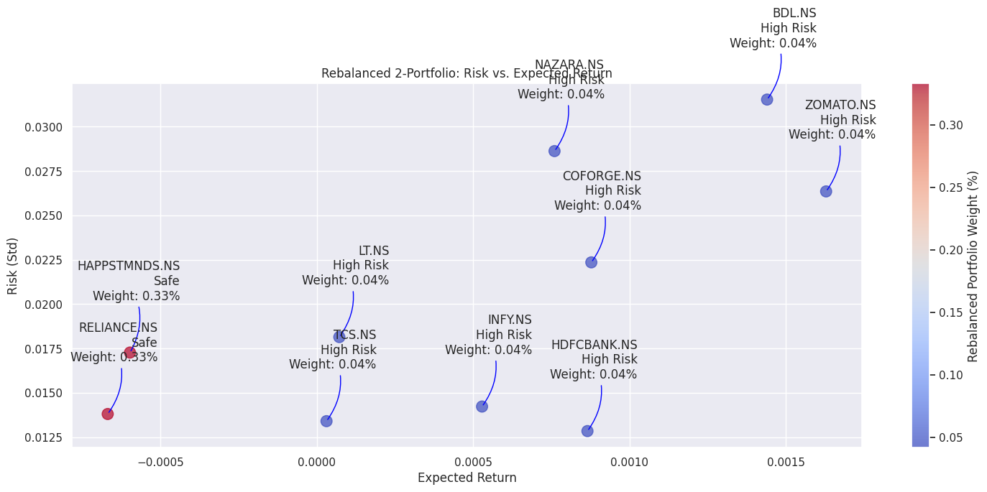
Implementation Output
Fig:-Risk to weightage analysis

Slide 23
Explanation of Module
4) Stock Price Prediction Model Using LSTM and Multiple Factors
Data Preparation:
Financial Data : Used Yahoo Finance API to fetch financial data.
Risk Metrics: Calculated risk-to-expected return ratios, using metrics like moving averages, closing price comparison, volume movement, and daily returns.
Stock Data: Prepared historical stock prices and related metrics for input into the LSTM model.
LSTM Model Architecture:
Input Features: historical stock data risk metrics ,moving averages, Volumes, Close Price history.
LSTM Layers: Used bi-directional LSTM layers to capture temporal dependencies in stock price movements.
Output Layer: The model predicts stock price movements (e.g., Up or Down) based on the integrated features.
Model Training:
Training Data: The LSTM model was trained using historical stock data with sentiment features and risk metrics as input.
Loss Function: Sparse categorical cross-entropy was used, with accuracy as a metric.
Prediction:
The trained model predicts whether the stock price will go up or down based on the combination of historical price patterns, sentiment analysis, and risk-adjusted return metrics.

Slide 24
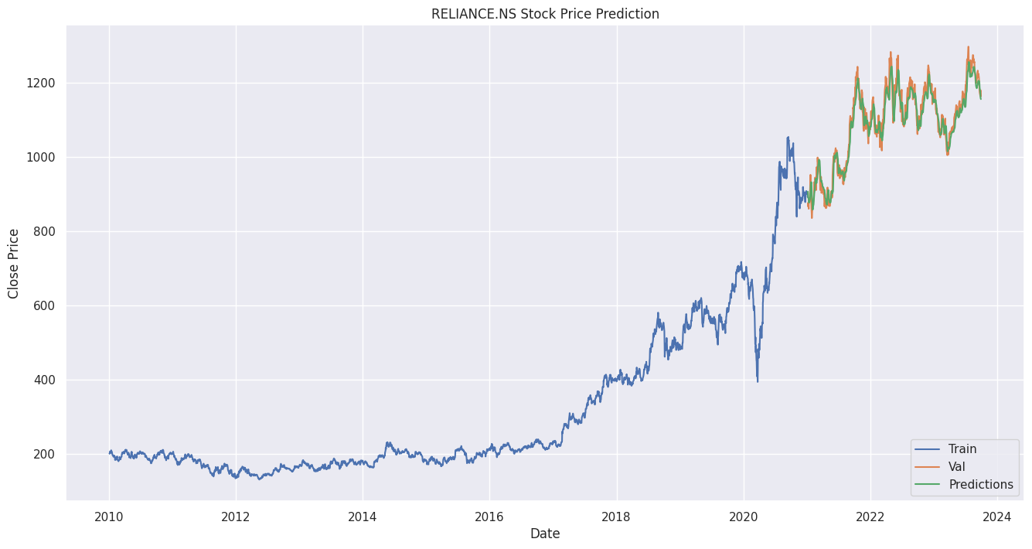
Implementation Output
Fig:- Future Price Prediction

Slide 25
Expected Outcome
Risk Factor Identification for Smarter Investment Decisions
The system will analyze market risks using AI-based volatility assessment to provide real-time alerts on high-risk stocks.
Investors can adjust their investment strategies based on dynamic AI-driven insights.
Automated Portfolio Rebalancing for Investors
AI-powered portfolio balancing will dynamically optimize asset allocation based on risk-adjusted return analysis.
The model will automatically adjust investments based on changing market conditions, reducing human error.
Improved Sentiment-Driven Market Analysis
The sentiment analysis module will identify bullish and bearish trends by processing financial news and social media in real-time.
Market sentiment scores will be integrated into stock prediction models to enhance decision-making accuracy.

Slide 26
References:-
1. Gu, Y., Shibukawa, T., Kondo, Y., Nagao, S., & Kamijo, S. (2020). Prediction of Stock Performance Using Deep Neural Networks. *Applied Sciences*, *10*(22), 8142.
2. Song, H., & Choi, H. (2023). Forecasting Stock Market Indices Using the Recurrent Neural Network Based Hybrid Models: CNN-LSTM, GRU-CNN, and Ensemble Models. *Applied Sciences*, *13*(7), 4644.
3. Nafia, A., Yousfi, A., & Echaoui, A. (n.d.). Equity-Market-Neutral Strategy Portfolio Construction Using LSTM-Based Stock Prediction and Selection: An Application to S&P500 Consumer Staples Stocks.
4. Gadde, N., Mohapatra, A., Dey, S., Manukonda, S., Uppaladinni, S., & Suresh, V. (n.d.). Machine Learning for Real-Time Portfolio Rebalancing: A Novel Approach to Financial Optimization.
5. Obeidat, S., & Shapiro, D. (n.d.). Adaptive Portfolio Asset Allocation Optimization with Deep Learning.
6. Martínez-Barbero, X., Cervelló-Royo, R., & Ribal, J. (n.d.). Portfolio Optimization with Prediction-Based Return Using Long Short-Term Memory Neural Networks: Testing on Upward and Downward European Markets.
7. Inani, S. K., Pagaria, V., Pradhan, H., Nghiem, X.-H., & Nagpal, G. (n.d.). Applications of Deep Learning Techniques in Stock Market Forecasting: A Bibliometric Analysis.

Slide 27
References:-
8. Quintana, D., Sáez, Y., & Isasi, P. (n.d.). Random Forest Prediction of IPO Underpricing.
9. Munshi, M., Patel, M., Alqahtani, F., Tanwar, S., Neagu, B.-C., Tolba, A., & Dragomir, A. (n.d.). Artificial Intelligence and Exploratory-Data-Analysis-Based Initial Public Offering Gain Prediction for Public Investors.
10. Haritha, P. H., & Rishad, A. (n.d.). An Empirical Examination of Investor Sentiment and Stock Market Volatility: Evidence from India.
11. Peivandizadeh, A., Hatami, S., Nakhjavani, A., Khoshsima, L., Chalak Qazani, M. R., & Muhammad, H. (n.d.). Stock Market Prediction With Transductive Long Short-Term Memory and Social Media Sentiment Analysis.
12. Nabipour, M., Nayyeri, P., Jabani, H., Shahab, S., & Mosavi, A. (n.d.). Predicting Stock Market Trends Using Machine Learning and Deep Learning Algorithms Via Continuous and Binary Data: A Comparative Analysis.

Slide 28
References:-
13. [Author(s)]. (n.d.). Analyzing Moroccan Stock Market Using Machine Learning and Sentiment Analysis.
14. Peng, D. (n.d.). Analysis of Investor Sentiment and Stock Market Volatility Trend Based on Big Data Strategy. Dalian Ocean University, Liaoning Dalian, China.
15. Inani, S. K., Pagaria, V., Pradhan, H., Nghiem, X.-H., & Nagpal, G. (2023). Applications of Deep Learning Techniques in Stock Market Forecasting: A Bibliometric Analysis. *Conference Paper*. DOI: 10.1109/ICCAKM58659.2023.10449584

