Slide 1
Capstone Project
Airbnb Data Analysis
By: Biswajit Sahoo

Slide 2
Point Of Discussion
Data summary
Descriptive stats
Missing Value analysis
Which Neighborhood group has the maximum count
Maximum and Minimum Booking for the rooms
Price-wise room selection analysis
Best place according to price and availability
Month that has received the highest review
Which neighborhood group has the most average reviews
Stats for top 10 neighborhoods According to the host count
Which is most expensive and why
which neighborhood has the least price with their room type
Which hosts are busiest and why
percentage of room types offered by the top 10 busiest host
Location spot and room type per location
Conclusion

Slide 3
Data summary(column wise)
id- This is the identity number of the property listed by a particular host.
name- Description of the property.
host_id- This is the identity number of the host who have registered on Airbnb website.
host_name- This is the name of the host who have registered on Airbnb website.
neighbourhood_group- This is the name of the neighborhood group.
neighbourhood- This is the name of the neighbourhood present in the neighbourhood group.
latitude- This represents the coordinate of latitude of the property listed.
longitude- This represents the coordinate of latitude of the property listed.
room_type- This represents types of room listed by the host.
price- This is rent of listed property in USD.
minimum_nights- This is the minimum number nights to be spend by the guest in that property to rent a property.
number_of_reviews- This represents the number of reviews the particular property received.
last_review- The date at which property was last reviewed.
reviews_per_month- Reviews per month property received.
calculated_host_listings_count- Number of listing done by a particular host on Airbnb.
availability_365- This represents the number of days property available in 365 days.

Slide 4
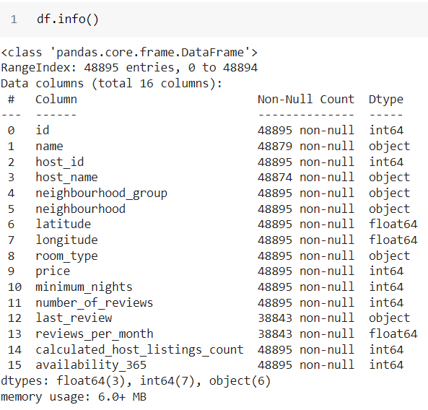
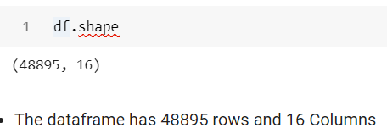
Know more about the Dataset(descriptive Stats)

Slide 5
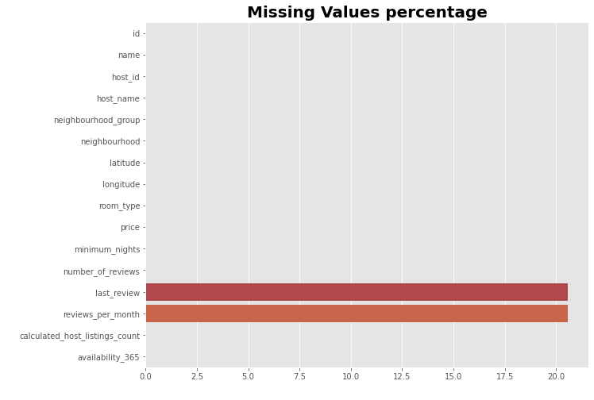
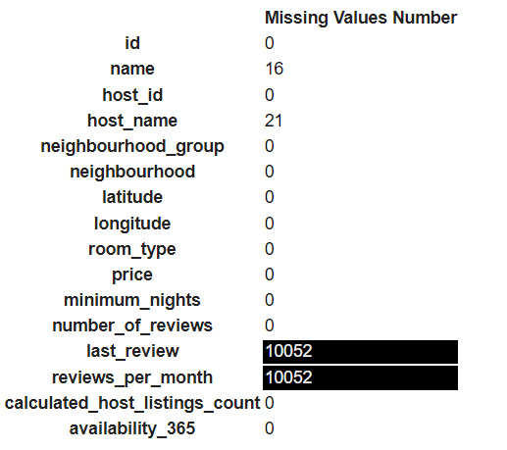
Missing Value Analysis
We can clearly see that there are more than 20% of Missing data in the “last_review” and “reviews_per_month” column and very few nos of missing data in the 'name' and 'host_name' column

Slide 6
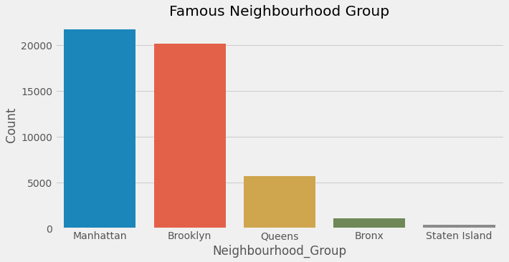
Neighborhood Group
Manhattan has the highest count which is 21661. It shows that the highest number of hosts prefer the Manhattan
Brooklyn is the second-highest and it holds the count of 20104
Queens is the third count I.e. 5666
Bronx and Staten Island are the least counts in Borough. That is 1091 and 373 respectively

Slide 7
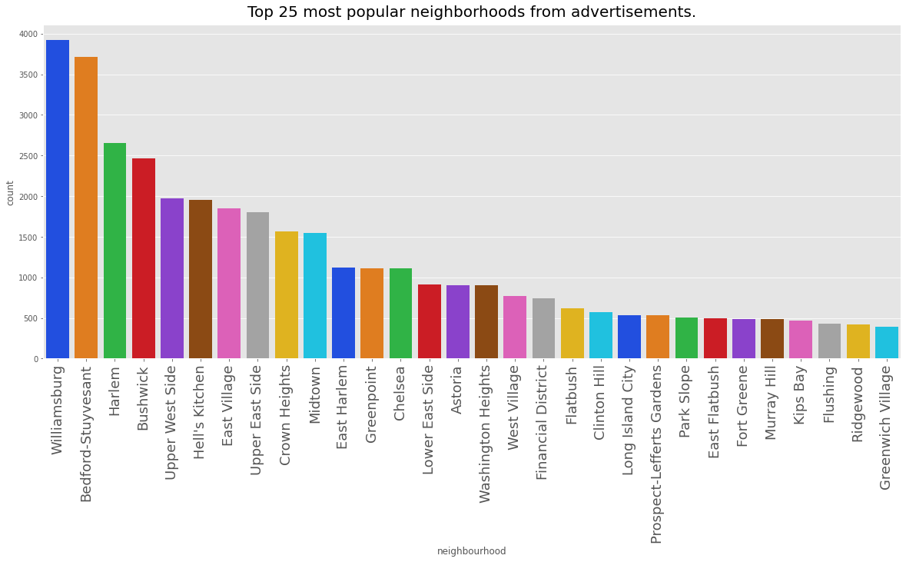
Neighborhood Group Contd.
Williamsburg and Bedford-Stuyvesant are the first and second choices of the Hosts and it holds the count record
Of 3920 and 3714 respectively.
Looking at the trend of the figure shows this is right-skewed data.

Slide 8
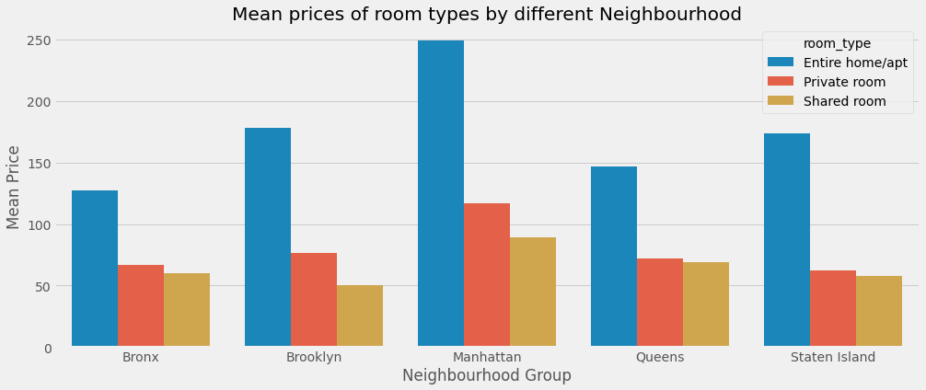
Room types vs Price Analysis
Entire home/Apt is always the highest-paid category among all.
Mean Price of the Entire home/Apt. in Manhattan, is the highest i.e 249 & the lowest mean price of an Entire home/Apt is 127 which is in the Bronx
The highest mean price of a Private room is 116 which is in Manhattan and the lowest is in Staten Island. I.e is 62
The Highest mean price of a shared room is 88 which belongs to Manhattan and the lowest is in Brooklyn which is 50

Slide 9
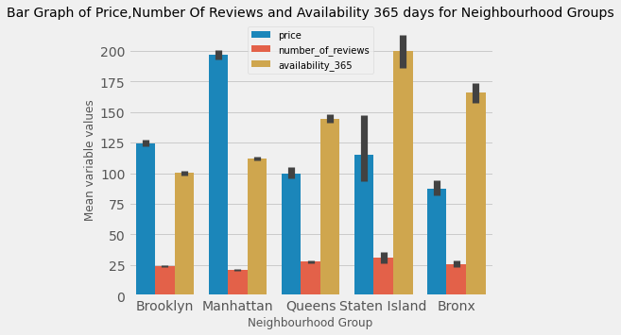
The good place to go in terms of price and availability
From the above bar graph we can say that the mean number of reviews given by the customers are same across all the neighborhood groups while the mean price is maximum in Manhatten and the mean availability is high in Staten Island throughout the year and the Bronx is good neighborhood group to go since this neighborhood has a minimum mean price and second highest availability 365 day's

Slide 10
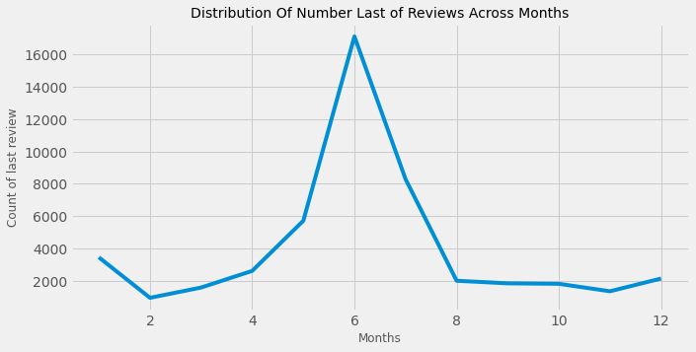
Let’s see which month has received the highest last reviews
The month June has the highest received last reviews

Slide 11
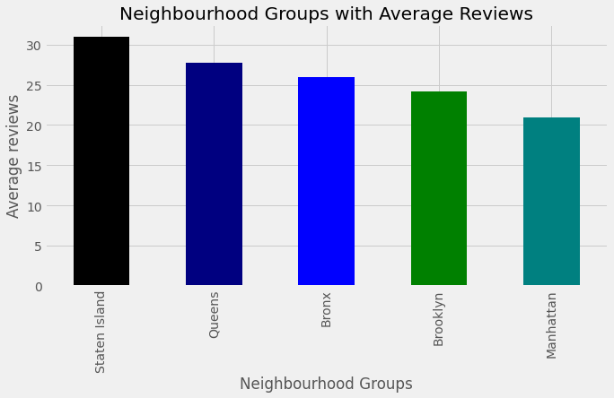
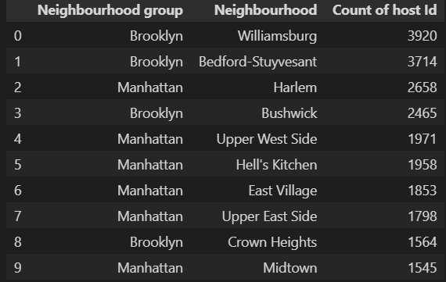
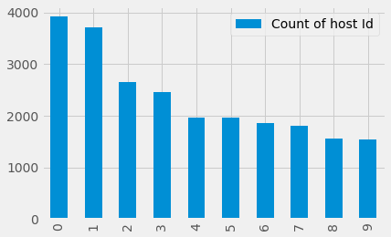
Which neighborhood group has got the most average reviews
Staten Island has the highest review of 30
Queens has an average review of 27
Bronx holds the avg. review count 26
Brooklyn holds the avg of 24
Manhattan has an avg review of 20
The top 10 neighborhood who has a high count of hosts

Slide 12
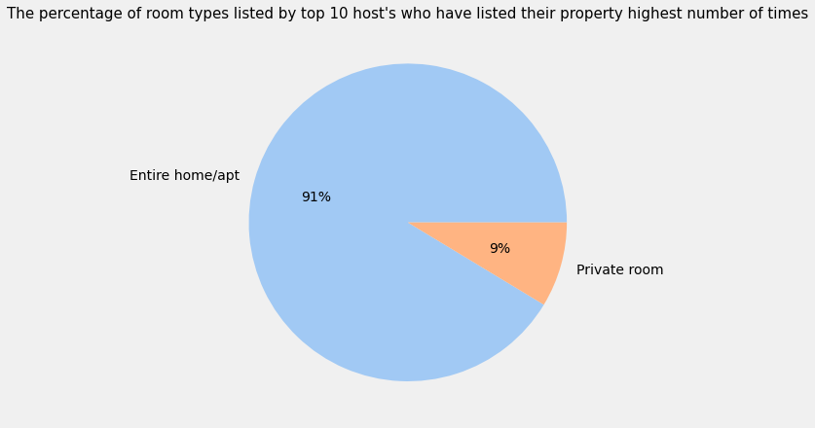
Percentage of room types listed by top 10 hosts who have listed their property highest number of time
Top 10 hosts only prefer to rent the Entire home/apt or Private room and not the shared room

Slide 13
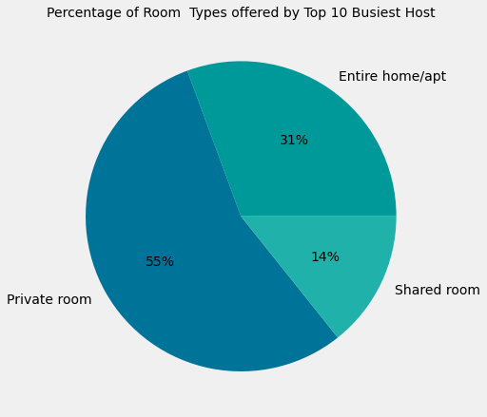
Percentage of room types offered by top 10 busiest hosts
These are the top 10 hosts that are busiest among all 16410 hosts that have 0 availability 365 days and here Count of 0 availability 365 days column shows the number of times that host has 0 availability.
In the pie chart with the title Percentage of Room Types with 0 Availability 365 days we can see that the Entire home/apt and Private room percentage of 0 availability 365 days is very high and in the above pie chart we can see that busiest top 10 host's offers Entire home/apt and Private room in higher percentage so this could be the one reason of being busiest hosts.

Slide 14
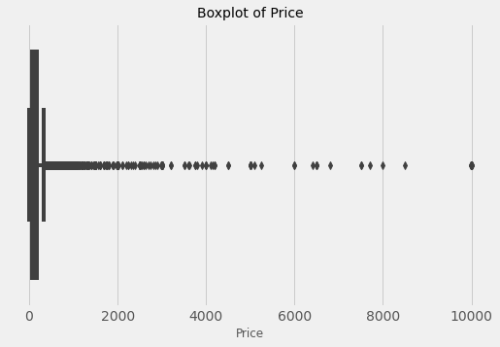
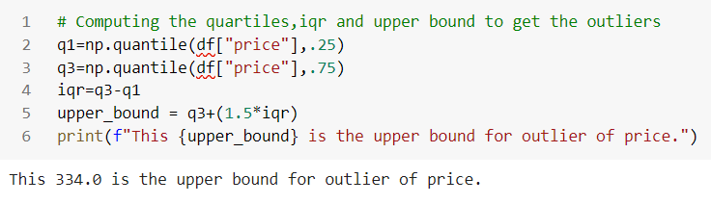
Which are is most expensive and why
334.0 is the upper bound for price anything above 334.0 in the price column would be considered as an outlier.

Slide 15
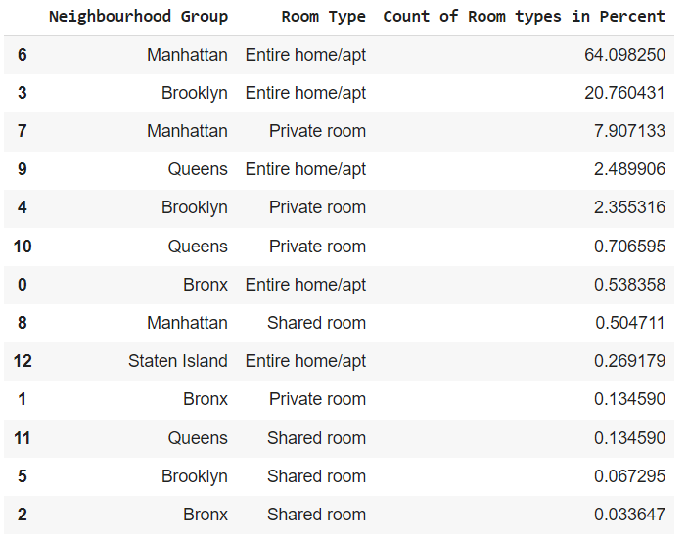
which area those outliers lie in and their room types.
From the above table, we can see that most of the outliers are from the Manhattan area and their room type is Entire home/apt which accounts for 64.1 % of the data and then followed by the Brooklyn area with the same room type i.e Entire home/apt with 20.8 % and so on.

Slide 16
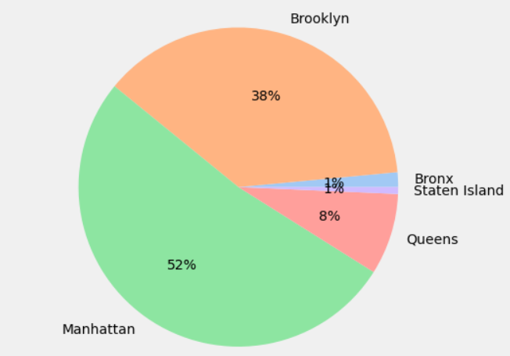
Why the Manhatten area has the highest outliers?
From above Pie chart Manhattan has the highest number of room types. Probably that could be the reason for the highest number of outliers

Slide 17
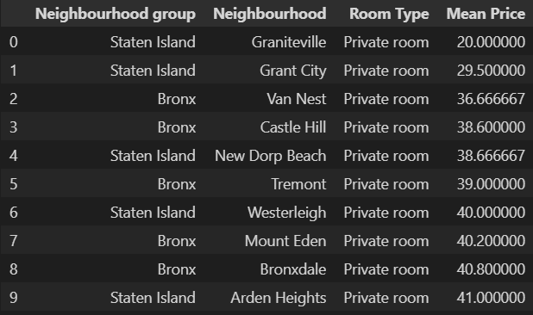
Neighbourhood has least price with their room type either as a Private room or Entire room/apt
Graniteville has the lowest mean price among all of the low-mean-priced neighborhoods. i.e 20

Slide 18
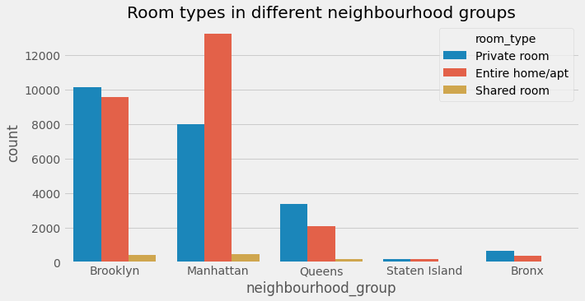
Distribution of room types in different neighborhood groups
Brooklyn has almost similar numbers of Private Room (10126) and Entire Homes/Apt (9558).
Manhattan has got the highest number of Entire Homes/Apt (13198) and there are very few shared rooms available in all the neighborhood groups in comparison to other room types.
Bronx and Staten Island has got very fewer rooms than the other neighborhood groups

Slide 19
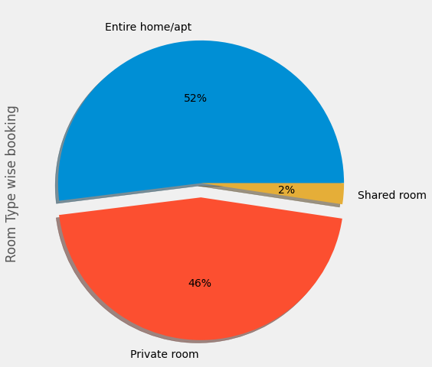
Room Type
Room type is categorized into three types.
The maximum booking goes for the Entire home or apartment and that is 25409 in stats which is 52% of the total room type
Hosts are preferring to a private room as their second choice and it holds 46% i.e 22326 of the total room type.
Very few shared room preferences are there, only 2% of the total room type.

Slide 20
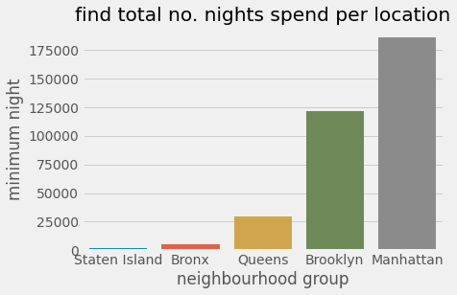
Popular Night stay Location
Manhattan is the most preferable night stay destination as 185833 records prefer to stay at night in Manhattan
The second highest night stay destination is Brooklyn and is has the 2nd highest count of 121761
And the rest of the night stay preferable location is Queens, Bronx and Staten Island and the stats record shows the count as 29358, 4976, and 1802 respectively.

Slide 21
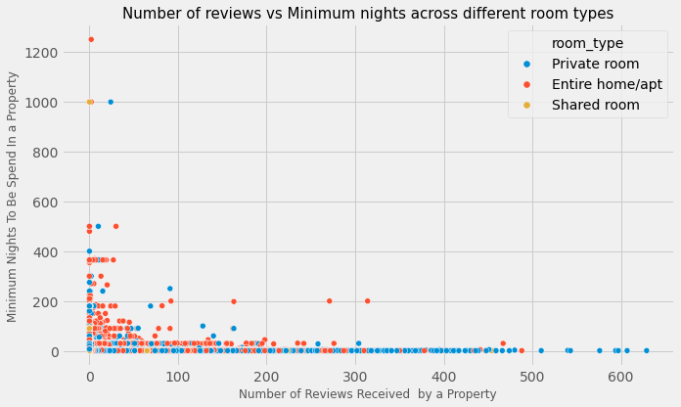
Relationship between the number of reviews and minimum nights with different room types
The reviews given by people are higher for a Private room type because people usually prefer either a Private room or an Entire home/apt but at the same time, the minimum number of nights to be spent in a private room is lower than any other room type. So we can say that people tend to review the property more likely if the minimum number of nights to be spent in that property is smaller.

Slide 22
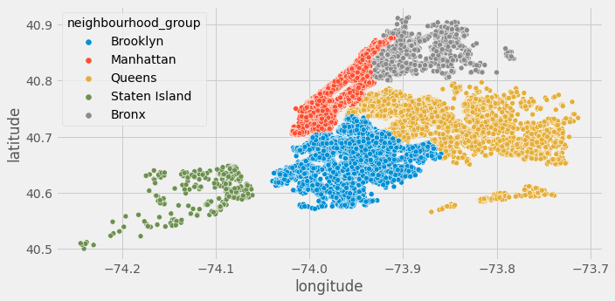
Locations based upon neighbors group

Slide 23
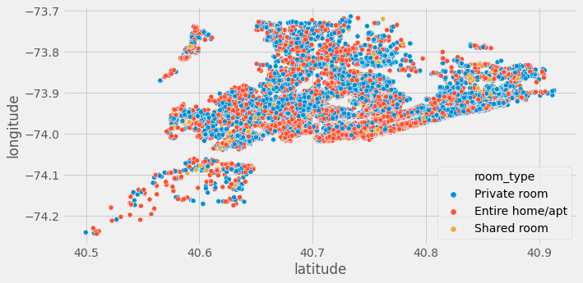
Room types per location of neighborhood groups

Slide 24
Conclusion
Bull's Head is the most affordable and good availability place to go which belongs to Staten Island.
Most of the hosts prefer to rent the Entire home/apt then followed by a private room and then a shared room.
The year 2019 has the highest percentage of the last review in the month of June.
Manhattan neighborhood group has a high percentage of hosts.
People usually go for an Entire home/apt or Private room and the Graniteville neighborhood has the mean minimum price among all neighborhoods.
Shared rooms do not have high traffic whereas Entire homes/apt and Private rooms are high in demand. The busiest top 10 hosts offer Entire homes/apt and Private rooms in a higher percentage so this could be the one reason for being the busiest hosts.
Brooklyn has high traffic among all neighborhood groups. The Manhattan area is the most expensive.

