Slide 1
Steps Included
Loading the Data
EDA
Data Preprocessing
Model Implementation
Hyperparameter Tuning
Comparing Model Performance

Slide 2
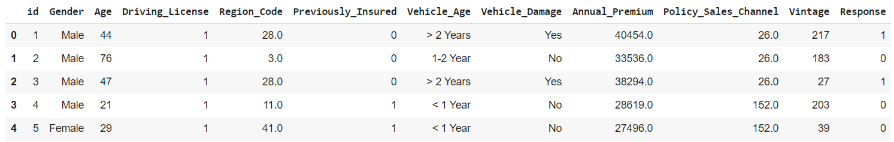
This Dataset has 381109 rows and 12 columns.
Three categorical features ‘Gender’, ‘Vehicle Age’, & ‘Vehicle Damage’.

Slide 3
Fortunately, there are No Missing Values present.
No Duplicate values present.
No null values are there.
‘response’ is the Dependent variable on which we need to make predictions.

Slide 4
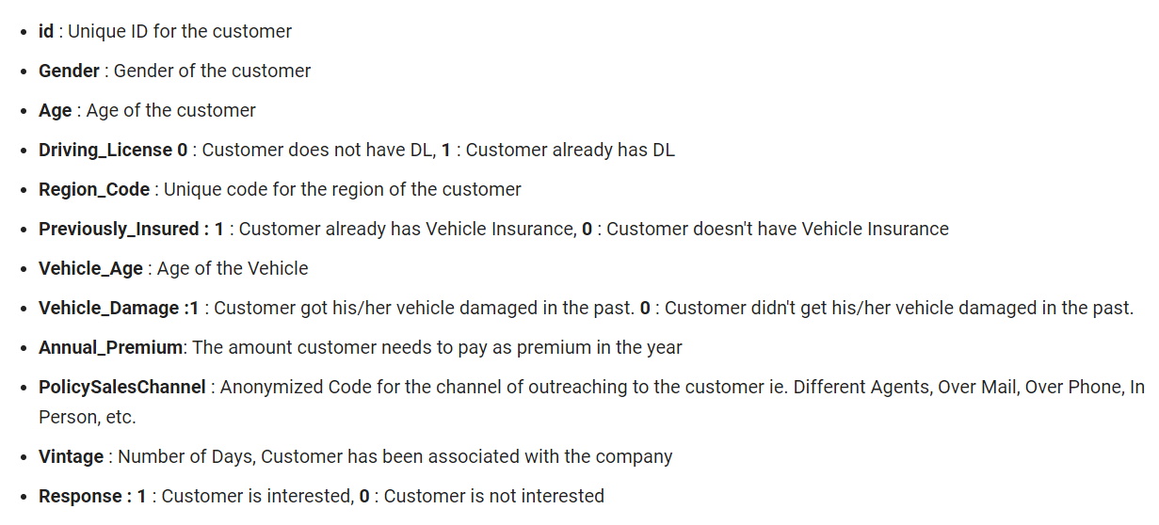

Slide 5
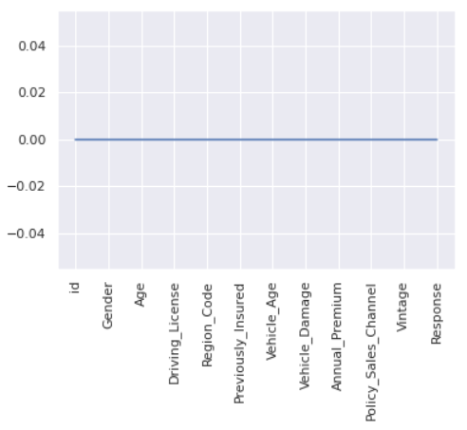

Slide 6
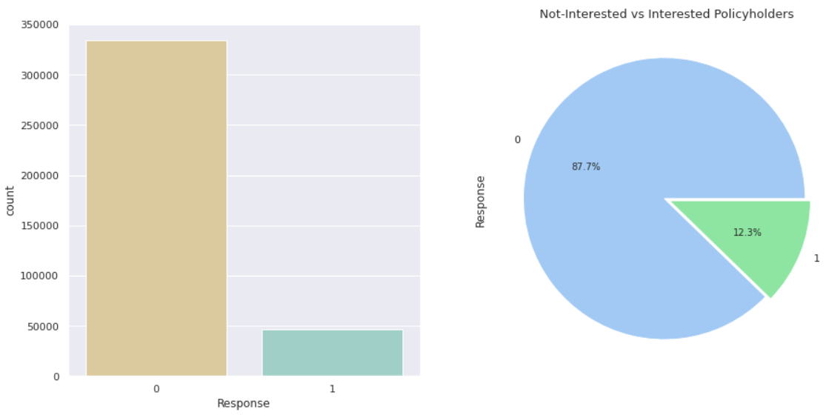
EDA
12.2 percent of the data are 1's and 87.7 percent of the data are 0s
Most people are not interested to Buy an insurance.

Slide 7
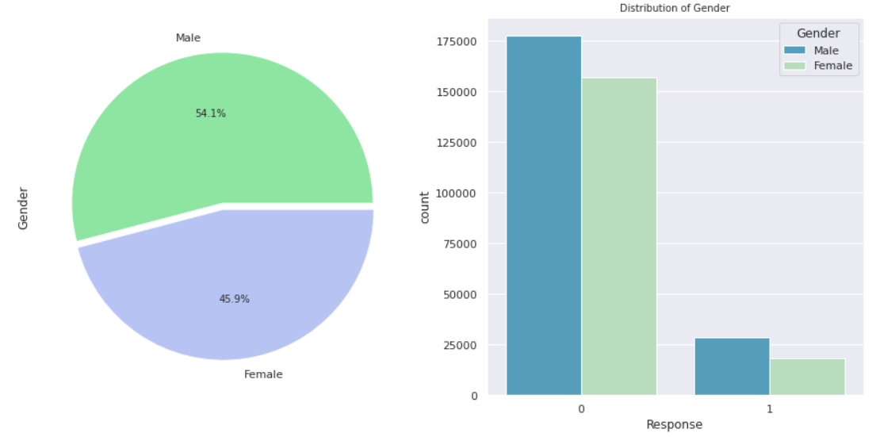
There is 206089 male i.e., (54.1 %) and 175020 female i.e., (45.9 %). S , we can say that the gender variable is almost equally distributed but males little bit more in comparison to females.
Among the Noninterested People the Males are more than the females and among the interested people males are also more than females

Slide 8
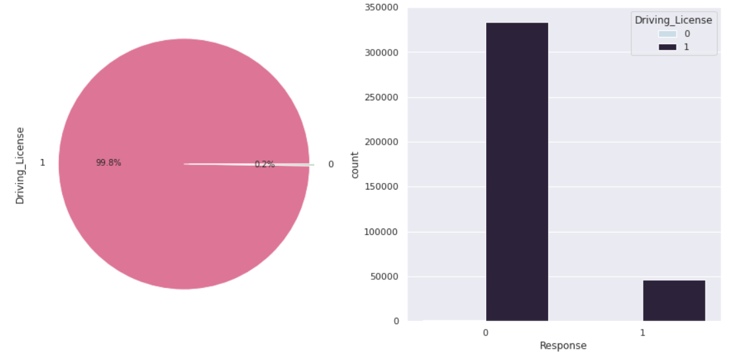
From the above count plot I found there are 99.8% people those who have driving licenses and 0.2% of people are not having driving licenses. So, we can say that the driving license variable is almost equally distributed.

Slide 9
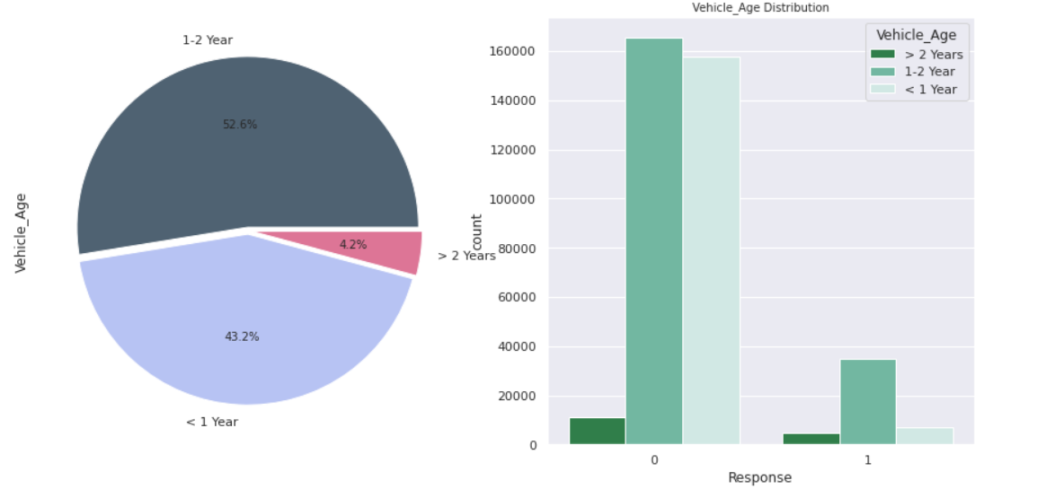
From the above count plot, we can say that most of the people having that vehicle whose age in the range 1-2 years in comparison other two.

Slide 10
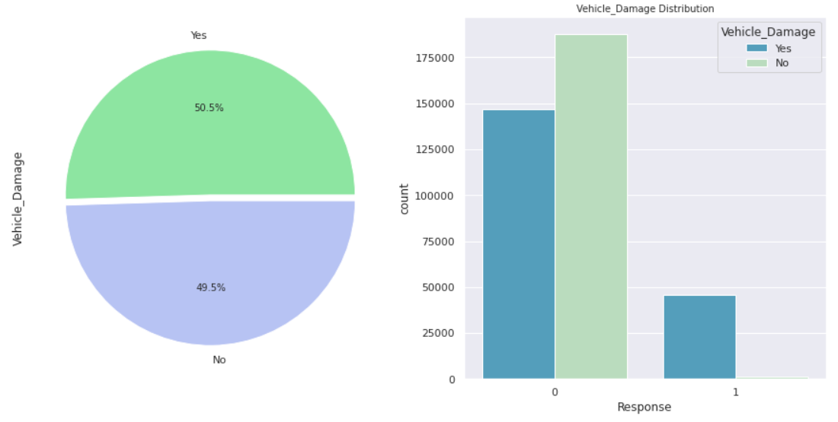
From the above pie chart I found there are 50.5 % of people whose vehicle is damage and 49.5 % are those people whose vehicle is not damaged. So, we can say that the Vehicle_Damage variable is almost equally distributed.

Slide 11
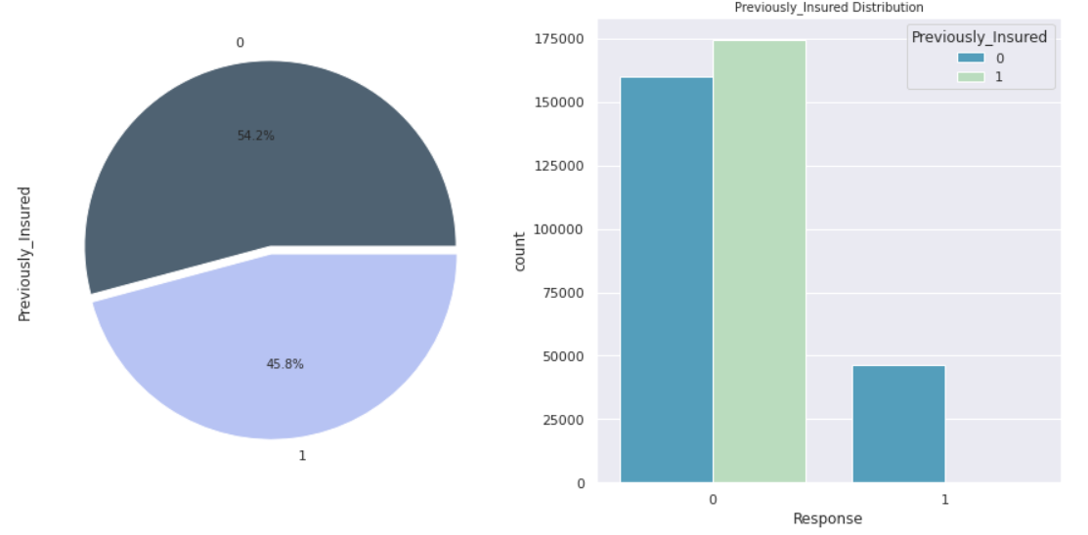
54.2% those people who not insured previously and 45.8% are those people who insured previously, which is almost equally distributed but Previously Insured people are little bit more in comparison to not insured people.

Slide 12
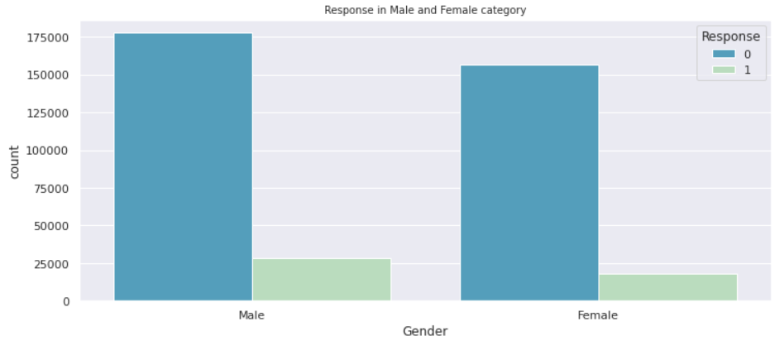
From the above count plot, We can see that males are more likely to purchase vehicle insurance.

Slide 13
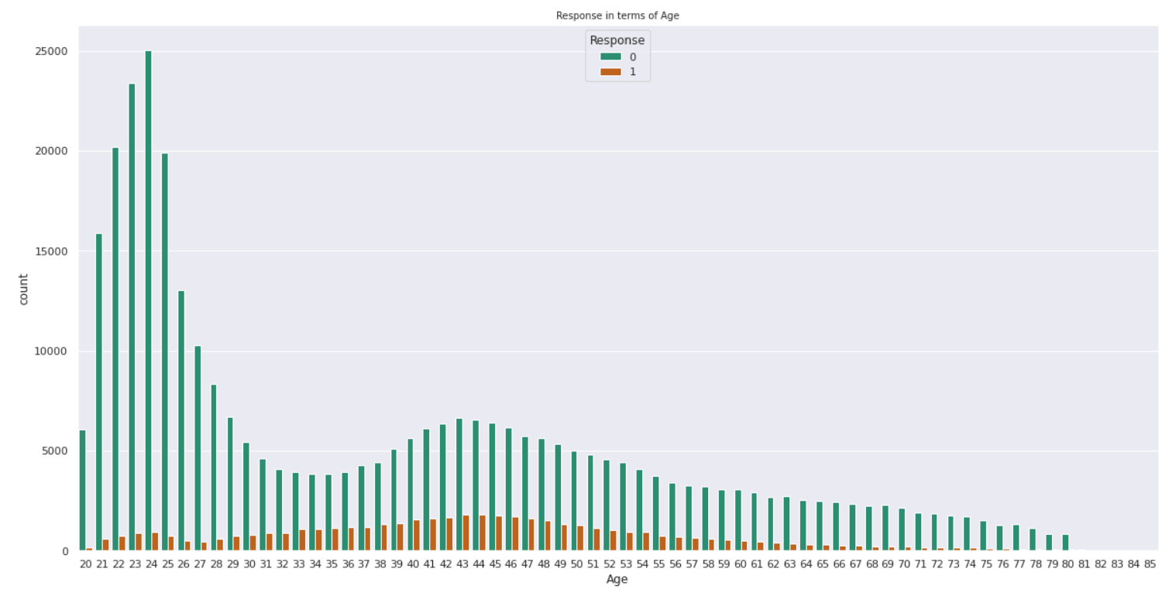
We can see that Ages below 30 are not more interested in purchasing vehicle insurance may be because of lack of experience and maturity levels.
People who are above 30-60 are more likely to be interested.

Slide 14
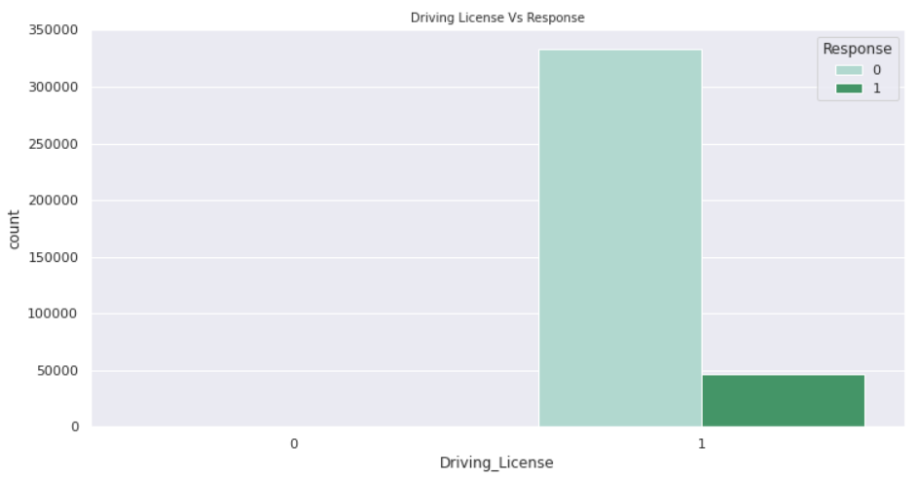
From the above count plot, we can say that Customers who are interested in Vehicle insurance are almost having a driving license.

Slide 15
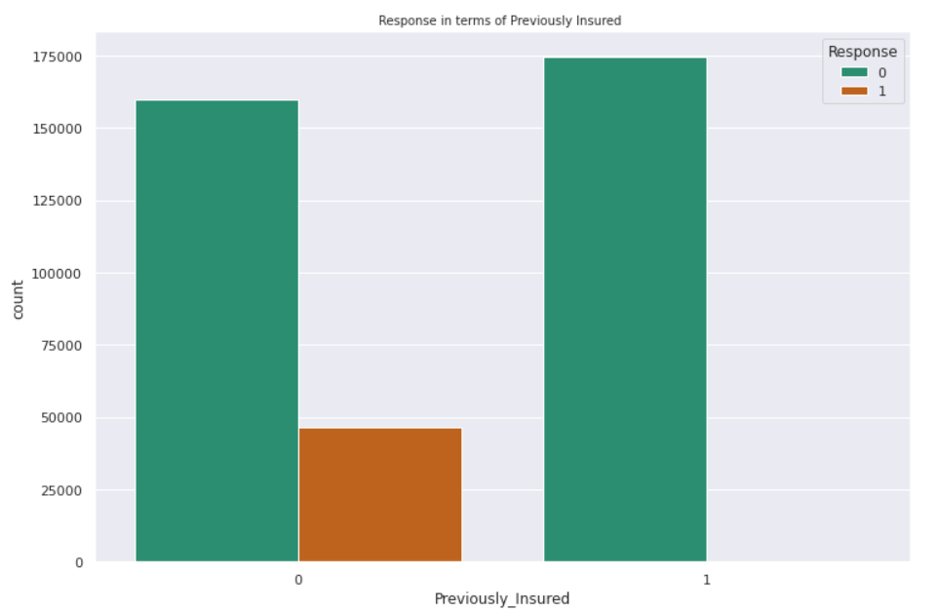
From the above count-plot, we found that their are almost everyone is purchase insurence those are previously insured.

Slide 16
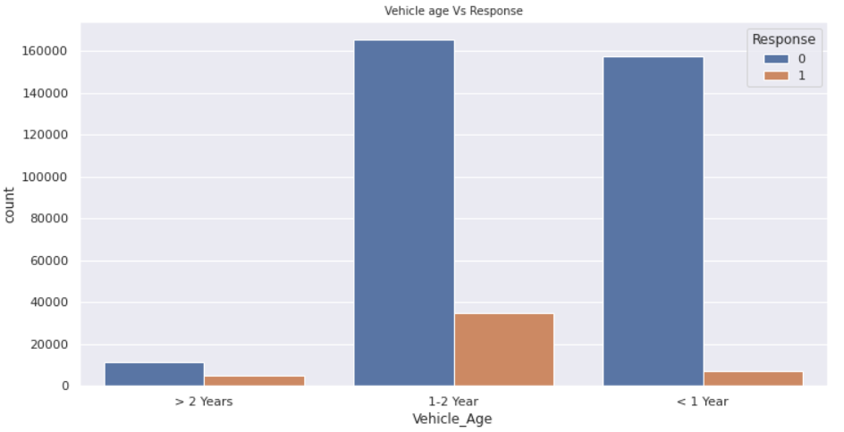
From the above graph, we can say that customers whose vehicle age is between 1-2 years are most likely to be interested when compared to the other two

Slide 17
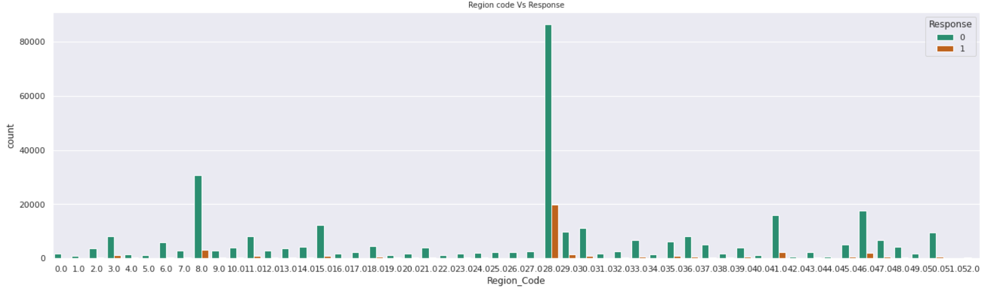
From the above graph, i found that the Region Code - 0.28 has more customers in comparison to others region codes.

Slide 18
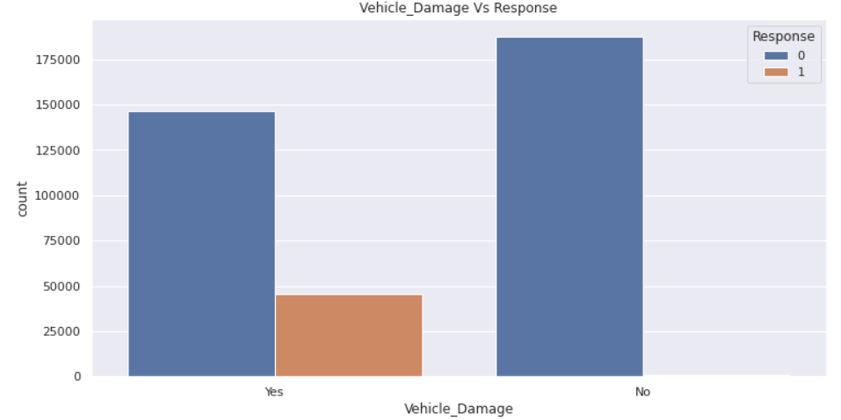
We can infer from the above plot that those people whose vehicle is damage are taking insurence more in comparison those who's vehicle are not damaged.

Slide 19
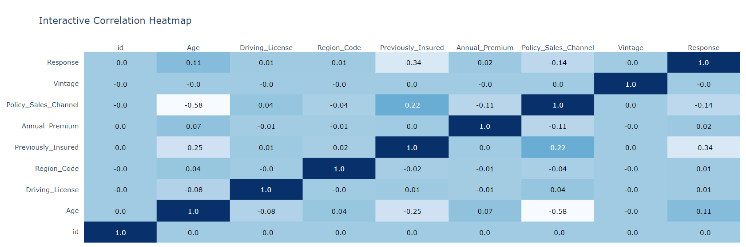
Target variable ( Response ) is not much affected by the Vintage variable. we can drop least correlated variable.
From the above correlation heatmap, we can see that the policy_sales_channel and age is negatively correlated.
Rest all correlation can be depicted from the above chart.

