Slide 1
Synergy Distributed Meeting Scheduler (SDMS)
Project Presentation
Students: Arnena Sheihk-Houssein
Hui Chen
Yiying Lee
CS6361 Requirement Engineering
Prof. Lawrence Chung
Computer Science Department
University of Texas at Dallas
Fall 2005

Slide 2
Contents
Project Overview
Requirement Description
Use Case Diagrams
System Level Class Diagram
Activity Class Diagram
Entity Class Diagram
Prototype

Slide 3
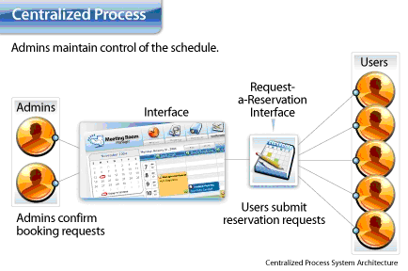
Project Overview
SDMS is a system simply refers to on-line scheduling between businesses personals as opposed to the more familiar way by calling and scheduling a meeting between businesses SDMS systems are a way of bringing business partners together in one location or across countries at the same time.

Slide 4
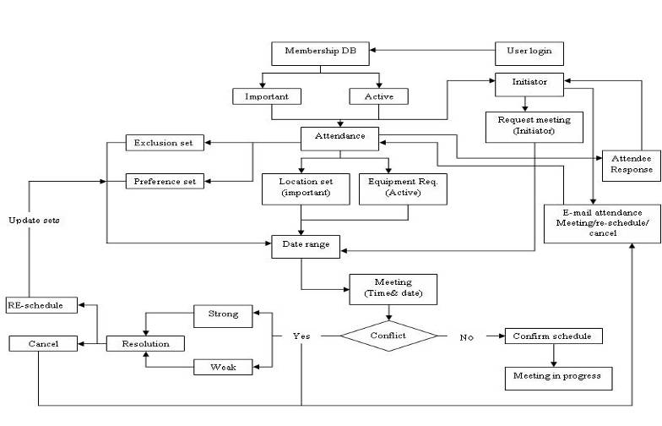
Informal requirement Description

Slide 5
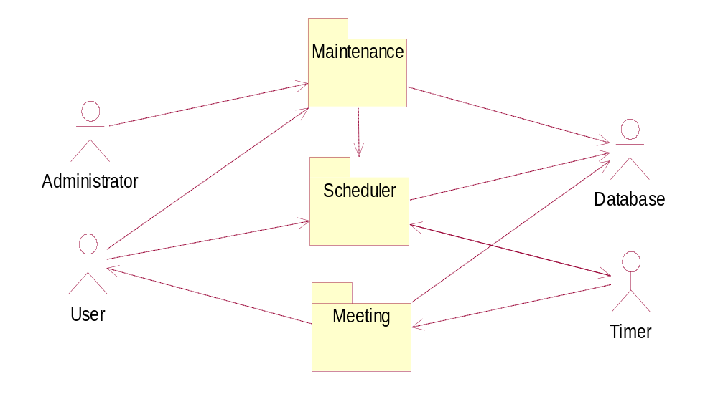
Use Case Diagram (Package)

Slide 6
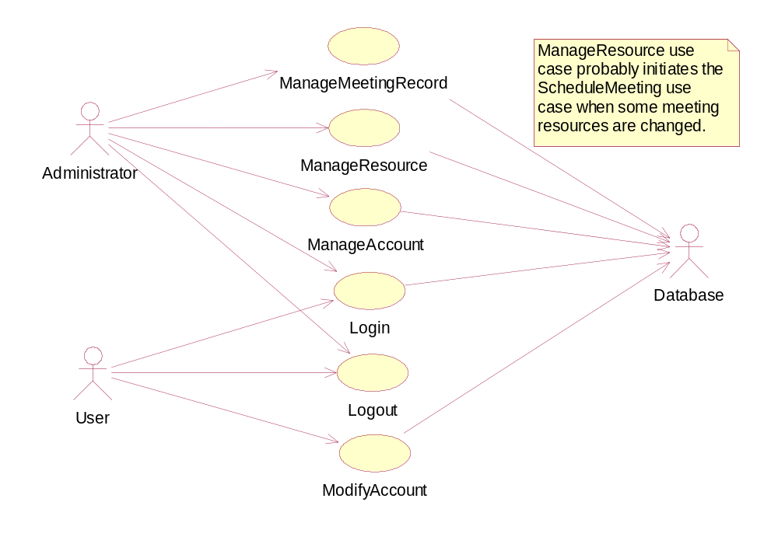
Use Case Diagram (Maintenance)

Slide 7
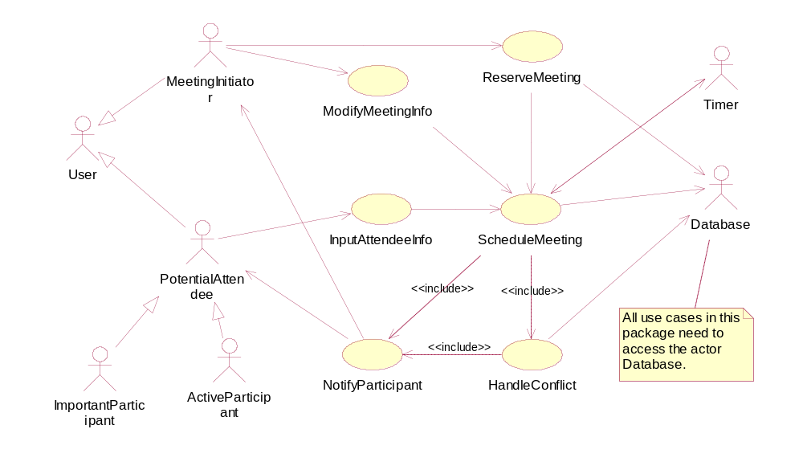
Use Case Diagram (Scheduler)
as

Slide 8
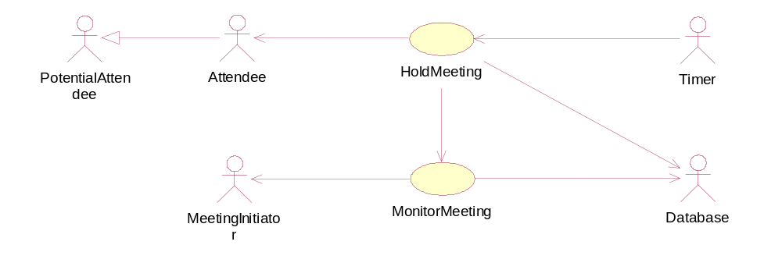
Use Case Diagram (Meeting)

Slide 9
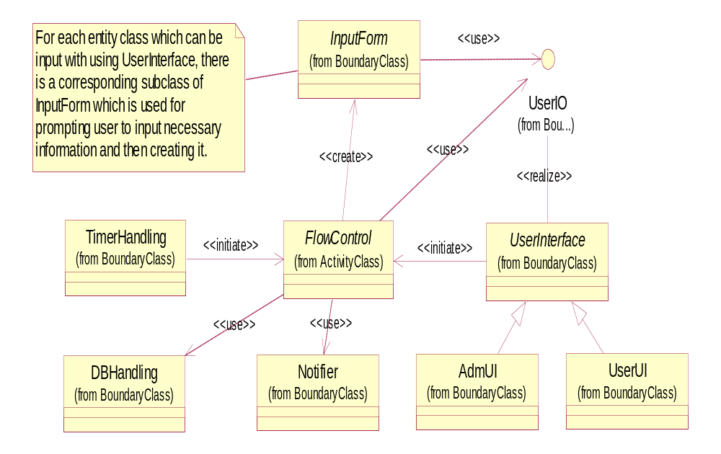
Class Diagram (System level)

Slide 10
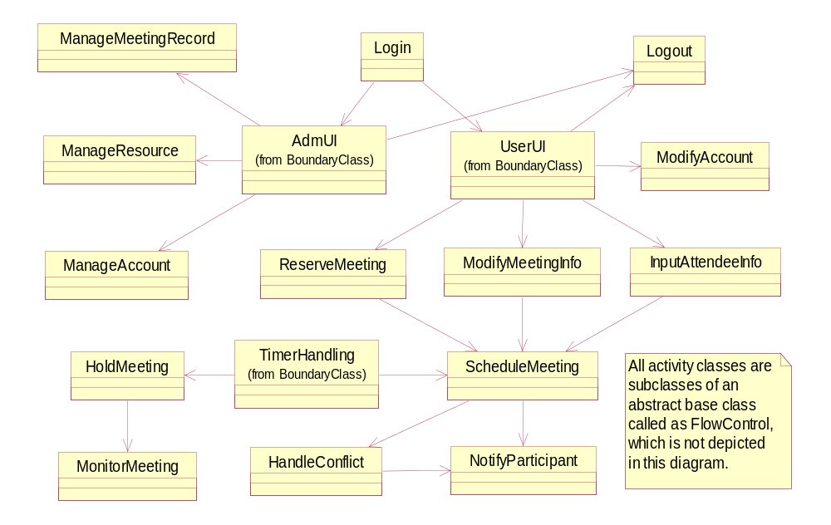
Activity Class Diagram

Slide 11
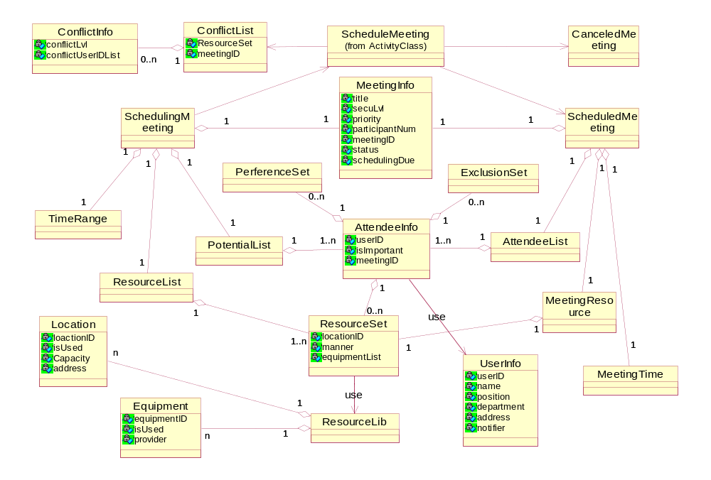
Entity Class Diagram

Slide 12
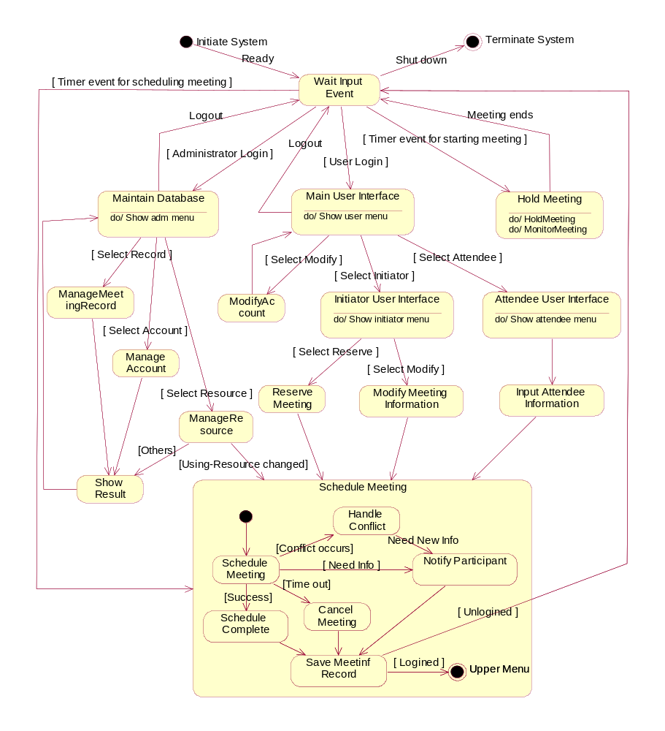
Statechart Diagram

Slide 13
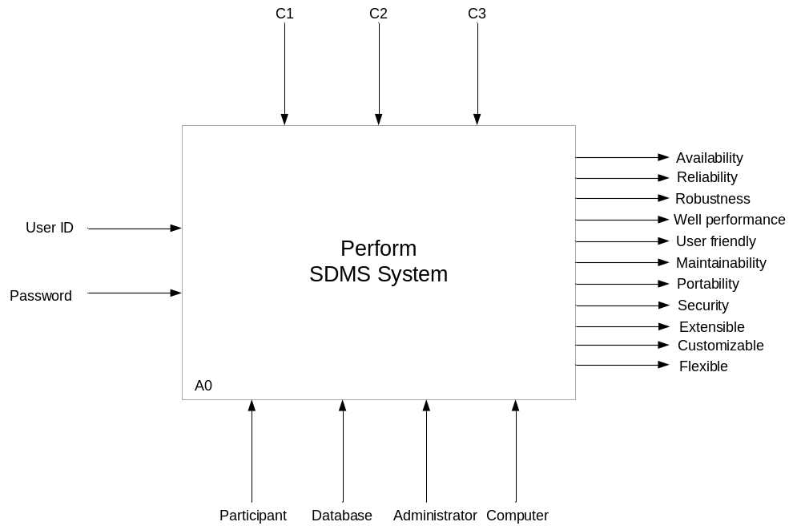
Non Functional Requirements

Slide 14
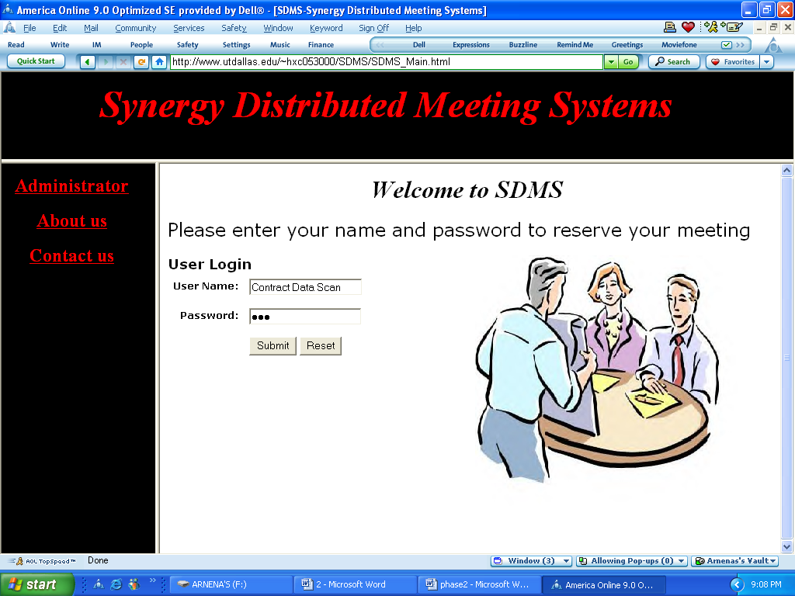
Prototype

Slide 15
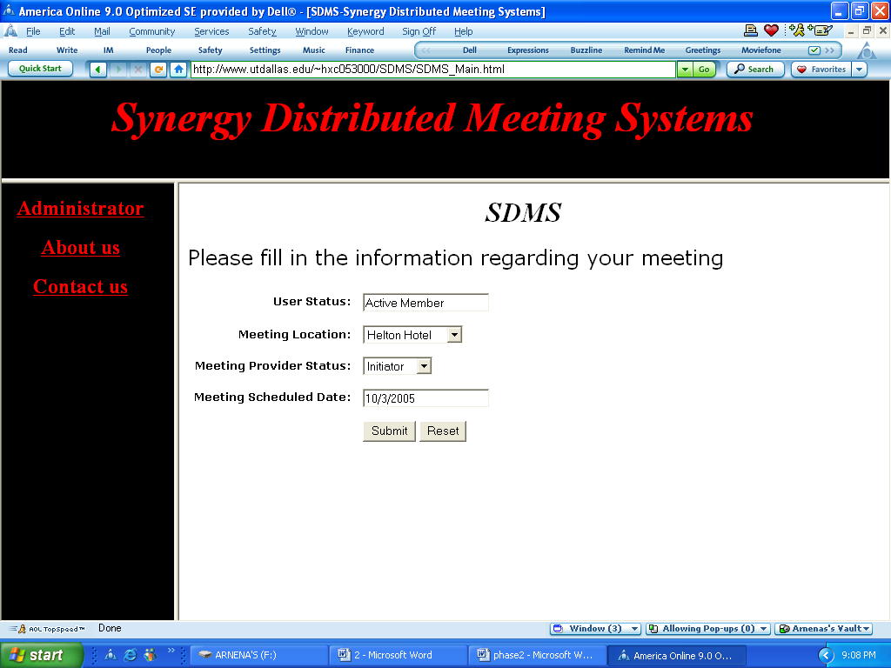
Prototype

Slide 16
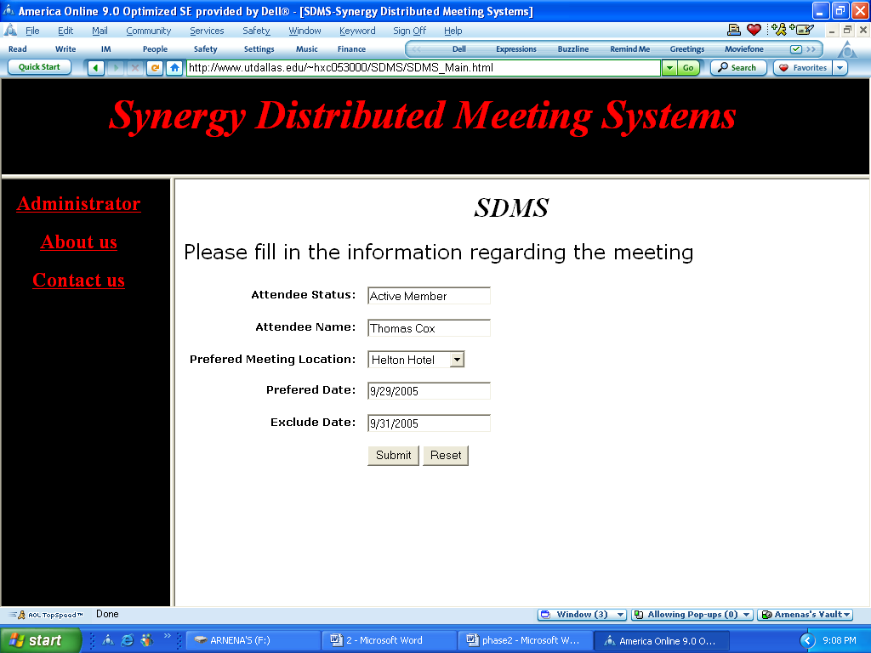
Prototype

Slide 17
Thanks !

