Slide 1
CNN-Based Uncertainty-Guided Adaptive Timestep Routing for Spiking Vision Transformer For Medical Image Segmentation
Biswajit Nahak (B222016)
Vaibhav Raj (B222054)

Slide 2
Introduction
Brain tumor segmentation is important for diagnosis and treatment planning
MRI modalities: T1, T1ce, T2, FLAIR
Need for accurate and energy-efficient models
Combines SNNs with Transformers

Slide 3
Problem Statement
Fixed timestep SNNs waste computation
Background regions need less processing
Tumor regions need deeper temporal integration
Goal: adaptive computation with high accuracy

Slide 4
Objectives
Design a Spiking Vision Transformer
Develop adaptive timestep routing
Reduce temporal computation
Maintain segmentation accuracy

Slide 5
Spiking Neural Networks (SNNs)
Biologically inspired neural computation
Event-driven sparse spikes
Energy-efficient compared to ANN
Uses Leaky Integrate-and-Fire neurons

Slide 6
Vision Transformers
Patch-based image representation
Uses self-attention for global context
Strong performance in medical segmentation
Combined with spiking computation

Slide 7
Proposed Architecture
Input: 4-channel MRI slices
Patch embedding layer
Spiking Transformer blocks
Adaptive timestep routing agent
Segmentation head output

Slide 8
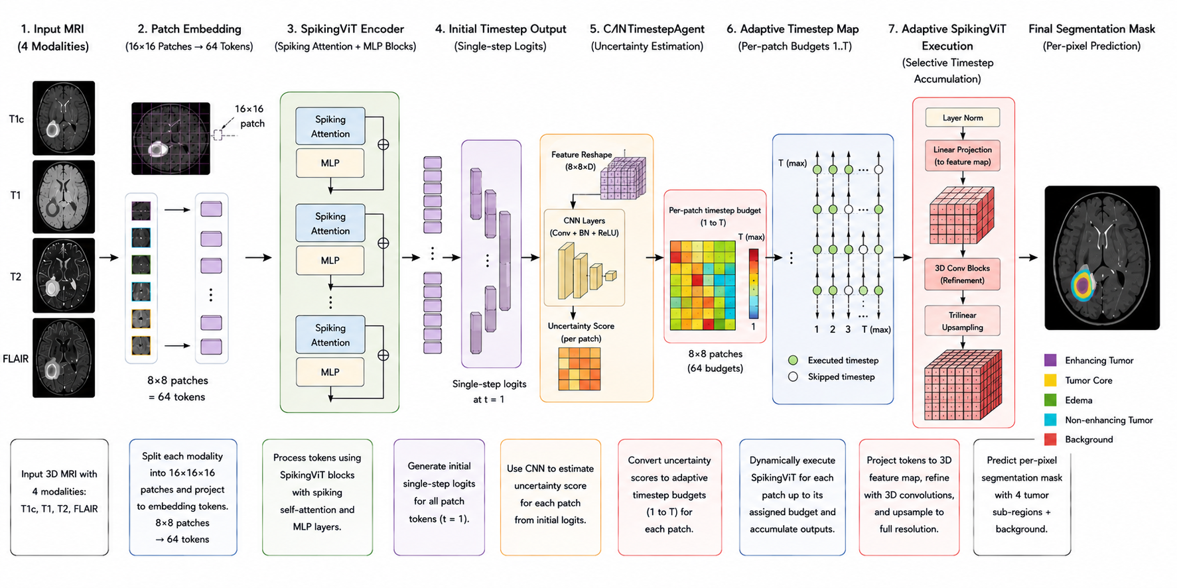

Slide 9
Adaptive Timestep Agent
Uses entropy and structural gradients
Assigns timesteps per patch
Low uncertainty → fewer timesteps
High uncertainty → more timesteps

Slide 10
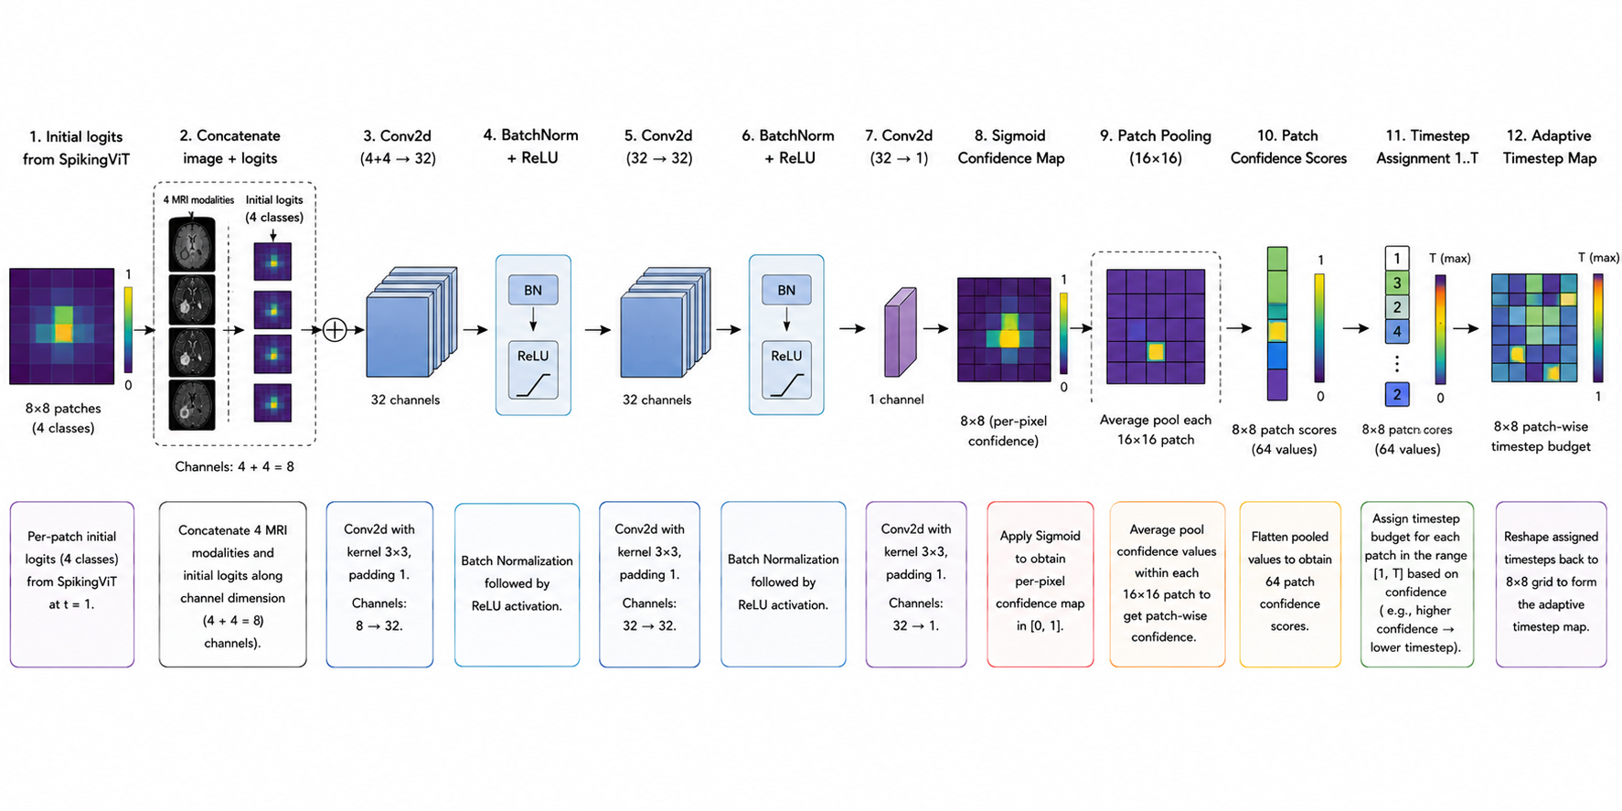

Slide 11
Training Strategy
Phase I: Fixed timestep warmup
Phase II: Adaptive routing enabled
Dice + Cross Entropy loss
End-to-end surrogate gradient learning

Slide 12
Dataset & Preprocessing
BraTS 2023 Dataset
2D axial MRI slices
128×128 resizing
Normalization and augmentation

Slide 13
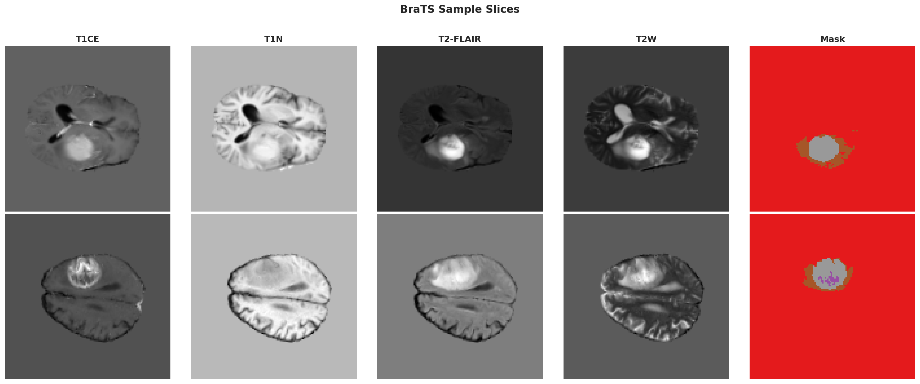

Slide 14
Evaluation Metrics
Dice Similarity Coefficient
Hausdorff Distance (HD95)
Energy Savings Metric
Comparison with fixed timestep baseline

Slide 15
Results
Validation Dice Score: 0.7410
HD95: 2.412
Energy Savings: 25.26%
Stable convergence and good segmentation quality

Slide 16
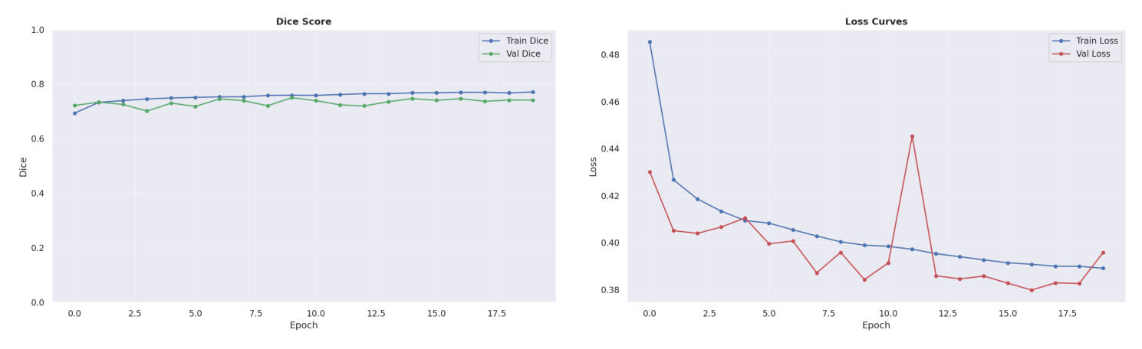

Slide 17
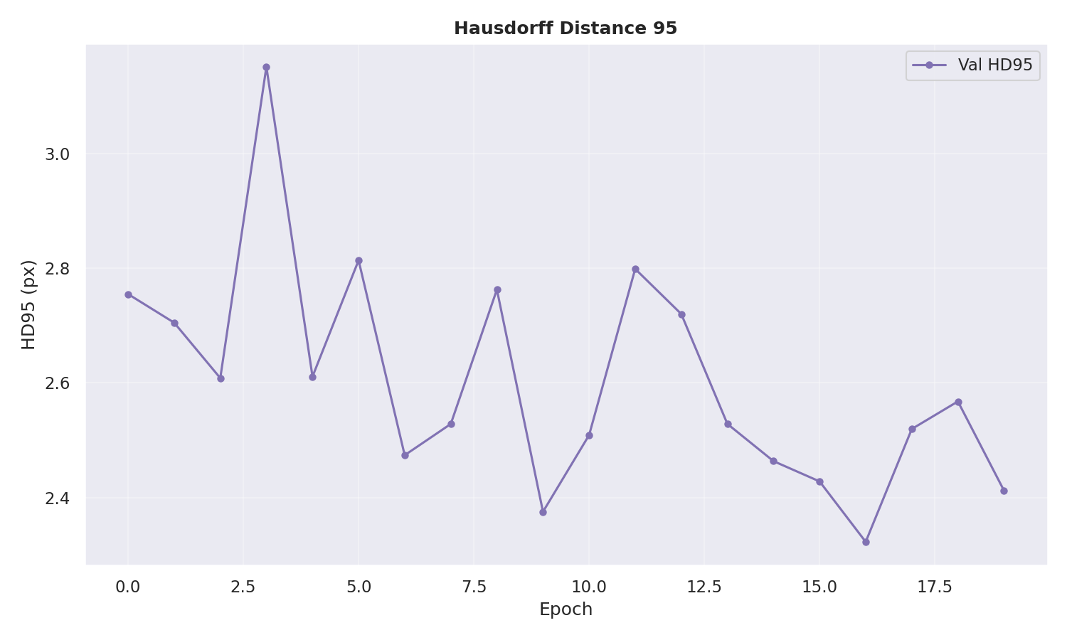

Slide 18
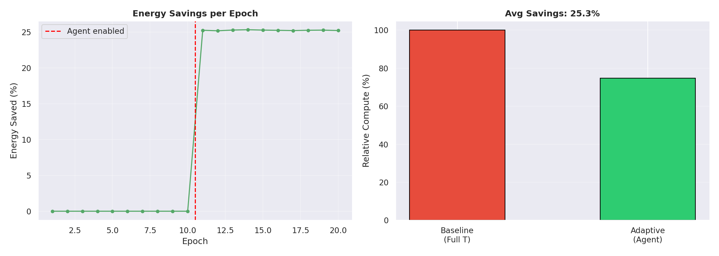

Slide 19
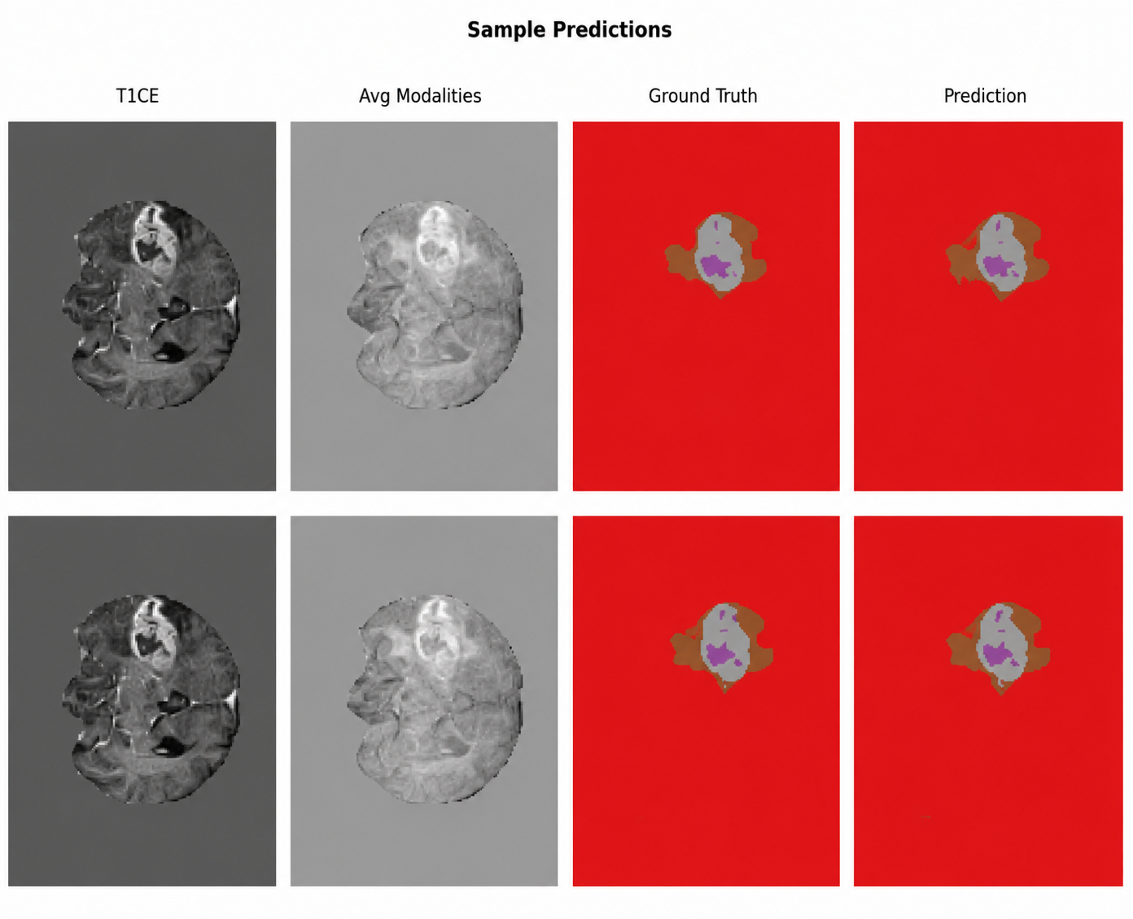

Slide 20
Ablation Study
Adaptive routing improved efficiency
Reduced temporal operations
Maintained segmentation accuracy
Better boundary precision than baseline

Slide 21
Future Scope
3D volumetric processing
Neuromorphic hardware deployment
Multi-resolution adaptive routing
Transfer learning and uncertainty calibration

Slide 22
Conclusion
Adaptive SNN-Transformer achieved efficient segmentation
Adaptive routing reduced computation significantly
Maintained strong Dice and HD95 performance
Promising direction for efficient medical AI

