Slide 1
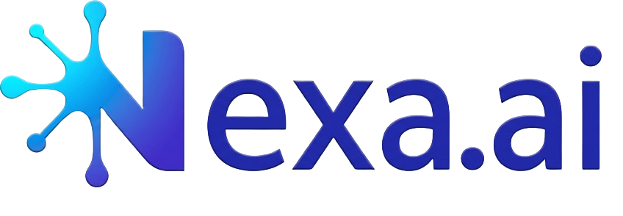
Agentic Pre-Development Workspace for Enterprise Delivery Teams
Theme 01 · AI at Work
Productivity + Teamwork
Team: Nexa | Members: Biswambhar Pal, Owendrila Saha
1

Slide 2
Requirements are getting lost between conversations and delivery
Problem Statement
Modern teams do not lack meetings - they lack a trusted, AI-assisted system that turns meeting context into approved execution artifacts.
The Hidden Tax Before Development Starts
Digital work overload
Execution fatigue
Innovation risk
57%
64%
60%
Average Microsoft 365 time is spent communicating in meetings, email and chat - only 43% creating.
People say they struggle to find enough time and energy to do their job.
Leaders are concerned that lack of breakthrough ideas is already affecting teams.
Every requirement conversation creates value - but too much of that value is still trapped in meetings, chats and manual follow-ups.
Real-world impact
Before developers write code, teams spend hours reconstructing what was decided, creating BRDs, Jira stories, technical designs, estimates and test cases manually. The result is delayed delivery, inconsistent handoffs, missed edge cases, and weak traceability from business intent to implementation.
Why it matters
This is directly inside the Microsoft work graph: Teams meetings, Outlook, M365 files, Azure DevOps and enterprise knowledge.
2

Slide 3
Nexa.ai captures meeting context once, then orchestrates AI agents and approval flows to create a trusted pre-development agentic package.
Solution Overview
Autonomous Project Management
1
2
3
4
Approve
Capture
Orchestrate
Generate
Conversation-to-delivery automation
User uploads meeting transcript on Power Pages portal.
Power Automate routes work by role, status and approval stage.
Copilot Studio + AI prompts create structured artifacts.
BA, Scrum, Tech Lead and QA Lead review before export.
5
Autonomous Project Management
A Power Platform-based AI workspace that converts requirement transcripts into governed, role-approved delivery artifacts.
Approved Artifacts will Autonomously upload into destination project management tool (Jira)
Power Pages
Power Automate
Requirement Pack
Delivery Backlog
Technical Design
QA Coverage
Copilot Studio
BRD, scope, assumptions, acceptance criteria.
Epics, stories, subtasks, estimates and dependencies.
Architecture notes, algorithm, API/data model guidance.
Test cases, edge case scenarios and traceability matrix.
AI Prompts + Dataverse
Autonomous Project Management
Feasible POC
Starts with manual transcript upload; scales later to Teams/DevOps integrations without changing the user workflow.
3

Slide 4
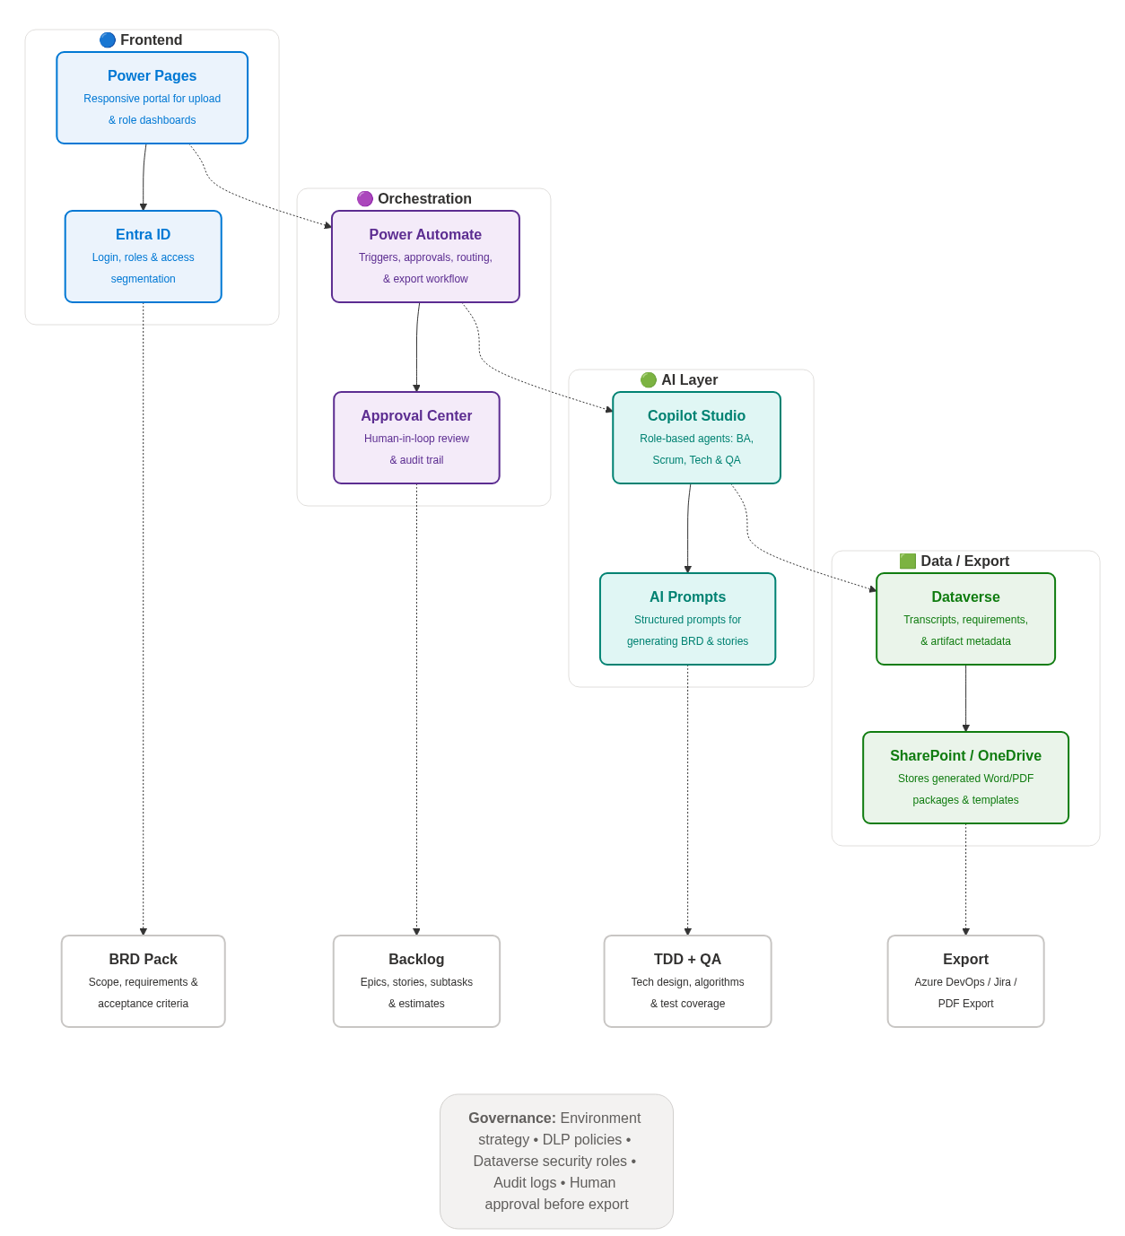
A feasible Power Platform architecture that starts as a POC and scales to enterprise-grade AI Suite
Architecture Diagram
Governance: Environment strategy · DLP policies · Dataverse security roles · Audit logs · Prompt versioning · Human In Loop
Power Platform Reference Architecture
AI governed enterprise-ready architecture for transcript-driven pre-development automation.
User Experience
Workflow + Approvals
AI Agents + Prompts
Data + Governance
4

Slide 5
Nexa.ai uses Power Platform AI prompts and Copilot Studio agents to generate artifacts with source grounding, confidence and review gates.
AI Integration Details
1
2
3
4
5
AI integration – Copilot and AI Prompts
Transcript Input
Context Extraction
Agent Generation
Validation Check
Review Gate
Uploaded Teams transcript is cleaned and chunked.
AI extracts actors, scope, decisions and open questions.
Role agents generate BRD, backlog, TDD and QA.
Validator checks completeness, consistency and risks.
Approvers edit, accept, reject or regenerate.
Role-specific AI agents convert unstructured meeting text into structured, reviewable delivery artifacts.
Grounded Generation
BA Agent
Scrum Agent
Tech Agent
QA Agent
Validator
Creates BRD, scope, assumptions and acceptance criteria.
Creates epics, user stories, subtasks and estimates.
Creates architecture notes, algorithm and data/API guidance.
Creates test scenarios, edge cases and traceability.
Flags gaps, conflicts and low confidence.
Specialist Agents
Human Approval
Guardrails
Prompt templates · JSON output schema · confidence score · source references · PII-aware handling · approval required before export
Responsible AI
Faster documentation
Consistent handoffs
Traceable decisions
Lower AI risk
5

Slide 6
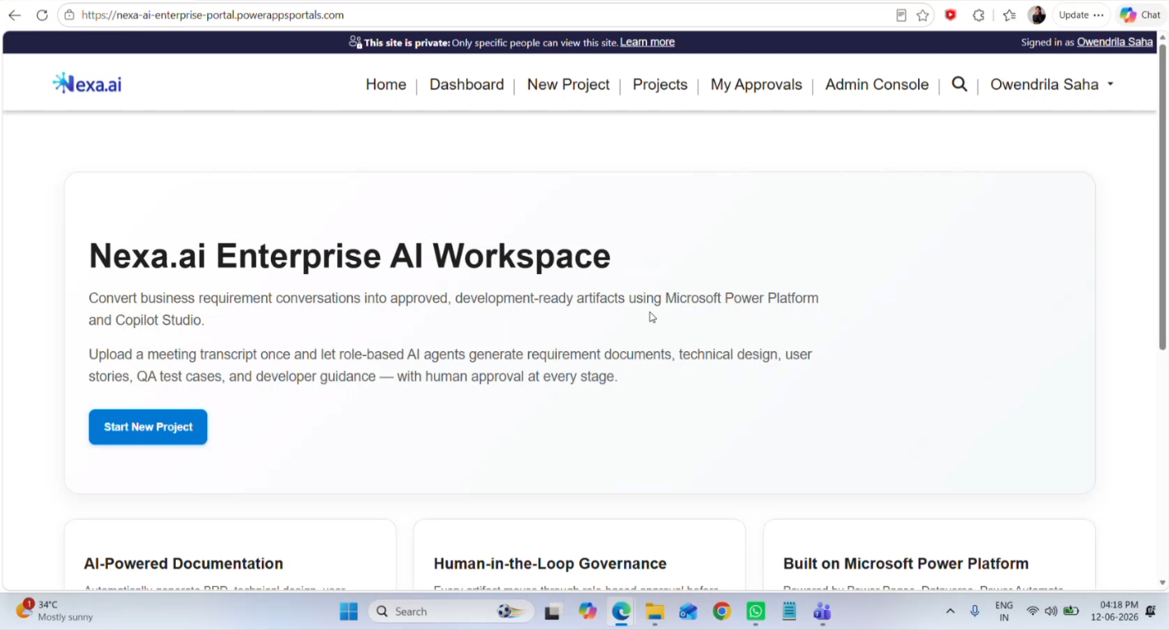
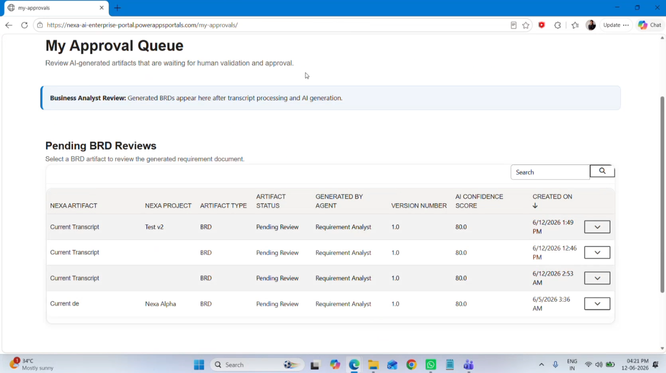
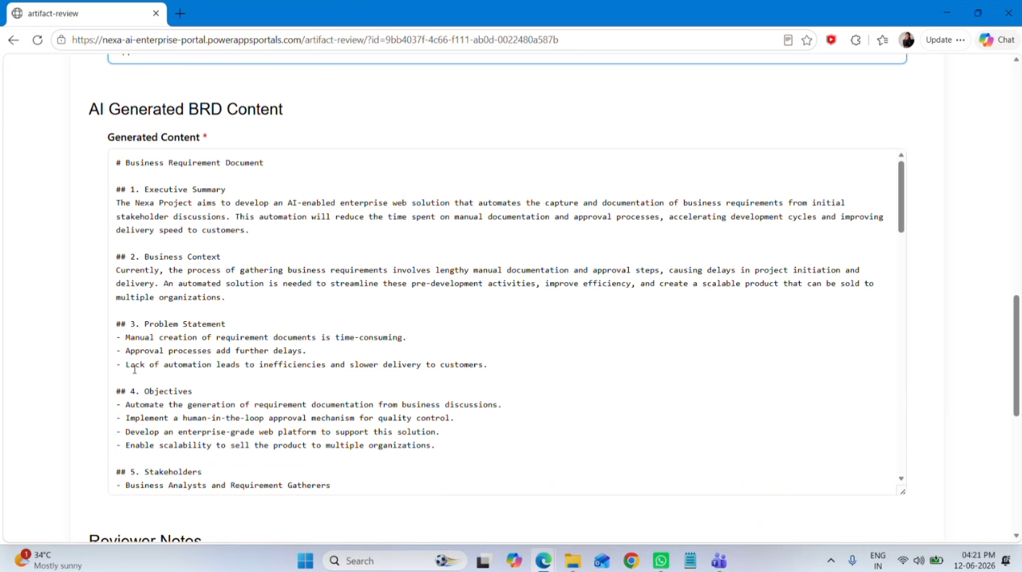
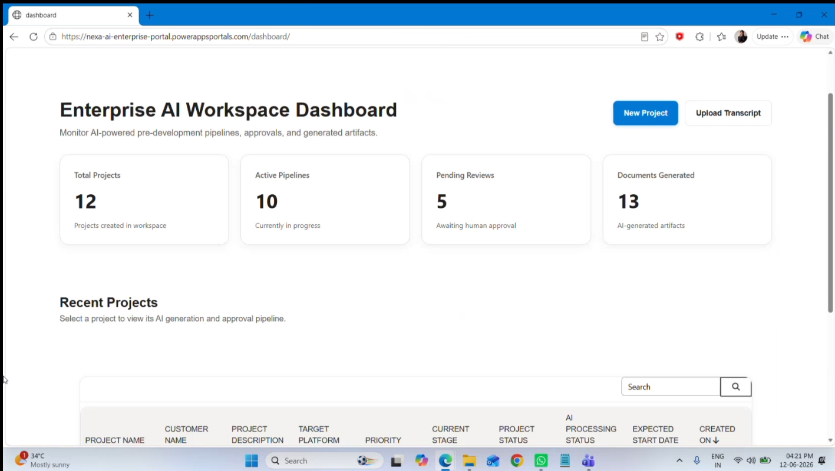
Demo Screens
6

Slide 7
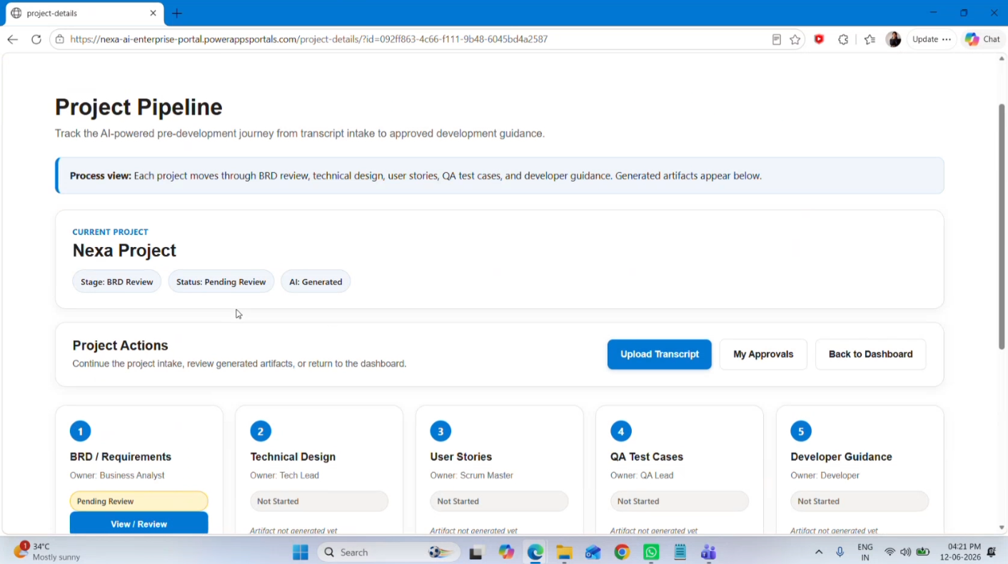
Demo Screen – Project Pipeline
7

Slide 8
Nexa.ai is designed to prove value quickly: reduce manual pre-development effort, improve traceability, and make AI outputs accountable.
Impact Metrics
Cycle Time
Manual Effort
Traceability
Approval Control
Impact & success metrics
↓ 60–70%
↓ 50%+
100%
100%
From transcript to first approved BRD, stories, TDD and QA drafts.
Less repeated documentation work across BA, Scrum, Tech and QA roles.
Every story, design note and test case mapped back to requirement context.
Human review gate before export, backlog creation or development handoff.
Measurable outcomes for productivity, quality, governance and enterprise adoption — built for a realistic Power Platform POC.
Productivity
Success =
Speed + Quality + Governance + Microsoft Platform Adoption
Quality
A working demo should show measurable handoff acceleration without removing human accountability from delivery decisions.
Governance
Current Phase
Adoption
Pilot KPI 1
Pilot KPI 2
Pilot KPI 3
Pilot KPI 4
Compare manual vs AI-assisted time for the same transcript.
Count AI outputs accepted, edited, rejected or regenerated.
Measure coverage of requirements mapped to stories and tests.
Track active users, approvals and exports from Power Platform.
POC
Team Pilot
Enterprise Scale
ROI
05

Slide 9
Why Nexa.ai Adds Value to Microsoft
Microsoft Value
Nexa.ai is not just an app - it is a repeatable enterprise pattern for converting collaboration data into accountable business execution.
Nexa.ai - value to Microsoft
1. Makes M365 work actionable
2. Showcases Power Platform AI
3. Increases trusted AI adoption
4. Creates enterprise demand
Turns Teams/meeting transcripts into approved requirements, stories, technical design and QA coverage.
Uses Power Pages, Power Automate, Copilot Studio, AI prompts and Dataverse as the core solution stack.
Adds human approval, source grounding, versioning and role-based access before outputs become official.
Solves a universal delivery problem across consulting, IT, product, operations and software teams.
A focused AI-at-work solution that turns Microsoft 365 conversations into governed Power Platform workflows.
Core value
From Copilot assistance to business process transformation
Extends Microsoft 365
Nexa.ai demonstrates how Microsoft AI can move beyond summarization into governed, measurable delivery workflows.
Drives Power Platform
Builds Trustworthy AI
5
1
100%
End to End
POC
Creates Enterprise Pull
Role-based agents mapped to real delivery personas
Power Platform backbone for scalable solution
Human approval before official handoff
Transcript → artifacts → approval → export
Feasible now, scalable later
9

Slide 10
Team Introduction and Live Prototype details
Nexa.ai was built by a focused two-member team: Biswambhar Pal and Owendrila Saha.
Biswambhar Pal
Owendrila Saha
Solution Architect and AI Power Platform Lead
AI Experience and Product Strategy Lead
Defined the problem statement, solution scope, and product flow.
Built the Power Pages portal, Dataverse structure, and Power Automate orchestration.
Managed lookup relationships, approval flow, pipeline tracking, and demo preparation.
Designed AI prompt flows for transcript analysis and artifact generation.
Supported the portal user experience across dashboard, project, pipeline, approvals, and admin screens.
Tested generated outputs, validation logic, and end-to-end demo readiness.
Prototype Details
Nexa.ai
Product URL : https://nexa-ai-enterprise-portal.powerappsportals.com/
Demo URL : https://youtu.be/9KQd5s89tso
GitHub URL : https://github.com/Biswambhar-Pal/nexa-ai
Note: Product Login credentials are shared only through the official hackathon submission channel for security reasons.
Thank You
9

