Slide 1
Assignment-1 Discussion (skip gram, animal-bird clustering)
Team Members :
Tejas Gunaghe - 213194002
Tanishq Awasthi - 213190003
Vaibhav Singh Panwar - 213190004
February 3, 2022

Slide 2
Problem Statement
Create a cluster of “animal words”: dog","tiger","cat","elephant","horse","bear","cow","monkey","deer","snake","lion"
Create a cluster of “bird words”: sparrow","parrot","dove","eagle","woodpecker","crane","owl","duck","cuckoo","penguin"
Run a concordancer for obtaining the neighboring words of these words
Train a skip-gram model with these words.
Collect the word representations.
Ensure that “animal” words are close to other “animal” words and so are “bird” words; Inter-cluster distance should be large compared to intra-cluster distance; use cosine similarity and other cluster-quality measures.

Slide 3
Dataset Discussion
We obtained our data set from online concordancer website called ‘Lextutorusing’ the Wikipedia corpus
Collected 25-30 sentences for each of the animal and bird words from the concordancer.
Corpus contains 1724 sentences with 2988 vocabs
Pre-processing on corpus :
removing the stop words,
removing punctuations,
removing spaces.
After the pre-processing, we obtained our final sentences containing unique words from the data set and now, our corpus is ready to be trained on Skipgram.

Slide 4
Details of Input words
Show your Animal words
dog, tiger, cat, elephant, horse, bear, cow, monkey, deer, snake, lion
Show your Bird words
sparrow, parrot, dove, eagle, woodpecker, crane, owl, duck, cuckoo, penguin

Slide 5
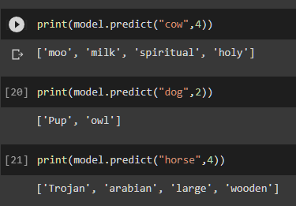



Details of context words
Size of context window = 2 words to the left, 2 words to the right
Give a SAMPLE of context words for a SAMPLE of Animal words
Give a SAMPLE of context words for a SAMPLE of Bird words

Slide 6
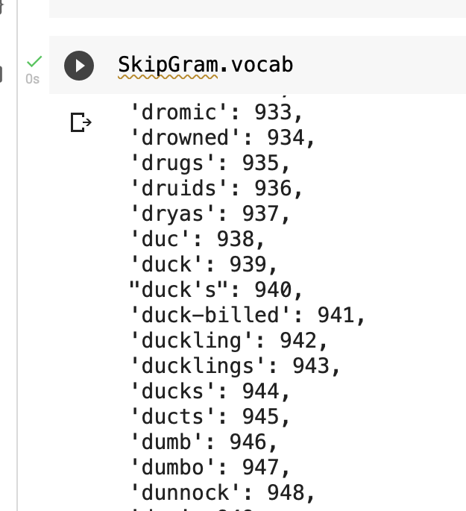
Vocabulary
Give the complete list of your vocabulary (separate list)

Slide 7
Skip Gram implementation

Slide 8
Details on the Skip Gram N/W
#Input neurons (equal to vocab) = 2988
#Hidden neurons (design decision) = 50
#Output neurons
#compartments (equal to context words) = 4
Each compartment of has #neurons=vocab size = 2988

Slide 9
Training details (hyper-parameters)
How many epochs? 47
What is the learning rate? 0.005
Convergence criterion (at what error level do you stop)
94496 at epoch 47

Slide 10
PoC (proof of concept)
On this slide, give cosine similarity values of
A few pairs of animal words
dog -cat = 0.237964
Elephant-horse = 0.045087
Deer-lion = 0.096581
A few pairs of bird words
dove-eagle = 0.181378
sparrow-parrot = 0.155735
owl-crane = 0.016791
A few pairs of animal-bird words (e.g., cow-crow)
dog-sparrow = -0.056614
monkey-parrot = -0.147835
bear-eagle = 0.058264

Slide 11
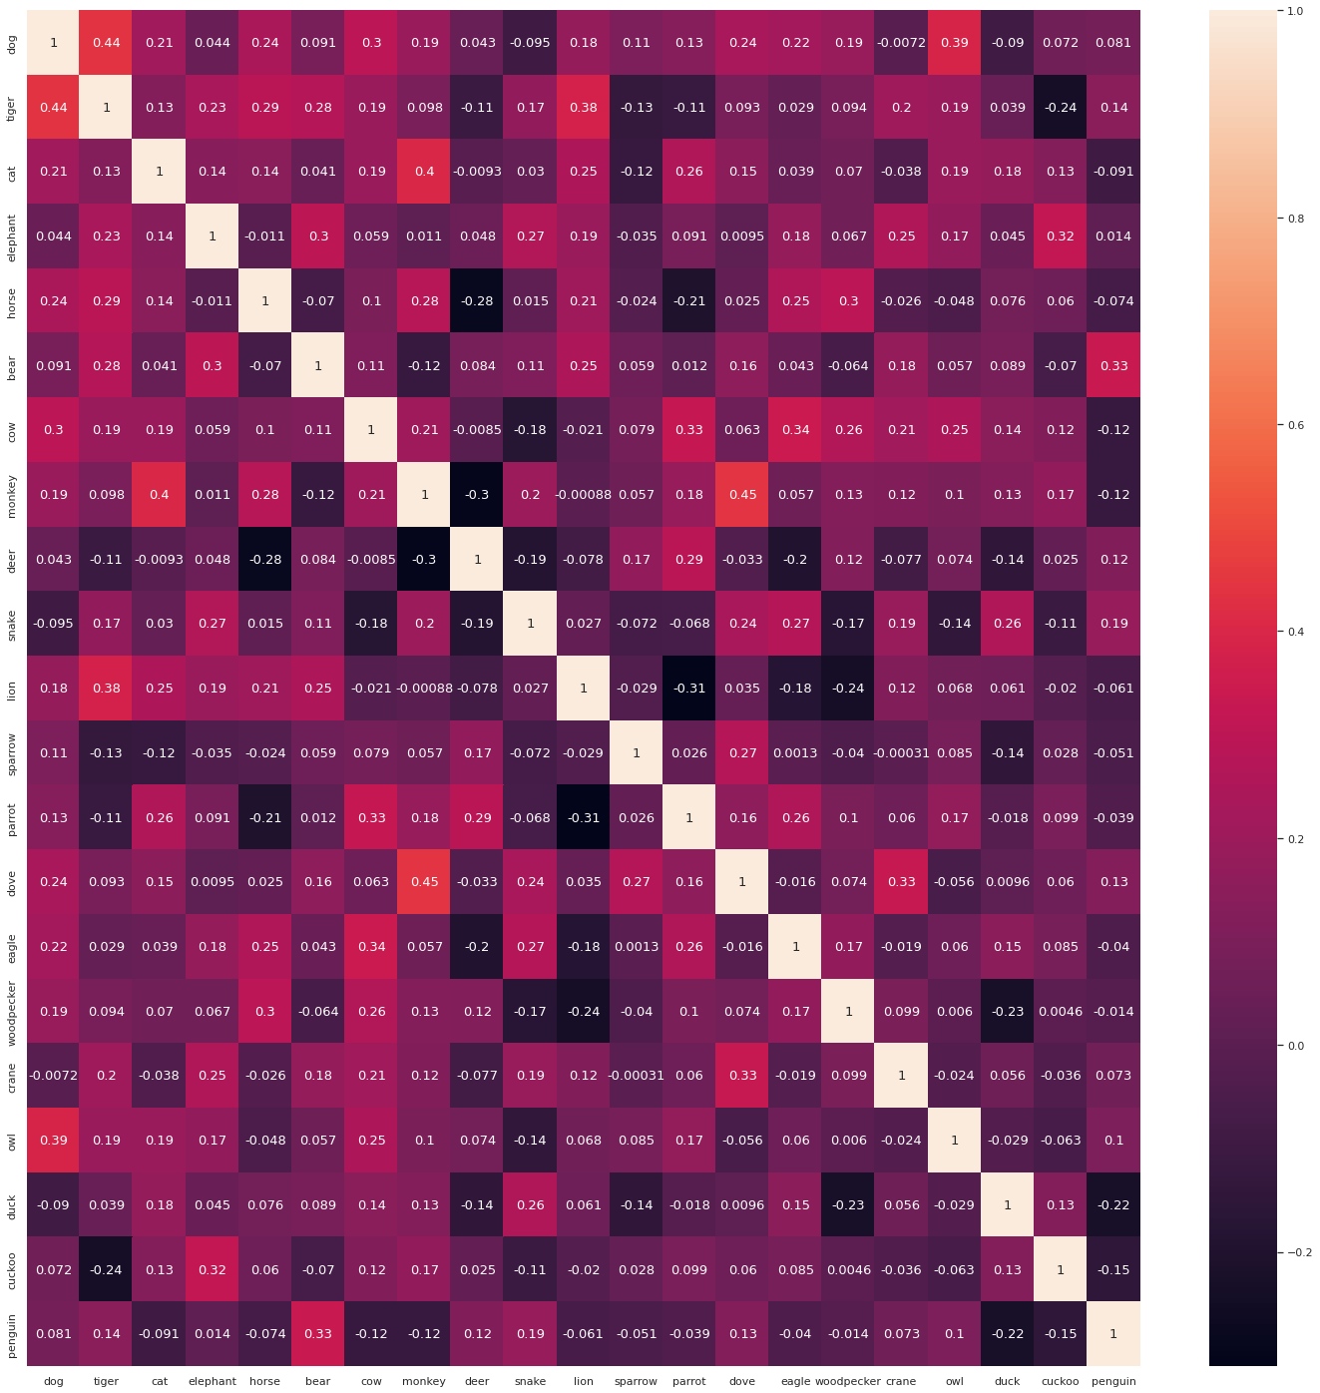
Heat graph of Cosine similarity between different words

Slide 12
Various performance parameters (basic)
INTRA-cluster distance for
Animal Cluster - 30.64 units
Bird Cluster - 24.65 units
INTER-cluster distance = 31.25 units

Slide 13
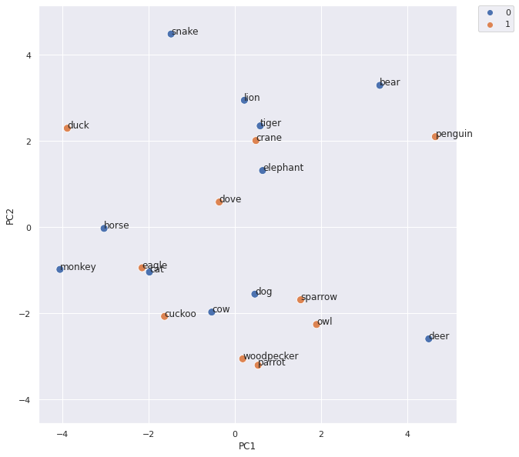
Clusters of animal and bird words

Slide 14
Various performance parameters (advanced)
Parameters as specified in the pdf file sir sent
DB Index – 1.769

Slide 15
Comment slide (evaluation guideline- students to note)
You are being evaluated on:
Data gathering and preparation (10 marks)
Skill with concordancer (10)
Implementation skill (skip gram); ML skill (training to low error value; hyperparameter fixing) (20)
Performance demonstration (basic: 10, Advanced: 10)
Analysis acumen (10)

