Slide 1
Warehouse Stock Management System

Slide 2
Contents
Problem Statement
Introduction
Software Packages and Libraries used
Working
Features
Further Development possibilities

Slide 3
Problem Statement
Warehouse management involves organizing, managing, and maintaining all the processes that occur in a warehouse, so that they run as smoothly and efficiently as possible. Even though some of these processes are automated and seem error-free, every warehouse operation is prone to mistakes and challenges. According to a report by McKinsey & Company in 2019, about £300 billion (approximately $385 billion) is spent each year, worldwide, on overall warehousing costs. And that amount doesn’t include the additional costs of correcting errors and mistakes.
Warehouse problems can affect the speed, efficiency, and productivity of either one particular warehouse operation or the entire chain of processes that are linked with it. In most cases, these errors are only identified after the process has begun or even after it has been completed. And by then, it’s usually too late to prevent the error—it may even be too late to reduce the amount of damage done. But with prior knowledge about the potential challenges that could occur in your warehouse operation, you can predict them beforehand and stop the damage before it starts.

Slide 4
Introduction
In this Mini project we have developed a solution to provide easy and an efficient management Technique which will help industry as well as warehouse managers to manage the inventory in an efficient methodology.
This software is generalized so that it can easily be implemented in any type of warehouse
For example this software can be used in a grocery warehouse as well as in a cement warehouse easily
This software too doesn’t need high end servers or computing system

Slide 5
Software Packages and Libraries used
Package/Library Name | Use
ODBC-Mysql.connector | Used to interface SQL with python Compiler
Date type library | Perform Data and Time Manipulations Easily
Pretty Tables | Display output in a User friendly manner
Anaconda Notebook | Compiler and IDE
Mysql | Preform Data manipulation

Slide 6
Working
At the system front end Python is used for its development
SQL is used for data manipulation
It accepts the amount of stock received in warehouse
It also tells which products which needs to be replenished by the user

Slide 7
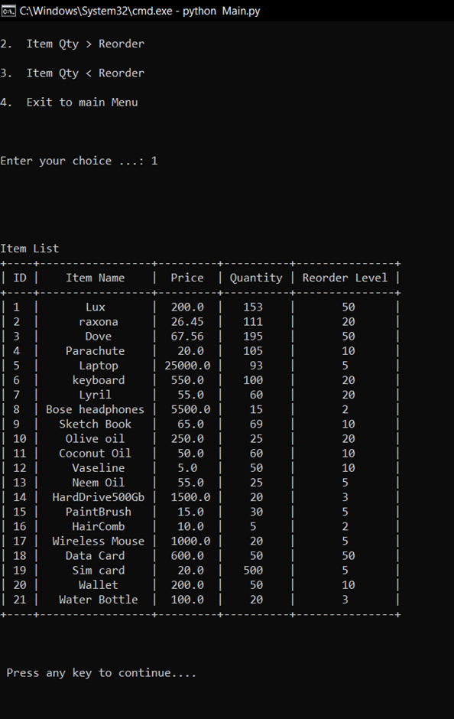
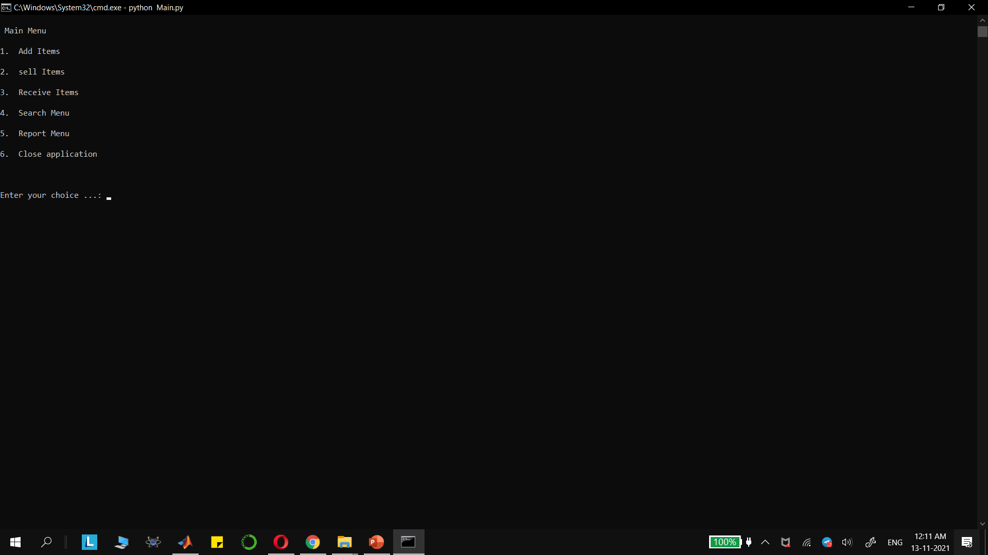
MAIN MENU
ITEM LIST VIEW

Slide 8
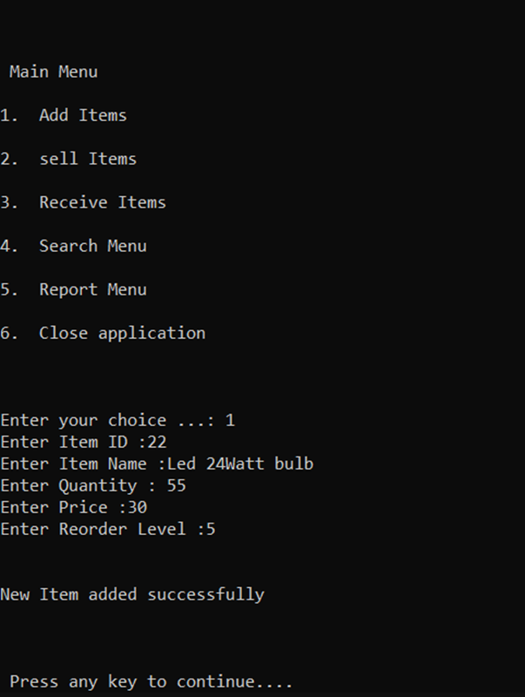
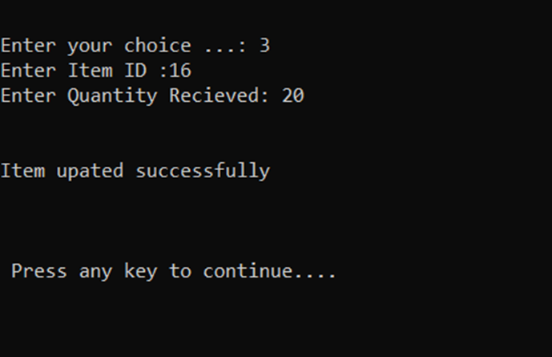
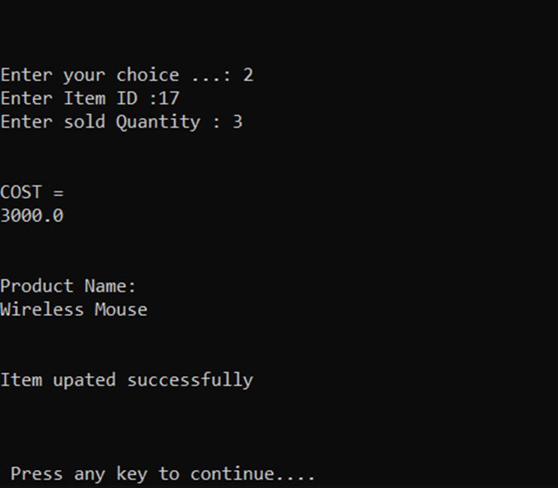
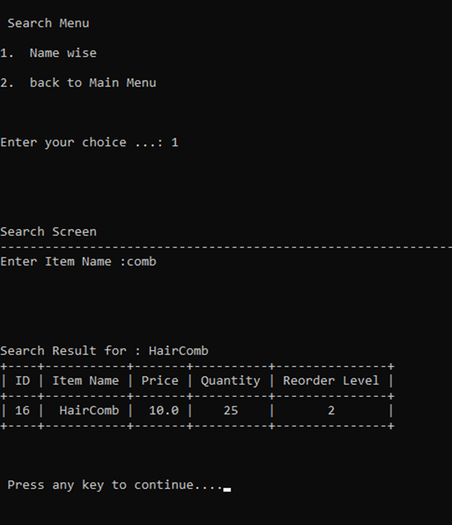
STRUCTURE
1. When a new product is laughed user can press 1 to add that item in the list
2. If a product is to be sold 2 is pressed it will reduce the quantity and show the price to be paid
3. If ordered products arrive then stock can be updated
4. To get the product id we can simply search the product with its name
5. We can generate report of products in stocks, products which need to be reordered and products which are in abundance also can be checked

Slide 9
Feature’s
Easy User Interface
Stocks can be pre ordered when they run low
Easy entry of new stocks
Current stocks can easily be viewed
Light Software
Low Setup investment

Slide 10
Further Development possibilities
Using Data analytics predictive ordering can be done
Digital Payment merchants too can be added for easier payment processing
More secure and restrictive access system can be added to it

