Slide 1

Kansas State University
Campus Network Infrastructure
Harvard Townsend, Director
Computing and Network Services
NLANR/Internet2 Workshop
June 6-9, 1999

Slide 2
Agenda
K-Who?
Off-campus connectivity
Campus network
Gigabit vs. ATM core
Roadblocks
Intra-building network issues

Slide 3
The University
Land grant institution in Manhattan, KS
20,000 students
Pay $1/credit hour technology fee, matched by $2 from state
I2 charter member, NSF HPC grant
CIO = Vice Provost for Academic Services and Technology

Slide 4
Network Overview
I2 - Abilene
GigaPoP - Great Plains Network (also I1)
State network - KANREN
Campus core - Gigabit Ethernet
Building distribution - 10/100/1000 Ethernet
Within buildings - a mess!
Switch/router vendor - Cisco

Slide 5
The Abilene Network
Seattle
Eugene
Minneapolis
Westfield
New York
New Haven
Cleveland
Newark
Detroit
Trenton
Salt Lake City
Philadelphia
Lincoln
Pittsburgh
Wilmington
Sacramento
Indianapolis
Columbus
Washington
Oakland
Denver
Kansas City
Raleigh
Albuquerque
Oklahoma City
Los Angeles
Nashville
Atlanta
Anaheim
Phoenix
Dallas
Abilene
Router Node
Access Node
Directly Connected Participant
New Orleans
GigaPop Connected Participant
Houston
GigaPoPs
(ALL COLORS)
UW Pacific North West
One Net
OARnet
Miami
CENIC
Texas
Pittsburgh (CMU)
Westnet
MREN
MCNC
Great Plains
MERIT
MAX
MAGPI

Slide 6

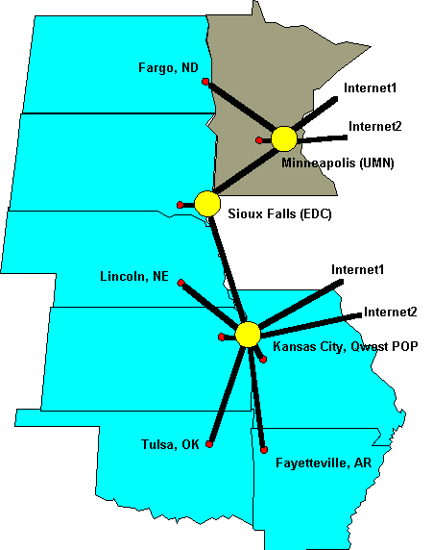
Operational Sept., 1998
Access to USGS EROS Data Center for Earth Systems Scientists
Shared OC-12 to Abilene
Co-located at Qwest PoP
I1 service (Sprint, Qwest)
DS-3 to K-State
Soon partner with Minnesota

Slide 7
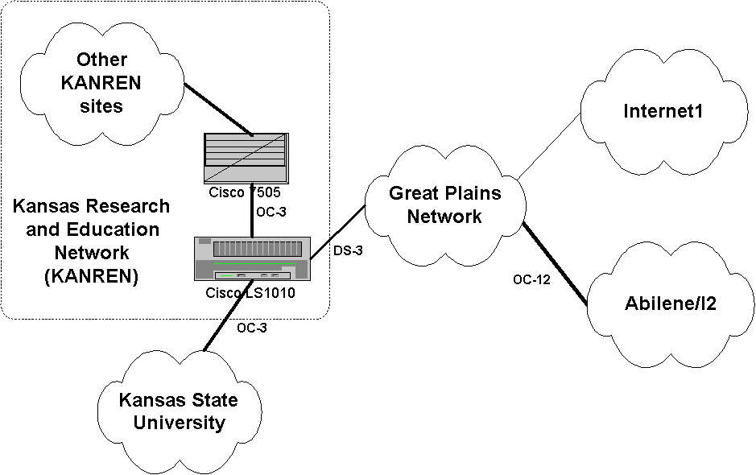

Slide 8
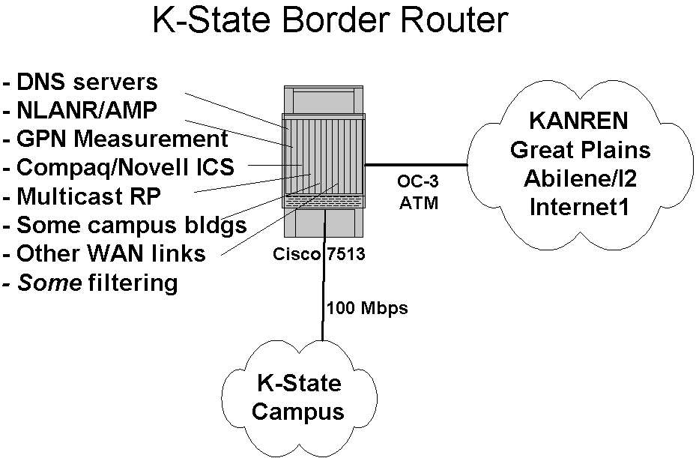

Slide 9
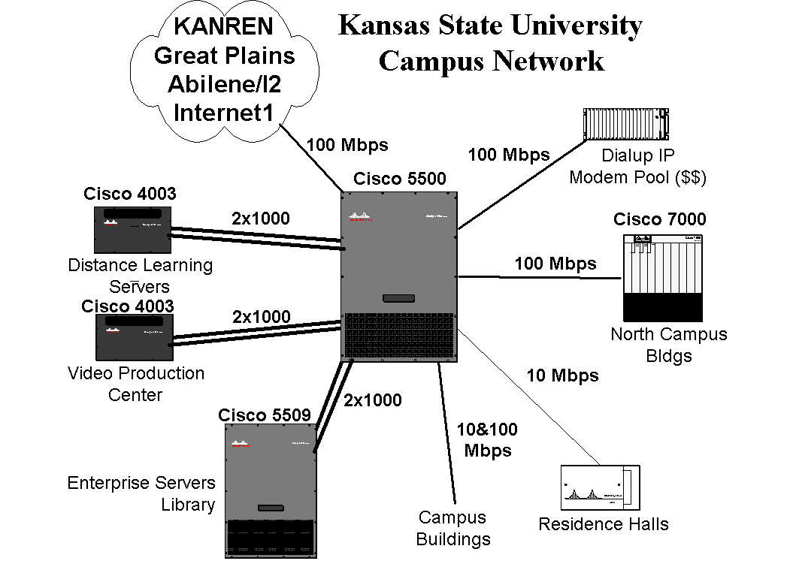

Slide 10
Previous Core Network
Collapsed backbone w/ Cisco and Wellfleet routers connected w/ Cisco 2900 10/100 switch
No more spare slots (only 8 bldgs @ 100 Mbps)
100 Mbps fiber interfaces expensive
AGS+ bottlenecks
Wellfleet expensive to upgrade
Internet2 on the way!
Vulnerable!

Slide 11
Core Network
Replaced core in March, 1999
Gigabit Ethernet between central Cisco 550X switches over single-mode fiber
Route Switch Modules
Cisco NetFlow Switching technology
Link aggregation with Fast and Gigabit EtherChannel

Slide 12
Core Network
Enterprise servers connected to core switch
10/100/1000 Mbps Ethernet to buildings
Integral RMON SwitchProbe
Multi-gigabit core with a consolidated server farm and 10/100/1000 Mbps Ethernet distribution to buildings.

Slide 13
Gains
Performance and Capacity
  Faster core
  Layer 3 switching
  Servers connected to core
  4 buildings @ 1000 Mbps
  31 buildings @ 100 Mbps
  Eliminated several bottlenecks

Slide 14
Gains
Growth capacity
  More slots plus higher port densities
  Link aggregation with EtherChannel
More cost effective growth
Flexible distribution to buildings
Some fault tolerance
y2k compliance
“I2-ready”

Slide 15
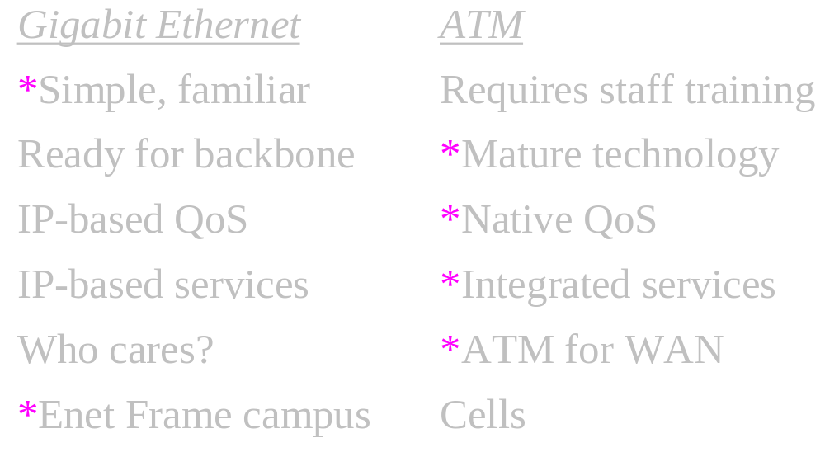
Gigabit vs. ATM

Slide 16
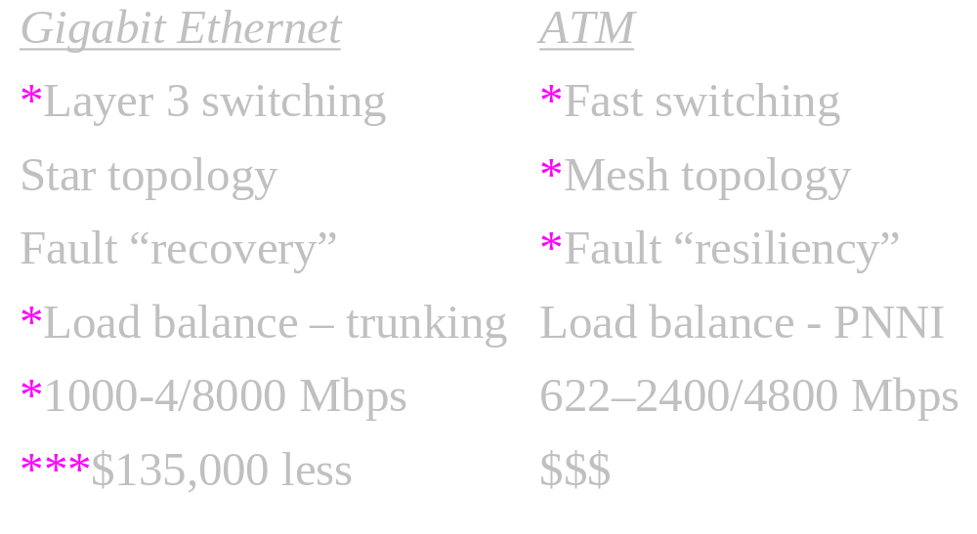
Gigabit vs. ATM

Slide 17
And the winner is...
Gigabit - by a score of 8 to 7!
  “IP can claim victory.” Data Communications, Oct. 21, 1998 [Voice, Video, QoS]
  Limitations of fiber topology - no ring/mesh
  “Put ‘em on the backbone!” Data Communications, Nov., 1998 [Gigabit ready for prime time]
  More functionality for less $$$

Slide 18
Roadblocks
Star configuration of steam tunnels!
  Gotta trench!
Quantity of single-mode fiber available
  Poor timing with fiber infrastructure project
  All data before Gigabit used multimode fiber
  Too conservative on fiber quantities

Slide 19
Roadblocks
Legacy of building-based routed subnets
  Didn’t deal with it! Did not flatten the network
  Scaled up routing performance by replacing legacy routers with layer 3 switches
  Intermediate step in migration to more fully switched, flatter network.

Slide 20
Intra-building Networks
An ugly mess
  10 Mbps shared hubs
  Thin Ethernet segments - some too long
  Thick Ethernet segments
  Retix bridges
  No power protection
  CAT3 cabling - some too long
  Do-it-yourself mystery cabling and electronics

Slide 21
Intra-building Networks
Yep, it’s a mess - a real ugly mess
  Old buildings, thick stone walls
  Large buildings
  Asbestos
  No false ceiling
  No raceways or conduit, or full conduit
  “Wiring closets” with janitors or in bathrooms
  Depts/Colleges reluctant to spend money

Slide 22
Solution - Political
Focus on building infrastructure
Ask legislature to fund network uprades
Provide upgrade plans to deans and department heads (including space and facilities requirements)
Share cost with deans and dept. heads
Phase in over several years
Convince people of the need...

Slide 23
Solution - Short-Term
Replace hubs with 10/100 switches
Upgrade all building entry points
Power protection, including generators
All new cable runs CAT5 or better
For I2 researchers, pulled new cable and connected them to 10/100 switches

Slide 24
Solution - Long-Term
Fiber infrastructure between entry point and remote terminal rooms
Copper from terminal rooms to wall plate
New terminal rooms with security, power, and HVAC - space wars!!
IT units involved at very early stage in new construction and major renovations

Slide 25
Questions?

