Slide 1

bitcurator-access-webtools Quick Start Guide
Last updated: May 8th, 2018
Release(s): 0.8.2 and later

Slide 2
About bitcurator-access-webtools
The bitcurator-access-webtools service allows users to browse file systems in raw and forensically packaged disk images using a web browser.
It is intended to support access scenaries in libraries, archives, and museums preserving born-digital materials extracted from source media as raw or forensically-packaged disk images.
The software is distributed with a build script to automatically provision and deploy a virtual machine running the service on any host with Vagrant and VirtualBox installed. This document will help you get started.

Slide 3
Getting started
Hardware (recommended):
Desktop or laptop with an Intel Core i5 or Core i7 processor (or AMD equivalent) running 64-bit Windows 7/8/8.1/10, Mac OS 10.10 (or newer), or a 64-bit Linux variant.
8GB RAM or more
8GB free hard disk space.
Software:
Current release of bitcurator-access-webtools. Download the latest release (.zip or .tar.gz file) from:
https://github.com/bitcurator/bitcurator-access-webtools/releases
Current release of VirtualBox. Download and run the current Windows, Mac, or Linux installer.
https://www.virtualbox.org/wiki/Downloads
Current release of Vagrant. Download and run the current Windows, Mac, or Linux installer (you may need to reboot after installing).
https://www.vagrantup.com/

Slide 4
Files and directories in the downloaded release
Unzipping the package extracts a directory named “bitcurator-access-webtools-X.X.X” (where X.X.X is the release number). Inside the directory are several files and directories, several of which you may wish to modify:
Vagrantfile: This is the configuration file for Vagrant. By default it assigns 4GB RAM to the VM (vb.memory = 4096) and 2 processors to the VM (vb.cpus = 2). These are appropriate settings for a host with 8GB RAM and a Core i5 or Core i7 CPU. You may wish to modify these depending on the hardware you are using.
disk-images: This directory contains some sample raw and E01 disk images. You may wish to remove these, or copy additional disk images to this location.
Tip: bca-webtools recognizes E01, AFF, raw (.dd), and ISO disk images. It does not currently support split images.

Slide 5
Getting started: Adding a Vagrant box
You will need a Ubuntu 18.04 Vagrant box in order to build and run bitcurator-access-webtools.
Open a terminal (in OS X or Linux) or a command prompt (Windows).
Mac how-to: Click on the Spotlight icon and type term. Hit enter.
Windows how-to: Click on the Start button and type cmd. Hit enter.
Type the following, hit enter, and allow the box to download:
vagrant box add bento/ubuntu-18.04
Change directory into bitcurator-access-webtools:
If you downloaded the bitcurator-access-webtools package onto your Desktop and extracted it there on a Mac, you would type the following:
cd /Users/your-user-name/Desktop/bitcurator-access-webtools-X.X.X
Similarly, on Windows:
cd \Users\your-user-name\Desktop\bitcurator-access-webtools-X.X.X
Type the following, hit enter, and wait. Building bitcurator-access-webtools the first time may take up to 30 minutes (you will see a success message in the terminal when it finishes):
vagrant up

Slide 6
Getting started: Navigating to the interface
In the previous steps, the installation script will provide feedback in the console as it installs each package.
Once the virtual machine has been provisioned, open a web browser on your host and navigate to:
127.0.0.1:8080
At this point you should see the bitcurator-access-webtools service running.

Slide 7
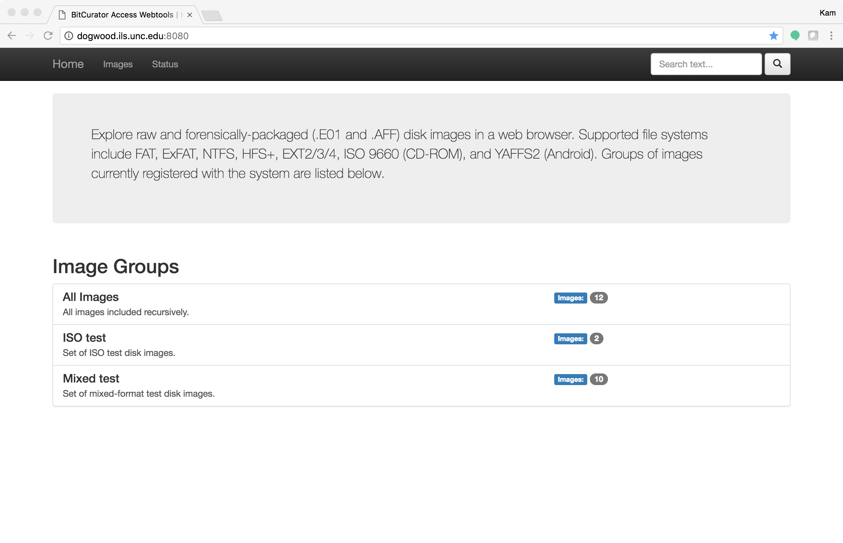
Getting started: Main page
You should see a page similar to the one above at 127.0.0.1:8080. Disk images groups defined in your groups.conf directory should appear in the listing on this page. Click on an individual group to see images associated with that group. In this example, we’ll select “All Images”.

Slide 8
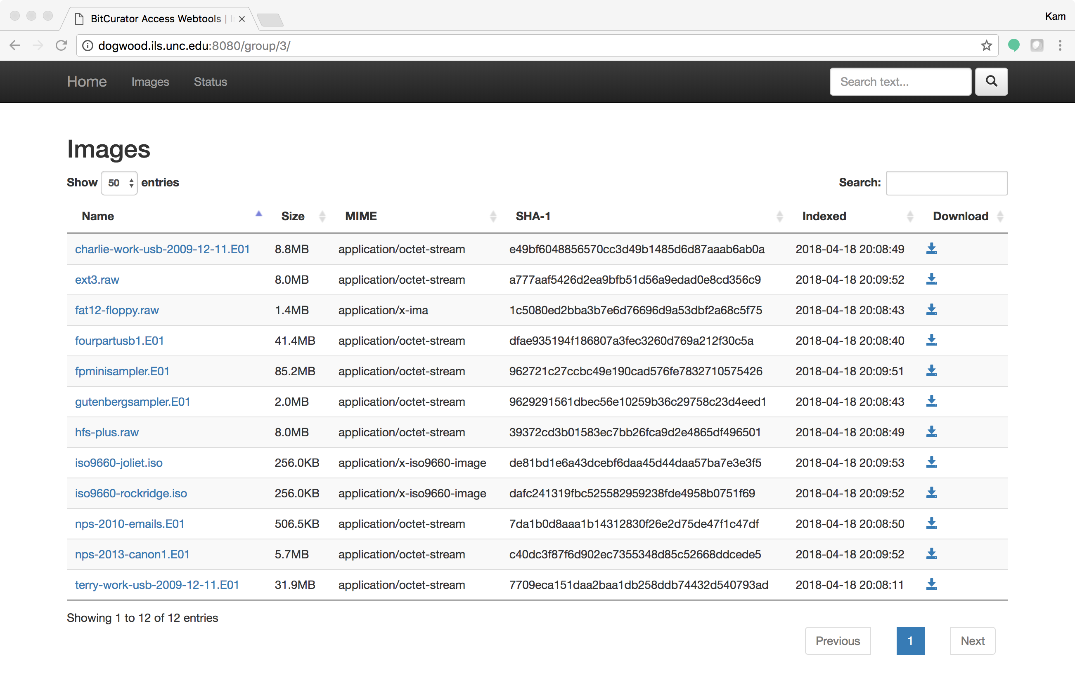
Getting started: Images in a group
Images associated with the group are displayed (and sortable) by size, MIME type, hash, and time indexed (an indicated time means the full-text indexer has finished processing a particular image). The full image may be downloaded using the Download link.

Slide 9
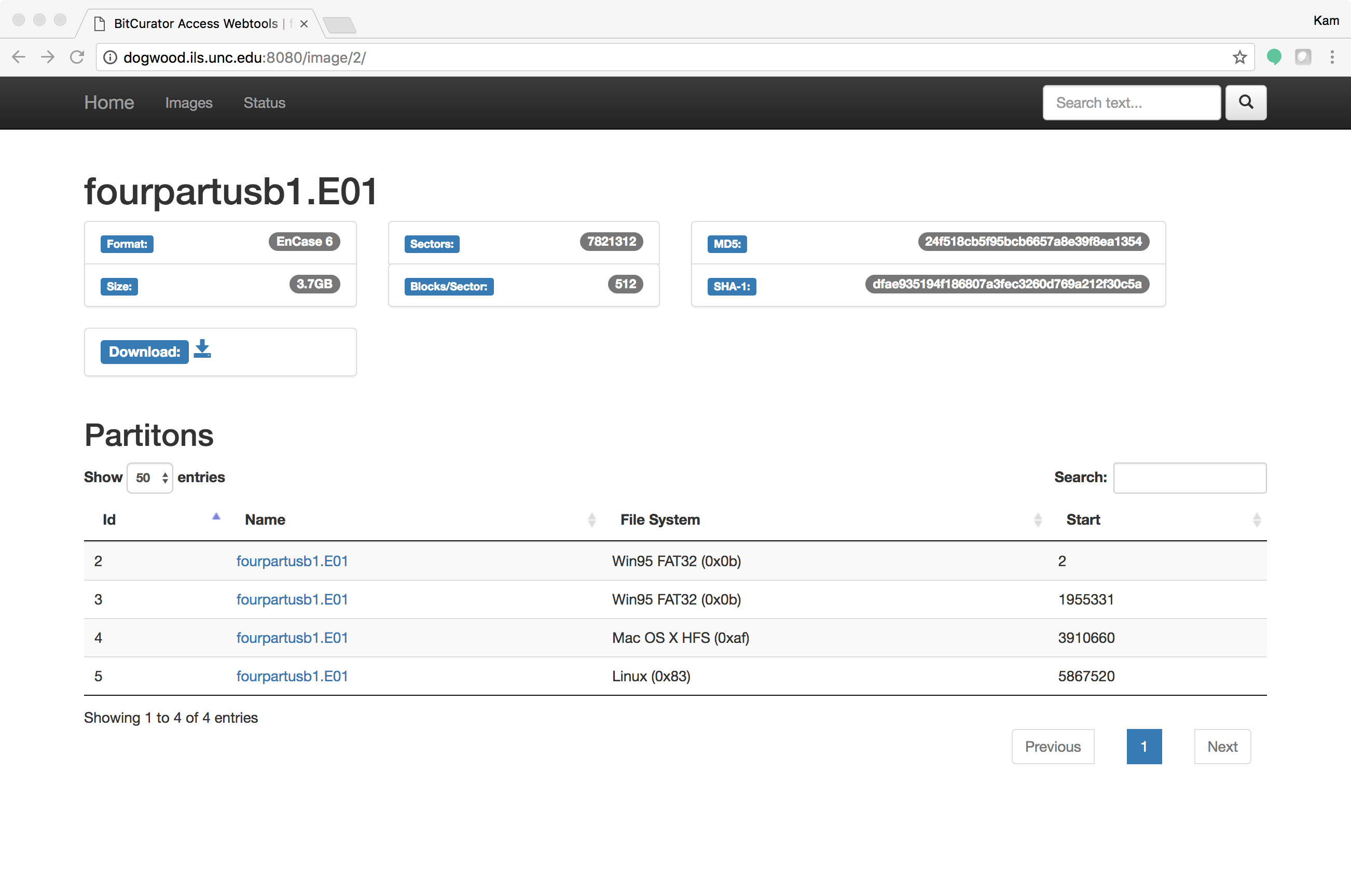
Getting started: Image selection
Select an image. In this example, we’ve selected fourpartusb1.E01. Selecting an image will display a page with basic metadata associated with the forensic container format (if available) and partitions identified within the image.

Slide 10
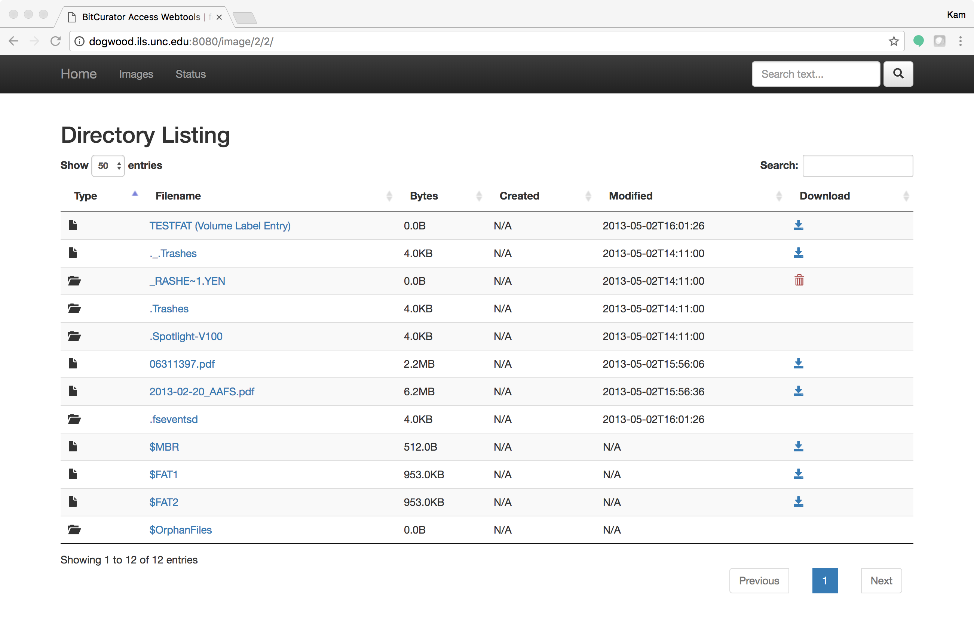
Getting started: Partition selection
Select a partition. Here, we’ve selected the first FAT32 partition on fourpartusb1.E01. A directory listing is shown for the root directory. Deleted files for which directory entries have been identified will be indicated with a trashbin icon in the Download column. Select download arrows to download individual files (as available), or click the filenames themselves for a full-text extraction (when possible).

Slide 11
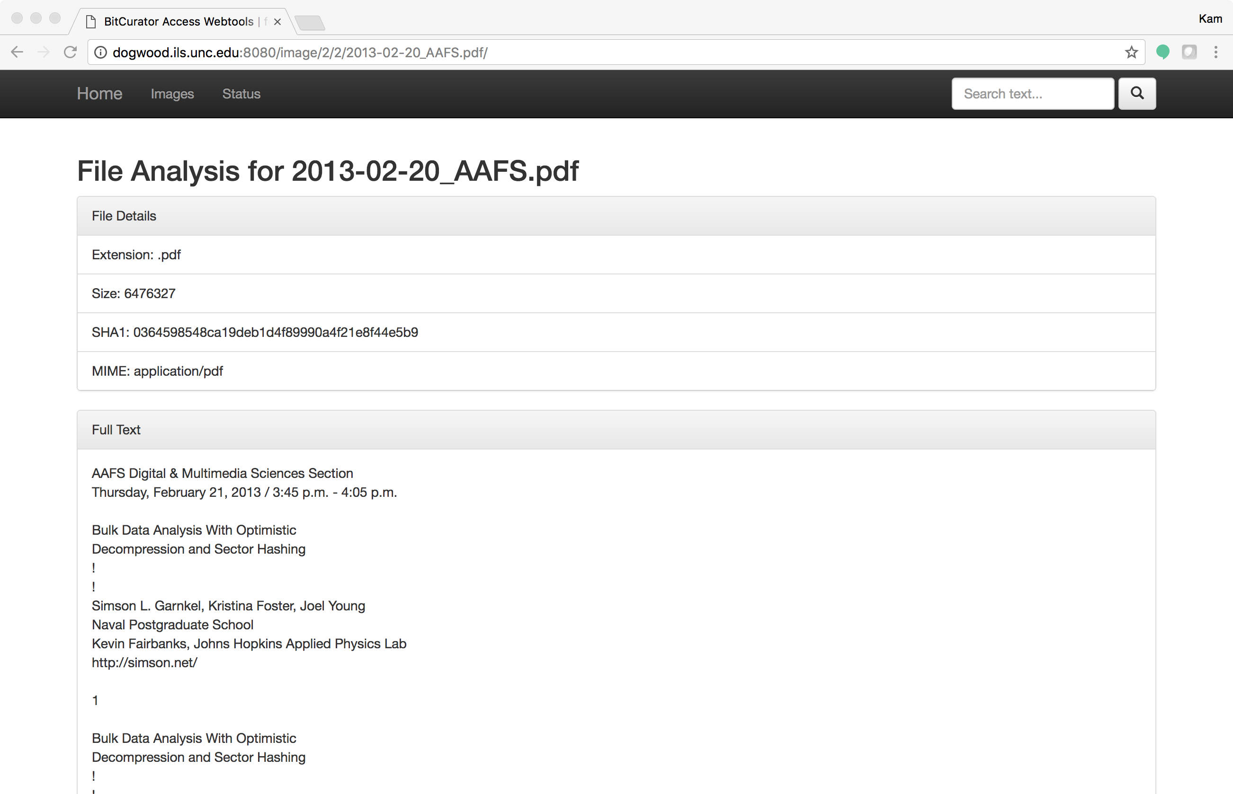
Getting started: Full-text file view
Click on an individual file name. In this example, we’ve selected 2013-02-20_AAFS.pdf. The server uses a text extraction library to present a full-text view of the file contents.

Slide 12
Halting and restarting the service from the host
You may wish to stop the virtual machine instance between sessions. You can do this by typing:
vagrant halt
in the same directory in the terminal or command window you opened earlier (if you closed it, open a new window and navigate to the bitcurator-access-webtools directory as per the earlier instructions before entering this command)
You can completely delete the virtual machine by typing:
vagrant destroy
in the bitcurator-access-webtools directory.
You can type vagrant up at any time in this directory to bring the service up again. If you have not run the vagrant destroy command, the service should boot in less than a minute. If you have run the vagrant destroy command, the virtual machine will be rebuilt from scratch.

Slide 13
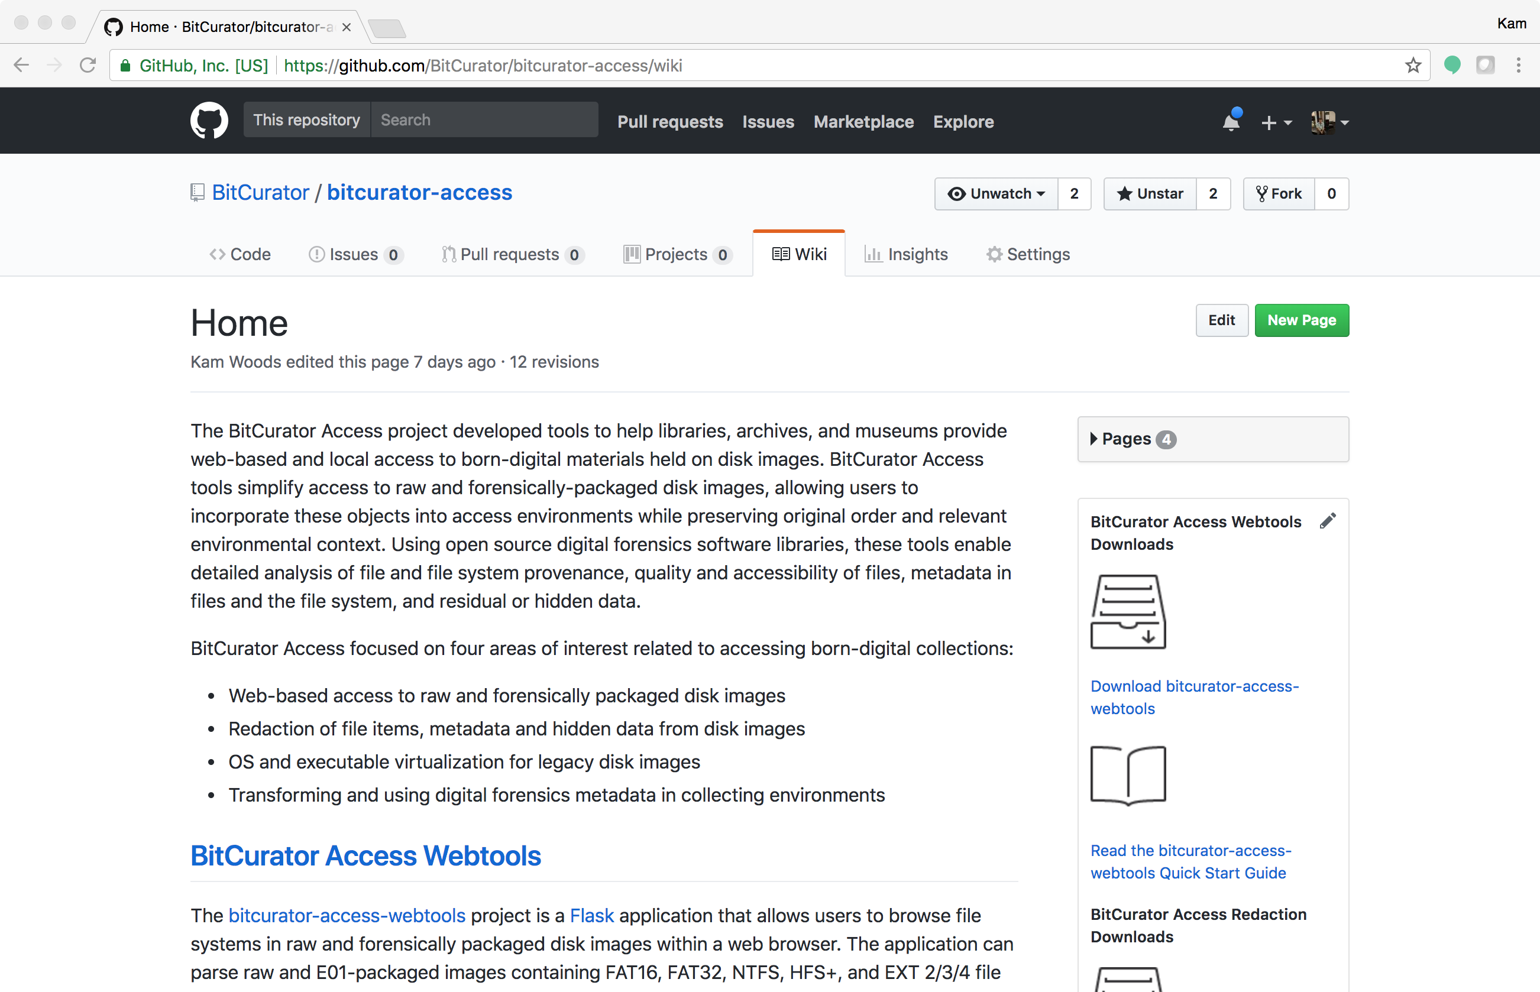
Additional resources
More detailed information can be found on the project wiki at https://github.com/BitCurator/bitcurator-access/wiki.
Source code and releases can be found on GitHub at https://github.com/bitcurator/bitcurator-access-webtools.

