Slide 1
Two-Feature Detection of
WireGuard-in-udp2raw
A Probe-and-Classify Methodology
Steven Schiavone · Nicholas Johannsen
Seidenberg School of CSIS · Pace University · CYB623, May 2026
Schiavone & Johannsen · CYB623 · Pace University
1 / 9
Notes:
Setup
• WireGuard = modern VPN. Encrypts well, but doesn't try to hide that it IS a VPN.
• Hiding the VPN is explicitly out of scope per Donenfeld's 2017 paper.
• Question: does the most popular hiding tool actually hide it?
The tool: udp2raw
• Used in Iran and China for censorship circumvention.
• Zero peer-reviewed analysis before this paper.
Two results we'll show
• Active attack: 5 test packets, identifies udp2raw server in 8.5 s.
• Passive attack: 2 traffic features, classifier at 99.9% accuracy.

Slide 2
WireGuard is encrypted, but not unobservable
Strong cryptography is not the same as traffic that hides itself
Every WireGuard message starts with this 4-byte header:
+---------+-------------------+ | type(1) | reserved zero (3) | …rest of message +---------+-------------------+
• type byte ∈ {0x01, 0x02, 0x03, 0x04}; the next three bytes are zero.
• Handshake messages are exactly 148 / 92 / 64 bytes.
• Three concatenated checks identify a WireGuard handshake with negligible false-positive risk.
• A 25-line Python predicate is the full detector. We re-implement it as our baseline.
• Reported in production by the Great Firewall (Wu et al., USENIX Security ’23).
Donenfeld’s WireGuard whitepaper (NDSS ’17) explicitly leaves obfuscation out of scope.
Schiavone & Johannsen · CYB623 · Pace University
Schiavone & Johannsen · CYB623 · Pace University
2 / 9
Notes:
Why WireGuard is easy to spot
• First byte = message type, always 1, 2, 3, or 4.
• Next 3 bytes = always zero.
• Handshake packets = fixed sizes: 148, 92, 64 bytes.
• → Identify WireGuard from first 4 bytes + packet length. No decryption needed.
• 25-line Python detector is the whole thing.
• Wu et al., USENIX Security 2023: Great Firewall does exactly this.
Important caveat — not a vulnerability
• Donenfeld's 2017 paper says hiding the VPN's existence is out of scope.
• That's a job for a separate tool on top.
• Real question: can you detect WireGuard once it's wrapped in the popular hiding tool?
• → That tool is udp2raw. Next slide.

Slide 3
udp2raw: the obfuscation shim, and the literature gap
Wraps WireGuard's UDP datagrams as TCP-shaped packets in userspace
End-to-end paths under test (same WG keys, same inner IPs; only the transport differs):
Direct (passive-detectable)
Kali wg client
↓ UDP / 51820
OCI wg server
Obfuscated (this paper's target)
wg client → udp2raw client
↓ TCP / 4096 (faketcp)
udp2raw server → wg server
Why udp2raw, specifically:
• ≈259,000 release-binary downloads on the primary repo, +41,000 on the multiplatform fork (GitHub API, May 2026).
• Reported blocked by state-level DPI in Iran and elsewhere (udp2raw issue #505, net4people thread #253).
• Cited in the WireGuard project's own “Known Limitations” page.
• No peer-reviewed analysis. Searched USENIX, NDSS, IMC, FOCI, PETS, CCS.
Schiavone & Johannsen · CYB623 · Pace University
Schiavone & Johannsen · CYB623 · Pace University
3 / 9
Notes:
Two paths in our lab (same WG keys, only the outer transport differs)
• Direct: WireGuard over UDP. What the Great Firewall already blocks.
• Obfuscated: udp2raw rewraps each WG packet as a TCP segment on port 4096.
• "faketcp" = shaped like TCP but not a real TCP connection.
• Why TCP? Looks normal — it's what web browsers use.
Why udp2raw specifically
• ~259,000 binary downloads (actual runs, not GitHub stars).
• Reportedly blocked at ISP level in Iran (issue #505, net4people #253).
• Zero peer-reviewed analysis. Searched USENIX, NDSS, IMC, FOCI, PETS, CCS.
Why not other tools?
• AmneziaWG, swgp-go = modify WireGuard itself. Different category.
• udp2raw = only big, unstudied tool in the "wrap it generically" category.

Slide 4
Two attacks, one lab
Following Xue et al.'s active-then-passive pattern (USENIX Security ’22) for OpenVPN
C1 · Active prober
• Send 5 stateless TCP probes to (IP, port).
• Real Linux TCP answers all 5.
• udp2raw answers SYN, drops 3 of 4 follow-ups.
• Verdict in ≤ 9 seconds. Same verdict 5/5 trials.
Adversary cost: ≈ 1.7 KB and ≈ 9 s per host.
C2 · Two-feature classifier
• bulk_fraction: share of MTU-class packets.
• ack60_fraction: share of 60-byte TCP ACKs.
• Both fall out of how the protocols are written, not statistical luck.
• Random Forest: 99.9 % accuracy, AUC = 1.000.
Trained on 24 WG flows + 1058 ISCXVPN2016 non-VPN flows.
Schiavone & Johannsen · CYB623 · Pace University
Schiavone & Johannsen · CYB623 · Pace University
4 / 9
Notes:
Two attacks, definitions
• Active = send packets, watch the reply.
• Passive = just watch traffic going by.
• Template from Xue et al., USENIX Security 2022 Distinguished Paper (did OpenVPN, not WireGuard).
C1 — Active (left card)
• 5 TCP probes, under 9 seconds.
• Same answer every time. Details next slide.
C2 — Passive (right card)
• Flow = one conversation between two computers.
• For each flow, compute 2 numbers, feed to a Random Forest.
• Random Forest (RF) = standard ML model that learns rules from examples.
• Features are mechanical, not statistical:
– WireGuard pads every packet to max size.
– udp2raw acks every wrapped packet 1:1.
Training data
• 24 WireGuard flows we captured ourselves.
• 1058 normal flows from ISCXVPN2016 (standard public dataset for this work).

Slide 5
C1: one set of probes distinguishes udp2raw from real TCP
Three targets on the same OCI host. Same verdict in 5/5 repeated trials.
Probe
TCP/22 (real SSH)
TCP/4096 (udp2raw)
TCP/9999 (closed)
P1 SYN
SYN-ACK in 181 ms
SYN-ACK in 163 ms
no response
P2 SYN + 32 B payload
SYN-ACK + 2 B echo
silent
no response
P3 bogus-seq ACK
RST in 81 ms
RST in 91 ms
no RST
P4 SYN, WS = 14
SYN-ACK
silent
no response
P5 FIN to unopened
RST
silent
no response
Total time
0.5 s
8.5 s
15.5 s
Verdict
REAL_TCP
UDP2RAW_FAKETCP
UNREACHABLE
Discriminator: count silent responses among {P2, P4, P5}. Real TCP answers all three. udp2raw answers none.
Schiavone & Johannsen · CYB623 · Pace University
Schiavone & Johannsen · CYB623 · Pace University
5 / 9
Notes:
Setup — three columns, same server, three ports
• TCP/22 = real SSH (real-TCP control).
• TCP/4096 = udp2raw.
• TCP/9999 = closed (negative control).
TCP terms for the table
• SYN starts a connection. SYN-ACK accepts. RST rejects. FIN closes.
Probes that DON'T discriminate (answered by both)
• P1 (SYN): udp2raw answers — that's the disguise.
• P3 (bogus ACK): kernel (not udp2raw) generates the RST.
The signal — probes 2, 4, 5
• P2: SYN with 32 bytes of payload.
• P4: SYN with unusual TCP option.
• P5: FIN to a port with no connection.
• Real Linux kernel answers all three. udp2raw drops all three.
• udp2raw's parser was written for one TCP shape; anything else, it ignores.
Rule
• Count silent responses among {P2, P4, P5}.
• Real TCP = 0 silent. udp2raw = 3 silent.
Timing
• Real TCP: 0.5 s.
• udp2raw: 8.5 s (we wait out timeouts on the silent probes).
• Closed port: 15.5 s.
• Same verdict 5/5 trials.

Slide 6
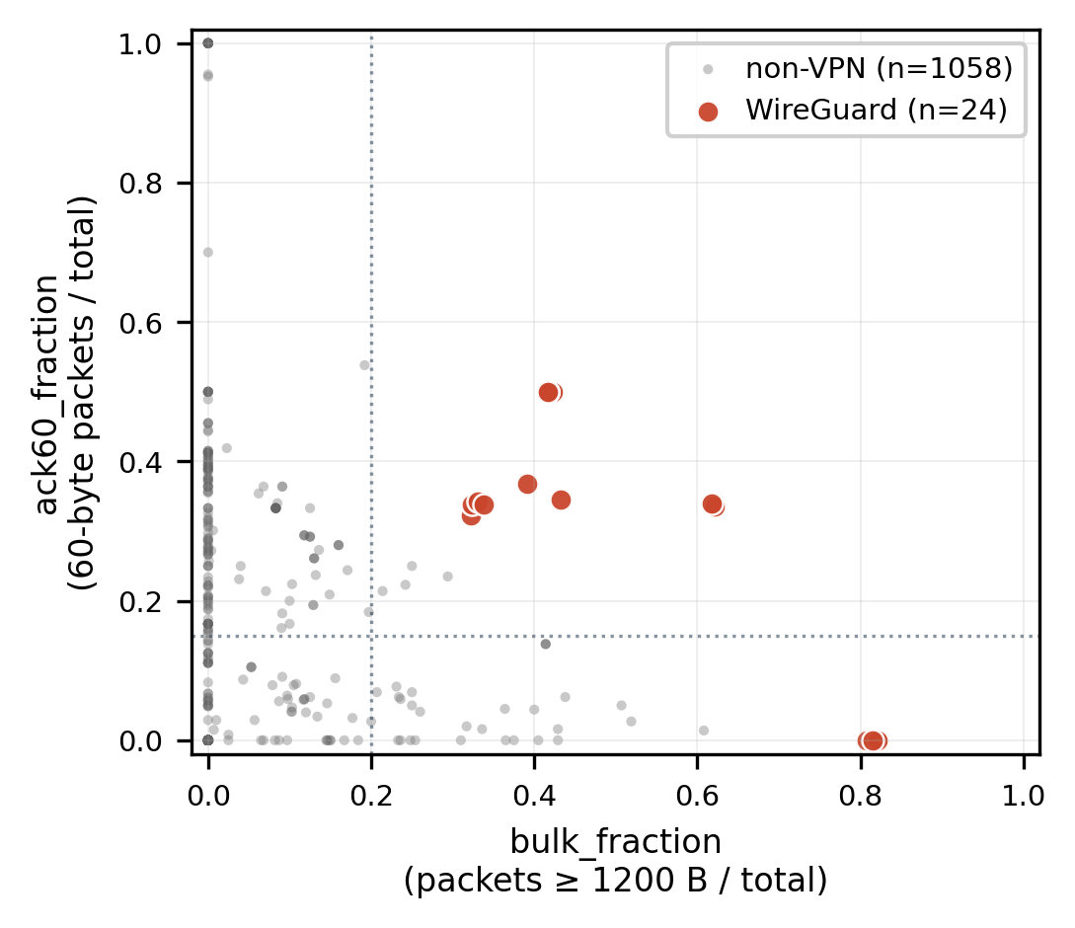
C2: two features carry the entire signal
Class means across 24 WireGuard flows and 1058 ISCXVPN2016 non-VPN flows
Feature
WireGuard
Non-VPN
Cohen's d
bulk_fraction
0.553 ± 0.186
0.019 ± 0.066
3.83
ack60_fraction
0.295 ± 0.187
0.069 ± 0.169
1.27
len_entropy
1.94 ± 0.82
1.23 ± 1.42
—
dominant_size_frac.
0.50 ± 0.19
0.71 ± 0.30
(inv.)
top3_size_fraction
0.88 ± 0.15
0.87 ± 0.19
—
rate_pps
3.23 ± 0.90
3.37 ± 30.27
—
All 1082 flows in the two-feature space. 24/24 WG flows have bulk_fraction ≥ 0.32; only 4/1058 non-VPN flows fall in the (≥0.2, ≥0.15) corner.
Naive intuition picked dominant_size_fraction. Real-world background INVERTS that signal (many idle flows are degenerately concentrated).
Schiavone & Johannsen · CYB623 · Pace University
Schiavone & Johannsen · CYB623 · Pace University
6 / 9
Notes:
Feature 1 — bulk_fraction
• Share of packets in a flow that are "big" (≥1200 bytes).
• Why it works: WireGuard pads every packet up to near MTU (~1500 B).
• MTU (or Maximum Transmission Unit)= max packet size the link will carry.
• WireGuard: 55% big packets. Normal: 2%.
• Cohen's d = 3.83.
• Cohen's d = "A measurement that quantifies the difference between two averages in units of standard deviation" Or, how cleanly two groups separate. Over 0.8 is "large." We have 3.83.
Feature 2 — ack60_fraction
• Share of 60-byte TCP ACK packets.
• Normal TCP uses "delayed ACK" — 1 ACK per 2 data packets, so ~33% ACKs.
• udp2raw breaks this: each WG packet wrapped as 1 separate TCP segment.
• Kernel ACKs each arrival individually → ACK fraction climbs.
• WG-in-udp2raw: 30%. Normal: 7%. Cohen's d = 1.27 (still large).
Scatter plot (right)
• 1082 flows total. Orange = WireGuard. Grey = normal.
• Barely overlap.
• All 24 WG flows have bulk_fraction ≥ 0.32.
• Only 4 of 1058 normal flows are anywhere near the WG cluster.
Orange note (bottom-left) — scientific honesty
• I expected dominant_size_fraction to be the killer feature.
• Real data inverted it: public dataset has idle keepalive flows where every packet is identical.
• Those flows score HIGHER than WireGuard on that feature.
• We dropped it. Surviving features are grounded in protocol mechanics, not intuition.

Slide 7
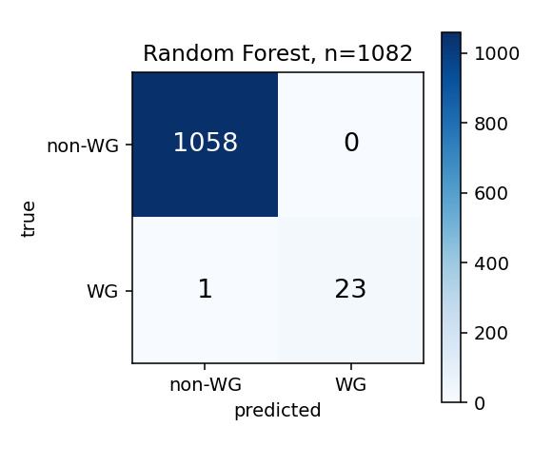
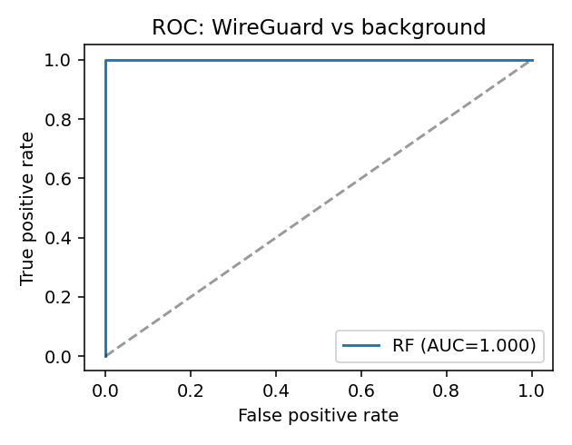
C2: two-feature Random Forest hits 99.9 %
5-fold stratified cross-validation; class-balanced; n = 1082
Two-feature Random Forest
99.91 %
Accuracy
1.000
Precision (zero false positives in 1058)
0.958
Recall (23 of 24 WG flows caught)
1.000
ROC AUC
Adding more features does not help.
model
acc
prec
rec
RF, 2 features
0.999
1.000
0.958
RF, 8 features
0.998
1.000
0.917
LR, 2 features
0.969
0.414
1.000
Schiavone & Johannsen · CYB623 · Pace University
Schiavone & Johannsen · CYB623 · Pace University
7 / 9
Notes:
Headline numbers (with definitions)
• Accuracy 99.91% — overall fraction labeled correctly.
• Precision 1.000 — when we say "WireGuard," we're always right. Zero false alarms on 1058 normal flows.
• Recall 0.958 — we catch 23 of 24 actual WG flows. One slips through.
• ROC AUC 1.000 — single score from 0.5 (random) to 1.0 (perfect), across all sensitivity settings. We're at the ceiling.
Adding more features doesn't help (small table)
• RF 8 features catches 1 FEWER WG flow than RF 2 features.
• Extra features added noise, not signal.
• LR = Logistic Regression, simpler model that draws a straight line between classes.
• LR catches everything but raises ~3% false alarms — real boundary isn't straight.
Plots on the right
• Top = confusion matrix: 2x2 grid of correct vs incorrect labels. Almost everything on the diagonal.
• Bottom = ROC curve hugs the top-left corner. Shape of a near-perfect classifier.

Slide 8
Where this sits in the literature
Narrow contribution alongside the recent Xue et al. line of work
Closely related
What this paper does NOT claim
• Xue et al., USENIX Sec ’22. Passive + active for OpenVPN. Methodological template.
• Xue et al., USENIX Sec ’24. Encapsulated TLS handshakes. Doesn’t fire on WireGuard (no nested TLS).
• Xue et al., NDSS ’25. Cross-layer RTT. Attenuated on UDP-only short flows.
• Wu et al., USENIX Sec ’23. GFW entropy detector for fully-encrypted protocols.
• Alice et al., IMC ’20. Shadowsocks active probes. Probe taxonomy.
• Frolov & Wustrow, NDSS ’20. Probe-resistant proxy detection.
• Single client/server pair. No ISP-scale deployment trace.
• udp2raw v20230206.0 only. Later forks may behave differently.
• Static defenses: a delayed-ACK patch + WG MTU below the bulk threshold weakens C2.
• C1’s P3 (bogus ACK) is mildly hostile. Adversary should fire only at already-suspected hosts.
• Not benchmarked against AmneziaWG, a more popular obfuscator for WG, or swgp-go, wstunnel. Future work.
Schiavone & Johannsen · CYB623 · Pace University
Schiavone & Johannsen · CYB623 · Pace University
8 / 9
Notes:
Lit positioning — Xue group at Michigan dominates this space
• 2022 OpenVPN paper → our methodology template.
• 2024 paper detects nested TLS handshakes → doesn't fire (WG has no TLS).
• 2025 NDSS uses cross-layer RTT anomalies → attenuates on our short UDP flows.
• → Protocol-agnostic methods don't solve our case. Protocol-specific structural features remain the approach.
What we are NOT claiming
• Single client/server. No ISP-scale data.
• One version of udp2raw (v20230206.0). Later forks may differ.
• Defeatable by a maintainer:
– Delayed ACK + smaller WG MTU weakens C2.
– More conformant TCP emulation weakens C1.
• Bogus-ACK probe (P3) is mildly hostile → fire only at already-suspected hosts.
• Not benchmarked against AmneziaWG, a more popular obfuscator for WG, or swgp-go, wstunnel. Future work.

Slide 9
Takeaway
WireGuard's wire format leaks.
A 25-line classifier handles bare WG. udp2raw is the deployed fix.
udp2raw doesn't actually fix it.
Five TCP probes in 8.5 seconds (C1). Two flow features, RF, AUC = 1.0 (C2).
Both signals are structural.
udp2raw drops unfamiliar TCP shapes; WG pads to MTU; udp2raw acks 1:1. None are statistical luck.
Defenses are obvious; the upstream tool does not implement them.
Delayed-ACK plus a sub-bulk WG MTU closes C2. More-conformant TCP emulation closes C1.
Code, configs, evidence, paper, and slides are in the project repository.
Schiavone & Johannsen · CYB623 · Pace University
Schiavone & Johannsen · CYB623 · Pace University
9 / 9
Notes:
1. WireGuard's wire format leaks
• Known result. Re-implemented as our baseline.
2. udp2raw doesn't fix it
• 8.5 s with the 5-packet prober (C1).
• 2 passive features, AUC = 1.0 (C2).
• Pick your weapon.
3. Not a statistical fluke — mechanical
• WG pads to MTU because that's its design.
• udp2raw acks 1:1 because that's how it wraps.
• udp2raw drops unfamiliar TCP shapes — parser was written for one shape.
• This is because udp2raw fakes TCP in userspace with a minimal parser to only handle the packet shapes it needs, everything else gets dropped.
4. Defenses are obvious
• Delayed ACK + smaller WG MTU kills C2.
• More conformant TCP emulation kills C1.
• Sketched in the paper, not patched upstream. Somebody else's PR.
Happy to take questions. LIVE DEMO NEXT.

