Slide 1
AGRO AUTOMATION BATCH NUMBER – 180456
Guided by:
Prof. Ashish Dalai
Dept. of CSE

Slide 2
Working prototype
Complete weather station including :
Temperature, Humidity, Atmospheric Pressure & Soil Moisture
Mobile chassis with all the sensors mounted
Working website for weather data
App for controlling vehicle
No external connections

Slide 3
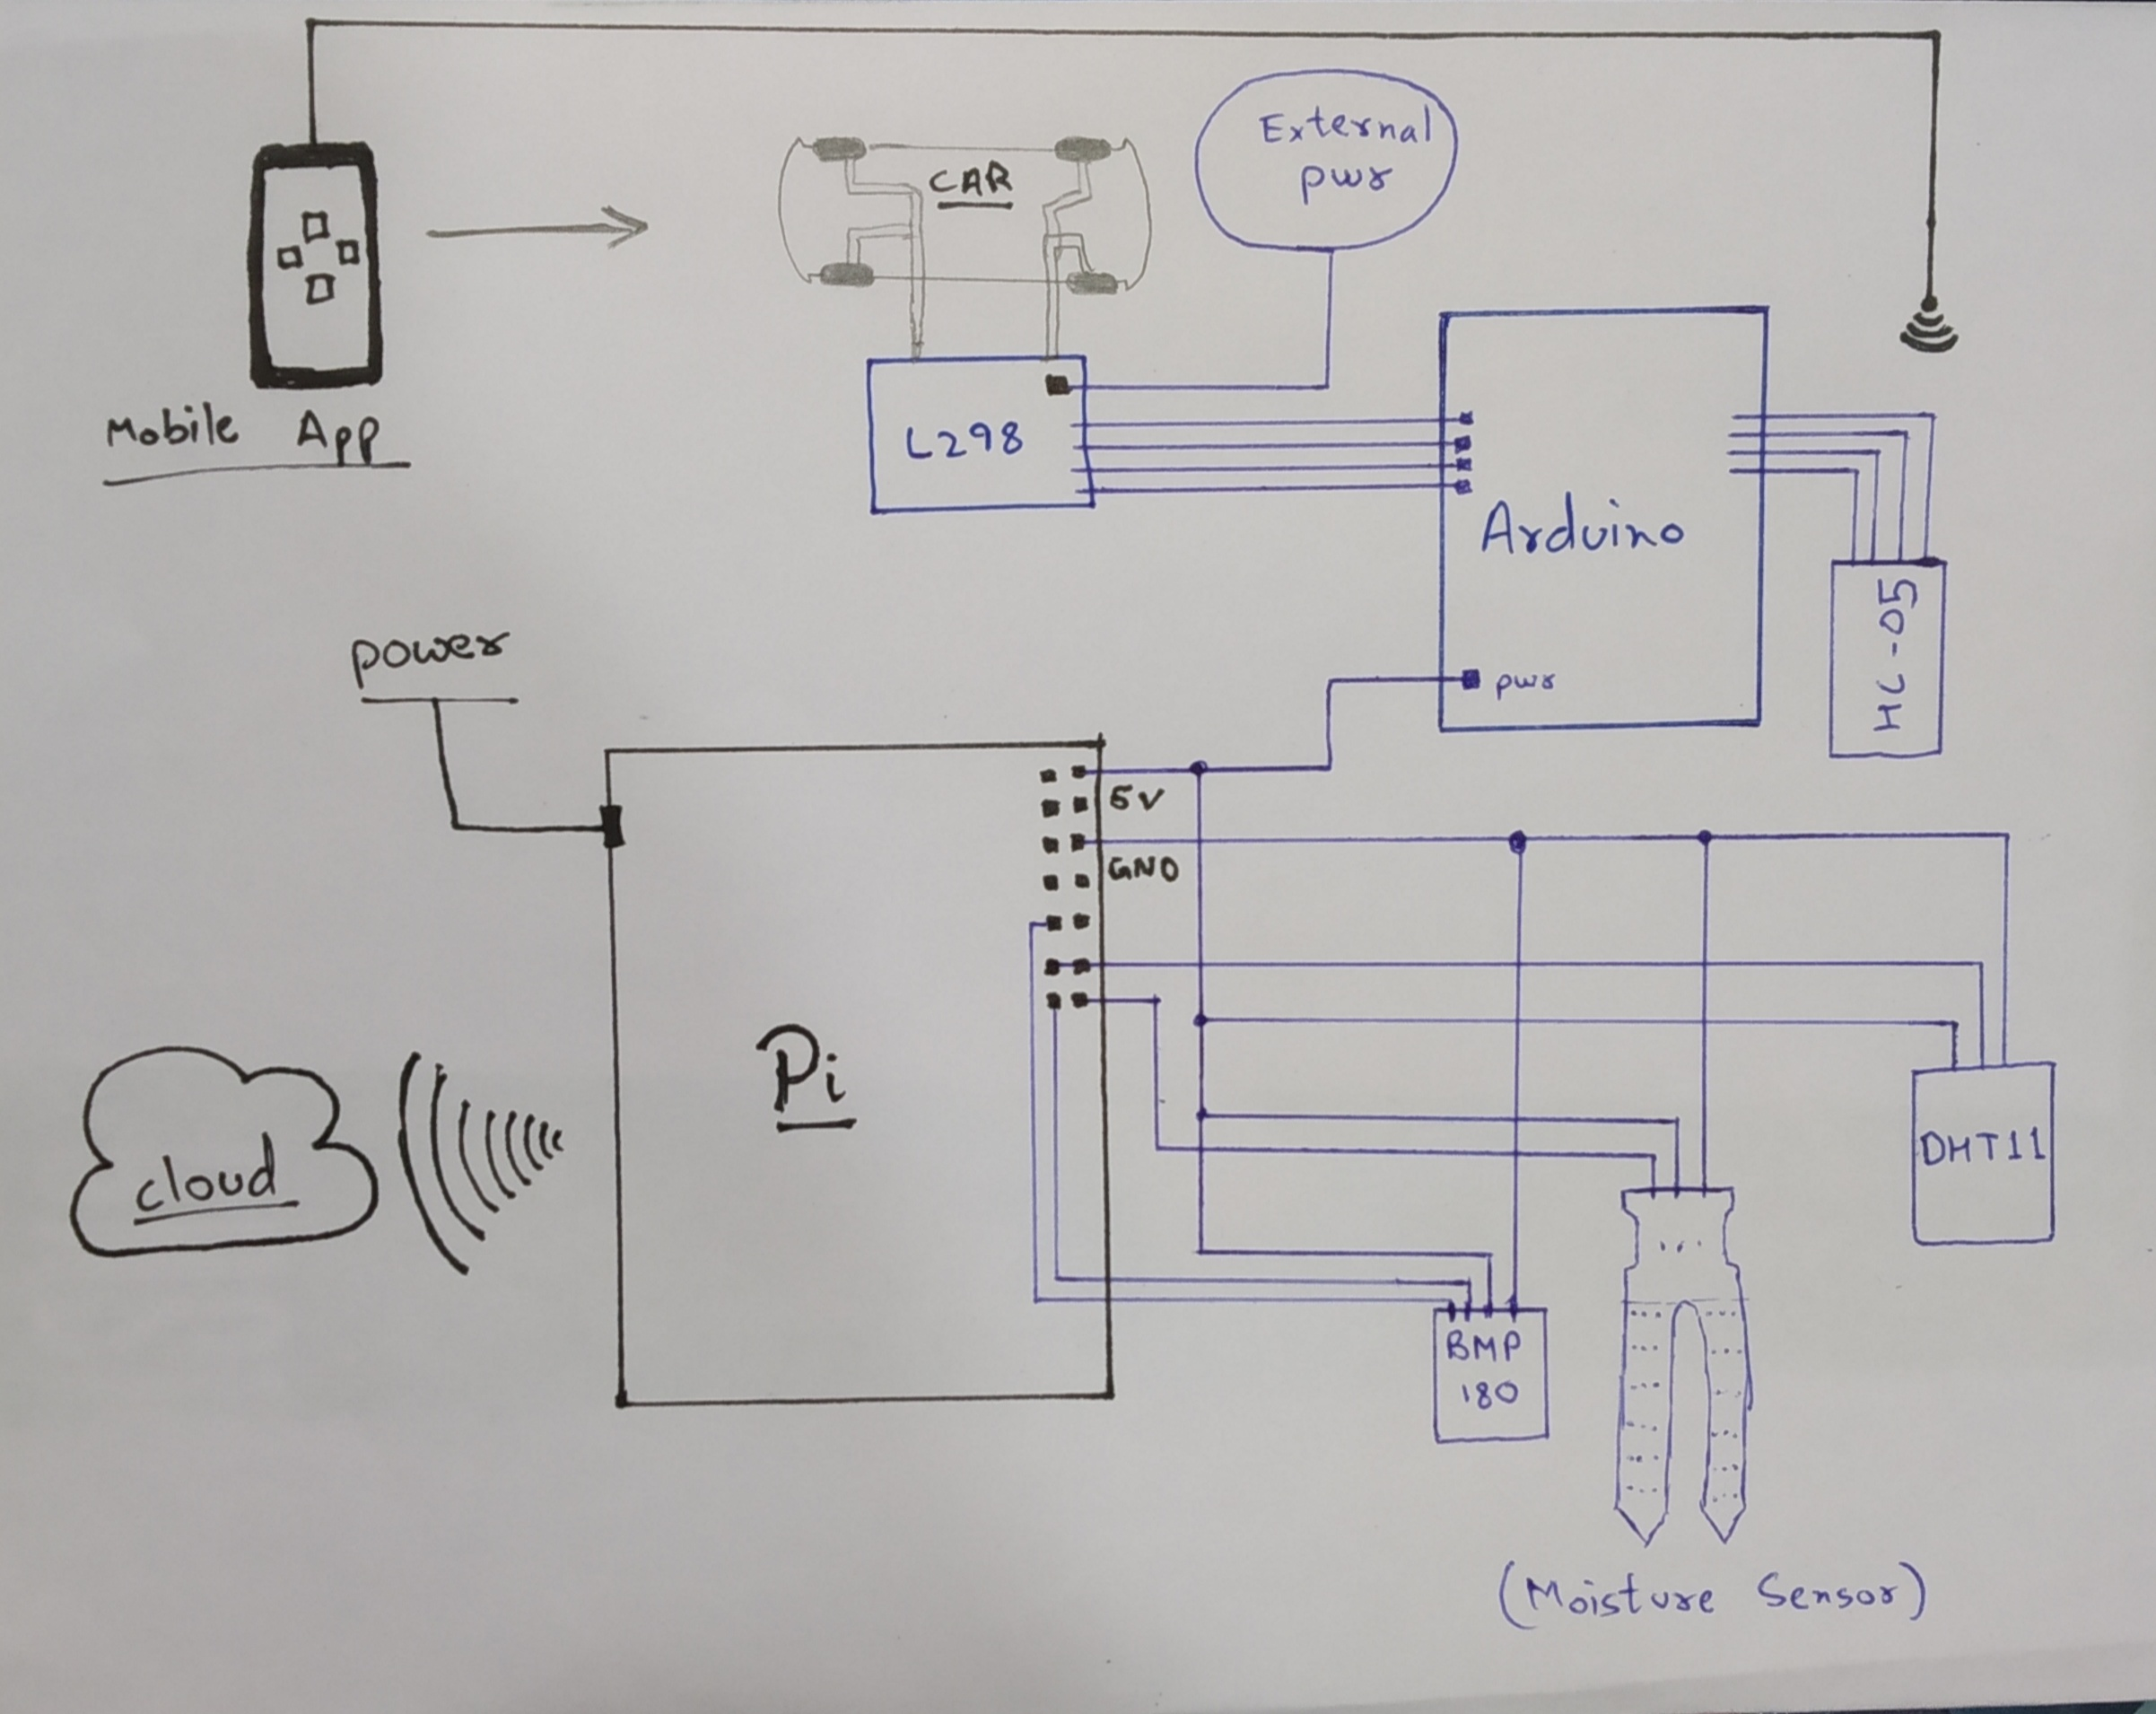
Circuit design

Slide 4
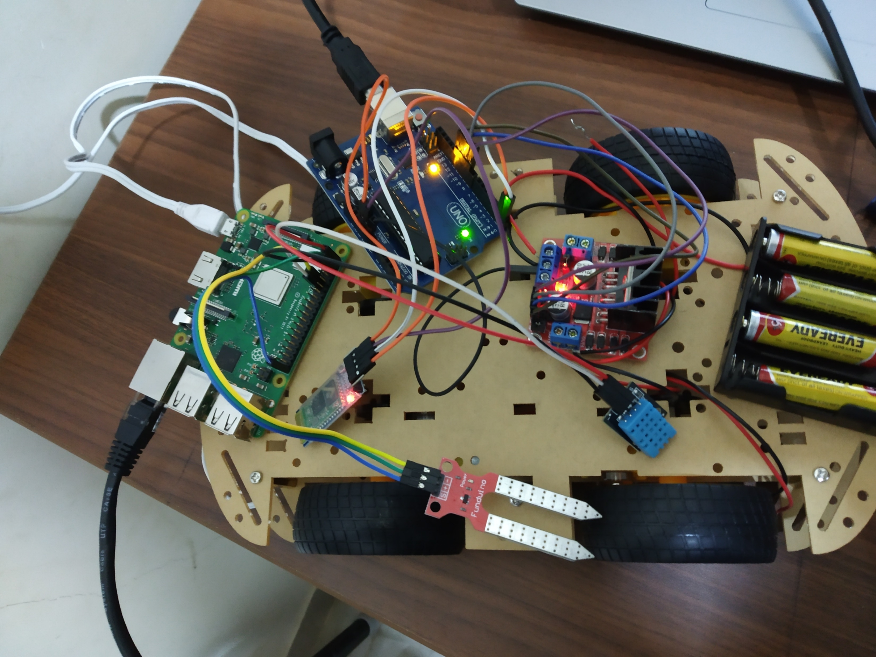

Slide 5
TARGET achieved
Partially operational chassis
Working website with data
Working weather station except Pressure sensor

Slide 6
Future improvements
Self driven Car
Intervallic soil moisture testing
Integrated app for car and weather data
Off –road chassis for farms
Connectivity via GPRS

Slide 7
references
https://www.instructables.com/id/Soil-Moisture-Sensor-1/
https://projects.raspberrypi.org/en/projects/build-your-own- weather-station
http://www.sparkfun.com
http://www.github.com

