Slide 1
FAKE NEWS CLASSIFICATION
Kathal Aditya Rajendra– 18BCD7008
Sharaj Raja Chandran – 18BCD7044

Slide 2
Abstract
In the words of Churchill: “A lie gets halfway around the world before truth puts on its boots.”
In today’s modern era, information (both credible and otherwise) is available within a number of clicks. As a result, fake news has become a new rising threat whose rippling effect can be seen throughout the world.
Through this project we aim to classify news as Real and Fake using Text Classification techniques which are described in the paper by Hadeer Ahmed, Issa Traore and Sherif Saad published in Wiley Journal in the year 2017.
We will be using the concepts which we learned during the Data Analytics (CSE4027) course such as Data Visualization, Data Cleaning, Statistical techniques and various other R functions in order to prepare the data for further Text Classification operations.

Slide 3
Literature Review
Many research papers have been written on the topic of “Text Based Classification” and throughout the years the methodology applied has been refined to yield better results.
We have taken inspiration from one such paper; Wiley Journal (2017) - Detecting opinion spams and fake news using text classification by Hadeer Ahmed, Issa Traore and Sherif Saad.
The text taken into consideration is in the form of news which gets classified as real and fake using multiple classifiers individually.

Slide 4
Problem Definition
The world is overflowing with data and a significant part of it comes from news outlets. It is vital for the news to be correct otherwise it could lead to unimaginable damage. As a result, any potential news must be vetted before being released.
So, through this project we aim to develop a program which can classify news as real or fake based on the news title and its contents.
The input will be in the form of a dataset consisting of the title of the news along with its content and the corresponding output will be its classification where 0 represents fake and 1 represents real.

Slide 5
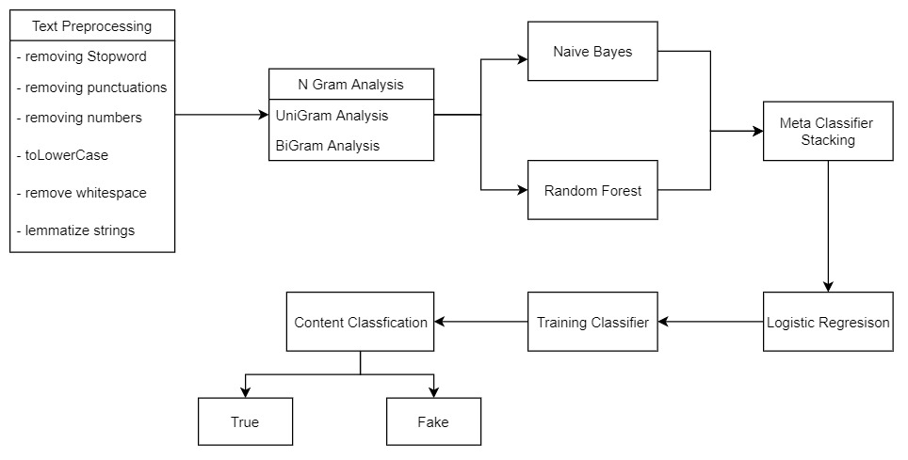
Algorithm (Model Deployed)

Slide 6
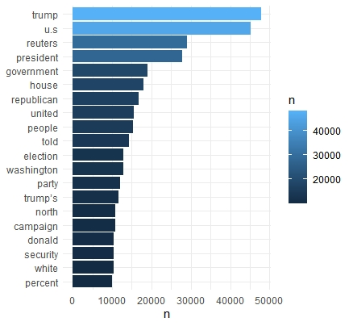
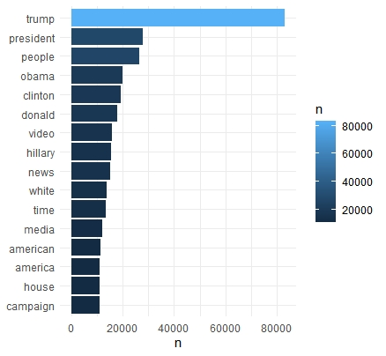
Results and Discussion
REAL FAKE

Slide 7
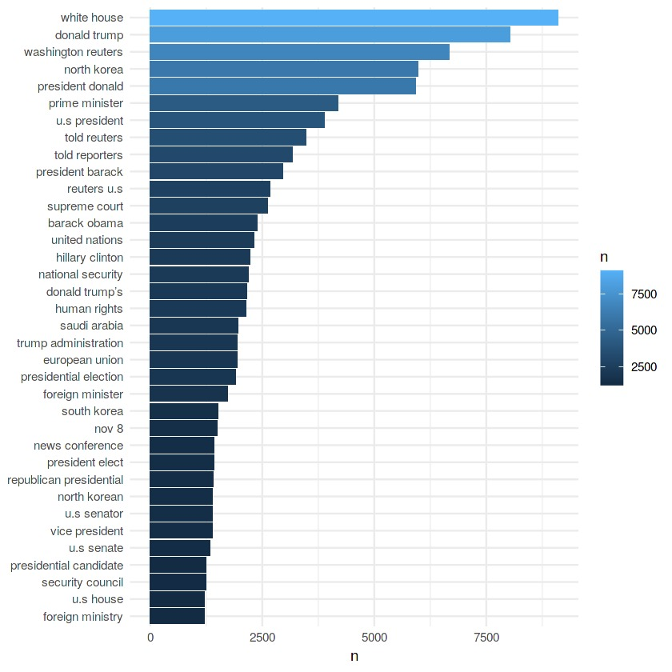
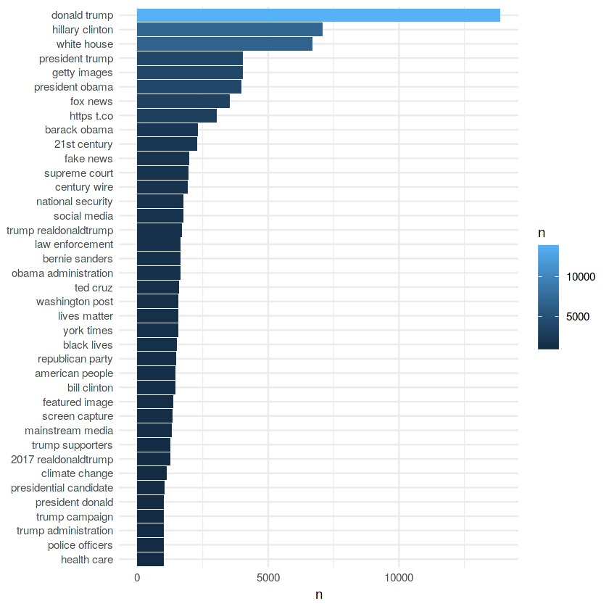
REAL FAKE

Slide 8
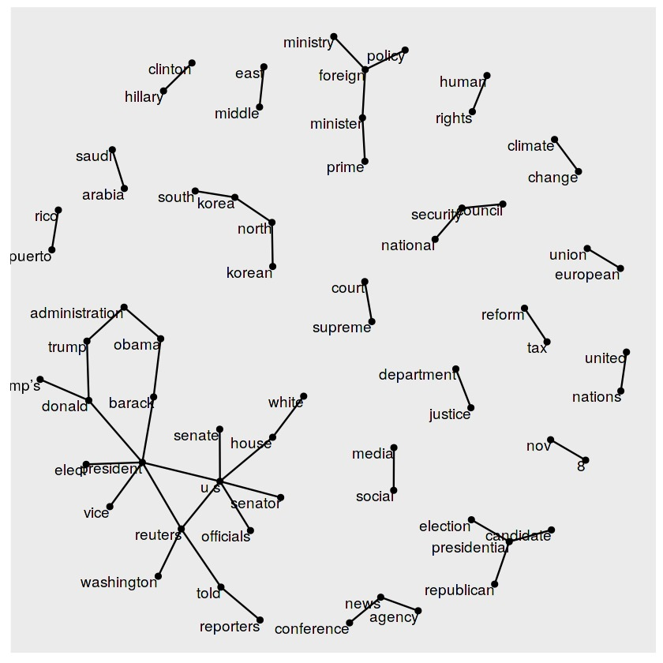
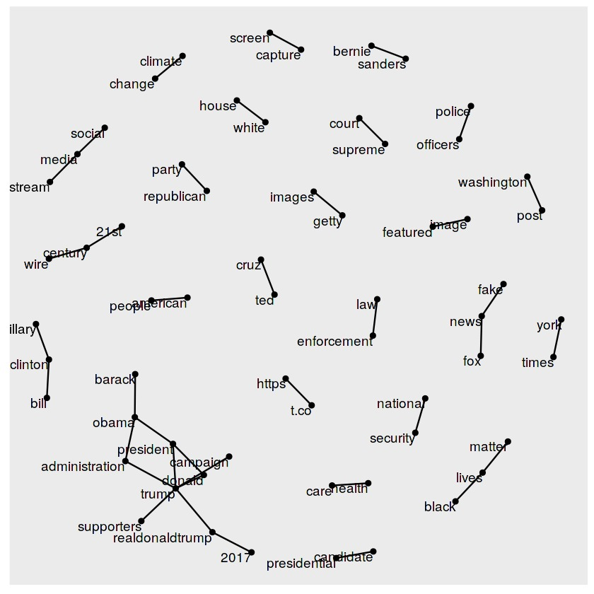
REAL FAKE

Slide 9
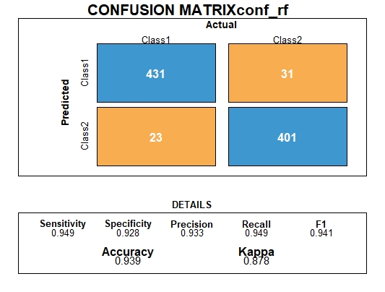



Slide 10
Conclusion
Random Forest Classifier works better than Naïve Bayes Classifier.
The Ensemble Techniques give us a high recall value which suggests that the classification techniques used are very good fits for the data and provide relevant classification and results.
With more computational power this methodology can be better refined and thus become applicable in real world scenarios.
The same model can be applied for any binary classification application which has its input as text.

Slide 11
References
https://www.oreilly.com/library/view/text-mining-with/9781491981641/ch01.html
https://onlinelibrary.wiley.com/doi/abs/10.1002/spy2.9

