Slide 1
TimePunch-StackedUI
Designing a new intuitiv user interface

Slide 2
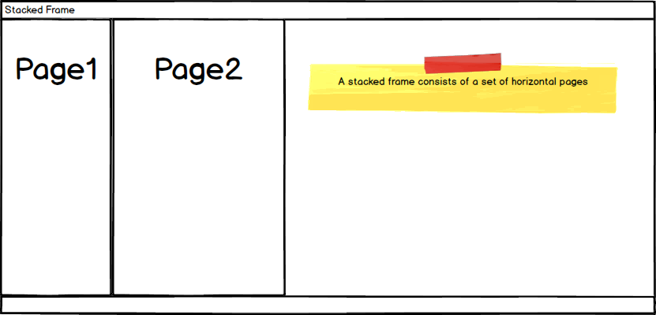
Simple Stack Navigation

