Slide 1
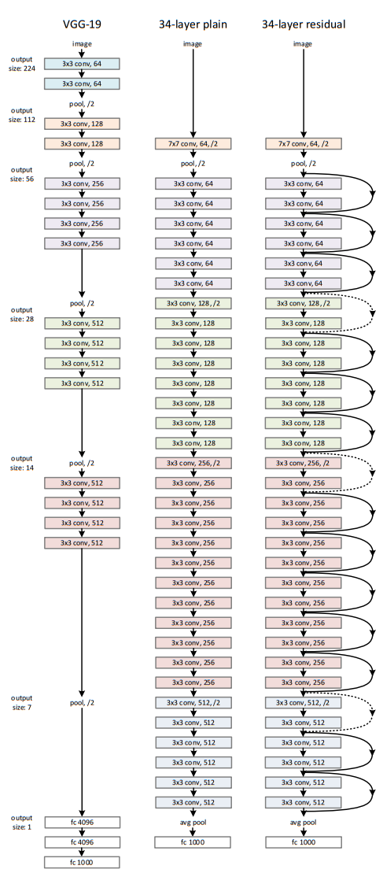
Medical image classification with Convolutional Neural Networks (CNNs)

Slide 2
Read and convert .czi files with python
Library aicspylibczi: read .czi files and metadata
2752 px
2208 px
overlap
overlap

Slide 3
Read and convert .czi files with python
1700 px
2752 px
1700 px
850 px
2208 px
overlap
850 px
overlap

Slide 4
Read and convert .czi files with python
2752 px
Tiles in one czi-file: 300 (1 channel):
300 1x images (1700x1700 px)
1200 4x images (850x850 px)
Full overview image at 25% scale
Without overlap, more images can be sliced!
Image processing:
Slicing
Percentile normalization (0.5 – 99.5)
Conversion from 14-bit to 8-bit
Downscaling to 512x512
Export as .png file
Time: 3min!
2208 px
1700 px
1700 px
850 px
850 px

Slide 5
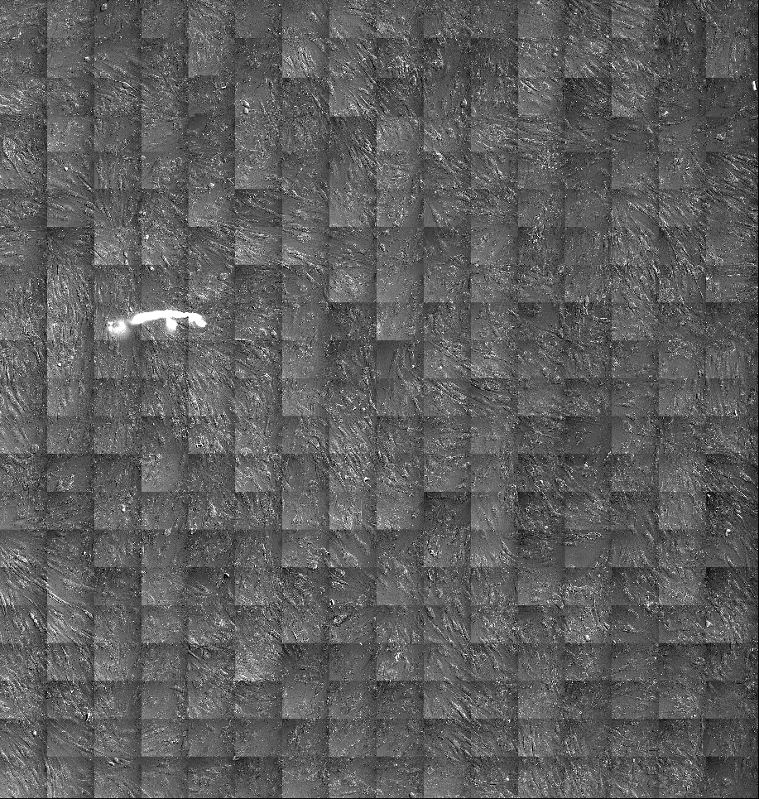
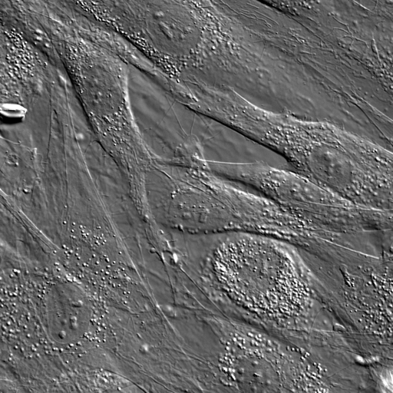
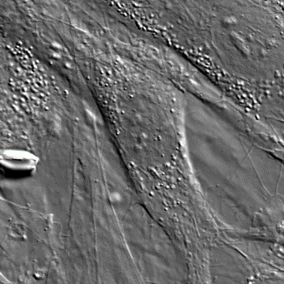
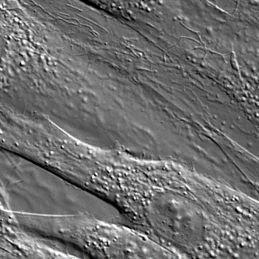
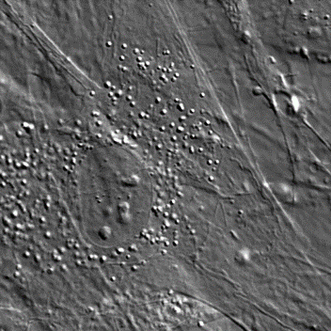
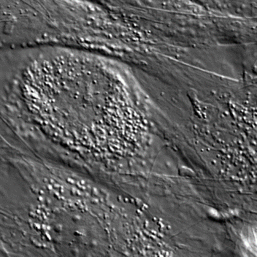
Read and convert .czi files with python
1700 px
850 px
1700 px
1700 px
850 px
850 px

Slide 6
Future plans
2752 px
Without overlap, 16 images with original size of 512x512 can be sliced as smallest images
4x size 1024x1024
1x size 2048x2048
2208 px
1024 px
1024 px
2048 px
512 px
2048 px

